Slide 1
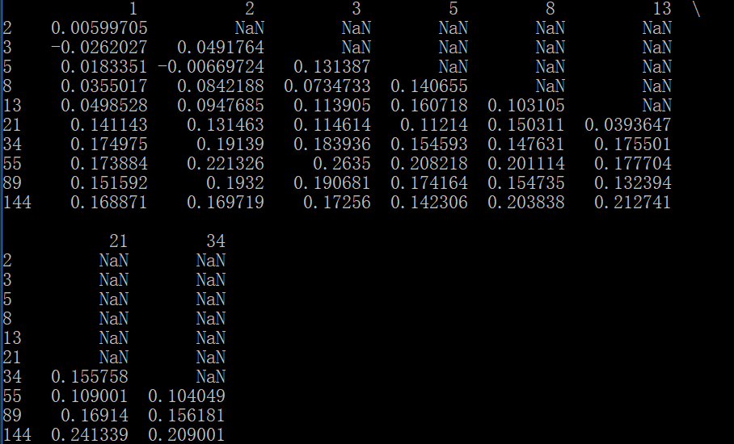
DMA(双均线)
短期均线可选值[1,2,3,5,13,21,34]
长期均线可选值[2,3,5,8,13,21,34,55,144]

Slide 2
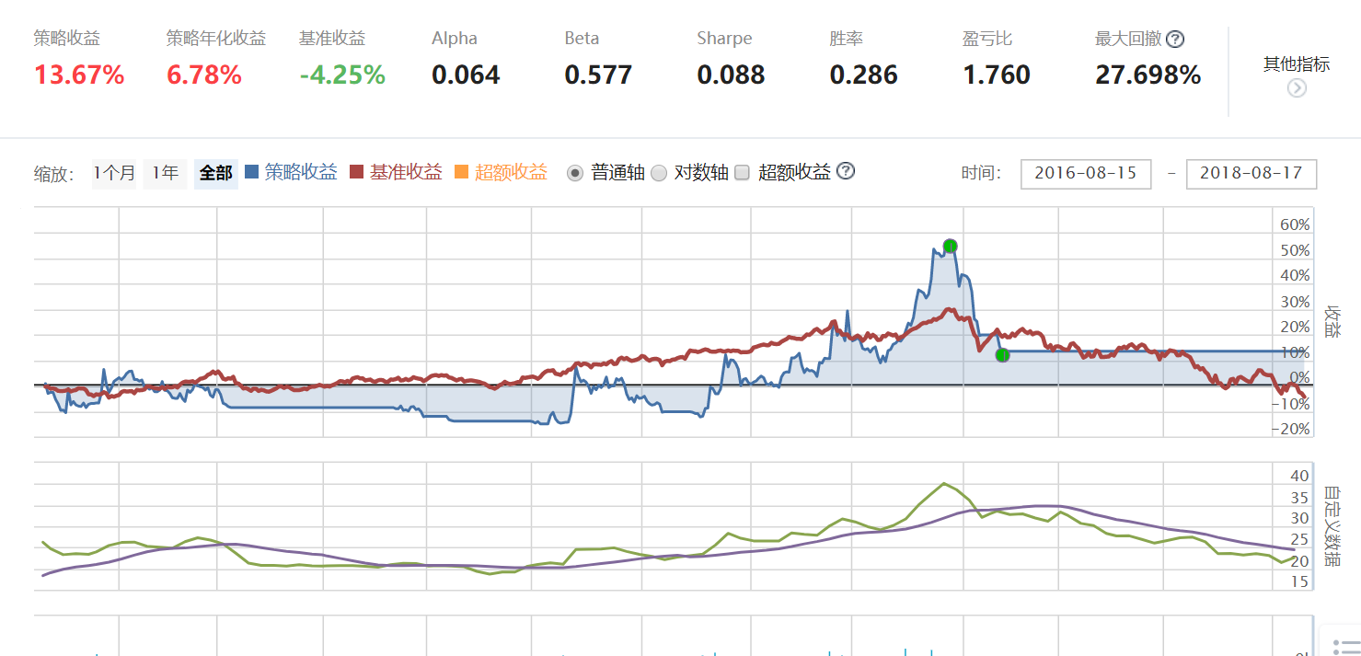

Slide 3
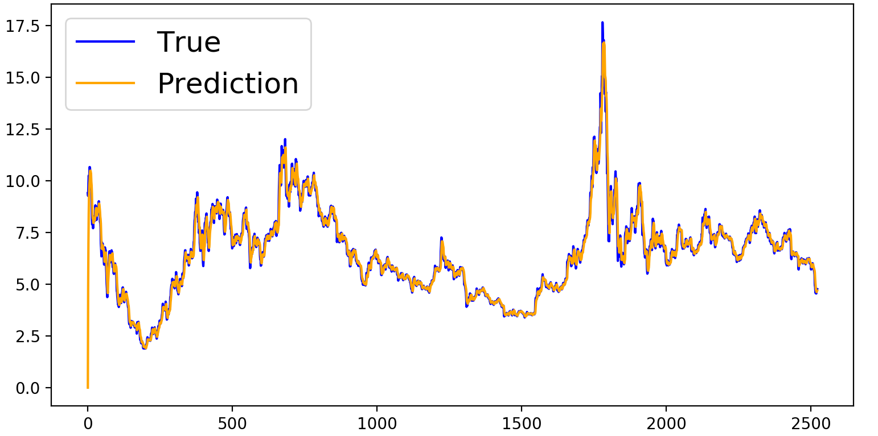
EMA(指数移动平均值)
EMA_{today}=α * Price_{today} + ( 1 - α ) * EMA_{yesterday}

Slide 4
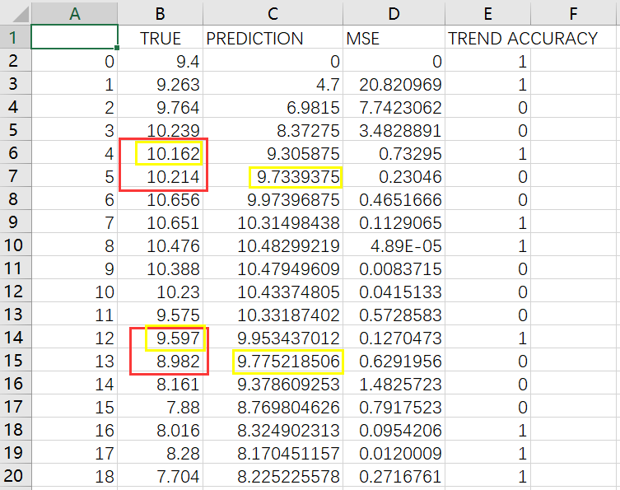

Slide 5
