Slide 1
Heterogenous Human Activity Recognition using Accelerometer And Gyroscope Data from Smartphones
( Under the Guidance of Dr. Manimala S )
As a part of Big Data Analystics Course ( CS746)

Slide 2
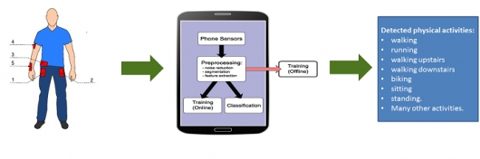
Project Introduction
We intend to classify the physical activities performed by a user based on accelerometer and gyroscope sensor data collected by a smartphone in the user’s pocket.

Slide 3
Background
Smart Phones and other mobile technologies identify their orientation using accelerometer and gyroscope, a small device made up of axis based motion sensing.
A gyroscope is a device that uses Earth's gravity to help determine orientation.
An accelerometer is a compact device designed to measure non-gravitational acceleration. It is designed to respond to the vibrations associated with non static movement.

Slide 4
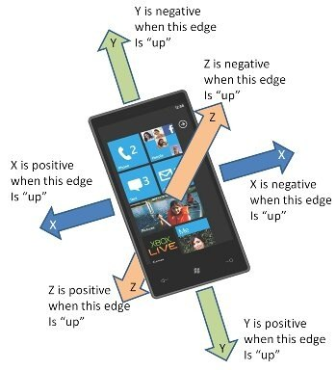

Slide 5
About our Dataset
We have used Heterogeneous Human Activity Recognition Dataset from UCI dataset repository.
https://archive.ics.uci.edu/ml/datasets/Heterogeneity+Activity+Recognition
The Heterogeneity Dataset for Human Activity Recognition from Smartphone and Smartwatch sensors consists of two datasets ( one containing accelerometer readings, the other containing gyroscope readings)

Slide 6
About our Dataset ( Contd.)
Number of Attributes : 16
Number of Instances: 26,000,000+
Users executed activities scripted in no specific order while carrying smartphones.
Activities: ‘Biking’, ‘Sitting’, ‘Standing’, ‘Walking’, ‘Stairs Up’ and ‘Stairs down’.

Slide 7
About our Dataset ( Contd.)
Sensors: Sensors: Two embedded sensors, i.e., Accelerometer and Gyroscope, sampled at the highest frequency the respective device allows (100 Hz)
Recordings: 9 users and 8 smartphones (2 Samsung Galaxy S3 mini, 2 Samsung Galaxy S3, 2 LG Nexus 4, 2 Samsung Galaxy S+)

Slide 8
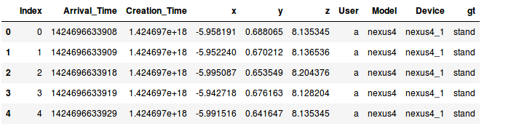
About Our Dataset ( Contd.)
Here is a snapshot of the Phone accelerometer dataset.
The Phone Gyroscope dataset also has similar features/attributes

Slide 9
Preprocessing
Why Preprocessing ?
Readings from both sensors are relevant in identifying Human Activity but both sensor readings are distributed among 2 different datasets
Hence there is a need to combine these 2 datasets
Among 16 features only few features are relevant for recognition of Human Activities.

Slide 10
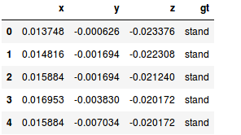
Preprocessing (Contd.)
Relevant features from both Accelerometer and Gyroscope datasets are
Accelerometer
X axis reading
Y axis reading
Z axis reading
Gt - The label for classification task
2. Gyroscope
X axis reading
Y axis reading
Z axis reading
Gt - The label for classification task

Slide 11
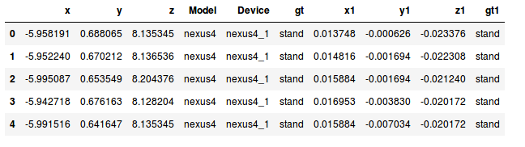
Preprocessing - Combining two datasets
The axis reading features from Gyroscope sensor dataset is merged with the accelerometer dataset.
The labels of x,y,z,gt from gyroscope is renamed to x1,y1,z1,gt1 before merging to avoid conflicts.

Slide 12
Preprocessing ( contd. )
All the samples with any one reading being is being dropped considering the entire sample as irrelevant or prone to user bias
The gt1 label is being dropped since it is extended data and similar to gt.
Since the dataset is very huge ( 26 million ) it was sampled to one fifth by considering one in every five instances.
The dataset was split to 75% for training purposes and 25% for testing.

Slide 13
Classification - The LSTM networks
The data from Gyroscope and Accelerometers are almost similar to video streaming data.
Thus there is a need to keep track of past data which is possible in Long Short term Memory networks.
LSTM networks are an extension of Recurrent Neural Networks .
A common LSTM unit consists of a cell, an input gate, an output gate and a forget gate.
The cell remembers values over arbitrary time intervals.

Slide 14

Classification - The LSTM networks ( Contd. )

Slide 15
Classification - The LSTM Networks ( Contd. )
We added a LSTM layer with 24 neurons, which is followed by another LSTM layer with 12 neurons. This now goes to the final classifying layer, a DENSE layer with 6 neurons whose activation function is sigmoid.
We have kept Adam optimization as it converges very quickly.
Categorical Cross entropy was used as the loss function.

Slide 16
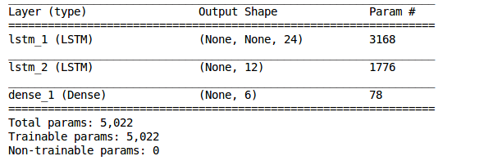
Our LSTM Model

Slide 17
Training
Our model was trained for 10 epochs for different batch sizes.
The batch size were in powers of 2 starting from 16 to 1024.
The test data was evaluated and accuracy was calculated for the same.
The batch size with highest accuracy is retained.

Slide 18
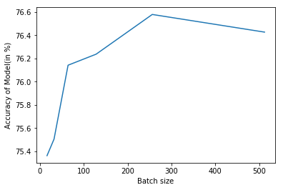
Accuracy
The highest accuracy was obtained for batch size of 256.
The highest accuracy obtained is 76.57%

Slide 19
Thank You
Implemented and Presented By :
Rohan Sapare ( 4JC15CS092 )
Pradeep Pai (4JC15CS077 )
Gagan Shetty ( 4JC15CS031)
Sharath Hebbar (4JC15CS100)

