Slide 2

ImageBank
Santiago Paiva
santiago.paiva@mcgill.ca
Notes:
Add logo on top

Slide 4

Today’s Challenges
Problem Domain
Functionality
Scalability
Speed
Automation

Slide 5
Design Process
Server
Dicom Server
Backend
LORIS MRI
Frontend
LORIS
Demo #1
Demo #2

Slide 6
Server
DICOM Server

Slide 7
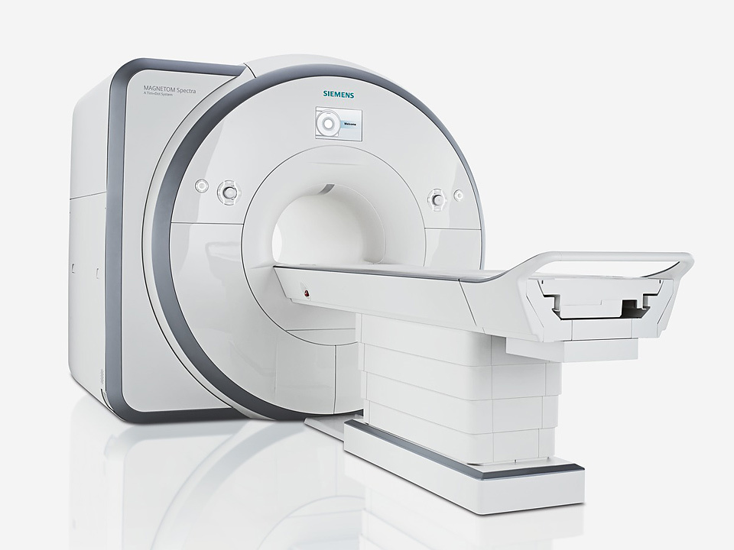
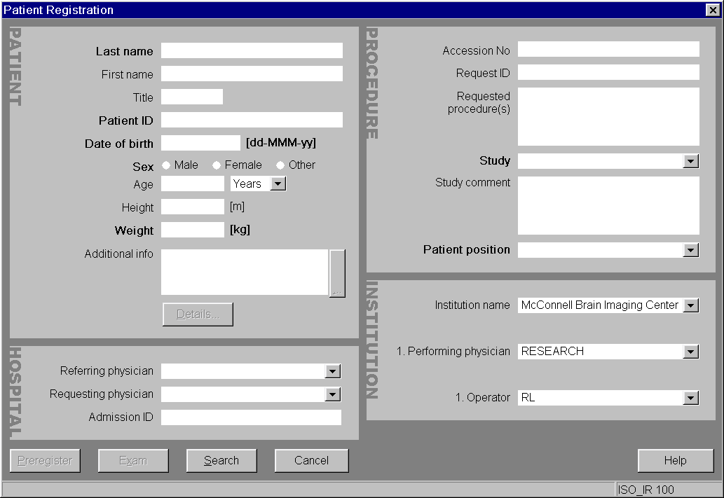
Patient Registration
S
B
F
Siemens 3T Prisma
Patient Registration

Slide 8
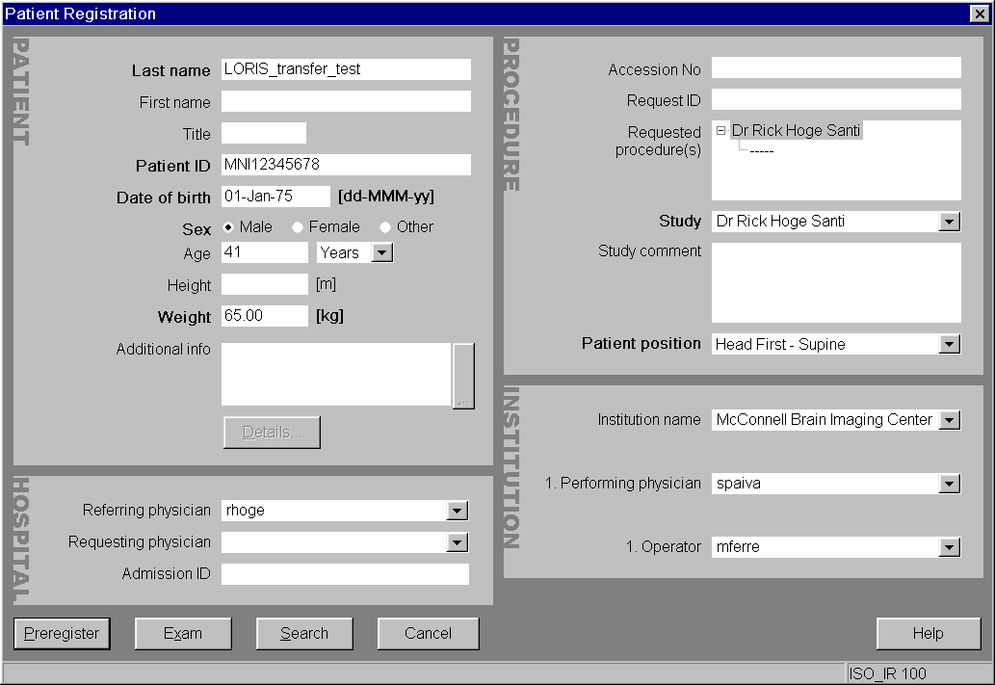
Patient Registration
S
B
F
Patient Name
Patient ID
PI
PI Team Member
(Researcher)
Patient Registration

Slide 9
DCMTK - DICOM Toolkit
Storescp & Transfer Protocol
S
B
F
Parameters:
IP = 132.206.178.113 (imaging.bic.mni.mcgill.ca)
AETITLE = IMAGING
Port = 50082

Slide 10
Data Transfer Command
S
B
F
/usr/bin/storescp -d --output-directory /dicom/data/dicom/ +xa +ac --sort-on-patientname --aetitle IMAGING --disable-host-lookup --eostudy-timeout 30 --exec-on-eostudy /dicom/bin/dicomtar #p #f 50082

Slide 11
Backend
LORIS MRI

Slide 12
Imaging Scripts
S
B
F
BIC
1
MINC Conversion + Log
Stores minc in /dicom/data/minc
2
Dicomtar + Log
Stores tar in /data/img/data/tarchive
LORIS
3
TarchiveLoader + Log
Stores pic in /data/img/data/tarchive/pic
Stores minc in /data/img/data/tarchive/assembly
LORIS MRI Imaging Pipeline

Slide 13
Dicom Archive
S
B
F
+-----------------------+-----------------------+--------------+------------------------+-------------------------+
| PatientID | PatientName | DateAcquired | ReferringPhysicianName | PerformingPhysicianName |
+-----------------------+-----------------------+--------------+------------------------+-------------------------+
| BICDCC9989_963206_V01 | LORIS_STAGING_TEST1 | 2016-05-11 | NULL | NULL |
| BICDCC9994_207083_V01 | LORIS_STAGING_TEST_2 | 2016-03-31 | rhoge | spaiva |
| BICDCC9995_926982_V01 | LORIS_STAGING_TEST_3 | 2016-05-04 | rhoge | spaiva |
| 10082016 | BICDCC9983_219988_V01 | 2016-08-08 | rhoge | spaiva |
+-----------------------+-----------------------+--------------+------------------------+-------------------------+
Tarchive Table

Slide 14
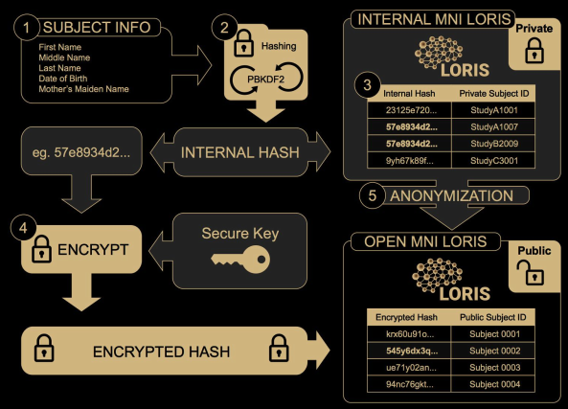
Hash Function & Candidate Module
S
B
F
Candidate
Hash Table
Hash
Hash Process

Slide 15
Hash Function & Candidate Module
S
B
F
+--------+----------------------+
| CandID | hash_value |
+--------+----------------------+
| 158500 | 365f9af63be2cd70f... |
| 187360 | ae5668487f7b354c3... |
| 378835 | c27f6da3954f9a287... |
| 499334 | 6225931f25b9056f9... |
| 651416 | b9f8abaf2ffce9cca... |
| 659980 | 818ae431452408326... |
| 893234 | cc048c56d53b7abc4... |
+--------+----------------------+
Hash Table

Slide 16
Demo #1

Slide 17
Frontend
LORIS

Slide 18

LORIS ImageBank
S
B
F
imaging.bic.mni.mcgill.ca

Slide 19
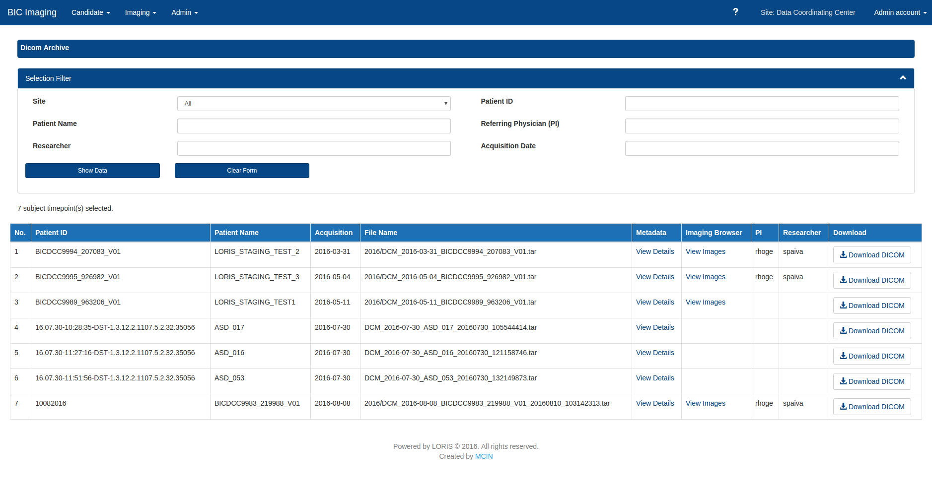
Dicom Archive
S
B
F
New Dicom Archive Module

Slide 20
Demo #2

Slide 21

Currently In Progress
BIC Unix Login Integration
LORIS Super Site
Group Permissions
Improvements in UX and UI
Dicom-Archive
Candidate Registration
Permissions
Tutorials

Slide 22
BIC Unix Login Integration
BIC
SSH Request
LORIS
Echo Response
DB
DB
BIC NIS Domain

Slide 23
LORIS Super Site
PI (Parent Site)
AAA
BBB
CCC
Shared Dataset
DDD
EEE
Grad Student - Researcher
Parent - Child LORIS Site Model

Slide 24
Conclusion
Development of a great product for BIC users :)
Automated, fast, and scalable data repository
LORIS Functionalities (Visualizations, QA, Statistics, etc)
Set of new exciting features coming soon
Public Release: soon

Slide 25
Special Thank You
Sylvain Milot (SysAdmin)
Mouna Safi-Harab (Imaging Scripts)
Jordan Stirling (Hash Function)
Pierre Rioux (SSH Authentication)
Rick Hoge (Functionality)
LORIS Team (Help & Support)

Slide 26
Q & A
Email Me: santiago.paiva@mcgill.ca

