Slide 1
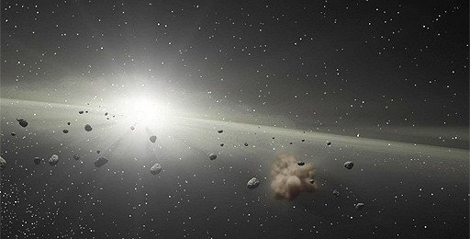

Slide 2
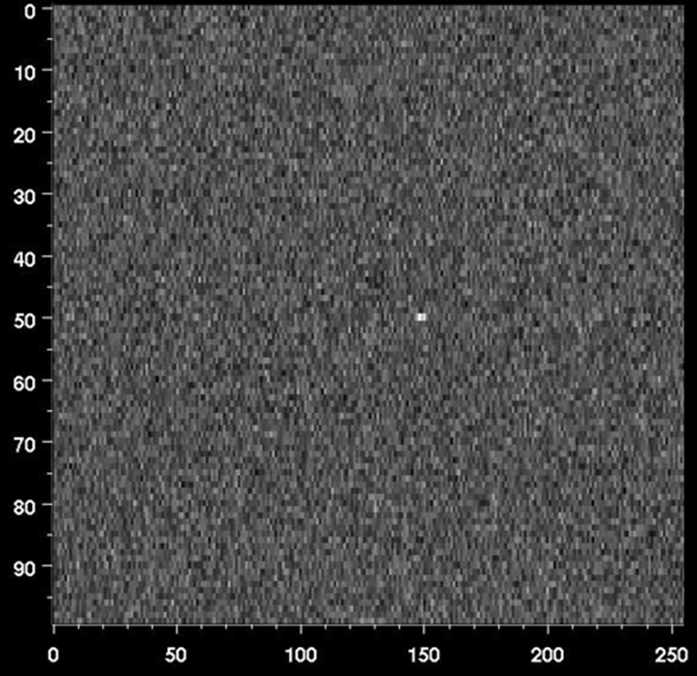
RADAR DETECTION
Range
Apophis
Frequency

Slide 3
Simulating Asteroids:
Detection & Analysis
Santiago Paiva

Slide 4
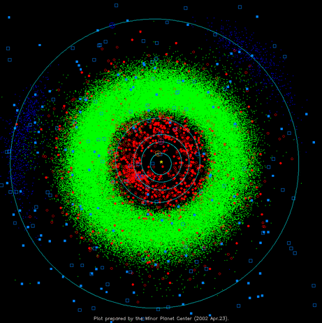


Slide 6

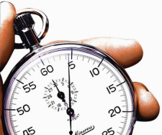
Today’s challenges
Problem Domain
Discoveries increase
Data-
Acquisition
Time-Cost
Sensitive
Data-
Analysis

Slide 8
Design Process
Pattern
Recognition
Physical
Simulator
Analysis
Detection
Simulation
Analysis
Prototype
Background
System Description
Conclusion

Slide 10
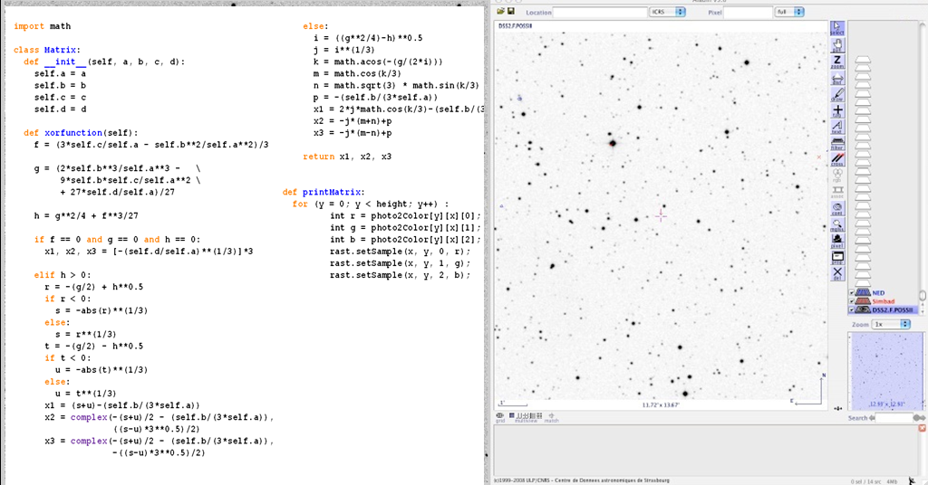
PR
SIM
Analysis
Detection
Pattern Recognition
Test
Debug
Read

Slide 12
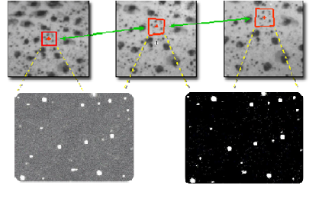
PR
SIM
Analysis
Detection
Pattern Recognition

Slide 13
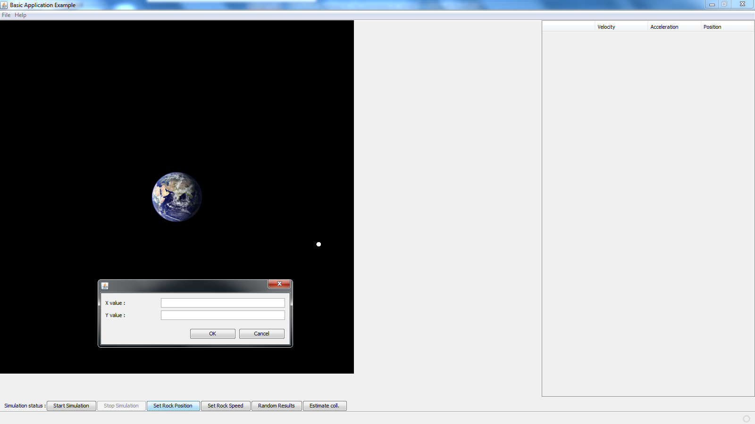
PR
SIM
Analysis
Physical Simulation Prototype
JAVA GUI Framework
Innovative
Easy
Fast

Slide 15
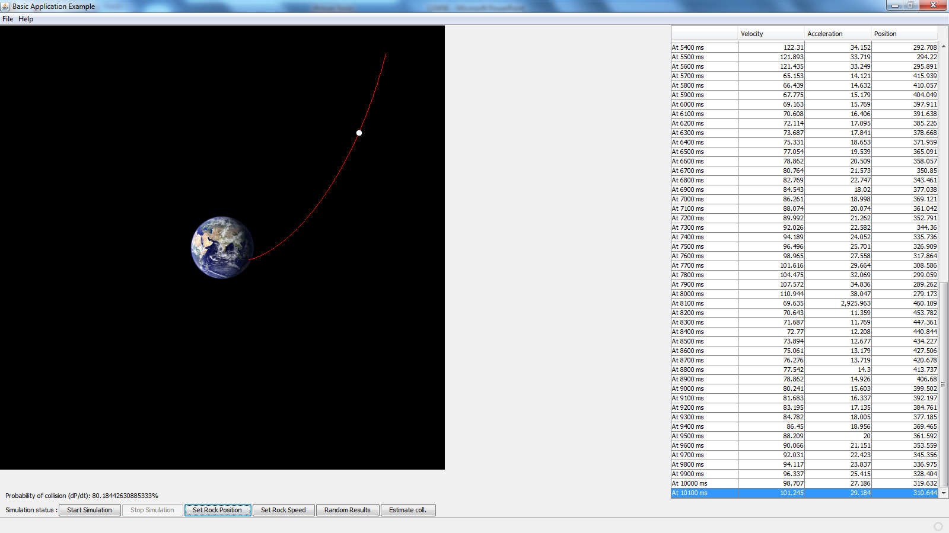

PR
SIM
Analysis
Physical Simulation Prototype
Collision Case
2
1
3

Slide 17
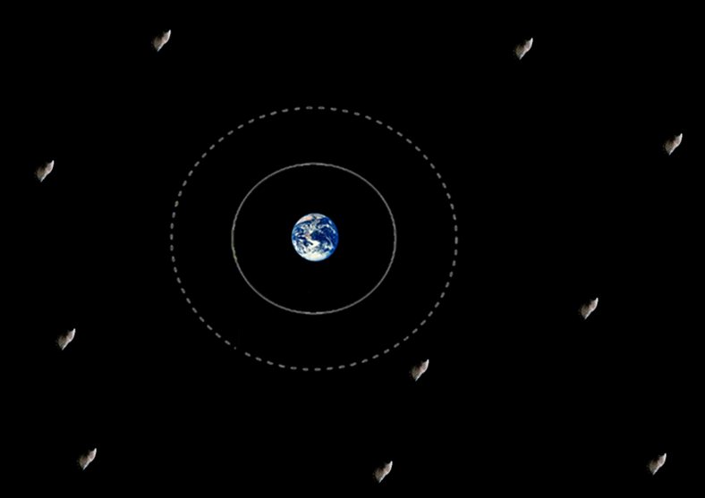



PR
SIM
Analysis
Discussion & Results
K-Nearest Neighbor Method

Slide 18
