Slide 2
Building a Better Terminal Experience
Santiago Paiva
Notes:
<number>

Slide 4
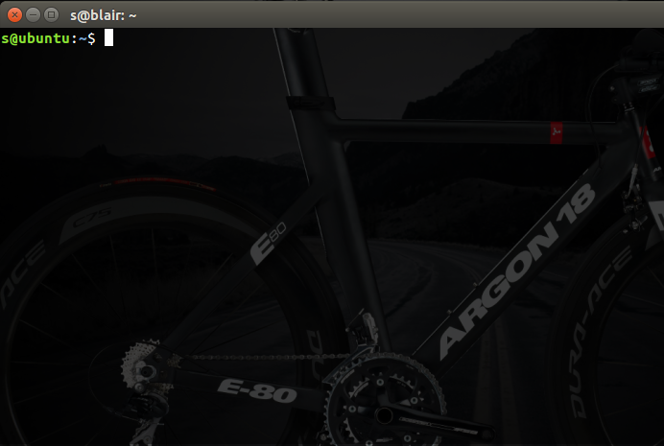
Test
Debug
Read

Slide 5
Today’s challenges
Problem Domain
Automation
Power
Time
Visual
Notes:
<number>

Slide 6
Notes:
<number>

Slide 7
Design Process
Tmuxinator
Fish Shell
Oh-My-Fish
Automation
Time
Power
Visually Apealling
Background
System Description
Conclusion

Slide 8
Notes:
<number>

Slide 9
TM
Fish
OMF
Tmuxinator
Manage complex tmux sessions easily
Test
Debug
Read
Notes:
<number>

Slide 10
Notes:
<number>

Slide 11
TM
Fish
OMF
Fish Shell
A smart and user-friendly command line shell
Notes:
<number>

Slide 13
TM
Fish
OMF
Oh-My-Fish
The Fishshell Framework.
Notes:
<number>

Slide 14
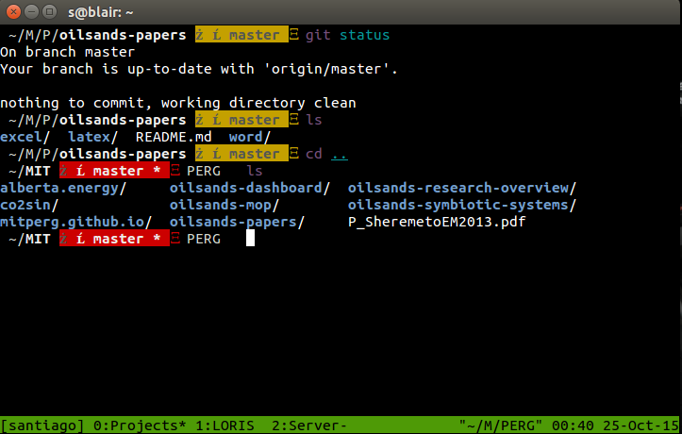
Innovative
Easy
Fast
Notes:
<number>

Slide 15
github.com/stronnics/terminal

