Slide 1
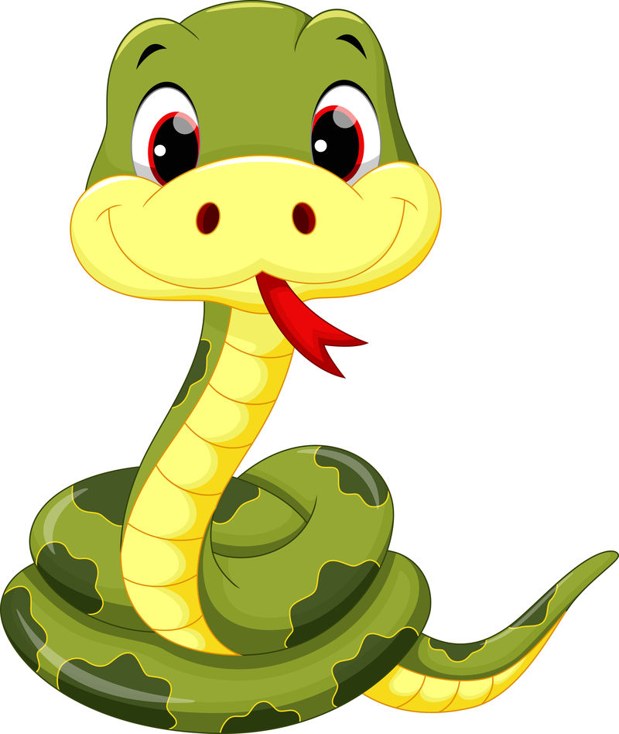
JAVA貪吃蛇
1083346左康澤
1081355吳百淵
1081416劉萬霆

Slide 2
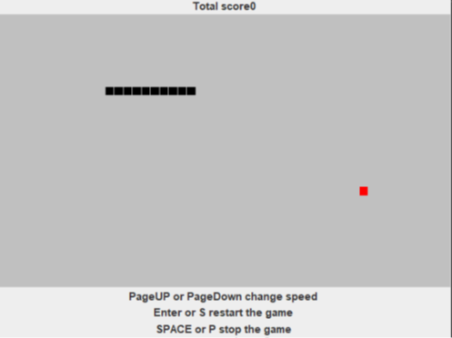

改版vs原版外觀

Slide 3
public GreedSnake(){
mainFrame=new JFrame("Snake game");
Container cp=mainFrame.getContentPane();
labelScore=new JLabel("The score",JLabel.CENTER);
cp.add(labelScore,BorderLayout.NORTH);
paintCanvas=new Canvas();
paintCanvas.setSize(DEFAULT_WIDTH+1,DEFAULT_HEIGHT+1);
paintCanvas.addKeyListener(this);
cp.add(paintCanvas,BorderLayout.CENTER);
JPanel panelButtom=new JPanel();
panelButtom.setLayout(new BorderLayout());
JLabel labelHelp;// help information
labelHelp=new JLabel(“PageUP or PageDown change speed”,JLabel.CENTER);
panelButtom.add(labelHelp,BorderLayout.NORTH);
labelHelp=new JLabel("Enter or S restart the game",JLabel.CENTER);
panelButtom.add(labelHelp,BorderLayout.CENTER);
labelHelp=new JLabel("SPACE or P stop the game",JLabel.CENTER);
panelButtom.add(labelHelp,BorderLayout.SOUTH);
cp.add(panelButtom,BorderLayout.SOUTH);
mainFrame.addKeyListener(this);
mainFrame.pack();
mainFrame.setResizable(false);
mainFrame.setDefaultCloseOperation(JFrame.EXIT_ON_CLOSE);
mainFrame.setVisible(true);
begin();
}
設置介面元素,選擇介面

Slide 4
void repaint(){
Graphics g=paintCanvas.getGraphics();
g.setColor(Color.LIGHT_GRAY);
g.fillRect(0,0,DEFAULT_WIDTH,DEFAULT_HEIGHT);
g.setColor(Color.BLACK);
LinkedList na=snakeModel.nodeArray;
Iterator it=na.iterator();
while(it.hasNext()){
Node n=(Node)it.next();
drawNode(g,n);
}
g.setColor(Color.RED);
Node n=snakeModel.food;
drawNode(g,n);
updateScore();
}
繪製遊戲介面,顏色改變

Slide 5
class SnakeModel implements Runnable{
GreedSnake gs;
boolean[][] matrix;
LinkedList nodeArray=new LinkedList();
Node food;
int maxX;
int maxY;
int direction=2;
boolean running=false;
int timeInterval=200;
double speedChangeRate=0.75;
boolean paused=false;
int score=0;
int countMove=0;
public static final int UP=2;
public static final int DOWN=4;
public static final int LEFT=1;
public static final int RIGHT=3;
貪吃蛇模型(速度)

Slide 6
int scoreGet=(10000-200*countMove)/timeInterval;
score+=scoreGet>0 ? scoreGet : 10;
countMove=0;
food=createFood();
matrix[food.x][food.y]=true;
return true;
public void updateScore(){
String s="Total score"+snakeModel.score;
labelScore.setText(s);
}
計分規則和移動長度及速度關聯
改變計分牌

