Slide 1

SIMPLE CLASSIFICATION OF BREAST CANCER DIAGNOSTIK USING A DECISION TREE
Pajar

Slide 2
INTRODUCTION & OBJECTIVE
Wisconsin Breast Cancer Diagnostic is one of the toy datasets from scikit-learn. It’s a classic and very easy binary classification dataset. It has 569 instances, and attributes; including: 30 numeric, predictive attributes and the class.
The objective is to build a machine learning model for predicting whether a breast tumor is benign (0) or malignant (1) using Random Forest Algorithm..

Slide 3
table of
CONTENT
Input data
explorasi data
data modeling
data visualization
creative portfolio

Slide 4






Tools

Slide 5
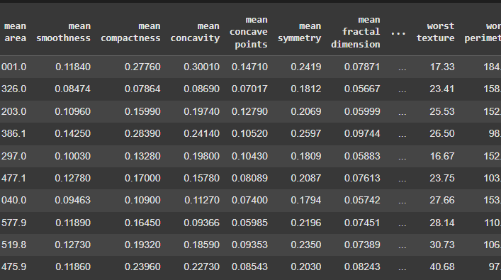

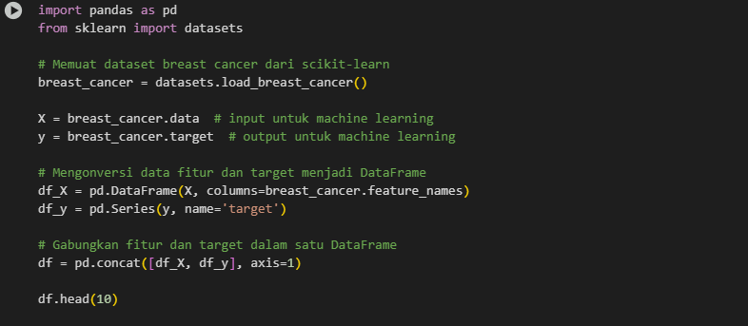
INPUT DATA

Slide 6

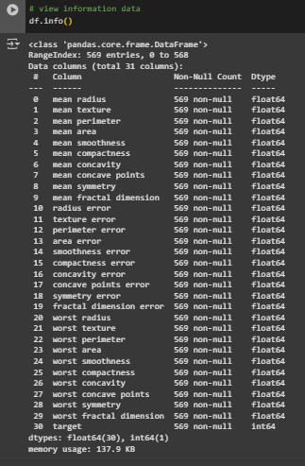
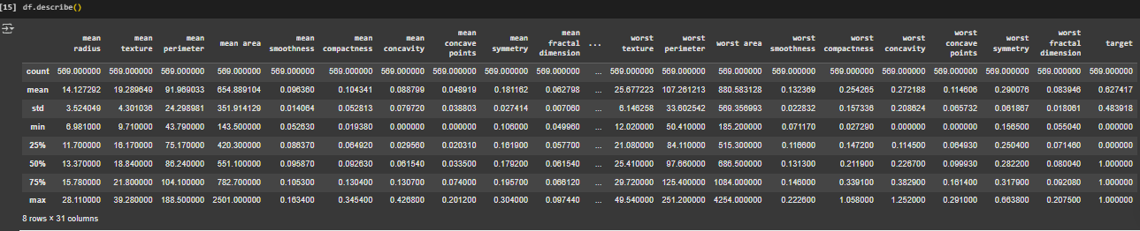
Page 13 of 15
EXPLORASI DATA ANALIS

Slide 7
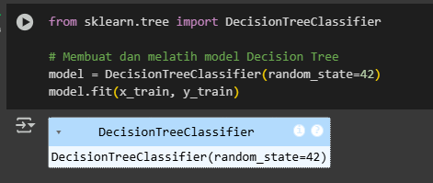
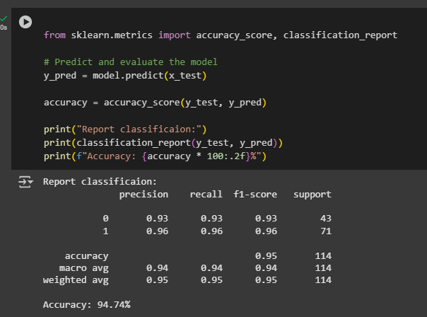
DATA MODELING

Slide 8
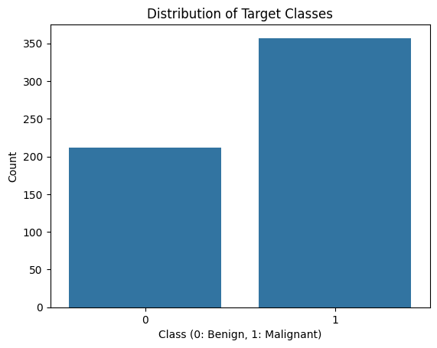
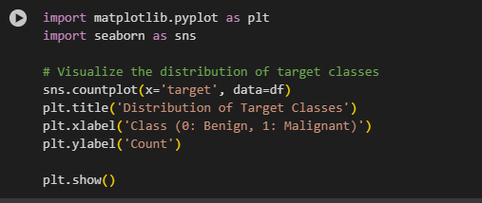
DATA VISUALIZATION

Slide 9
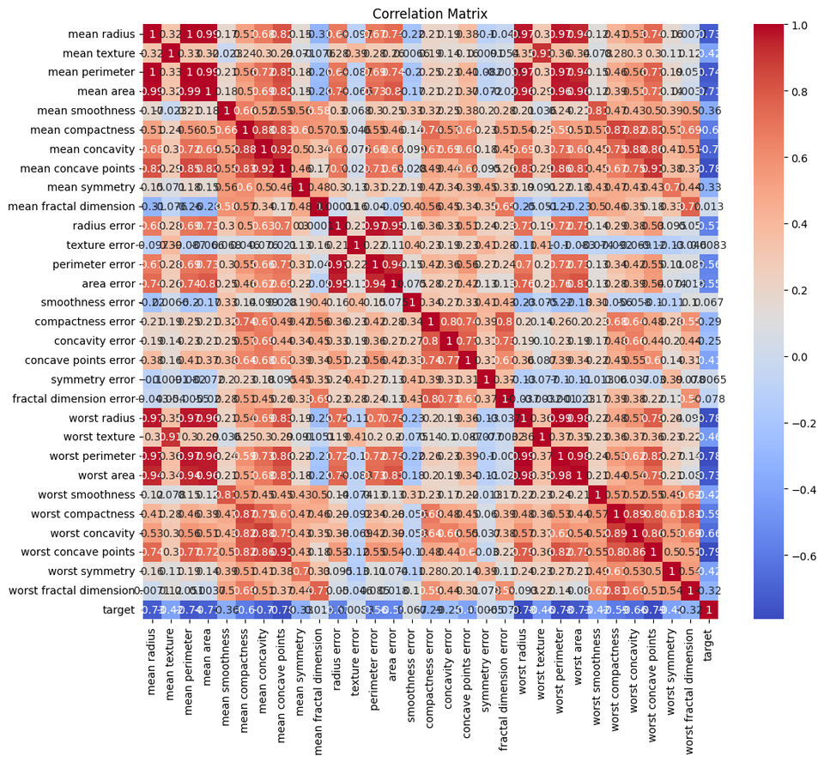
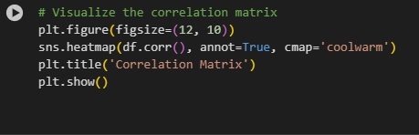
DATA VISUALIZATION

Slide 10
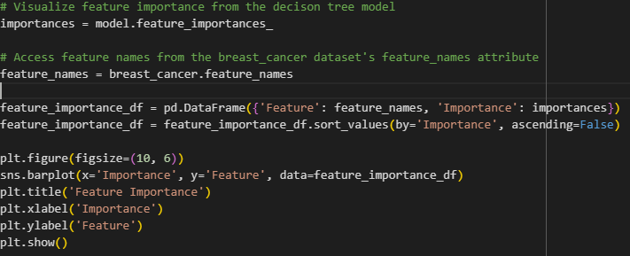
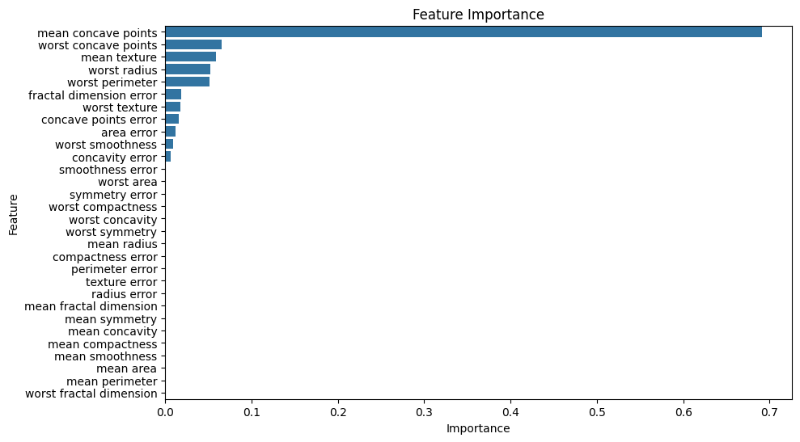
DATA VISUALIZATION

Slide 11
Thanks
085715964578
www.linkedin.com/in/pajar-saputra-88563b2a6
https://github.com/pajarbeuy

