Slide 1
Recommender System Project
Sep. 2025
Philip

Slide 2
Overview
Recommender systems are algorithms designed to suggest items to users based on their preferences and behaviors.
Are widely used in various domains, such as e-commerce, streaming services, social media, etc. to enhance user experience by providing personalized content.
In recommender systems, machine learning models are used to predict the rating r_{ui} of a user (u) on an item (i).
At inference time, item (i) having the highest predicted rating r_{ui} is recommended to each user (u).
Recommender systems can be categorized into two main types:
content-based filtering and
collaborative filtering.

Slide 3
Content-Based Filtering (CBF)
Content-based filtering is a technique used in recommender systems that relies on the features of items to make recommendations. It assumes that if a user liked an item in the past, they will likely enjoy similar items in the future.
Uses item features to create a profile for each user, which is then used to recommend items that match the user's preferences.
Focuses on the attributes of items and gives recommendations based on the comparison between the content of items and user preferences. It uses item features to recommend additional items similar to what the user likes, based on their previous actions.
Content-based filtering can be implemented using various algorithms, such as:
TF-IDF (Term Frequency-Inverse Document Frequency)
Cosine similarity
Jaccard similarity
Euclidean distance
Machine learning models (e.g., decision trees, support vector machines)
Content-based filtering can be divided into two main categories:
User-based content filtering
Item-based content filtering.
Notes:
For example, if a user likes a movie with a certain genre, director, or actor, CBF will recommend other movies that have similar features. CBF does not require any information about other users or their ratings, only the user's own profile and preferences. CBF can be seen as a form of supervised learning, where the user's ratings or feedback are used as labels to train a model that can predict the user's interest in new items.

Slide 4
Collaborative Filtering (CF)
Collaborative Filtering is a technique relies on the interactions between users and items to make recommendations.
It makes predictions about the preference of a user by collecting preferences from many users (collaborating). In general, it uses collective intelligence from a group of users to recommend items to an individual. It uses the past behavior of users to predict their future behavior.
It assumes that users who have interacted with similar items in the past will have similar preferences in the future. The underlying assumption is that if a person A has the same opinion as person B on an issue, A is more likely to have B’s opinion on a different issue.
It can be used to recommend items to users based on their past interactions with items, such as clicks or ratings.
CF does not require any information about the features or attributes of the items, only the user-item rating matrix, and can be seen as a form of unsupervised learning, where the user's interest in new items is inferred from the similarity or correlation between users or items.
Collaborative filtering can be implemented using various algorithms, such as matrix factorization, k-nearest neighbors, and deep learning-based approaches.
Collaborative filtering can be divided into two main categories:
Memory-based collaborative filtering
Model-based collaborative filtering
Notes:
**Memory-based collaborative filtering** uses the entire user-item dataset to generate recommendations. It includes user-item filtering and item-item filtering. It can be further divided into two types:
*User-based collaborative filtering*: This method recommends items to a user based on the preferences of similar users. It creates a user-item matrix, where each row represents a user and each column represents an item. The values in the matrix represent the interactions between users and items, such as ratings or clicks. The similarity between users is calculated using metrics such as cosine similarity or Pearson correlation. The users with the highest similarity scores are then recommended items that they have not interacted with yet.
*Item-based collaborative filtering*: This method recommends items to a user based on the similarity between items. It creates an item-item matrix, where each row represents an item and each column represents a user. The values in the matrix represent the interactions between items and users, such as ratings or clicks. The similarity between items is calculated using metrics such as cosine similarity or Pearson correlation. The items with the highest similarity scores are then recommended to the user.
**Model-based collaborative filtering** uses predictive models to predict a user's interest in an item. Predictive models like neural networks, SVD, and matrix factorization are used to predict user’s interest, for example, predicting a user’s movie preference. It can be further divided into two types:
*User-based collaborative filtering*: This method uses predictive models to predict a user's interest in an item based on the preferences of similar users. It creates a user-item matrix, where each row represents a user and each column represents an item. The values in the matrix represent the interactions between users and items, such as ratings or clicks. The predictive model is trained on the user-item matrix to predict the user's interest in an item.
Using this method, the model learns to predict a user's interest in an item based on the similarity between users. It creates a user-user matrix, where each row represents a user and each column represents an item. The values in the matrix represent the interactions between users and items, such as ratings or clicks. The predictive model is trained on the user-user matrix to predict the user's interest in an item.
Example using the cosine similarity
The cosine similarity between two users $u$ and $v$ is calculated as follows:
$$\text{similarity}(u,v) = \frac{\vec{u} \cdot \vec{v}}{||\vec{u}|| \cdot ||\vec{v}||}$$
where $\vec{u}$ and $\vec{v}$ are the normalized vectors of user $u$ and user $v$, respectively, and $||\vec{u}||$ and $||\vec{v}||$ are the magnitudes of the normalized vectors. The cosine similarity measures the cosine of the angle between two vectors, which indicates how similar the two users are based on their interactions with items.
*Item-based collaborative filtering*: This method uses predictive models to predict a user's interest in an item based on the similarity between items. It creates an item-item matrix, where each row represents an item and each column represents a user. The values in the matrix represent the interactions between items and users, such as ratings or clicks. The predictive model is trained on the item-item matrix to predict the user's interest in an item.
In item based collaborative filtering, the predicted score for a user $u$ and an item $i$ is calculated as follows:
$$r_{ui} = \frac{\sum_{j \in N(u)} w_{ij} r_{uj}}{\sum_{j \in N(u)} |w_{ij}|}$$
where
$r_{ui}$ is the predicted rating for user $u$ on item $i$,
$N(u)$ is the set of items that user $u$ has interacted with,
$w_{ij}$ is the similarity between item $i$ and item $j$, and
$r_{uj}$ is the rating given by user $u$ to item $j$.
*Collaborative filtering has several advantages, such as:
No Need for Feature Extraction: CF operates purely on user interaction data.
High Novelty: Recommendations are based on behaviors across the user base, often leading to serendipitous discoveries.
Highly Personalized: Learns from community patterns to give suggestions.
*Collaborative Filtering also has some limitations, such as:
Cold Start Problem: New users or items with no interactions cannot be recommended.
Sparsity: User-item matrices can be sparse, making it difficult to find similar users or items.
Scalability: As the number of users and items grows, the computational cost increases.
Over-reliance on User History: Limits exploration and may reinforce past behavior excessively.
Both content-based and collaborative filtering methods have their strengths and weaknesses. Content-based filtering is more suitable for recommending items that are similar to the items a user has interacted with in the past, while collaborative filtering is more suitable for recommending items based on the interactions between users and items. In practice, a hybrid approach that combines both methods is often used to provide more accurate and personalized recommendations.
Some factors that can affect the performance of a recommender system include:
The quality and quantity of the data available
The diversity and novelty of the recommendations

Slide 5
Hybrid Recommender Systems
Hybrid recommender systems combine both content-based and collaborative filtering methods to leverage the strengths of both approaches. By integrating the two methods, hybrid systems can overcome some of the limitations of each individual approach, such as the cold start problem and data sparsity.
Hybrid systems can be implemented in various ways, such as:
Weighted hybrid: Assigning weights to the recommendations from both content-based and collaborative filtering methods and combining them to generate a final recommendation list.
Switching hybrid: Using one method for certain users or items and switching to the other method for others, depending on the context or available data.
Feature augmentation: Using the features from one method to enhance the input of the other method, such as using item features to improve collaborative filtering recommendations.

Slide 6
Limitations of CBF and CF Methods
While CBF & CF are powerful techniques, they have limitations that can affect their performance and applicability in real-world scenarios. Some of the common limitations of CBF and CF methods include:
Cold Start Problem: Both CBF and CF struggle with new users or items that have no prior interactions or ratings. CBF relies on item features, while CF relies on user-item interactions, making it difficult to recommend items to new users or recommend new items to existing users.
Data Sparsity: The user-item interaction matrix is often sparse, meaning that most users have rated only a few items, and most items have been rated by only a few users. This sparsity can lead to challenges in finding similar users or items, especially for CF methods.
Scalability: As the number of users and items increases, the computational cost of both CBF and CF methods can grow significantly. This can lead to performance issues, especially in real-time recommendation scenarios.
Overfitting: CBF can overfit to the features of items, leading to recommendations that are too similar or redundant. CF can also overfit to user interactions, resulting in recommendations that do not generalize well to new items or users.
Lack of Diversity: CBF may recommend items that are too similar to the user's past interactions, leading to a lack of diversity in recommendations. CF may also reinforce existing user preferences, limiting the exploration of new or diverse items.
Bias and Fairness: Both CBF and CF can suffer from biases in the data, such as popularity bias, where popular items are recommended more frequently than less popular ones. This can lead to fairness issues, where certain groups of users or items are favored over others.
Interpretability: CBF can provide more interpretable recommendations based on item features, while CF methods, especially model-based approaches, can be less transparent in how recommendations are generated. This can make it difficult for users to understand why certain items are recommended.
Notes:
When choosing a recommender system, it is important to consider the specific requirements and constraints of the application. Different recommender systems have different strengths and weaknesses, and the choice of system will depend on factors such as:
The type of items being recommended (e.g., movies, books, articles)
The type of users being targeted (e.g., new users, returning users)
The type of data available (e.g., user-item interactions, item features)
The size of the dataset (e.g., number of users and items)
The computational resources available (e.g., memory, processing power)

Slide 7
The Data Set
The dataset used in this project is a collection of user-item interactions and item metadata. It contains information about user clicks on articles, including user IDs, session IDs, article IDs, timestamps, and various item features such as category ID, publisher ID, and word count.
The dataset is structured into two main Datasets: 'clicks' and 'articles_metadata'.
The 'clicks' Dataset contains user-item interactions, while the 'articles_metadata' Dataset contains item features.
The ‘articles_metadata’ dataset includes various features such as user ID, session ID, article ID, timestamps, and item metadata like category ID, publisher ID, and word count.
The `clicks` Dataset has several columns such as ‘user_id', ‘session_size’, ‘click_article_id' among others.
Notes:
: The ID of the item that was interacted with.
`click_timestamp`: The timestamp of the interaction.
`click_environment`: The environment in which the interaction occurred (e.g., web, mobile
`click_deviceGroup`: The type of device used for the interaction (e.g., desktop, mobile).
`click_os`: The operating system used for the interaction (e.g., Windows, macOS, Android).
`click_country`: The country from which the interaction originated.
`click_region`: The region from which the interaction originated.
`click_referrer_type`: The type of referrer for the interaction (e.g., direct, search engine).
`click_hour`: The hour of the day when the interaction occurred.
`click_day`: The day of the week when the interaction occurred.
`click_month`: The month when the interaction occurred.
`click_year`: The year when the interaction occurred.
The `articles_metadata` DataFrame has the following columns:
`article_id`: The ID of the item.
`category_id`: The ID of the category to which the item belongs.
`created_at`: The timestamp when the item was created.
`publisher_id`: The ID of the publisher of the item.
`words_count`: The number of words in the item.
## Data Preparation
We start by loading the relevant data files and prepare the data for analysis and modeling. We will read in the data from the CSV files, display the shape, columns, data types, unique values, and missing values. We will also analyze the number of clicks per user, article, session, and other features such as user type, location, device, browser, operating system, and language.
We will also visualize the distribution of words per article and the number of clicks per session size and hour.
## Data Exploration and Recommender System
In this section, we will explore the data to understand its structure and contents. We will also build a recommender system using collaborative filtering. The goal is to recommend articles to users based on their past interactions and the features of the articles.
In this notebook, we will explore the data and build a recommender system using collaborative filtering.

Slide 8
Exploratory Data Analysis (EDA)
Examine the dataset to understand its structure, identify patterns, and uncover insights.
EDA helps in understanding the data distribution, detecting anomalies, and formulating hypotheses for further analysis.
We will analyze the distribution of clicks per article, user, and session, as well as the distribution of clicks based on user metadata such as device, browser, operating system, and language. We will also visualize the data to better understand the relationships between different variables.

Slide 9
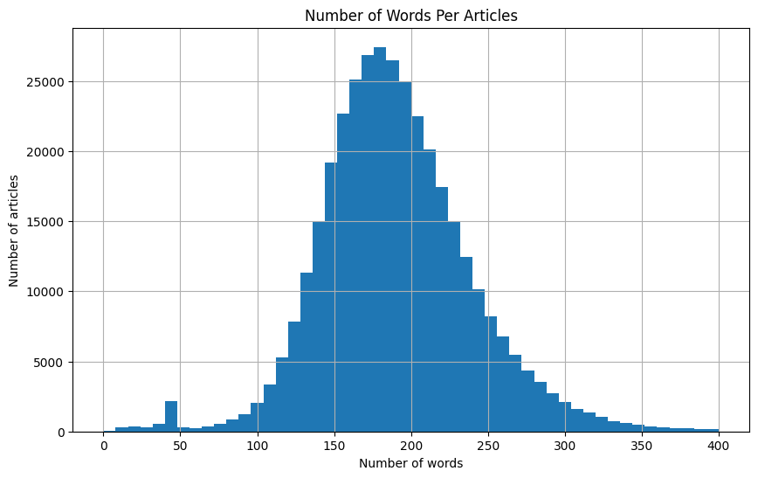
Distribution of Number of Words

Slide 10
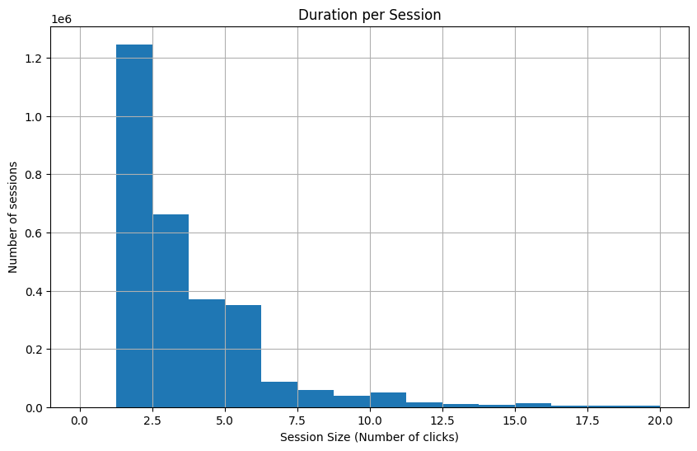
Distribution of Session Size

Slide 11
Singular Value Decomposition (SVD)
Using matrix factorization, we can create a user-item matrix that represents the interactions between users and items. This matrix can be used to calculate the similarity between users or items, which can then be used to make recommendations.
The SVD (Singular Value Decomposition) approach is a powerful technique for collaborative filtering. It decomposes the user-item interaction matrix into three matrices: user features, item features, and singular values. This allows us to capture latent factors that explain the interactions between users and items. By reconstructing the user-item matrix using these latent factors, we can predict missing ratings and make personalized recommendations.
Using SVD, we decompose the matrix:
$$ R \approx U \Sigma V^T $$
where:
$R$ is the user-item interaction matrix
$U$ is the user feature matrix
$\Sigma$ is the diagonal matrix of singular values (also known as latent factors or importance of factor)
$V^T$ is the item feature matrix

Slide 12
Recommendations for 10 users
Recommended articles for user 104588: [264644, 226232, 88905, 88886, 239781]
Recommended articles for user 34003: [118314, 29730, 70092, 2075, 13811]
Recommended articles for user 221092: [199118, 88886, 88887, 88894, 88893]
Recommended articles for user 107929: [226232, 72328, 88886, 264279, 88891]
Recommended articles for user 97713: [217963, 341972, 88886, 5557, 307744]
Recommended articles for user 72416: [283608, 201773, 284442, 208199, 206407]
Recommended articles for user 116208: [4395, 304640, 58019, 161988, 96141]
Recommended articles for user 141703: [88901, 88905, 88897, 88894, 88896]
Recommended articles for user 122477: [226231, 239781, 72328, 226222, 226216]
Recommended articles for user 33294: [72331, 72328, 72312, 72330, 88901]

