Slide 1

Smart Cities- Paris, France.
Philip Okoth

Slide 2
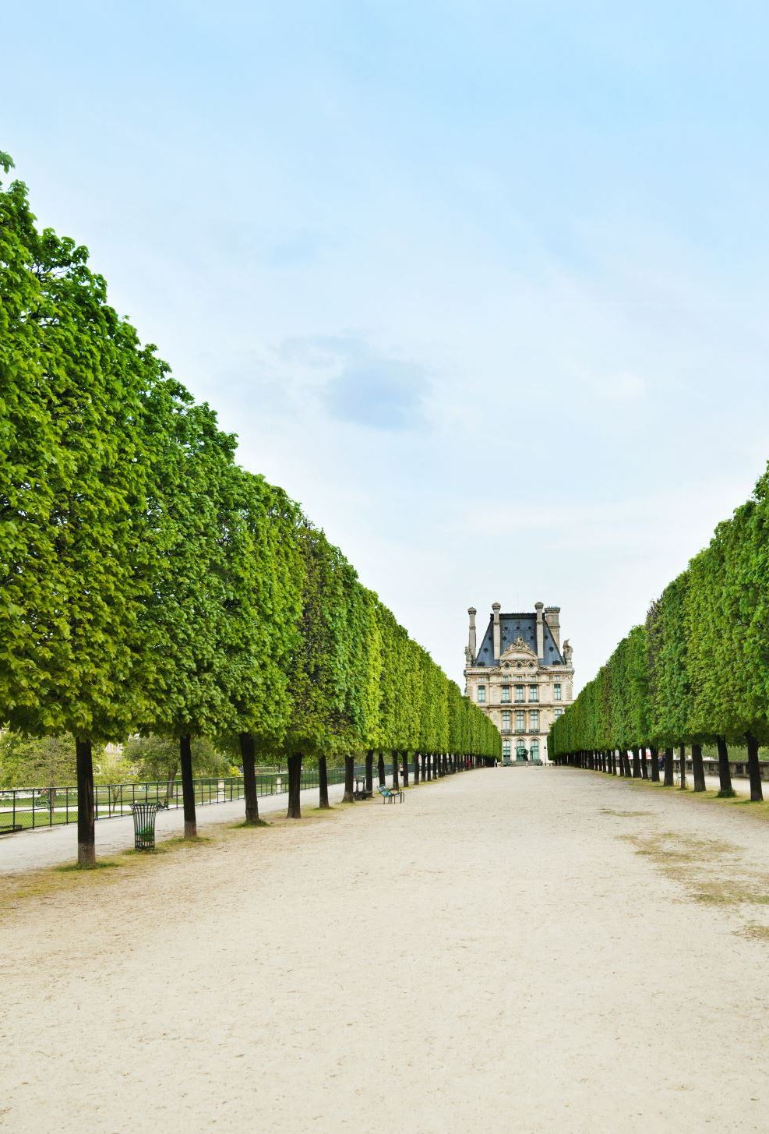
Brief Introduction
The city of Paris has more than 200,000 trees planted in the streets.
These trees have numerous benefits i.e.
improve air quality.
maintain a cool temperature in the city.
help fight climate change.
Unique location, require special approach.

Slide 3
Analysis
We will use Python, JupyterNoteBook, and python libraries i.e., Pandas, Seaborn, matplotlib etc. to analyze the data. Below are the steps of the analysis.
Read in the data.
Clean the data.
Descriptive Statistics.
Graphical summaries.

Slide 4
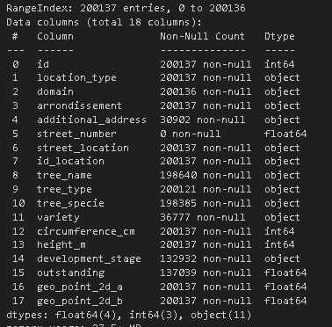
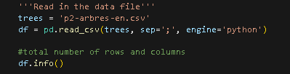
Data Description
The data consisted of 18 columns (variables) and 200,137 rows (observations). Some of the variables with significant number of missing values were dropped from analysis.

Slide 5
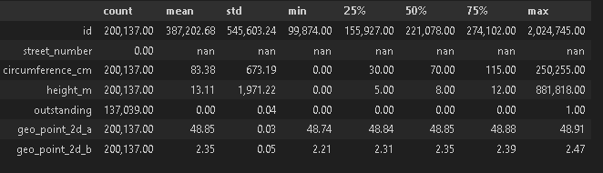
Descriptive Statistics
Some summaries standout.

Slide 6
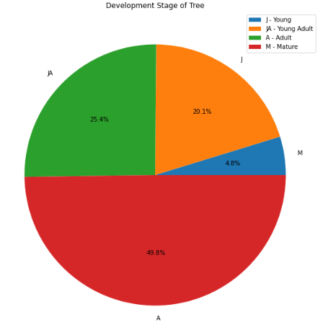
Distribution of Trees
Approximately 50% of the trees are adult, 25% are young adult, 20% are young, and 5% are mature.

Slide 7
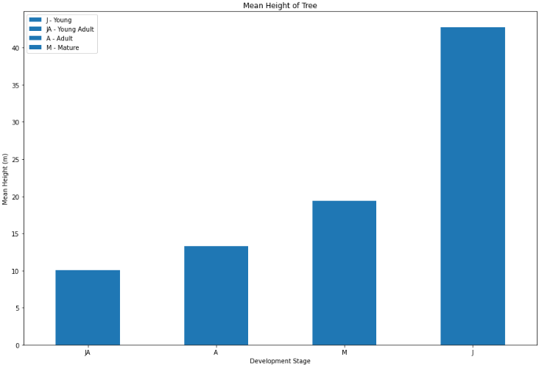
Height of Trees by stage
Young trees on average are the tallest and young adult trees the shortest.

Slide 8
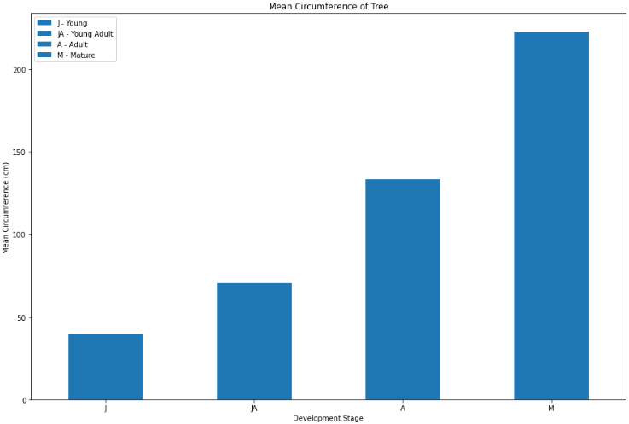
Mean Circumference by Stage
Mature trees are the largest and young trees the smallest in circumference.

Slide 9
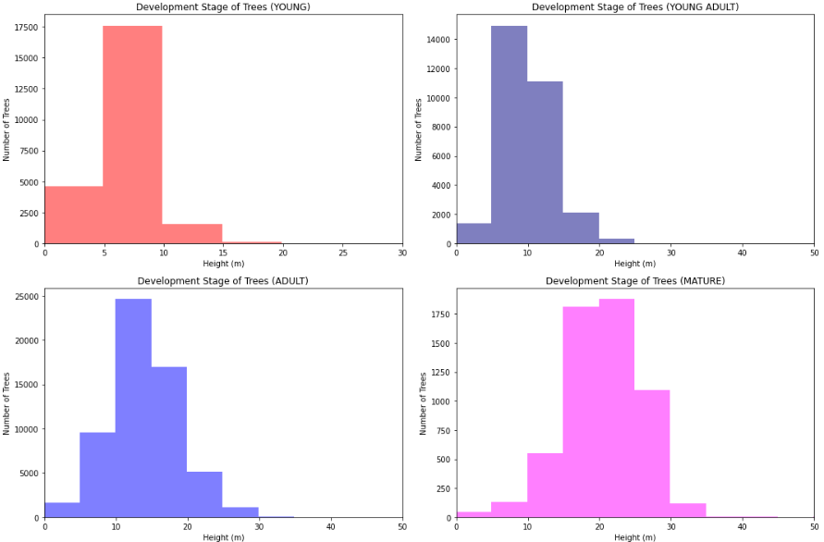
Tree Height

Slide 10
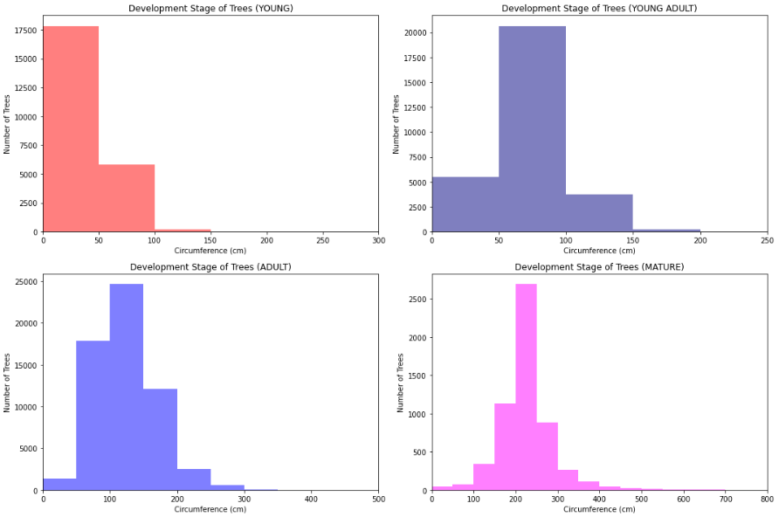
Tree Circumference

Slide 11
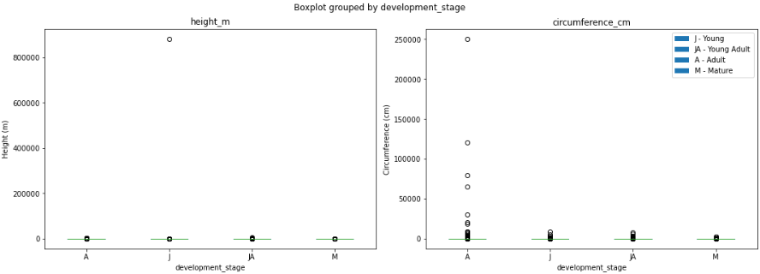
Boxplots
Plots show numerous outliers for height and circumference

Slide 12
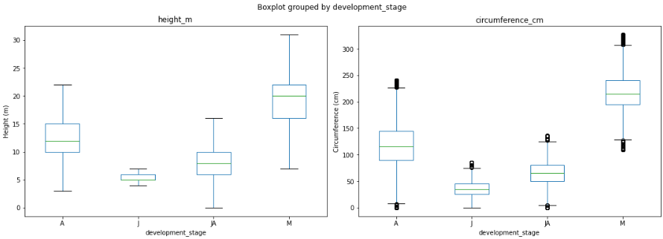
Boxplots (continued)
With outliers removed

Slide 13
Thanks.
Data was obtained from:
Trees — Paris Data for more information on the data visit Everything you need to know about trees in Paris - Ville de Paris
Questions?

