Slide 1
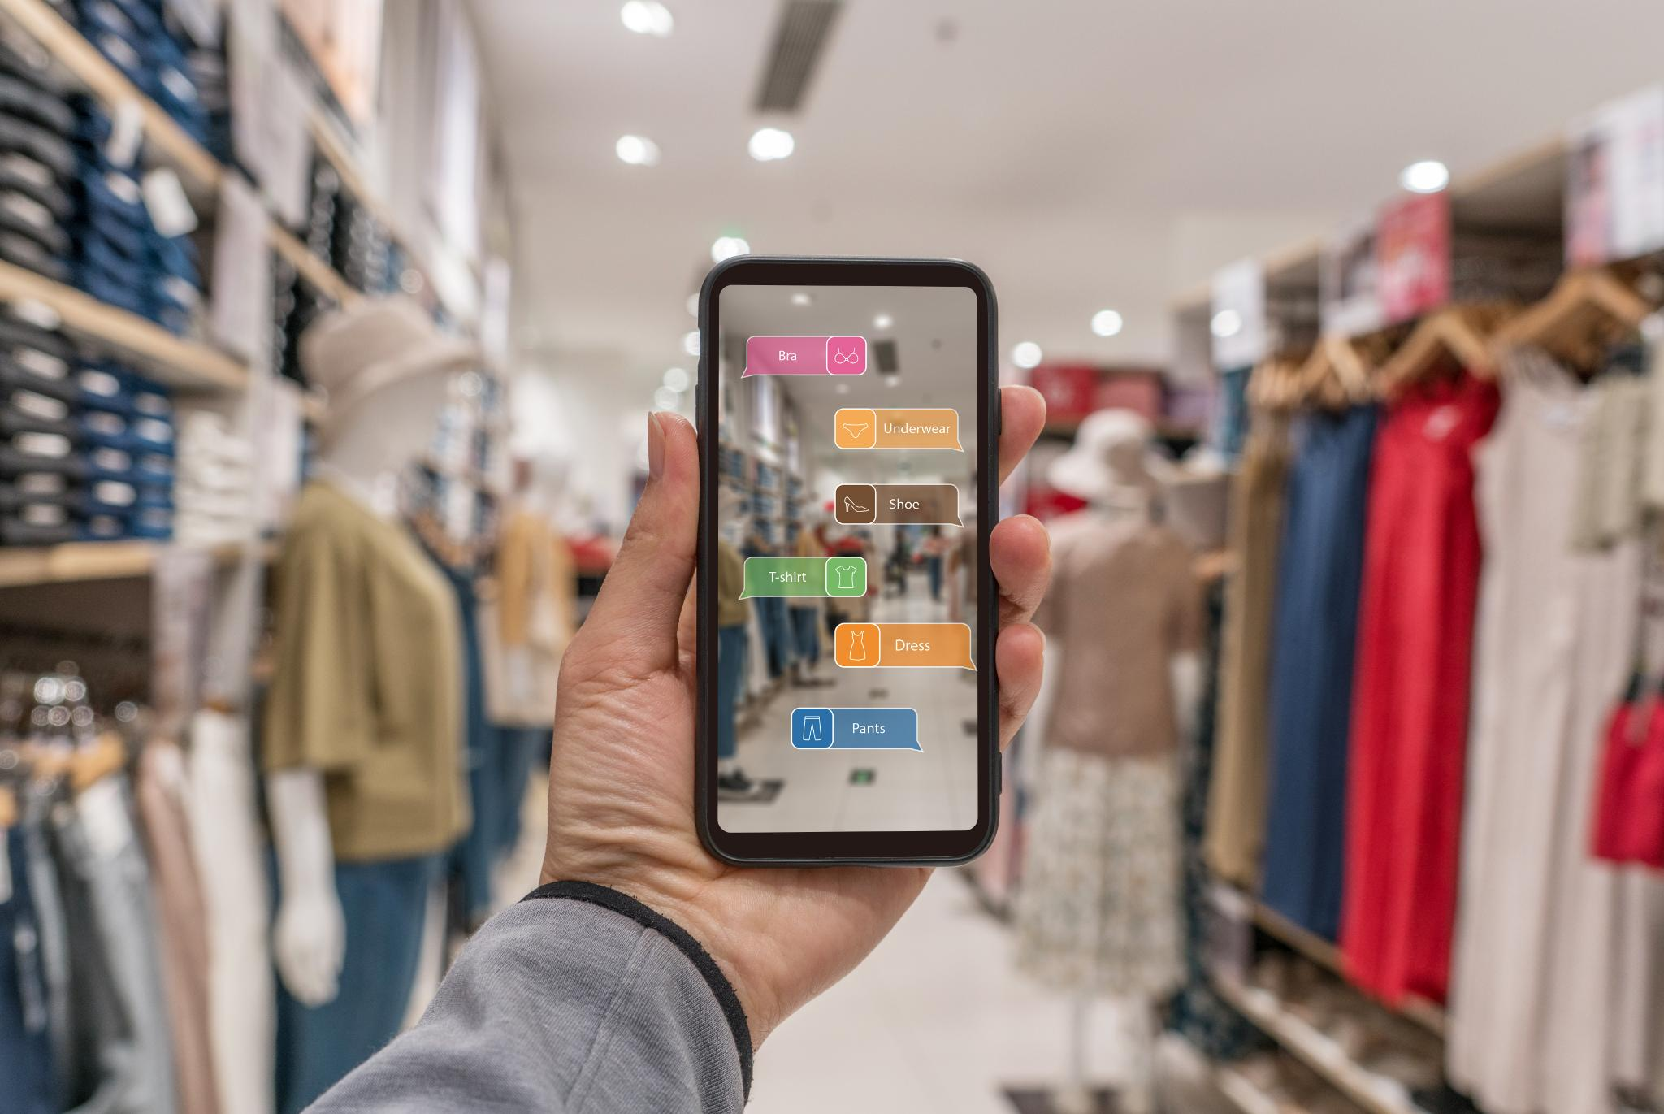
Fashion-insta Empowering Fashion Shopping
Philip Okoth
January 2026
Fashion-Insta

Slide 2
Executive summary
Project goal:
Improve user experience through an app allowing photo upload and returning a digitally curated fashion recommendations.
Value Proposition:
Improved user experiences, engagement, and retention and increased sales.
Project Scope:
The estimated timeline of the project is six weeks (design to deployment).
Project Cost:
Estimated Total Budget $221,000-$520,000.
ROI:
Projected profit in the first three years is $300M per year.

Slide 3
Problem Statement
Shoppers struggle to browse the large fashion catalog, making it difficult to decide what to buy.
Poor customer experience and reduced customer satisfaction ultimately results in lower sales.

Slide 4
Solution statement
Improve user experience by creating an app where a customer can upload a photo and get digitally curated fashion recommendations based on the photo.

Slide 5

OBJECTIVES AND EXPECTED BENEFITS
Objective:
Improve user experience by creating a mobile App with fashion predictability capabilities. This feature will analyze customer’s fashion trends and recommend similar styles based of body shape, color preferences, trends and budget.
Benefits
Improved user experiences.
Improved user engagement.
Increased sales.
Higher Customer retention.

Slide 6
Technical REQUIREMENT
Engineering
Mobile App development frameworks (e.g., Azure)
Backend infrastructure for user accounts, product catalog, and order management.
API integration for payment gateways and third-party services.
Data Team
Database design for storing user profiles, product information, and transaction history.
Data analytics for tracking user behavior and app performance. (Azure Analytics)
Machine learning models for personalized recommendations and fashion trend analysis.
UX
Intuitive and user-friendly interface design.
Responsive layouts for various device sizes.
Acceptability features for inclusive shopping experiences.
Software
Secure authentication and authorization mechanisms through Azure.
Reliable cloud hosting and scalability solutions .
Continuous integration and deployment pipelines for app updates.

Slide 7
Project backlog
Title… | As a… | I want to… | In order to… | Weight… | Required data…
Photo Upload and wardrobe capture | Application user | Upload photos of my outfit | Have the App recommend and build a wardrobe catalog | 13 | User’s photos Catalog photos AI/ML training & testing data
Shopping cart and checkout | Application user | Add products to cart and complete purchase | Efficiently and conveniently shop | 13 | Catalog photos Catalog items User’s payment information
See Appendix 1 for more details

Slide 8

HUMAN requirements
Software Engineers(x1)
Responsible for developing the mobile app, backend systems, and integrating APIs for payments and third-party services.
Data Analysts/ Scientists(x2)
Design and manage databases, analyze user behavior, and build machine learning models for personalized recommendations and fashion trend analysis.
Product Managers(x1)
Oversee project scope, timeline, and ensure alignment with business goals and user needs.
AI/ML Engineers(x2)
Develop and implement machine learning algorithms for predictability and recommendation features.
UX/UI Engineers(x2)
Desing intuitive, user-friendly, and accessible interfaces for seamless shopping experience.

Slide 9
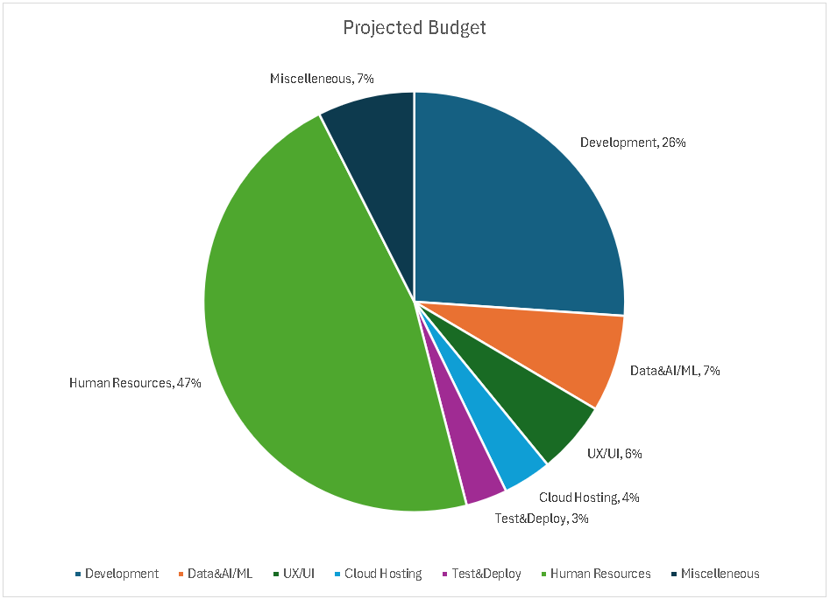
FINANCIAL cost & budget
Notes:
Development Costs
Mobile App development, Backend infrastructure & APIs, Database design & integration
Data and AI/ML Costs
Data Analytics setup, ML model development
UX/UI Design
Accessibility & responsive design
Cloud Hosting and Software
Cloud hosting & scalability, Security, authentication, and compliance
Testing and Deployment
QA testing & bug fixing, Continuous integration & deployment
Human Resources
Salaries for engineers, data scientists, product managers, UX designers
Miscellaneous
Legal & Ethical compliance
Marketing & launch
Estimated Total Budget $221,000-$520,000

Slide 10
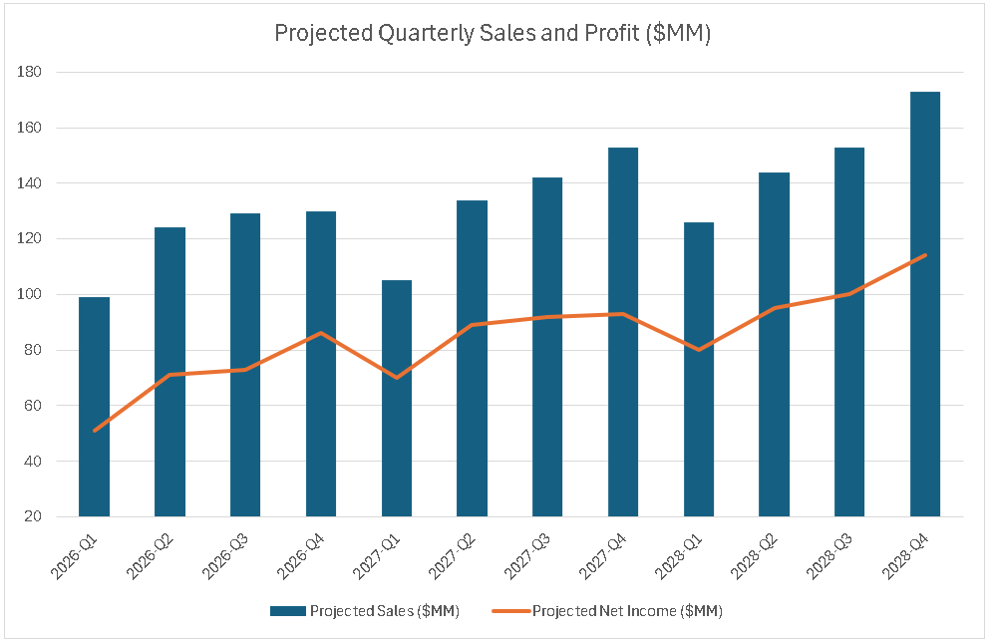
Return on investment
Through preliminary runs of the app on several platforms, we project that Fashion-Insta will generate:
$300MM in year1
$300MM in year2
$400MM(year 3).
Clear pattern in sales and profit growth.

Slide 11
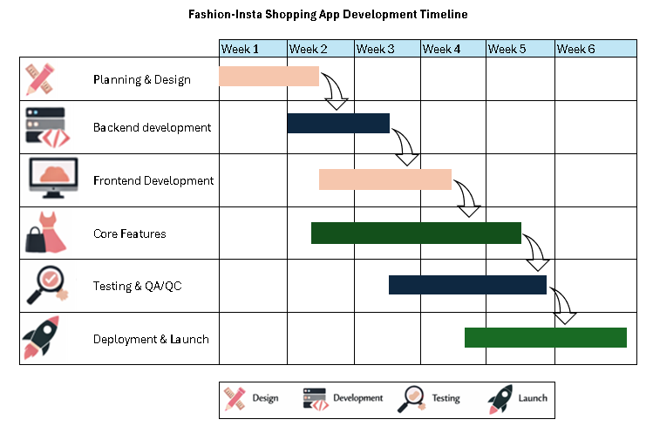
See Appendix 4 for detailed explanations
1/15/2026
11

Slide 12
milestones
Research Problem
MVP Demo & Feedback
Monitor App
Train/test Model
Secure Leadership Approval
Deploy/Launch App
Create Mobile App
Final Demo

Slide 13
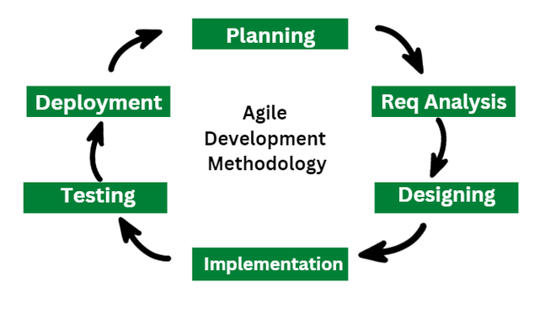
AGILE Methodology
A project management framework that emphasizes iterative development, collaboration, flexibility and customer feedback allowing teams to adapt to changing requirements and deliver high-quality products efficiently.
The Agile methodology approach breaks projects into smaller manageable phases also known as sprints.
There are three Agile frameworks
Scrum
Kanban
Extreme Programing (XP)
Image from adopted from geeksforgeeks

Slide 14
Agile manifesto
The guiding principles of the agile methodology. Consist of the following four principles
People over Processes
Individuals and interactions over processes and tools.
Emphasizes teamwork and collaboration
Working Software over Documentation
Working product over comprehensive documentation
Focus on delivering working/functional products over lengthy documentation.
Collaboration over Contracts
Customer collaboration over contract negotiation
Close engagement with customer to ensure their requirements and needs are met.
Responding to change over following a Plan
Responding to change over following a plan
Allows team to shift/pivot as project requirements change without derailing the project.

Slide 15
Benefits of agile
Flexibility and adaptability: Agile allows teams to respond to changes in requirements and market conditions swiftly.
Faster Delivery: By working in short cycles, teams can deliver functional increments of the product more frequently.
Enhanced Collaboration: Agile promotes teamwork and communication, leading to better problem-solving and innovation.
Transparency: Agile keeps stakeholders informed at every stage, ensuring clarity and alignment.
Iterative Development: Work is done in small, manageable steps, allowing for regular improvements and quick adjustments.
Customer-Centric: Continuous feedback from customers ensures that the final product aligns with their needs and expectations

Slide 16
Risks and mitigation plans
Category | Risk | Mitigation
Technical | Software Bugs & Integration Issues: Problems with code quality and model bias. Platform Compatibility: continuous updates to remain compatible with new devices and operating systems | Diverse and comprehensive data set. Comprehensive testing (unit, integration, and user acceptance). Use agile methodologies for iterative development and rapid bug fixes. Employ experienced developers and maintain clear documentation
Security & Privacy | Data Breaches: Insecure data storage, weak encryption, and inadequate authentication can expose user information. Regulatory Compliance: Failure to comply with privacy laws (GDPR, CCPA) can result in legal and financial penalties. | Implement robust encryption and secure data transmission protocols. Use strong authentication mechanisms (MFA i.e., Azure Authentication). Ensure compliance with relevant regulations and provide clear privacy policies.
See Appendix 2 for more details

Slide 17
Ethical and Legal issues
Issue | Legal/Ethical | Mitigation
Data Protection and Privacy | Legal: App must comply with data protection laws such as GDPR (EU), CCPA (California), and other regional regulations. These laws require explicit user consent, clear privacy policies, and mechanisms for users to access, correct, or delete their data. Ethical: Minimize data collection to only what is necessary, be transparent about data usage, and empower users with control over their personal information. | Use Azure’s built-in security features (encryption, secure authentication). Implement transparent privacy policies and granular permission controls. Regularly audit data practices and update security protocols.
Intellectual Property Rights | Legal: Using unlicensed assets or code can lead to infringement lawsuits. Protecting original content (code, designs, logos) and respecting third-party IP is crucial. Ethical: Always credit and obtain permission for third-party resources. | Register copyrights and trademarks for our app’s unique feature. Use only licensed third-party libraries and assets.
Accessibility and Inclusivity | Legal: Many jurisdictions require digital products to be accessible to users with disabilities (e.g., ADA in the US, WCAG guidelines). Ethical: Apps should be designed for diverse users, including those with disabilities and from different cultures. | Use Azure’s accessibility tools and follow WCAG standards. Test app features for usability across a range of abilities and devices.
See Appendix 3 for more details

Slide 18
Conclusion
User Empowerment
A well-designed app makes shopping easy and enjoyable, increasing user empowerment and satisfaction.
Enhanced Customer Loyalty
Effortless shopping experiences boost customer loyalty and repeat business for fashion-insta.
Competitive Market Success
Focusing on user-friendly features allows fashion-insta to thrive in a competitive marketplace.

Slide 19
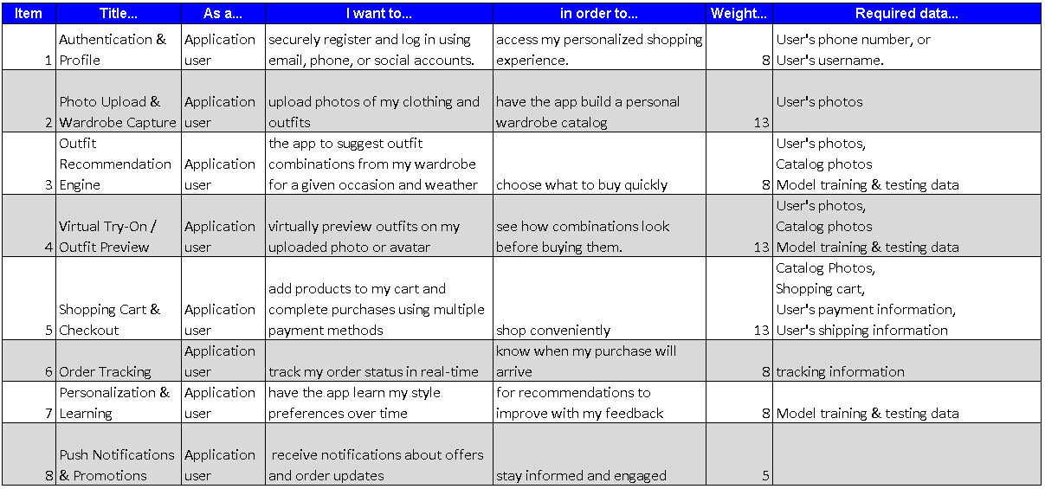
Appendix 1 : Project backlog

Slide 20
Appendix 2: Risks and mitigation plans
Category | Risk | Mitigation
Technical | Software Bugs & Integration Issues: Problems with code quality, compatibility across devices, and integration with third-party services can lead to crashes, poor performance, or data loss. Platform Compatibility: Apps must be continually updated to remain compatible with new devices and operating systems. | Comprehensive testing (unit, integration, and user acceptance). Use agile methodologies for iterative development and rapid bug fixes. Employ experienced developers and maintain clear documentation.
Security & Privacy | Data Breaches: Mobile apps often handle sensitive user data (personal info, payment details). Insecure data storage, weak encryption, and inadequate authentication can expose users to cyber threats. Regulatory Compliance: Failure to comply with privacy laws (GDPR, CCPA) can result in legal and financial penalties. | Implement robust encryption and secure data transmission protocols. Use strong authentication mechanisms (multi-factor authentication) i.e. Azure Authentication Regularly update security protocols and conduct vulnerability assessments. Ensure compliance with relevant regulations and provide clear privacy policies.
Project Management | Scope Creep: Uncontrolled changes in project scope can lead to delays and budget overruns. Budget Overruns: Poor planning and estimation can cause costs to spiral out of control. | Use a risk assessment matrix to prioritize risks by likelihood and impact. Maintain transparent communication and regular check-ins with stakeholders. Set clear project milestones and monitor progress closely.
Operational | Resource Allocation: Inadequate resources or poor team management can derail development. Communication Problems: Miscommunication within teams or with stakeholders can result in misaligned objectives. | Hold frequent, formal check-ins and sprint reviews. Foster open communication and collaboration among all contributors. Assign technical liaisons for outsourced projects.
Market & Usability | Market Competition: Standing out in a crowded app marketplace requires a unique value proposition and flawless functionality. User Experience: Poor usability or accessibility can lead to low adoption and high abandonment rates. | Conduct market research and user testing to refine features. Continuously gather user feedback and iterate on design. Ensure accessibility standards are met for inclusive user experiences.

Slide 21
Appendix 3: Ethical and Legal issues
Issue | Legal/Ethical | Mitigation
Data Protection and Privacy | Legal: Apps must comply with data protection laws such as GDPR (EU), CCPA (California), and other regional regulations. These laws require explicit user consent, clear privacy policies, and mechanisms for users to access, correct, or delete their data. Ethical: Developers should minimize data collection to only what is necessary, be transparent about data usage, and empower users with control over their personal information. | Use Azure’s built-in security features (encryption, secure authentication). Implement transparent privacy policies and granular permission controls. Regularly audit data practices and update security protocols.
Security Measures | Legal: Failure to protect user data can result in legal penalties, lawsuits, and reputational damage. Azure provides robust security tools, but developers must configure them correctly. Ethical: Developers have a duty to safeguard user data from breaches, unauthorized access, and cyber threats. | Use Azure’s multi-factor authentication, encryption, and secure APIs. Conduct regular vulnerability assessments and penetration testing.
Intellectual Property Rights | Legal: Protecting original content (code, designs, logos) and respecting third-party IP is crucial. Using unlicensed assets or code can lead to infringement lawsuits. Ethical: Always credit and obtain permission for third-party resources. | Register copyrights and trademarks for your app’s unique features. Use only licensed third-party libraries and assets.
Accessibility and Inclusivity | Legal: Many jurisdictions require digital products to be accessible to users with disabilities (e.g., ADA in the US, WCAG guidelines). Ethical: Apps should be designed for diverse users, including those with disabilities and from different cultures. | Use Azure’s accessibility tools and follow WCAG standards. Test app features for usability across a range of abilities and devices.
Transparency and User Consent | Legal: Clear terms of service and end-user license agreements are required to establish legal relationships and responsibilities. Ethical: Users should be informed about how their data is used and given the ability to opt out. | Draft clear, enforceable contracts and terms of service. Provide opt-out options for data collection and targeted advertising.
Compliance with App Store and Platform Policies | Legal: Apps must comply with the guidelines of platforms like Apple App Store and Google Play, as well as Azure’s own terms of service. | Review and adhere to all relevant platform policies before deployment.
Third-Party Integrations | Legal/Ethical: Ensure that all third-party services integrated with Azure also comply with privacy and security standards. | Vet third-party vendors and require compliance with our app’s standards.

Slide 22






Appendix 4: App development timeline
 | Item | Details
 | Planning & Design | Define app requirements (features, user flow, payment integration). Create wireframes for UI/UX design.
 | Backend Development | Set up server and database in Azure. Implement user authentication and account management (Azure Authentication). API design for product catalog and shopping cart.
 | Frontend Development | Build core screens (Home, Product Listing, Product Details). Integrate UI with backend APIs.
 | Core Features | Add shopping cart functionality. Implement checkout and payment gateway. Add search and filter options.
 | Testing & QA | Unit testing for backend and frontend. Integration testing for payment and cart. Fix bugs and optimize performance.
 | Deployment & Launch | Deploy app to production environment (Azure). Final security checks. Launch marketing campaign and app store submission.

Slide 23
App Features for Streamlined Fashion Item Purchasing
User-Friendly Navigation
Easy navigation helps users browse fashion items quickly and find products effortlessly.
High-Quality Visuals
High-quality images display fashion items clearly, enhancing users' decision-making process.
Personalized Recommendations
Personalized suggestions improve user engagement by offering relevant fashion items.
Secure and Efficient Checkout
Secure payment options and smooth checkout process ensure safe and quick purchases.

