Slide 1
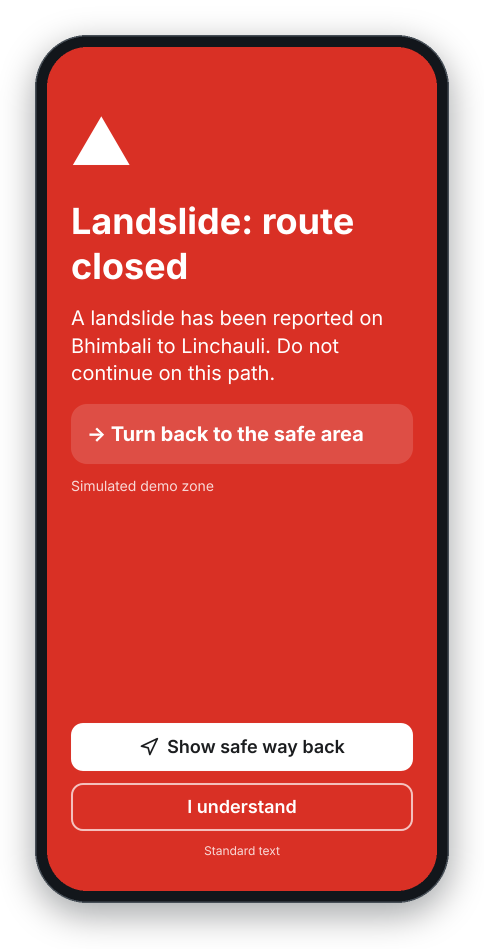
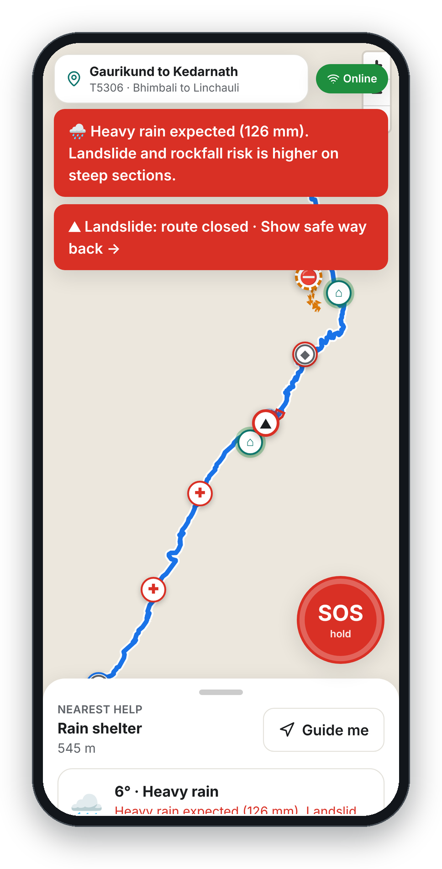
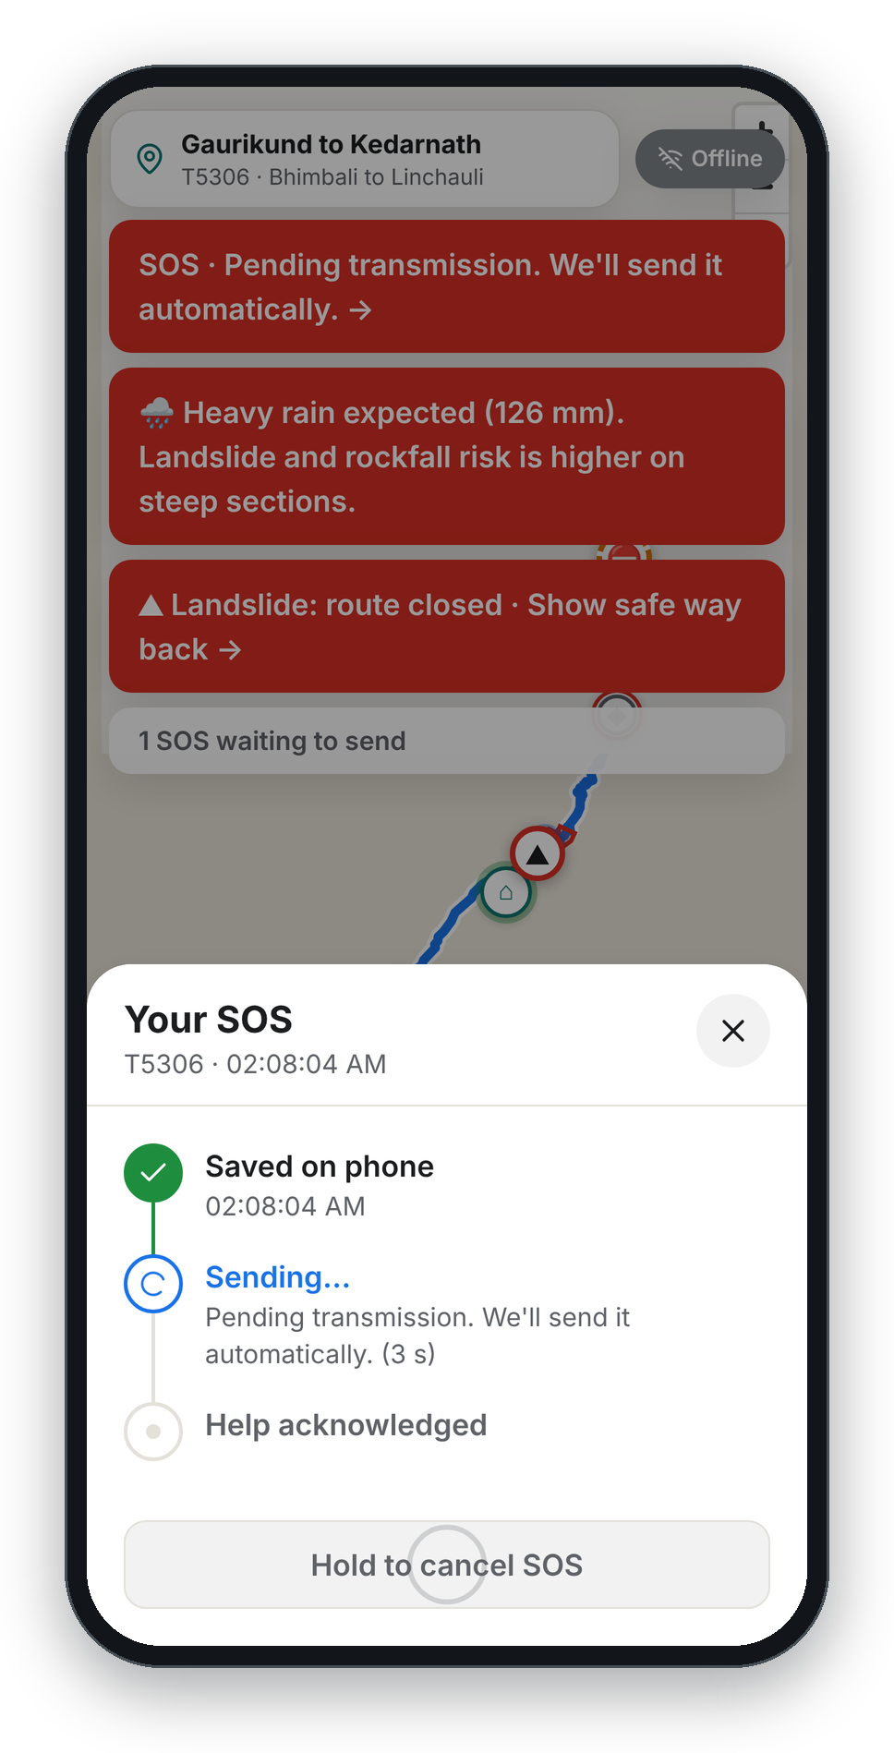
SafeTrail
BIOS V2 · PRUNE TRACK · SHIP IT LEAN
A safety companion for treks, pilgrimages and national parks
Warns you before danger, keeps your SOS when there's no signal, and lets responders act fast. Every AI call runs through Prune, so it costs paise per trip.
WARN EARLY
NEVER LOSE AN SOS
PROVE EVERY RESPONSE
PILOT ROUTES
Kedarnath, Uttarakhand · Lachung–Yumthang, Sikkim · Corbett Tiger Reserve
Team SafeTrail · BIOS V2, Thapar Institute, Patiala
Notes:
Imagine trekking to Kedarnath when a landslide blocks the path. No signal, no common language, and a crowd building up behind you. SafeTrail is a safety companion for treks, pilgrimages and national parks. These are real screens from our working build: the full-screen landslide alert, the trail map with a weather warning, and an SOS saved on the phone while it's offline. Edit the team line with your names.

Slide 2
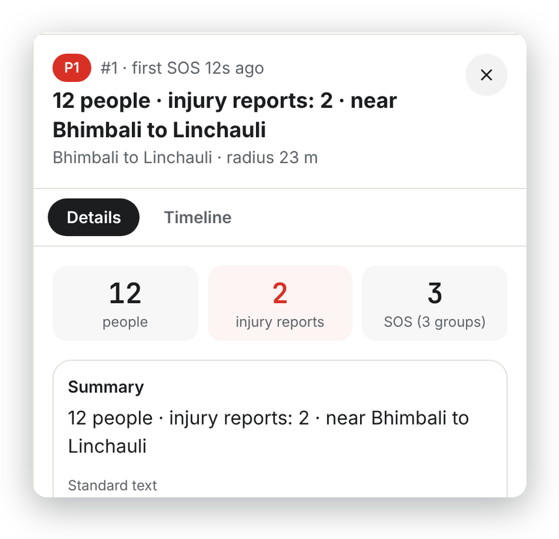
When a landslide hits, three things fail at once
01 · THE PROBLEM
01
02
03
No warning
No signal
No common language
Tourists don't know the trail is closed, the zone is restricted, or the crowd ahead is dangerous.
Long stretches of mountain and forest routes have no mobile data, exactly where trouble starts.
A foreign trekker or a pilgrim from another state can't explain what happened to local responders.
What responders get today
Why it matters
2013
Kedarnath floods: over 5,700 people presumed dead or missing
2023
Flash flood cuts off Lachen and Lachung in North Sikkim; thousands of tourists stranded
2024
Crowd crush at a religious gathering in Hathras: 121 dead
40 separate calls: late, vague, duplicated, no location
With SafeTrail: one incident, exact counts (real screen)
Sources: Govt. of Uttarakhand (2013); national news reports (Oct 2023, Jul 2024).
Notes:
Every year tourists and pilgrims get trapped by landslides and floods, go missing on treks, wander into restricted border or core forest zones, or get crushed in crowds. Three things fail at the same moment: no warning, no signal, no common language. Responders get late, vague, duplicate calls and nobody knows who is stuck where. On the right, one incident card from our app: three SOS from one spot become one card with exact counts. Check the figures in 'Why it matters' against your own sources before presenting.

Slide 3
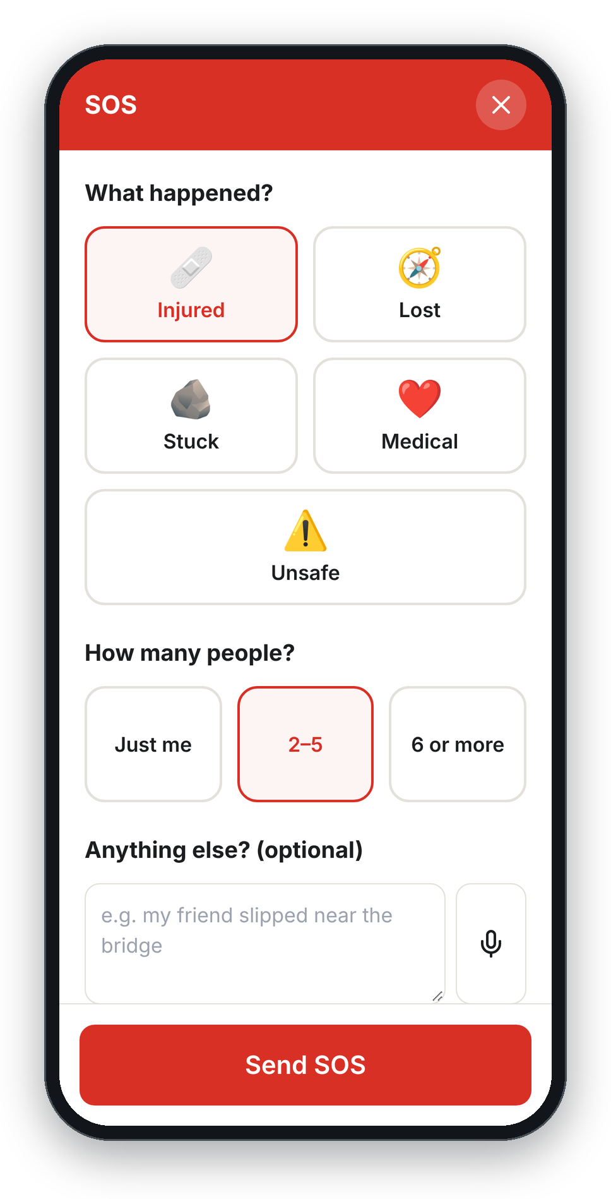
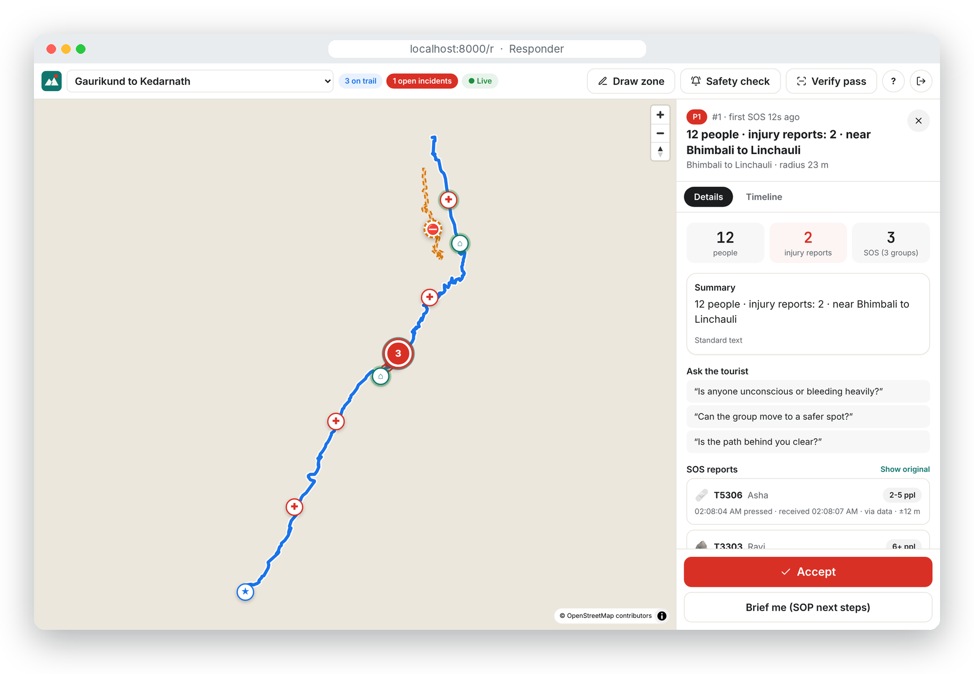
One app, two modes: the tourist and the responder
02 · THE SOLUTION
TOURIST MODE · PHONE · WORKS OFFLINE
RESPONDER MODE · SAME APP · OFFICER LOGIN
Digital Tourist Pass
Linked to the visa, e-ILP or yatra registration you already hold. Signed QR.
Offline safety pack
Route brief, last medical posts, altitude and weather signs, local phrasebook.
Danger-zone alerts
Geofencing on the phone: landslide, closed trail, border, tiger core.
Crowd red zones
Stampede warning with a wait time or another route.
One-tap SOS
Saved offline, sent on the first signal, by SMS if data is down.
“Are you safe?”
One tap after a disaster: I'm safe or I need help.
Family link
Trip status and last check-in. Never live location.
Live map
Dots, red zones, crowd heatmap, SOS pins. Draw a zone in seconds.
Grouped incidents
Three SOS from one spot become one card: 12 people, 2 injury reports.
Copilot
A short brief and next steps from the route's standard procedure.
Accept + signed log
The tourist sees “Help acknowledged”. Every step is hash-chained.
SOS in three taps, no typing
Notes:
One app with two modes. Tourist mode: a Digital Tourist Pass from the permit you already have, an offline safety pack, danger-zone alerts that run on the phone, crowd red zones, one-tap SOS that works offline, an 'Are you safe?' check-in, and a family link that never shows location. Responder mode, same app with an officer login: a live map, grouped incident cards in the officer's language, a copilot with next steps from the route's procedure, and Accept with a signed timeline. Both screenshots are from our running build.

Slide 4
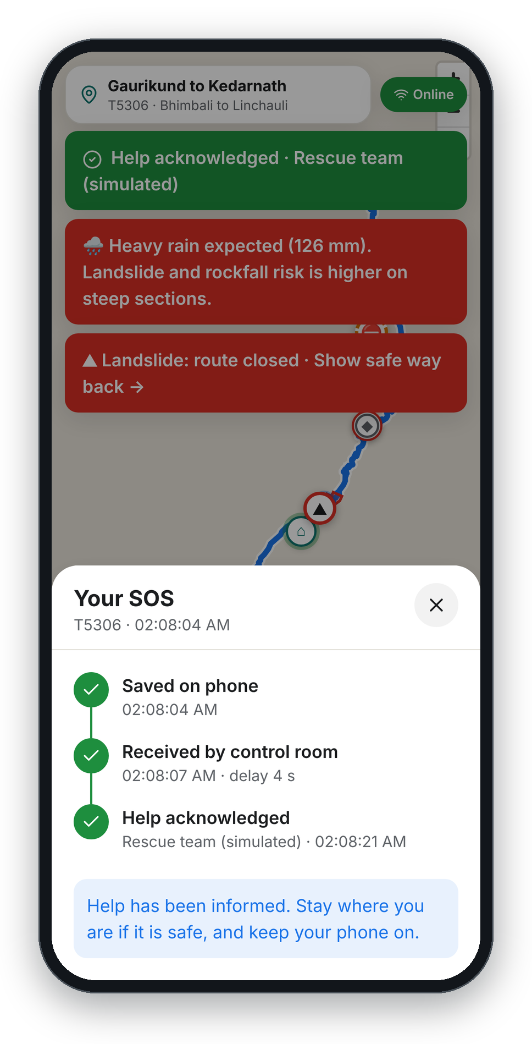
The AI is never in the emergency path
03 · BUILT FOR NO SIGNAL
01
02
03
04
05
06
Hold SOS
Saved on phone
First signal
Server
One incident
Acknowledged
Pick what happened. No typing.
IndexedDB queue shows “Pending transmission”
Mobile data, SMS fallback or a checkpoint
Drops duplicates, groups nearby SOS
Exact counts, live on the responder map
“Help acknowledged” on the phone; every step signed
Side lane, through Prune: AI writes the report and translation seconds later. If it fails → Standard text.
Works with zero internet
“In a true dead zone nothing can send a message. So we warn people before they enter one, save the SOS the moment it's pressed, and send it on the first bar of signal.”
Our honest answer on connectivity. Next: satellite SOS and phone-to-phone Bluetooth relay.
✓
Danger-zone alerts: on-phone geofencing with hysteresis
✓
Pass shown and checked offline (Ed25519 signature)
✓
Approach warning and “show safe way back”
✓
Compass guide to the nearest help point
✓
Offline safety pack and local phrasebook
✓
Whistle, strobe and read-out-to-112 tools
✓
SOS saved instantly, retried automatically
✓
Last weather forecast for each trail section
✓
Coded SOS by SMS when data is down
✓
Crowd red zones already received
Offline: “Pending transmission”
Back online: received in 4 s
Notes:
The rule: the AI is never in the emergency path. An SOS is saved on the phone the moment it's pressed, shows Pending transmission, and goes out on the first signal: mobile data, an SMS the server parses without any AI, or a checkpoint. The server drops duplicates and groups SOS within 150 metres; the responder sees one incident and taps Accept. The AI only writes the report and translation afterwards, through Prune. If it's down or over budget, a fixed template is used and alerts never stop. Everything in the checklist works with no internet at all. The two phones are real: offline, then back online and acknowledged.

Slide 5
Every AI call goes through Prune, one base URL
04 · PRUNE AT THE CORE
Tourist phone
Responder app
Feature | Model | What Prune does
Offline safety pack | Small | Exact cache: pack #10,000 is free
Zone warnings | Small | Cache: each language paid for once
SOS report + translation | Small → large | Routes to the cheapest model that works
Grouping summary | Large, per cluster | Run budget + step limit per incident
Responder copilot | Small | Daily spend cap on the key
Free-text SOS notes | Any | Injection detection: flags, never blocks
Pass and visa numbers | Never sent | PII shield as a second wall
Every call | Any | Signed receipt: verifiable cost per trip
SafeTrail server · FastAPI
Zones, SOS, grouping, passes, signed log: plain code, no AI
AI jobs only, after the fact
ai/prune_client.py · the only code that calls an LLM
api.withprune.com/v1
PRUNE
the gateway every call passes through
▪ Exact cache
▪ Model routing
▪ Run budget + step limit
▪ Daily spend cap per key
▪ Injection detection
▪ PII shield
▪ Signed receipts
▪ Provider keys in Prune's vault
Cost, measured on our benchmark (R1 to R4)
— paise
— paise
—×
per monitored trip
per emergency
cheaper than naive
Small model · most jobs
Large model · complex cases
Same scenario (500 trips, 40 SOS) run four ways: R1 naive, large model, no cache · R2 our design · R3 + Prune routing · R4 + Prune cache. Every cost comes from Prune's signed receipts.
Notes:
Every LLM call goes through Prune with one base URL, from one file on our server; a checker fails the build if any other code calls a model. Provider keys live in Prune's vault, not in our code. The table shows where each Prune feature earns its place: exact cache makes the ten-thousandth safety pack free, routing sends easy reports to the cheapest model, run budgets and step limits cap each incident, injection detection flags tricks like 'ignore this alert' without ever blocking a real SOS, and every call comes with a signed receipt. BEFORE PRESENTING: replace the three dashes with the real numbers from docs/BENCHMARK.md after running scripts/benchmark.py with your Prune keys. Never estimate these.

Slide 6
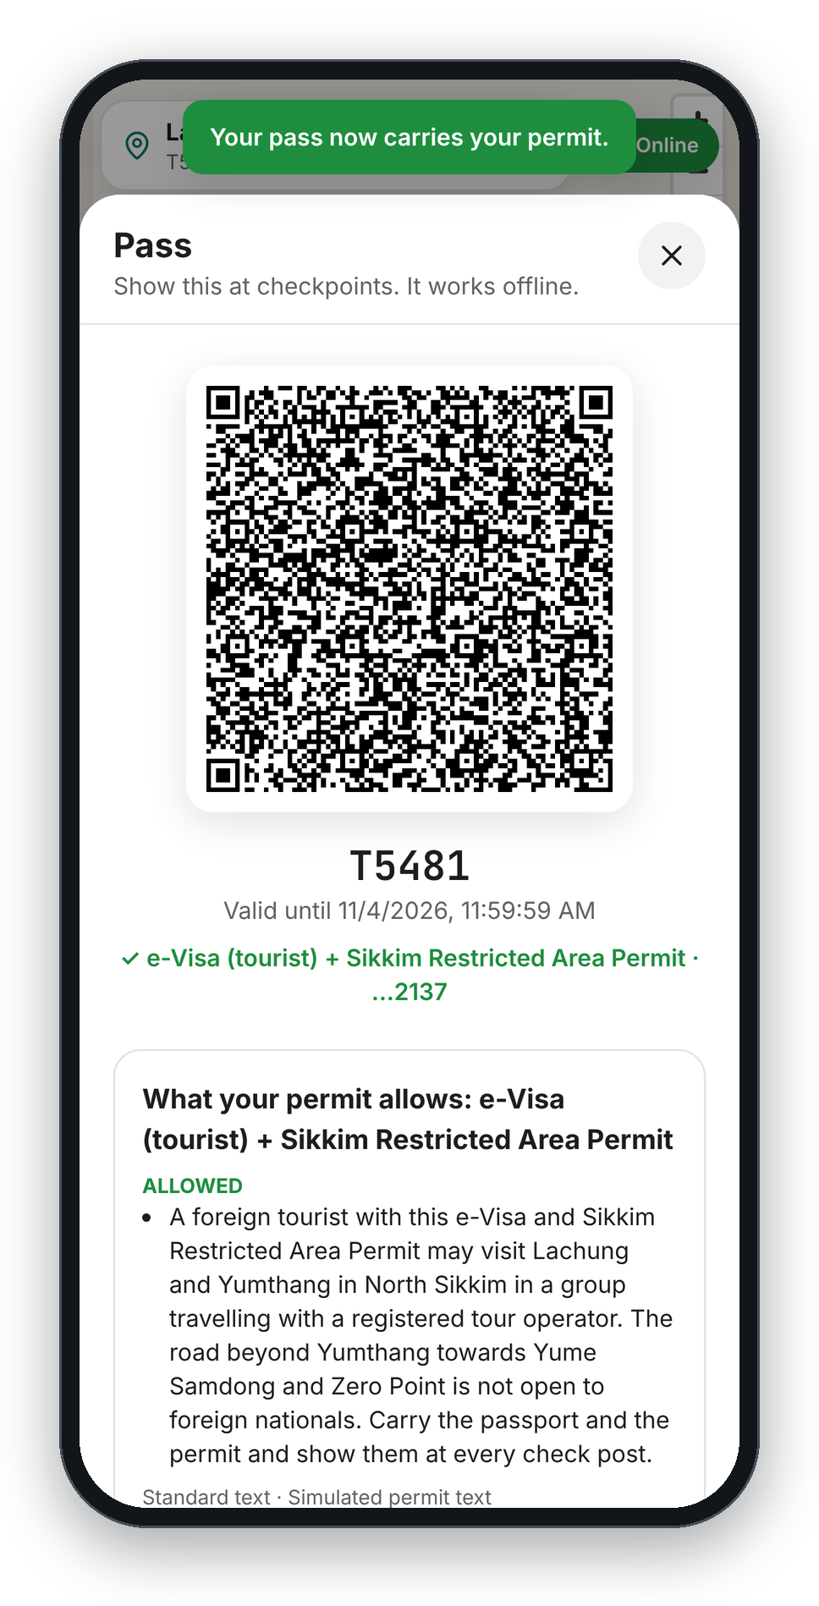
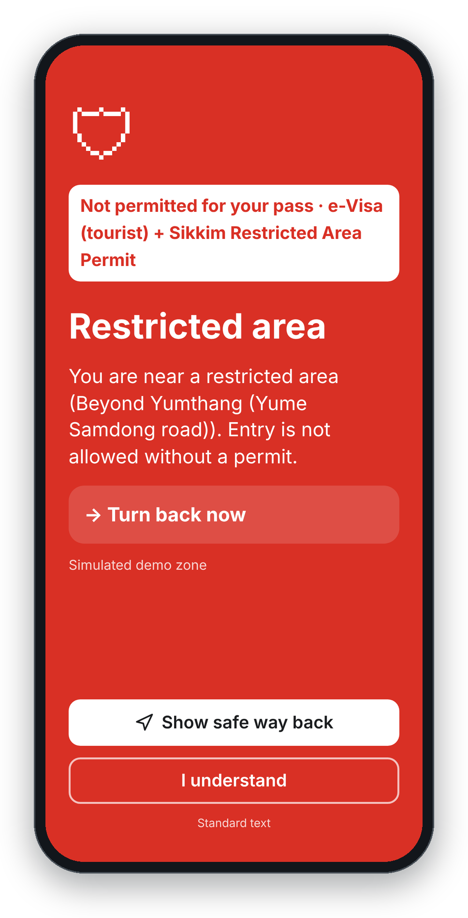
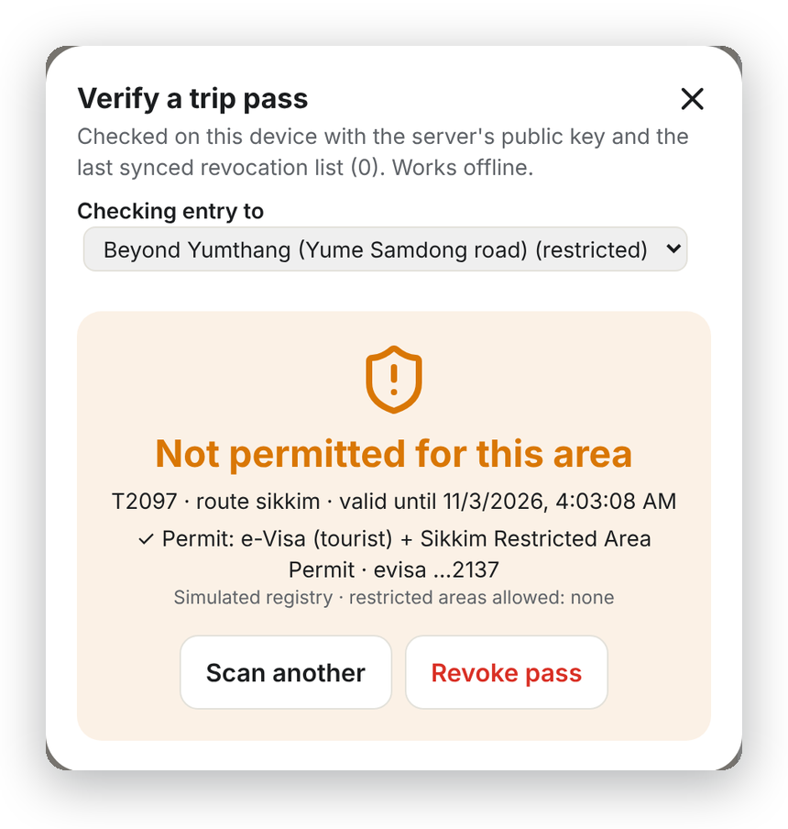
Your pass comes from the permit you already have
05 · DIGITAL TOURIST PASS · VISA, e-ILP, YATRA
Foreign visitor
e-Visa or visa number, plus PAP / RAP where the state requires one
Indian visitor
e-ILP, yatra registration, DigiLocker, passport or voter ID
Aadhaar
Optional only: last 4 digits, never required
1
2
3
4
Checkpoint scan, offline: “Not permitted for this area”
Enter the visa or permit number
Checked against the registry
Hashed at once; only last 4 kept
Pass re-signed with permit and allowed zones
Why it matters
Border and core zones are permit-based. Linking the pass to the real permit lets the phone warn a foreign visitor before they cross into an area their permit doesn't cover, and lets any checkpoint verify it without signal.
Checked offline at any checkpoint:
✓ Valid ✗ Expired ✗ Forged ✗ Revoked ⚠ Not permitted for this zone
The full number is never stored, logged or sent to the AI: only a salted hash and the last 4 characters. Upgrades and revocations go into the signed event log.
Hackathon build: a simulated registry with fake numbers. A real rollout needs the official e-Visa, e-ILP and yatra verification APIs.
e-Visa + Sikkim RAP linked to the pass
Walking toward the road beyond Yumthang
Notes:
The Digital Tourist Pass builds on the permit each traveller already has. Foreigners use their e-Visa or visa number plus the PAP or RAP the state requires; Indians use e-ILP, yatra registration, DigiLocker, passport or voter ID. Aadhaar is optional and masked, never required. The number is hashed immediately; only the last four characters are kept, and it never reaches the AI. The pass is re-signed with the permit and the zones it allows, so a foreign visitor walking toward the road beyond Yumthang gets 'Not permitted for your pass' on the phone, and a checkpoint officer sees the same thing offline. In the hackathon the registry is simulated with fake numbers; say so.

Slide 7
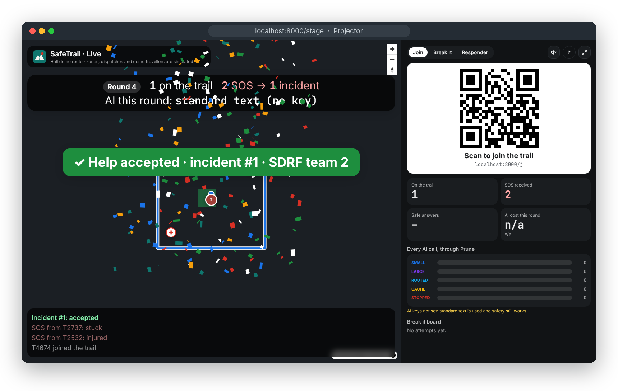
Built, tested and ready to pilot
06 · PROOF OF WORK
APP
React · TypeScript · Vite · installable PWA, works offline
MAPS
MapLibre GL + OpenStreetMap (real 15.1 km Kedarnath trek)
OFFLINE
Service-worker cache · IndexedDB queues for SOS and pings
GEO
On-phone geofencing with hysteresis · haversine grouping
SERVER
Python · FastAPI · SQLModel + SQLite · server-sent events
TRUST
Ed25519-signed passes · hash-chained, signed event log
AI
OpenAI SDK pointed at Prune · validators · templates
DATA
Open-Meteo weather per section · SMS gateway webhook
Projector view, real screen: live counter, grouped SOS, confetti when help is accepted
62
4
8
0
Why not just 112?
112 responds after an emergency. SafeTrail warns before it, works without signal or a shared language, and hands 112 and the police one clear, grouped report.
Who pays
A state or park licenses it, plus a small fee per tourist. Start where permits exist: Char Dham, North East permit states, national parks; then Amarnath, Ladakh, Kumbh.
What's next
Official permit APIs, satellite SOS on newer phones, phone-to-phone Bluetooth relay, a native app for background location.
automated tests
pilot routes
abuse tricks judges can try
provider keys in our code
Warn early. Never lose an SOS. Prove every response.
Notes:
This is a working build, not a mock-up: a React PWA that works offline, MapLibre with the real Kedarnath trek from OpenStreetMap, a FastAPI server, Ed25519-signed passes and a hash-chained log, and every AI call through Prune. 62 automated tests, and a checker that fails the build if a provider key or a direct model call appears in the code. Judges can try eight real abuse tricks on it. SafeTrail doesn't replace 112: it's the safety layer before it. A state or park licenses it with a small per-tourist fee, which works because Prune keeps the AI cost per tourist in paise. Close with: Warn early. Never lose an SOS. Prove every response.

