Slide 1
SHOE MART

Slide 2
INTRODUCTION
The "Shoe mart" has been developed to override the problems prevailing in the practicing manual system. This software is supported to eliminate and in some cases reduce the hardships faced by this existing system. Moreover this system is designed for the particular need of the company to carry out operations in a smooth and effective manner.
Shoe mart, as described above, can lead to error free, secure, reliable and fast management system. It can assist the user to concentrate on their other activities rather to concentrate on the record keeping. Thus it will help organization in better utilization of resources.

Slide 3
Problem Definition
The aim of this project is to develop an website of Shoe Mart is to buy products online and save the timing. A shoe mart, who want to buy any product of their need, has to contact different Shoppers, before deciding upon a particular Product that best suit his needs, requirements and satisfaction. Moreover, most of the work involved in this development process has to be done manually which is very time consuming and cumbersome and also, it reduces the efficiency, accuracy.
To know the facts and understanding of the problem in detail, System Analysis is carried out. It is the process of studying the business processes and procedures, generally referred to as business systems, to see how they can operate and whether improvement is needed

Slide 4
Objectives
The main objective of the Project on shoe mart is to manage the details of Customer, Order, Shoes, Payment.
It manages all the information about Customer, Shopping Cart, Payment, Customer.
The project is totally built at administrative end and thus only the administrator is guaranteed the access.
The purpose of the project is to build an application program to reduce the manual work for managing the Customer, Order, Shopping Cart, Shoes.
It tracks all the details about the Shoes, Payment.

Slide 5
Hardware and Software Requirements:
At Developer Side
Hardware Used Intel i3 Core Processor 500 GB Hard Disk Drive. 4GB RAM. O.S. – Windows 10 | Software Used WAMP SERVER MYSQL Database NOTEPAD MS PAINT

Slide 6
At System Users Side
Hardware Requirements Intel I3 Processor 100 GB Hard Disk Drive. 2 GB RAM. O.S. – Windows 10 | Software Requirements Browser (Mozilla Firefox, Google Chrome Browser Must be JavaScript Enabled

Slide 7
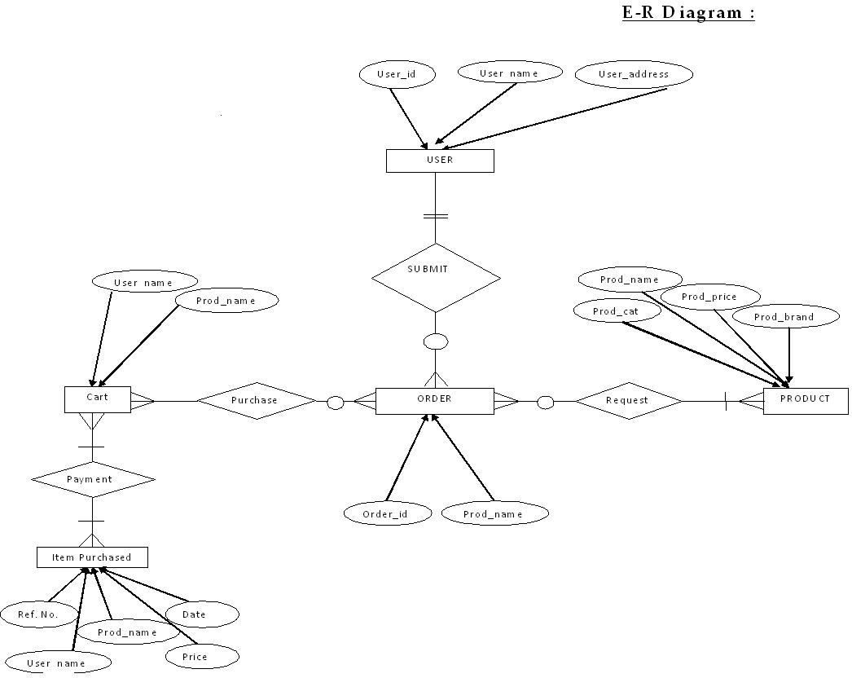
E-R Diagram

Slide 8
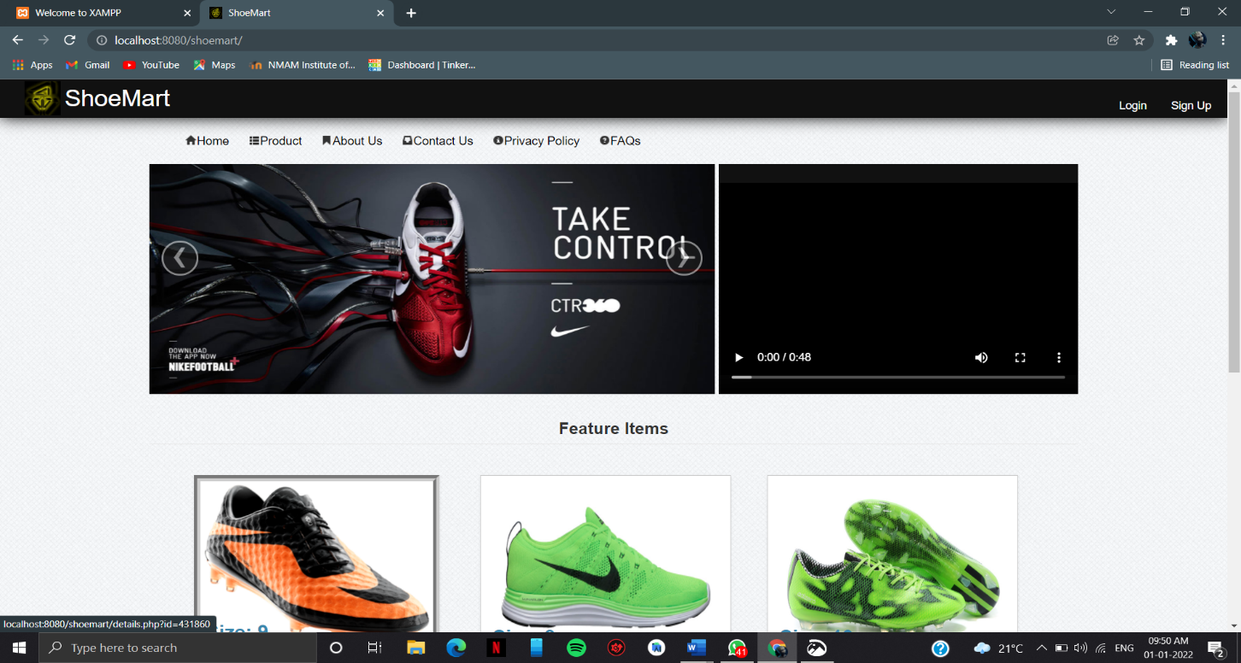
SCREENSHOTS:
Home Page:

Slide 9
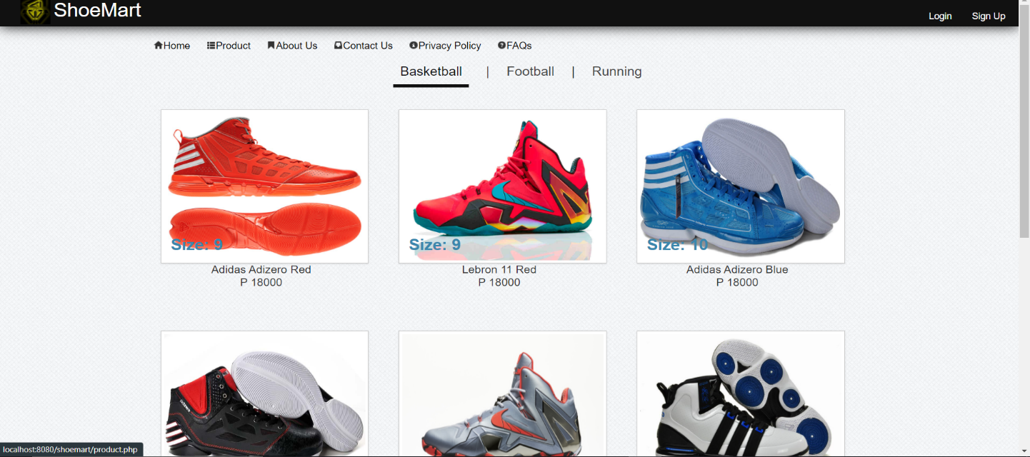
Product Page:

Slide 10
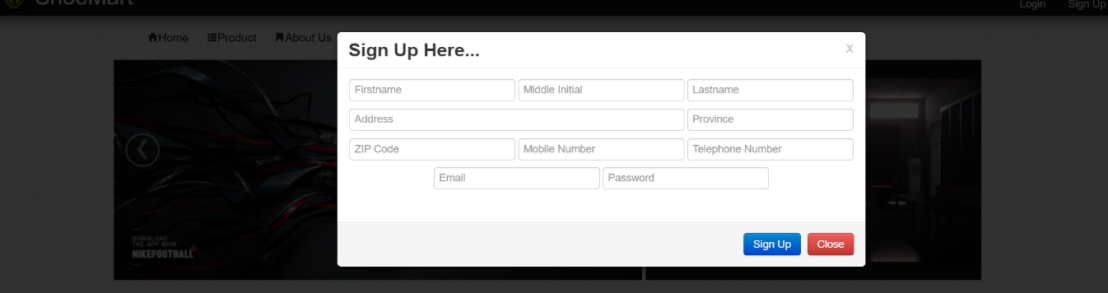
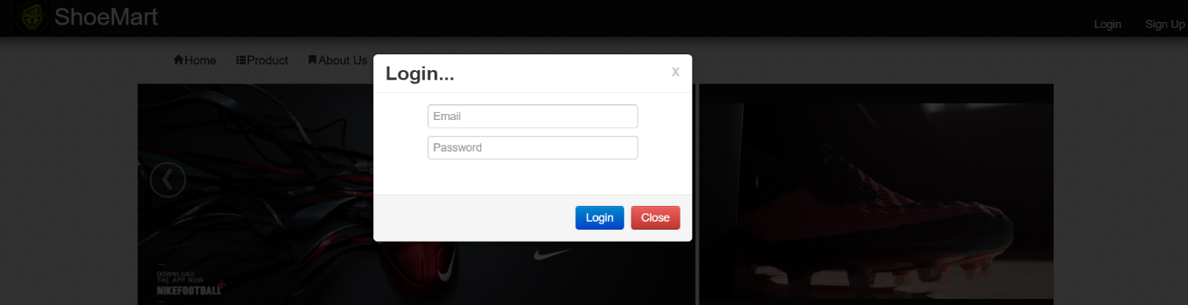
Sign Up Page:
Login Page:

Slide 11
Conclusion
The project work entitled “ Shoe Mart” has been designed using JAVASCRIPT,CSS as front end and PHP, MYSQL as back end, were in many users friendly from have been added in order to make it a user interactive application. The system is developed in such a way that the user with basic knowledge of computer can work with it easily. The system has produced the report required by the customer and fulfilled all the objectives.
Therefore, it is important to have an online platform that can be managed by admins and accessed by customers (the application). Hence, these components are essential to ensure that the application can provide the best experience to the users. Simply put, the application can be used as a powerful module that can solve customer’s problems especially finding the right vehicle in online. Also, the application can help online sellers and showroom creators to promote their products to millions of customers by injecting various products into the application. Therefore, there can be so many possibilities of what the application are capable of achieving.
The future enhancement to the system can be made as technology changes.

Slide 12
References
Keeves PHP- MYSQL
Wrox Press – Beginning PHP5
Online at www.w3schools.org
Murach’s-PHP/MYSQL

Slide 13
THANK YOU

