Slide 1

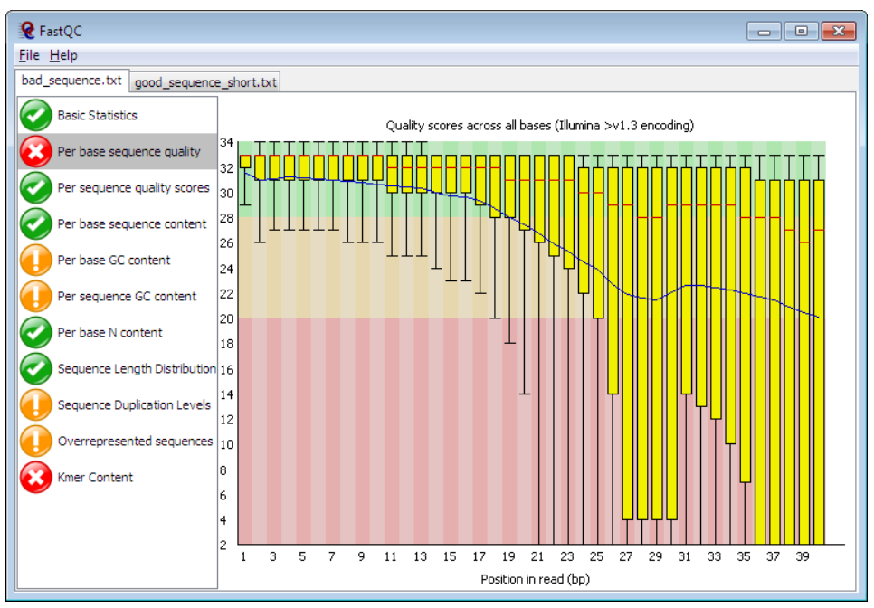



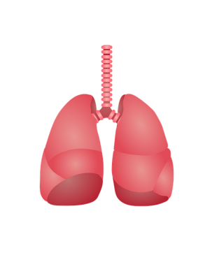

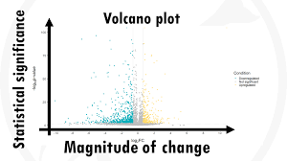


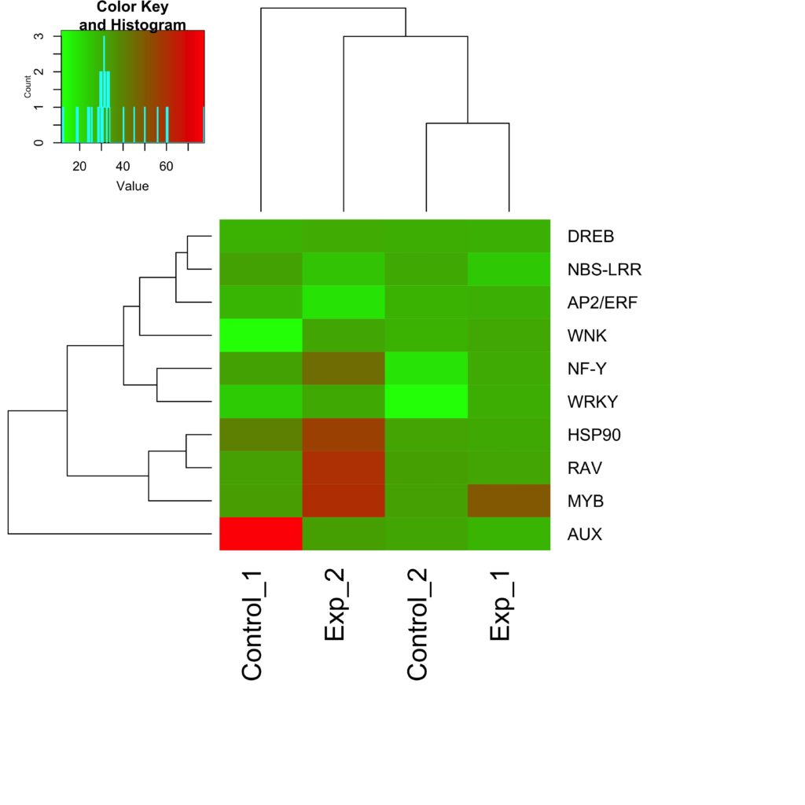

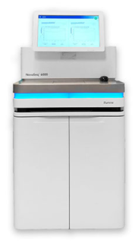
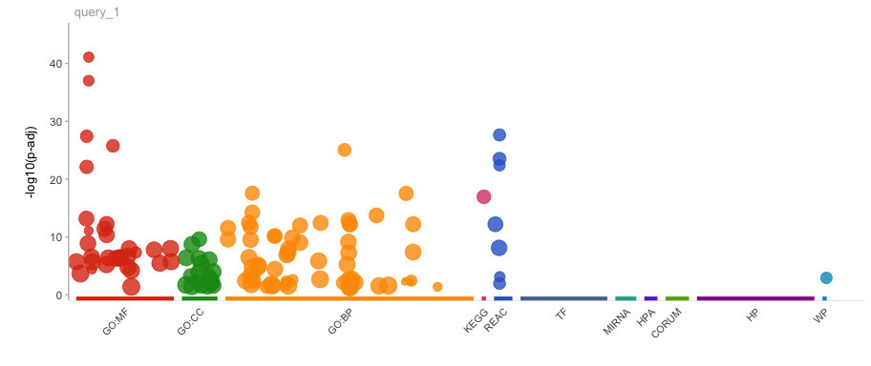


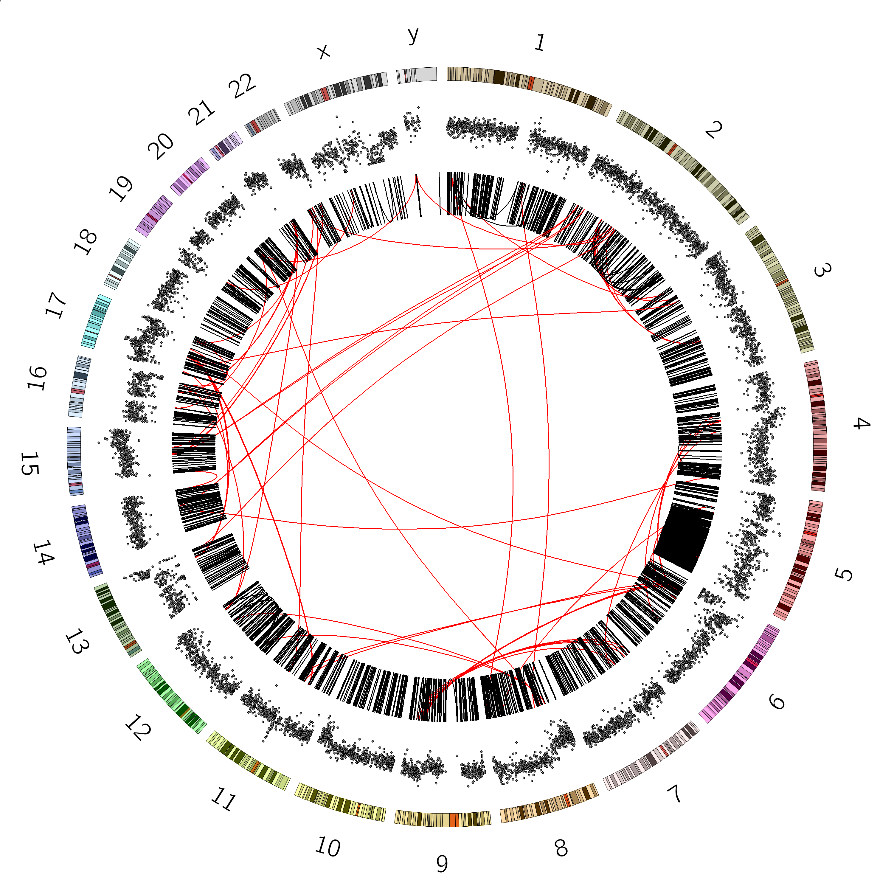
Gene expression of NCI-H292 cells after coculture with Trichomonas tenax (humans).
BIOINFORMATICS ANALYSIS PROJECT
Data Processing
Experiment
EXPERIMENT AND SEQUENCING DONE BY INVESTIGATORS
DATA DOWNLOAD USING NCBI SRA TOOLKIT
QUALITY CONTROL WITH FASTQC
DATA TRIM WITH CUTADAPT
ALIGNMENT WITH HISAT2
COUNTS TABLE CREATION WITH FEATURECOUNTS
+
TRICHOMONAS TENAX (ORAL)
LUNG EPITHELIAL CELLS
Data Analysis
Library Preparation
RNA EXTRACTION
POLY(A) CAPTURE & ISOLATION
FRAGMENTATION
REVERSE TRANSCRIPTION TO cDNA
Next Generation Sequencing
COUNTS TABLE MANIPULATION
IDENTIFICATION OF DIFFERENTIALLY EXPRESSED GENES
ADAPTER LIGATION
AMPLIFICATION
SEQUENCING DATA TO DATABASE
DATA VISUALIZATION
ILLUMINA NOVASEQ 6000 SEQUENCING

Slide 2
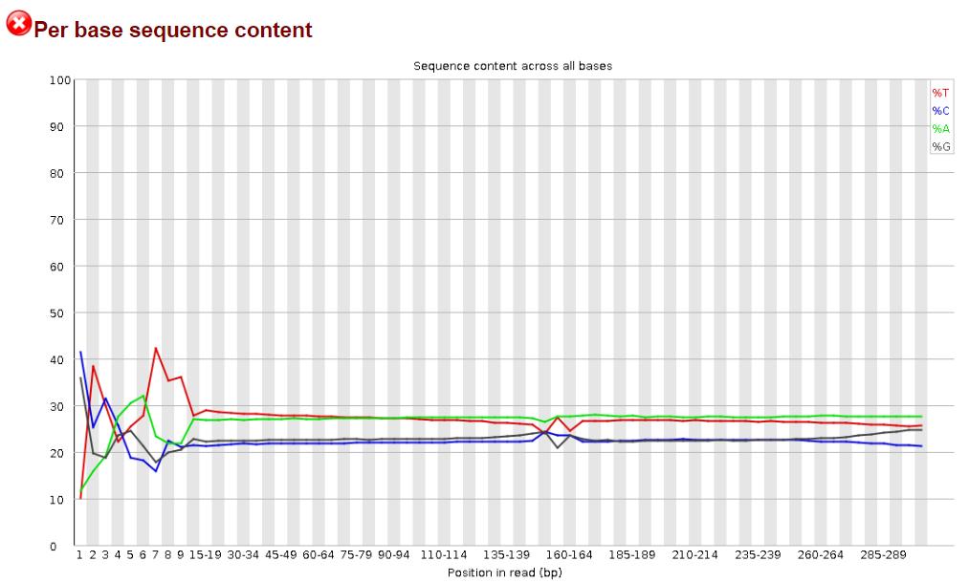
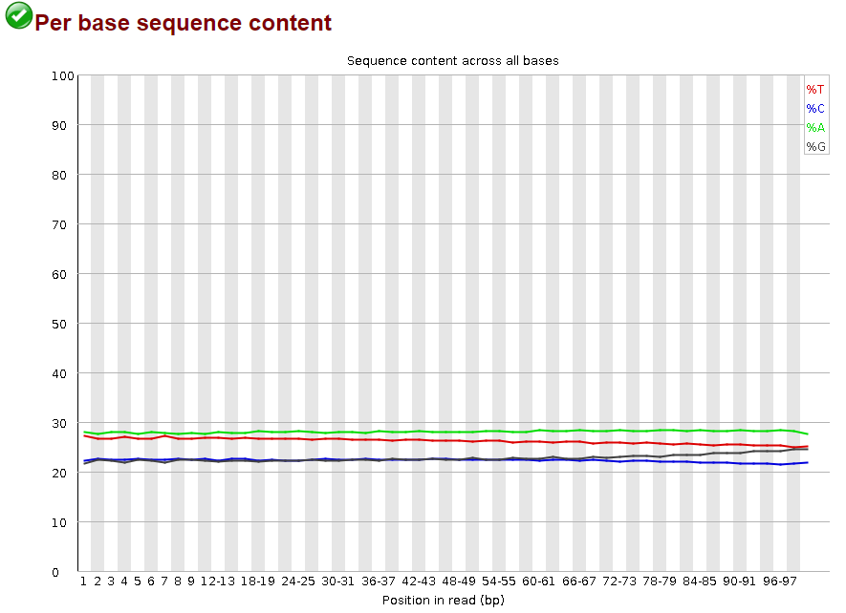
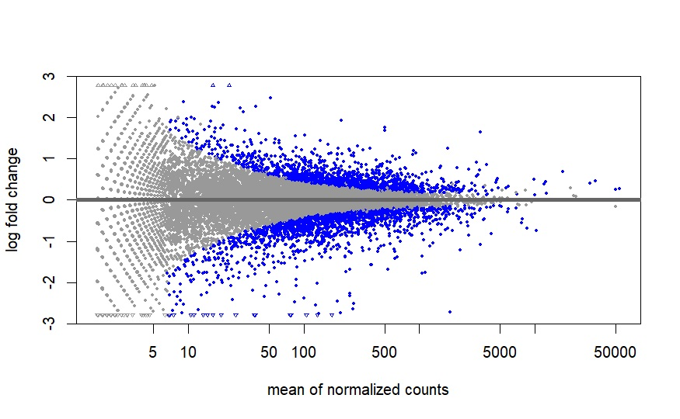
Gene expression of NCI-H292 cells after coculture with Trichomonas tenax (humans).
Sample | Treatment | Successfully assigned alignments | Proportion of assigned alignments
SRR23972383 | Cocultured | 3,355,176 | 58.3%
SRR23972384 | Cocultured | 3,337,609 | 57.2%
SRR23972385 | Cocultured | 3,353,226 | 55.7%
SRR23972386 | Untreated | 3,333,710 | 54.4%
SRR23972387 | Untreated | 3,344,595 | 53.9%
SRR23972388 | Untreated | 3,331,932 | 55.5%

Slide 3
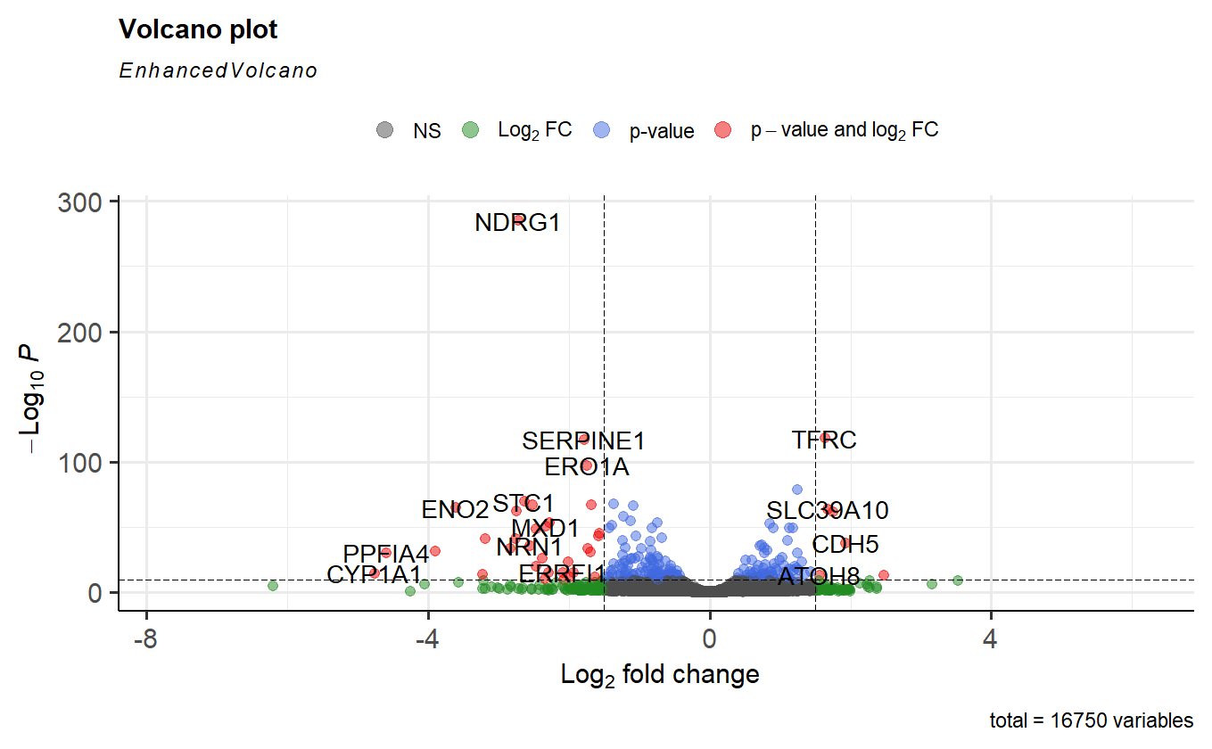
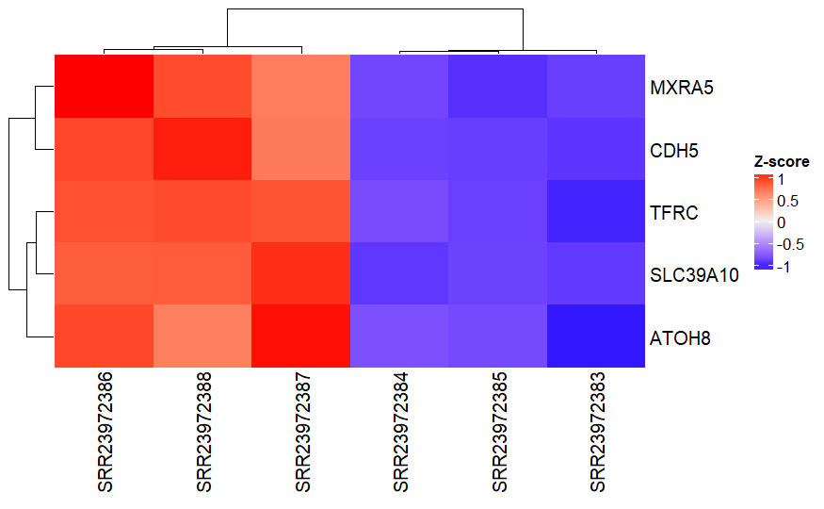
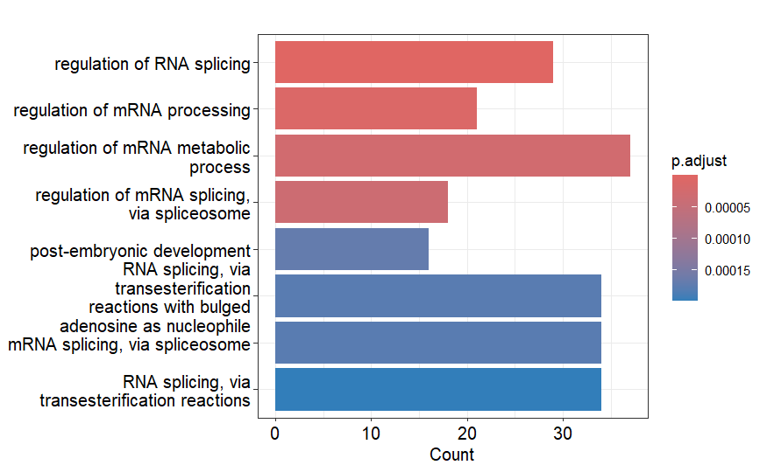
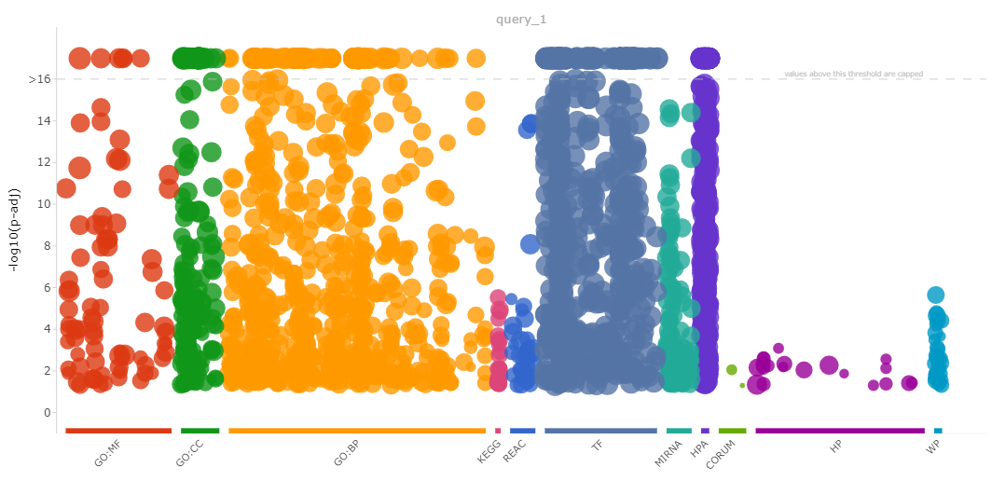
Gene expression of NCI-H292 cells after coculture with Trichomonas tenax (humans).

Slide 4
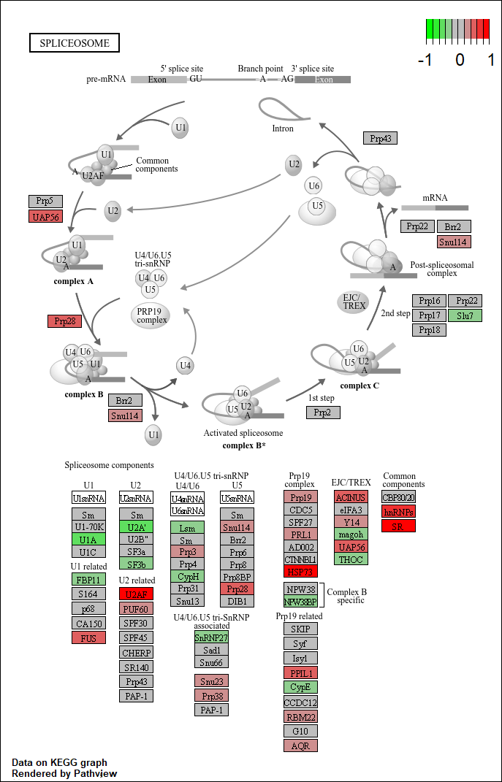
Gene expression of NCI-H292 cells after coculture with Trichomonas tenax (humans).

