Slide 1
.. is a light-weight solution to add references into existing Web service meta-data
Annotations refer to
  external dictionaries for non-functional properties, data quality aspects, controlled vocabularies, application profiles
  ontologies, thesauri, gazetteers capturing the data semantics

Slide 2
Why proxy?
Annotations are not part of the data model
  which external vocabulary to use depends on the context (they are domain specific)
  annotations are not needed for every potential application
  correct referencing is not trivial for data providers (but for domain experts)

Slide 3
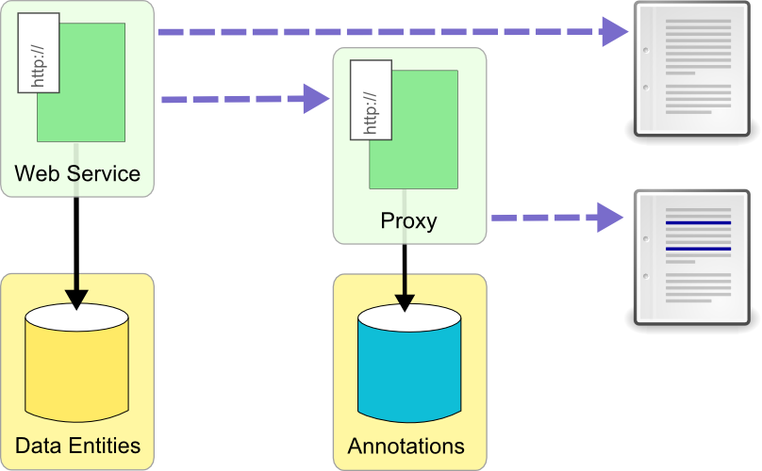
Injecting Annotations
„injecting“ references into the meta-data stream
ensures compliance to standards
simple HTTP API: no difference for clients
Notes:
(if the element to be referenced still exists)

Slide 4
Some features
It is fast: We are working directly on the data streams; sophisticated parsing and caching ensures high-performance.
It is robust: Changes to the source document, e.g. due to updates to underlying data models, won’t affect the annotations.
It is reliable: The proxy is running in the cloud. This will ensure scalability and availability.
It is free: This is a free service, and all code developed for the proxy is open source.
It is growing: For now we have support for WSDL Web services and the OGC Web Processing Service.

