Slide 1

Context-aware access to ontologies
Patrick Maué
Institute for Geoinformatics (IFGI)
Muenster Semantic Interoperability Lab (http://musil.uni-muenster.de)
patrick.maue@uni-muenster.de
Notes:
Name and Status,
Background,
Title: Web Services in the Geosaptial Semantic Web:
I will introduce you in the wonderful world of geographic information science, and the current state of the geospatial web. The problem is: it is a world without w3c standards, no wsdl , no soap , no fortunately no uddi.

Slide 2

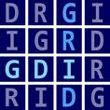

Background
Context:
Geospatial Decision Making
Environmental Modelling
Why Ontologies?
Semantic Annotation of Web services to facilitate
Discovery & Integration
Semantic Validation of Workflows
http://purl.org/ifgi/projects/swing
http://purl.org/ifgi/projects/GDI-Grid
http://www.envision-project.eu
Notes:
Quick presentation of the projects where the presented repository has been deployed and tested. We build this thing more due to the lack of exsing repositories which matched our requirements (late 2007) (e.g. using WSML, supporting filtering e.g. by traversal).

Slide 3
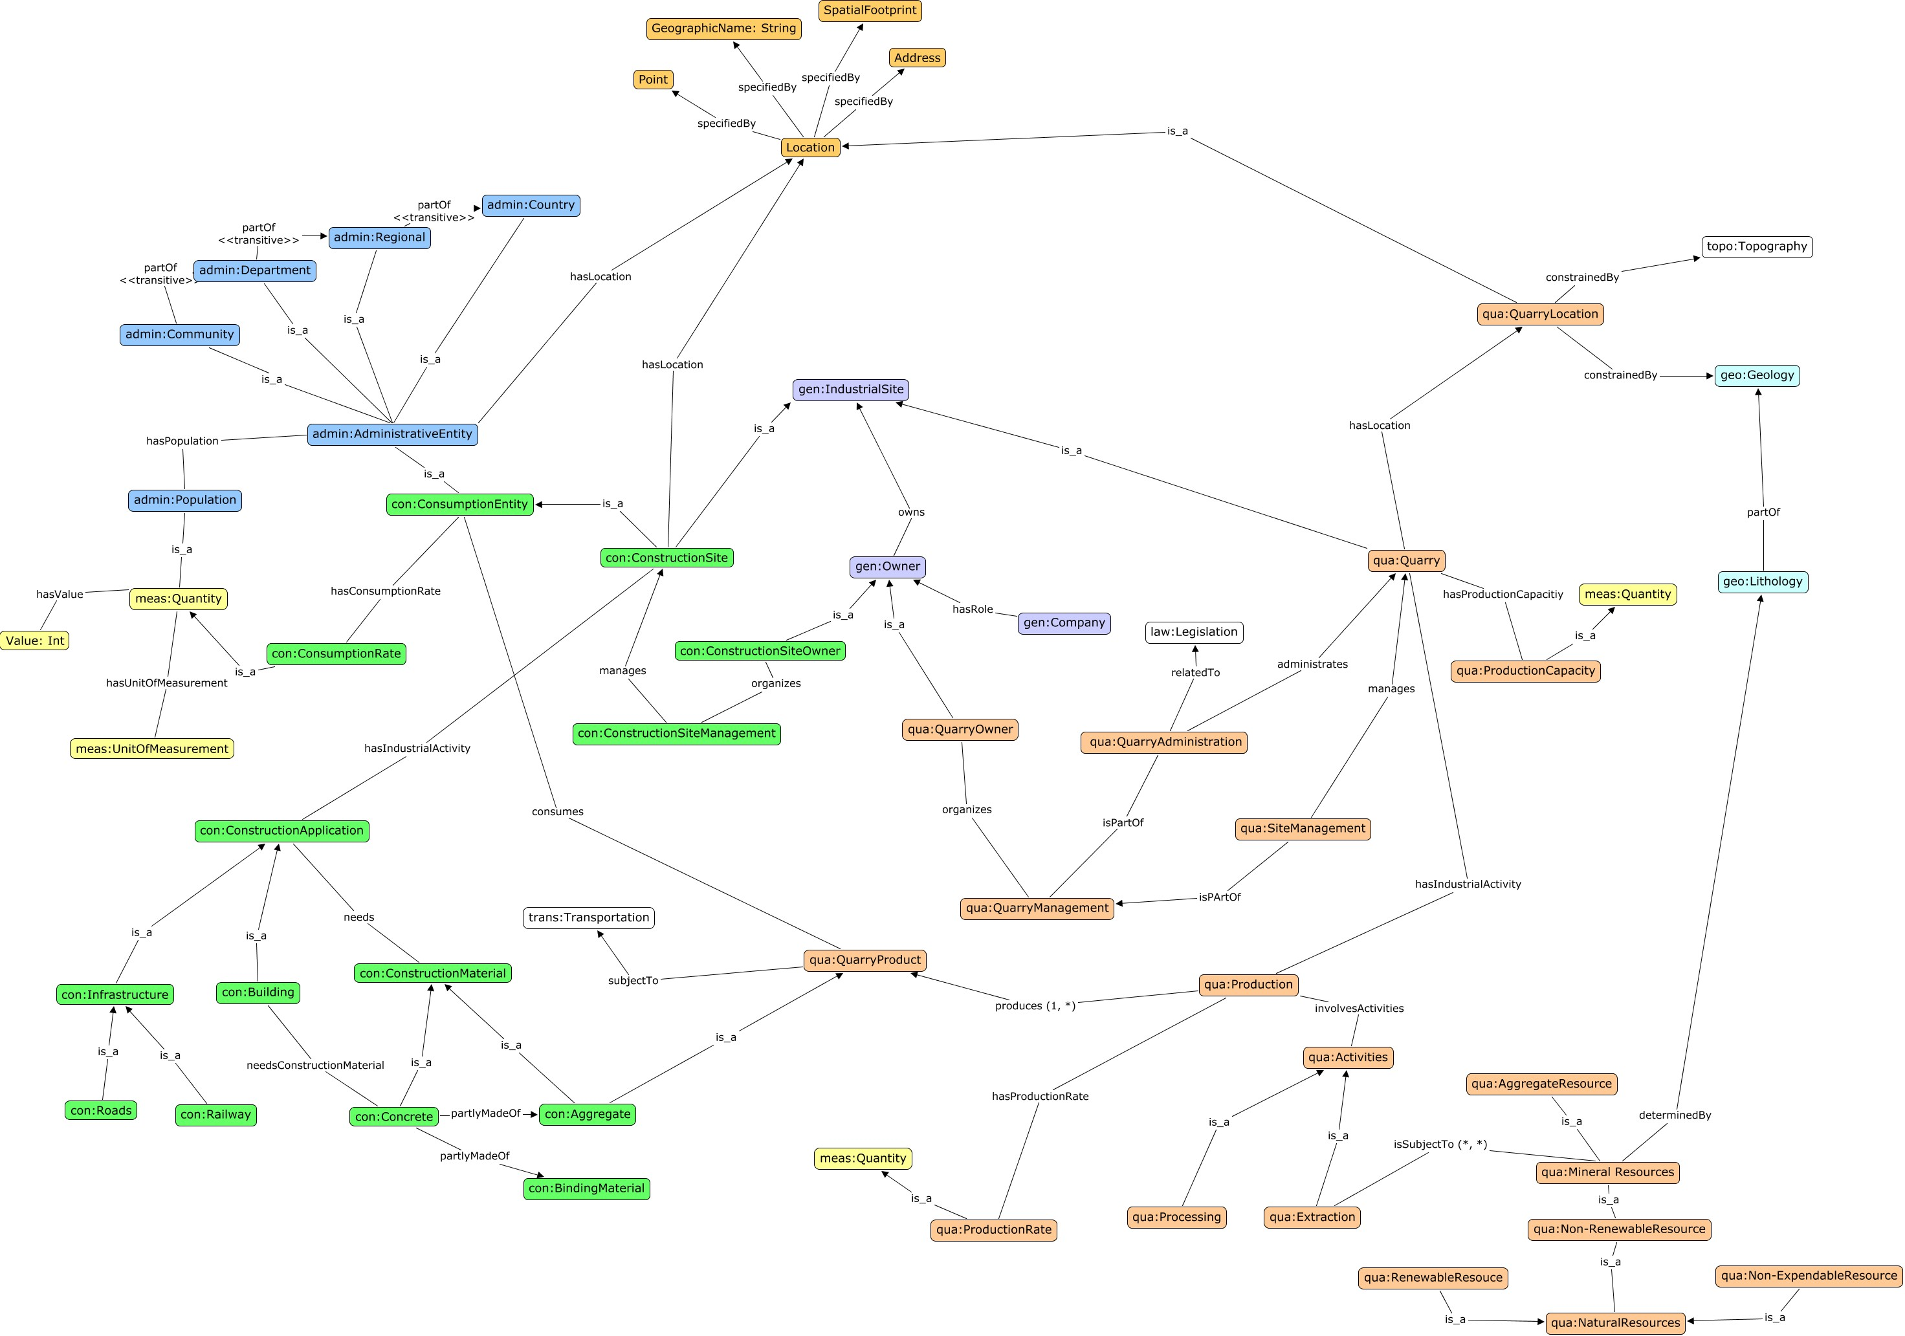
Notes:
The concept map as result from the knowledge aqcuisition process with the domain experts
Colors and location represent the different subjects, and how the different concepts belong together
Main challenge we dealt with during the engineering and provision: how can we keep this information which concepts are related to each other. And how can we efficiently cope with all these borderline cases (concepts which can not be unambigiously assigned to a domain)

Slide 4
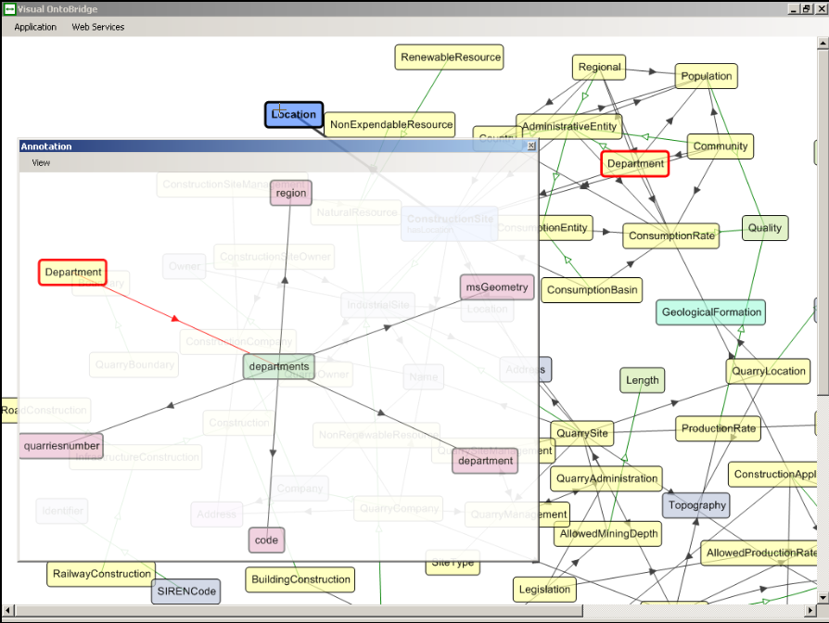
Using Ontologies for Semantic Annotations
Demo Video and Download on SWING website
Notes:
Thhe user interface developed in the SWING project, and currently enhanced in ENVISION. As you can see in the background, the complete ontology is retrieved from the repository, which is basically a big mess. We decided that we need an option to enhance the filtering capabilities to show only those concepts which are relevant to the user's task. In the video you can see a query interface based on natural language processing, which suggests concepts and relations which can be used for the semantic annotations.

Slide 5
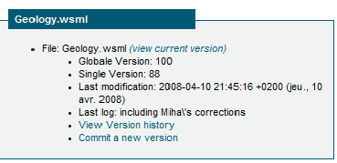
Serving the ontologies as files (1st Try)
http://swing.brgm.fr/repository/ontologies
  File-based approach (Ontology is a file)
  Versioning via Subversion
Notes:
In our first approach, we created WSML files, with each file representing an ontology (which is I guess still today the prevalent form). Subversion was used for publishing and versioning, a website simply listed all the ontologies.

Slide 6
Serving the ontologies as files
http://swing.brgm.fr/repository/ontologies
  File-based approach (Ontology is a file)
  Versioning via Subversion
but..
  Modularization difficult (borderline cases)
  Versioning on file-level
Notes:
The lack of mature tools for storing and engineering WSML was
....

Slide 7
Concept Repository (first implementation)
Focus shifts from Ontology to Concept Definition
Concept Repository
  Only serving RDF
  (no added functionality like reasoning)
  Domains (Context) encoded in namespace
  http://purl.org/net/concepts/Swing/ (context)
  http://purl.org/net/concepts/Administration/Swing/Community
  RESTful, follows W3C best practice recipes for publishing RDF vocabularies
Notes:
The biggest change was, as we believe, to simply forget the idea to manually define what an ontology is. The unit of interest is, what we called the concept description (consisting of a class with a unique identifier, metadata about e.g. version, relations, axioms, and pointer to instances)
Internally, the class has a generated ID. The identifying properties are part of the metadata. The URLs pointing to the concept description have these identifying properties encoded (example)
r

Slide 8
Concept Repository (current implementation)
Identifying concepts using DC metadata
  1..n dc:title (e.g. River)
  0..n dc:subject (e.g. Hydrology)
  1 dcterms:version (e.g. 23)
Encoding in the URL
  http://../River?subject=Hydrology
  http://../River_Hydrology
  http://../Hydrology/River
Query Actions to retrieve relevant concepts
  http://../River/neighbors (by traversal)

Slide 9
Concept Repository (Outlook)
Moving into the cloud (Google App Engine)
  Backend RDF Storage → distributed data storage
  Versioning on the object level
Support NLP to retrieve relevant concepts
Integrating user feedback for ontology maturing
User interfaces, API, ...
Notes:
Problems:
- Different URLs pointing to the same concept, but this is only handled internally (an external reasoner wouldn't know that these are the same concept)

Slide 10
Thanks.
Source Code, Documentation, et al.
http://purl.org/net/sapience/docs

