Slide 1

ECE 425/L · MICROPROCESSOR SYSTEMS · FINAL PROJECT
Bluetooth-Controlled
Music Player
Songs stored on a TM4C123 LaunchPad. Your phone sends a number over Bluetooth Low Energy to pick which one plays on the buzzer.
Paul Simbulan & Kailai Huang
Prof. Shahnam Mirzaei, Ph.D. · CSUN · Summer 2026
Notes:
Intro. This is a Bluetooth-controlled music box. Ten songs are stored on the TM4C123 itself. You send a single number from your phone over Bluetooth Low Energy, and the board plays that stored song on its buzzer. No audio streams over the air, and everything comes from Labs 1, 2, 3, and 6.

Slide 2

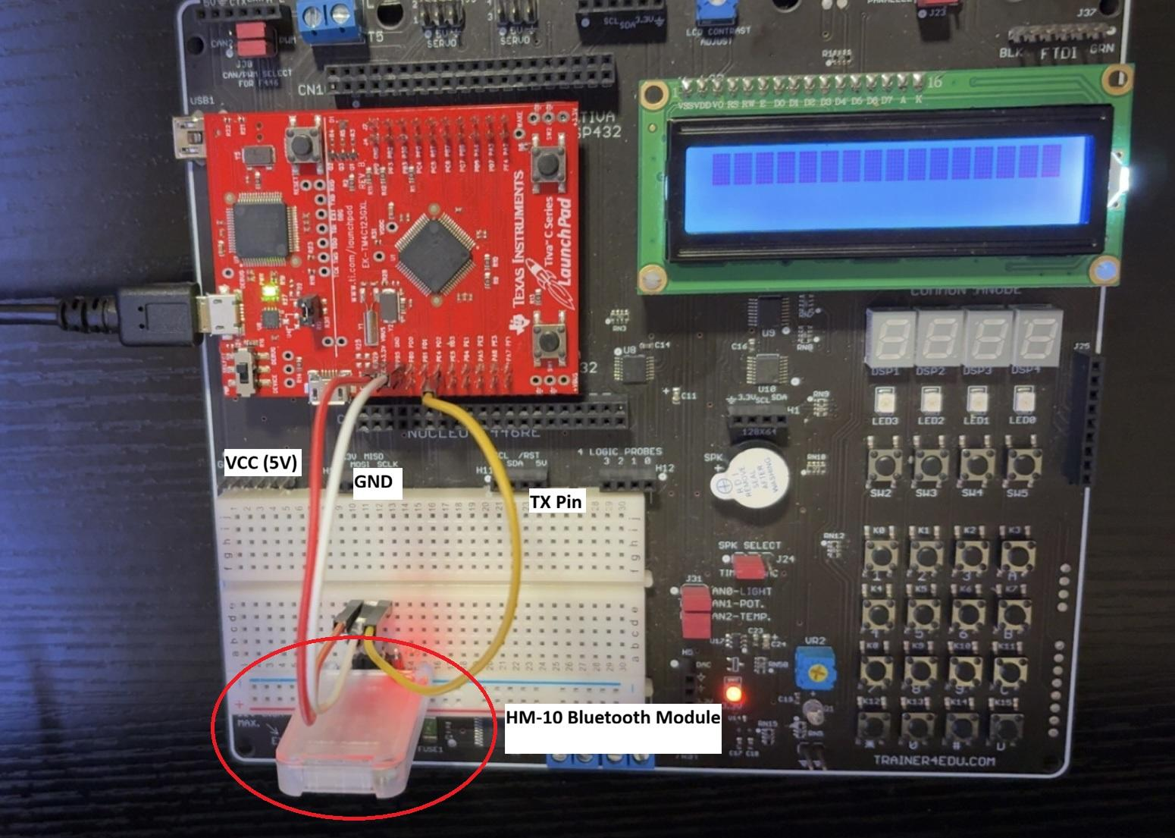
WHAT IT IS
Project Overview
A wireless music box. The songs live in the microcontroller's memory. You send a single character from your phone over BLE, and the board plays that song on a buzzer. No cable, and no audio streams over the air.
1
iPhone + LightBlue app
↓
2
HM-10 BLE module
↓
3
TM4C123 (UART + Timer0)
↓
4
Buzzer plays the stored song
Full build: TM4C123 LaunchPad + EduBase trainer, HM-10 wired on the breadboard.
BLE 4.0
UART @ 9600
10 songs
Notes:
The whole idea in one line: the phone picks a song, the board plays it. Stress that the songs are stored on the chip. The phone is only a remote control that sends one character. Point at the photo: red board is the LaunchPad, black board is the EduBase trainer with the buzzer, clear module is the HM-10.

Slide 3

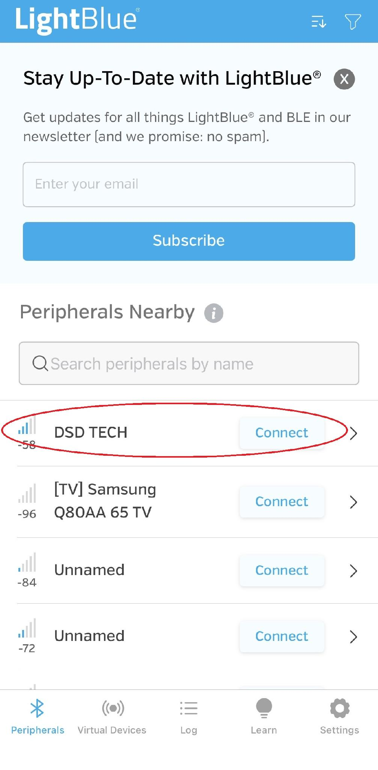
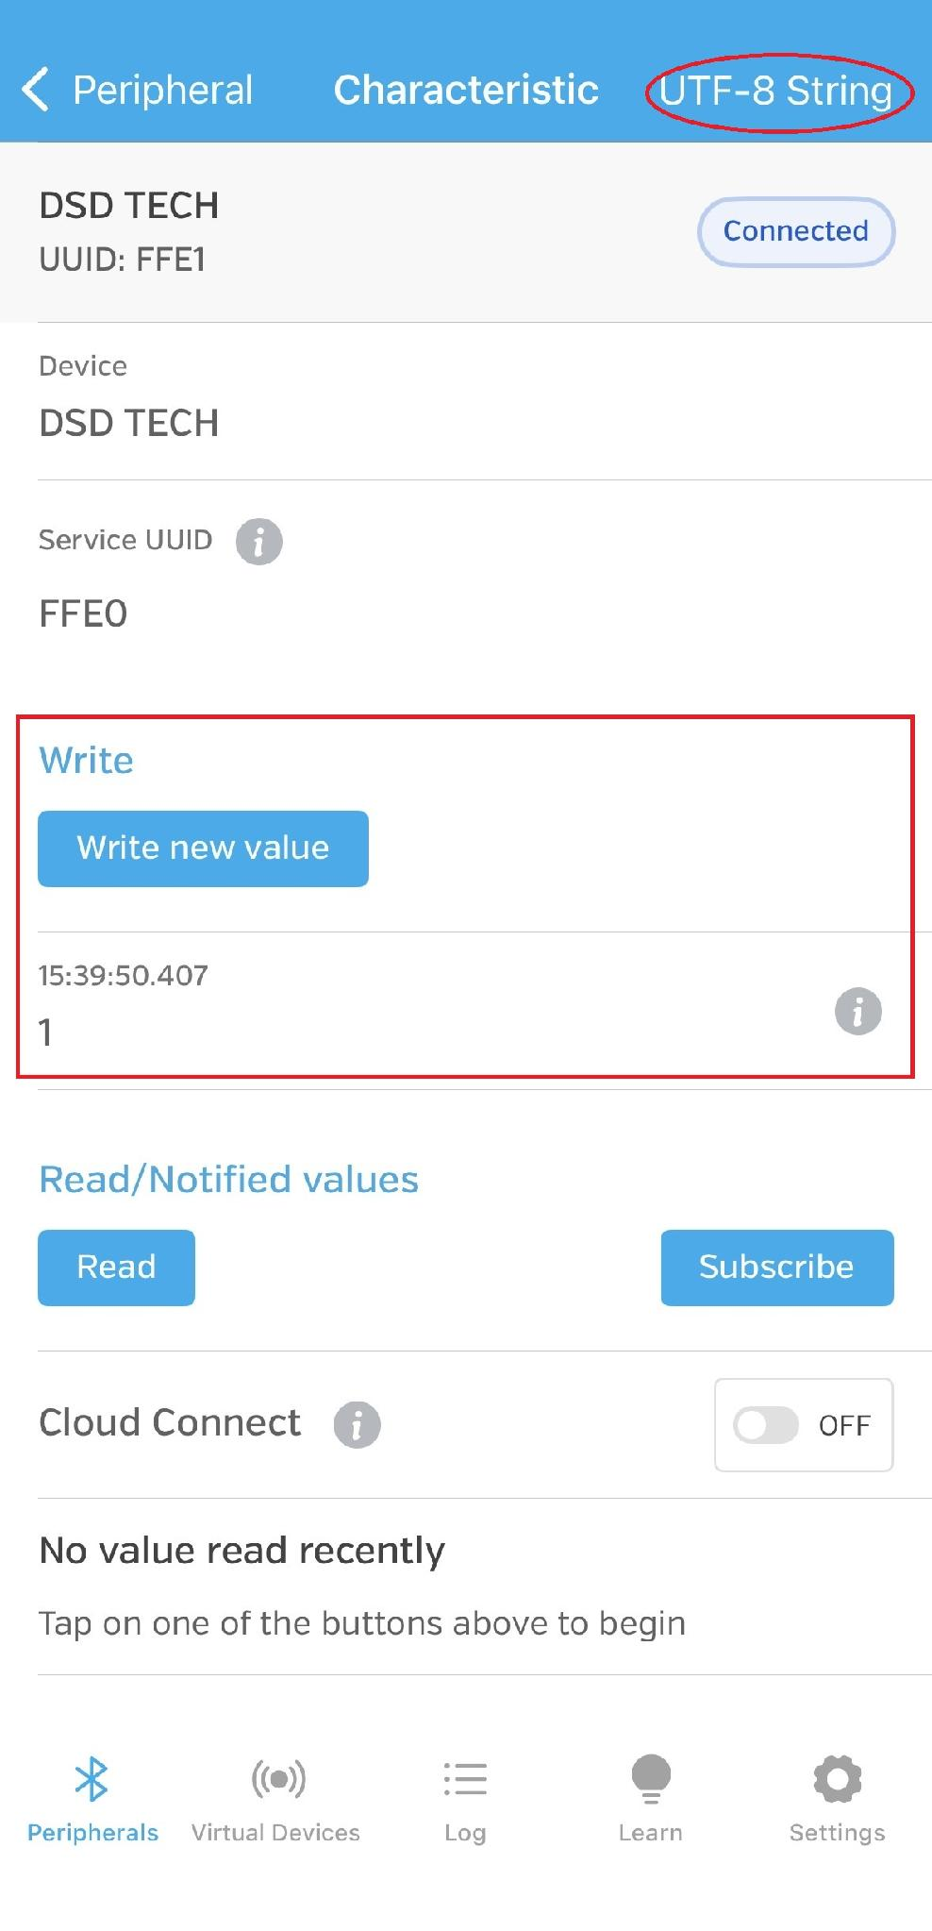


THE WIRELESS LINK
Bluetooth Low Energy & the App
Classic Bluetooth
Bluetooth Low Energy
(2.0 / 5.0)
(BLE)
Headphones, speakers, cars. Pairs at the phone's OS level, so it shows up in Settings.
Small, low-power devices like our HM-10. iOS hides these from Settings, so you reach them through an app.
Not what we use
What the HM-10 uses
Sending a command in LightBlue
1
Scan & connect Find the peripheral named “DSD TECH” and connect.
2
Set the format Change the write type to UTF-8 String.
3
Send Type a digit like “1” and press Write.
Find & connect
Write “1” as UTF-8
Notes:
Key point: BLE devices do not show up in the iPhone's Bluetooth settings the way a speaker does, so we use a free app called LightBlue. The left card is Classic Bluetooth, what speakers and cars use, and it is NOT what we use. The right card, highlighted, is BLE, what our module uses. Then three steps: connect to DSD TECH, set the write format to UTF-8 String, and send a digit.

Slide 4

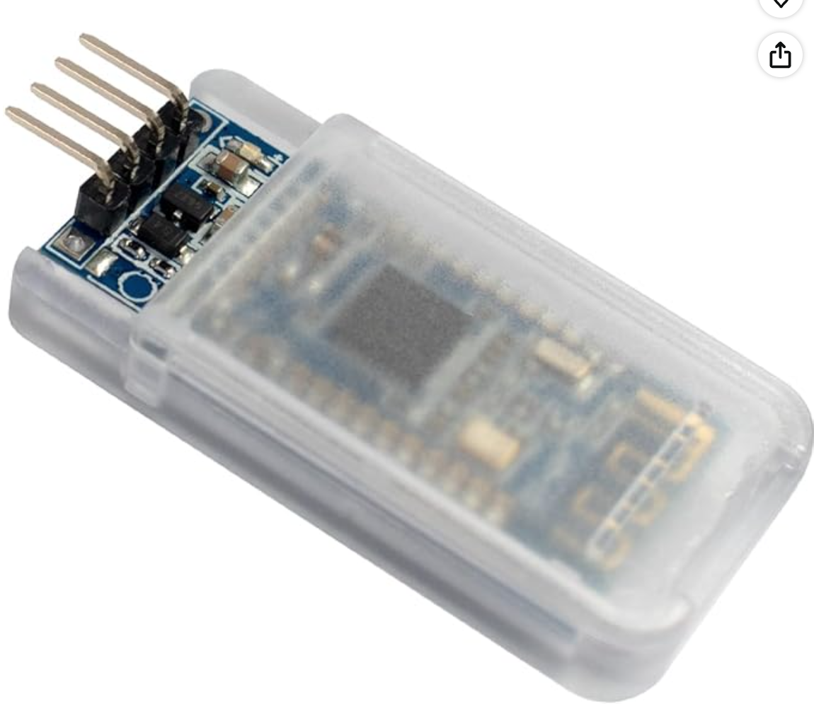



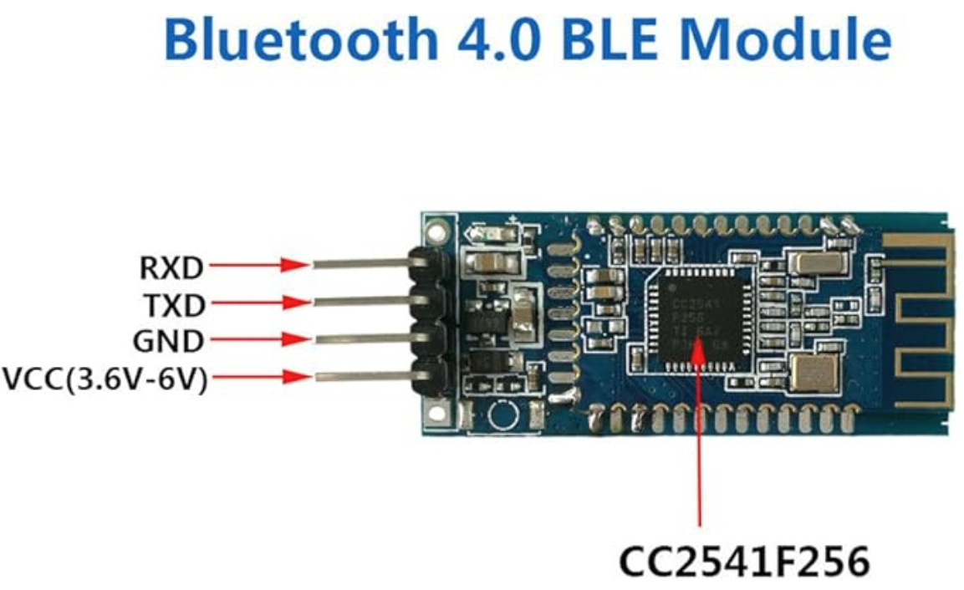


BLE-TO-UART BRIDGE
The HM-10 Module
TI CC2541
Bluetooth 4.0 BLE System-on-Chip
BLE, not Classic
Works with iOS; Apple blocks Classic from apps
VCC 3.6-6 V
On-board regulator; TX / RX are 3.3 V logic
9600 8N1 default
Acts as a transparent serial bridge
~10-30 m range
LED: blinking = advertising, solid = connected
4 pins: VCC · GND · TXD · RXD. We only wire TXD to the Tiva, since the board only listens.
Notes:
The HM-10 is built on TI's CC2541 chip. We chose it over the HC-05 from the project list because HC-05 is Classic Bluetooth, which iOS blocks, but the HM-10 is BLE, so it talks to an iPhone. It is a transparent serial bridge: bytes in one side come out the other wirelessly. Four pins, but since the phone only sends to the board, we only wired the module's TXD line in.

Slide 5

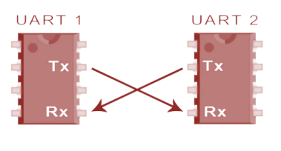
HM-10 ↔ TM4C123
LAB 6
Wiring the Serial Link
Wiring - UART5 on Port E
HM-10 TXD
→
PE4 (U5RX)
the byte the board receives
HM-10 RXD
-
PE5 (U5TX)
unused; the board never replies
VCC
→
5V rail
power (on-board 3.3 V reg)
The one rule: one device's TX wires to the other's RX. Get it backwards and everything looks connected but nothing moves.
GND
→
GND
shared ground, required
Only RX is needed. The phone talks, the board listens.
Notes:
The hardware bridge, from Lab 6. UART is serial, one wire per direction, and the rule is TX to RX, crossed. We put the HM-10 on UART5, on Port E pins PE4 and PE5. Because the phone only sends to us, we only use PE4, the receive pin. Emphasize the ground wire: a missing shared ground was one thing we checked during debugging.

Slide 6


CODE FLOW
Firmware: Setup Order
The 10 songs are baked into the program. Bluetooth sends only a single character to choose one, so nothing but that one byte ever travels over the air.
What main() configures, in order
1
GPIO - PC4 as buzzer output
LAB 1
Command scheme
Drive the buzzer pin high and low
'1'-'9' and '0' pick the 10 songs
2
Timer0 - 1 us time base
LAB 2
's' stops playback
Sets how long each note is held
One ASCII character per press.
3
UART5 - 9600 8N1 on PE4
LAB 6
Four peripherals, four labs
Receives the command byte
Nothing here is new hardware. Each block is a peripheral we already configured in an earlier lab, now combined into one program.
4
NVIC - enable UART5 RX interrupt
LAB 3
Runs the handler on each byte
Notes:
The code-flow overview the professor asked for. The top callout is the key concept: songs are stored in the program, Bluetooth only sends one character to choose which plays. main() configures four things in order, each mapping to a lab: PC4 output is Lab 1, Timer0 time base is Lab 2, UART5 is Lab 6, receive interrupt is Lab 3. The next three slides walk through each piece.

Slide 7


MAKING THE TONES
LAB 2
Generating Sound
A note is a square wave
main.c · sound generation
Flip PC4 on and off at the note's frequency and the buzzer plays that pitch.
// Timer0: 1 us time base (Lab 2)
TIMER0->CFG = 0x04; // 16-bit
TIMER0->TAMR = 0x02; // periodic
TIMER0->TAILR = 16 - 1; // = 1 us @16MHz
TIMER0->CTL |= 0x01; // enable
// play one note = square wave
for (i=0; i<cycles; i++) {
GPIOC->DATA |= 0x10; // PC4 high
delayUs(half);
GPIOC->DATA &= ~0x10; // PC4 low
delayUs(half);
}
Timer0 sets the timing
A 16-bit periodic timer ticks every 1 us (TAILR = 16 at 16 MHz) so delayUs is accurate.
Each song is a table
An array of {note, octave, duration}. To add a song, add another table.
Octaves are easy
A higher octave just doubles the frequency; a lower one halves it.
Notes:
Lab 2, the sound engine. A musical note is a square wave at that note's frequency, so we flip PC4 high and low at the right rate and the buzzer produces the pitch. Timer0 gives an accurate one-microsecond delay, which controls the frequency. Each song is a table of notes with a pitch and duration, so adding a song is just adding another table. The code shows the Timer0 setup and the loop that toggles the pin.

Slide 8

RECEIVING THE COMMAND
LAB 6
UART5 Configuration
Turn on the hardware
main.c · UART5 setup
Enable the clock to UART5 and to Port E before touching any registers.
// clocks
SYSCTL->RCGCUART |= (1<<5); // UART5
SYSCTL->RCGCGPIO |= 0x10; // Port E
// baud = 9600 (16 MHz clock)
UART5->IBRD = 104;
UART5->FBRD = 11;
UART5->LCRH = 0x60; // 8N1
UART5->CTL |= (1<<0)|(1<<8)|(1<<9);
UART5->IM |= (1<<4); // RX interrupt
Route the pins
Set PE4 / PE5 to their UART alternate function so the pin becomes U5RX.
Set the baud rate
9600 to match the HM-10: IBRD = 104, FBRD = 11 for a 16 MHz clock.
Frame and enable
8 data bits, no parity, 1 stop (LCRH = 0x60); then enable UART, RX, and the RX interrupt.
Notes:
Lab 6, configuring the UART to receive. Enable the clocks to UART5 and Port E. Route PE4 to its UART alternate function so it becomes the receive line. Set the baud to 9600 to match the HM-10, using the IBRD and FBRD values for 16 MHz. Set 8 data bits, no parity, one stop bit, then enable the UART, the receiver, and the receive interrupt. That last line connects to the next slide.

Slide 9

REAL-TIME CONTROL
LAB 3
The Interrupt Handler
No polling
main.c · the ISR + NVIC
When a byte arrives, the hardware runs UART5_Handler on its own.
void UART5_Handler(void) {
if (UART5->MIS & (1<<4)) { // RX?
char ch = UART5->DR; // read
if (ch!='\r' && ch!='\n')
command = ch; // to main
}
UART5->ICR = 0x7F0; // clear ALL
}
NVIC->IPR[61] = 3 << 5; // priority
NVIC->ISER[1] |= 1 << (61-32); // enable 61
Keep the ISR short
Read the byte, store it in a volatile command, return. That is all.
Hand off to main()
The main loop reads command and plays the matching song.
Interrupt a song
playSong() checks command between notes, so a new key switches or stops mid-song.
Lab 3 lesson: clear the flag or you loop forever in the ISR. We clear every UART flag (0x7F0), which fixed a real bug.
Notes:
Lab 3, the interrupt. Instead of a loop asking whether a byte arrived, the hardware calls our handler automatically. The handler is tiny: read the character into a volatile variable command and return. The main loop plays the song, and because playSong checks command between notes, a new key switches or stops instantly. The bottom callout is the Lab 3 lesson: if you do not clear the interrupt flag you get stuck in the handler forever. We clear all the UART flags, and getting that wrong was an actual bug we hit.

Slide 10

WHAT ALMOST BROKE IT
LAB 2
Debugging: The 50 MHz Clock Bug
Symptom
one line = the whole fix
Board connected and the byte arrived, but no song played, and the startup chirp sounded too high.
// system_TM4C123.c
//#define CLOCK_SETUP 1 <- commented out
// default (bug): 50 MHz
// note pitch 3x too high
// 9600 baud -> ~30000 baud
// after fix: 16 MHz
TIMER0->TAILR = 16-1; // = 1 us
UART5->IBRD = 104; // = 9600
Cause
Keil boots the chip at 50 MHz. Our Timer0 tick and 9600 baud are both figured for 16 MHz, so everything ran 3x off and every byte arrived scrambled.
Fix
Comment out one line so the chip stays at 16 MHz. This is the same setup Lab 2 required.
Takeaway: the system clock feeds both the timing and the baud rate, so one wrong clock silently broke the music and the Bluetooth at once.
Notes:
Our best debugging story, tied to Lab 2. Everything looked right, the module connected, the interrupt fired, but no song, and the boot chirp sounded high. Cause: Keil defaults the chip to 50 MHz, but all our math assumes 16 MHz. The Timer0 tick was three times too fast, making notes too high, and the UART ran near 30000 baud, so every byte came in garbled and matched no song. The fix was commenting out one line, CLOCK_SETUP, exactly what Lab 2 told us to do. The lesson: the clock feeds both timing and baud rate, so one wrong setting breaks two things at once.

Slide 11



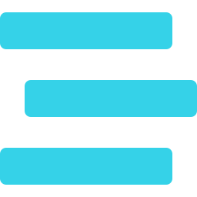
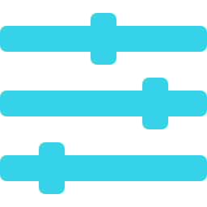
PUTTING IT TOGETHER
How It All Connects
one byte over BLE
UART TX → PE4
PC4 toggling
iPhone
HM-10
TM4C123
Buzzer (PC4)
picks a song
BLE ↔ UART
ISR → command → playSong
square wave = tone
Built from the labs
Lab 1 GPIO / buzzer
Lab 2 Timers / tones
Lab 3 Interrupts / NVIC
Lab 6 UART / HM-10
Room to grow
LED light show synced to the notes
Stream notes live from the phone
Playback controls: pause, next, tempo
Live demo to follow.
Notes:
Tie it together: the iPhone sends one character over BLE to the HM-10, the HM-10 forwards it over UART into PE4, the interrupt stores it, the main loop plays the song by toggling PC4 into a square wave, driving the buzzer. Everything came from four labs. Briefly mention where it could go next, an LED visualizer or streaming notes from the phone, then move into the live demo.

