Slide 1
Home Network 2.0
Hackathon – Eth meets california
Julien Romero, Krysztof Lis, Andrey Rusakov & Pascal Jud
San Francisco, 10th April 2016

Slide 2
Content
Motivation
Problems & Solution
Prototype & Demo

Slide 3
Motivation
Today‘s smart houses are not perfect:
In sensory network many things can go wrong:
No response, faulty values, cascading crashes, …
These networks are usually configured by professionals, BUT are used by regular people
Tools for monitoring and reacting to network disasters become more important since they help to minimize the cost of possible damage

Slide 4
Problems
Awareness of sensors‘ status any time
Robustness of the damaged or hacked system
Learning possible risks and ways of handling and preventing them

Slide 5
Solution
Monitoring
Reporting anomalies
Coordination
Communication protocol
Architecture representation and crash testing

Slide 6
PrototypE
Local network
HTTP Server
Network nodes: Delta Kit, Smartphones & Laptops
Air pressure, gyroscope, temperature, humidity & GPS
A lot of future work

Slide 7



SH Manager
Laptop
Delta Kit
Binary
T$º$
GPS
IMU
...
Smartphone
pressure
Delta Kit
T$º$
GPS
Smartphone
T$º$
IMU
...

Slide 8
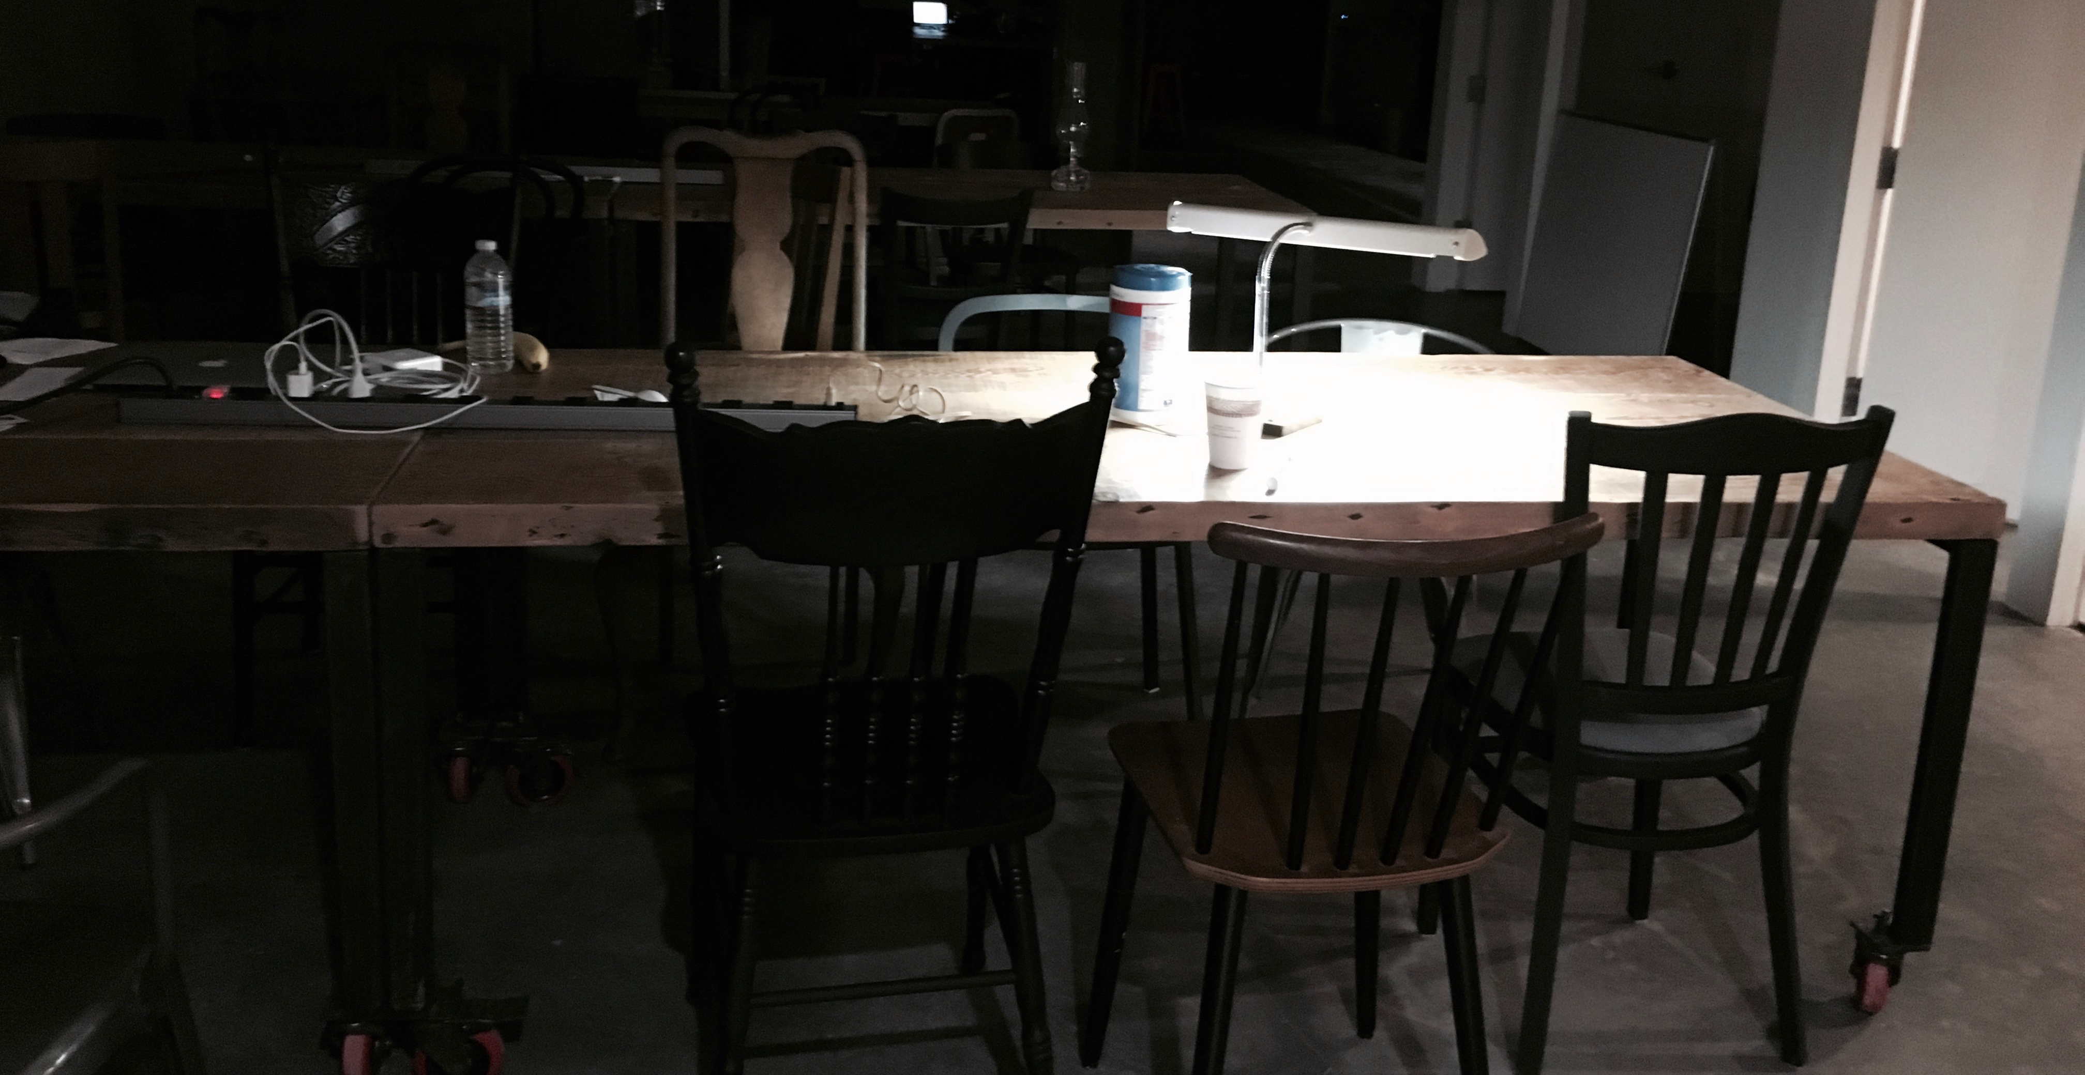
DEMO

