Slide 1


Power BI Driven Exhaustive Analysis of Indian Agriculture Sector
Title :Total production Analysis
Project By -
STU656e12fa0de351701712634
Paka Shirisha

Slide 2
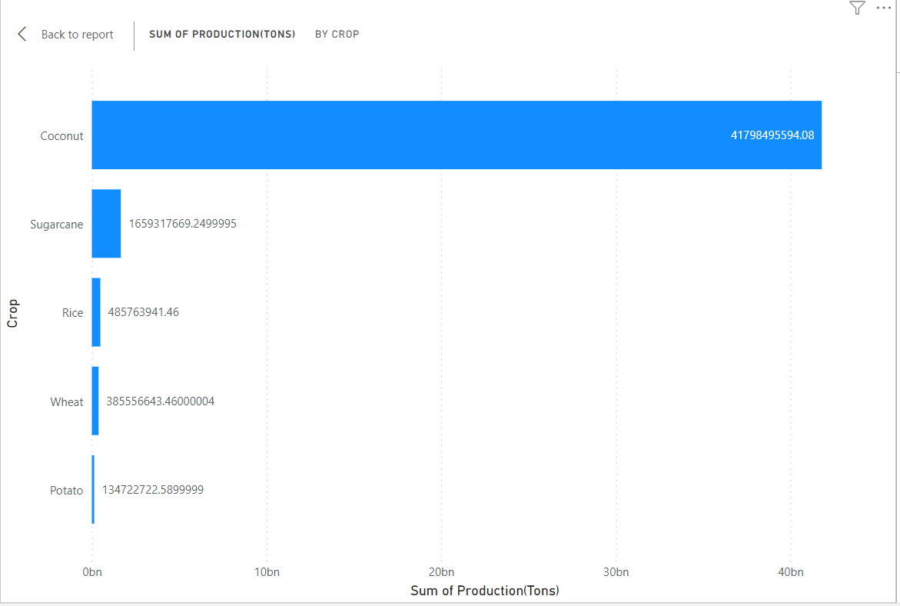
Top Five Crops by production

Slide 3
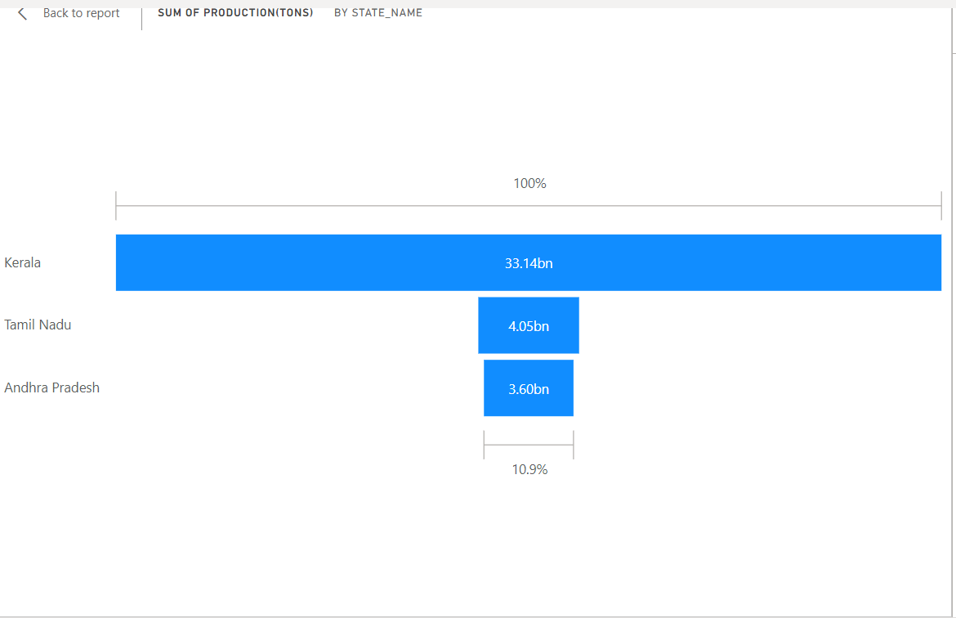
Top 3 States by production

Slide 4
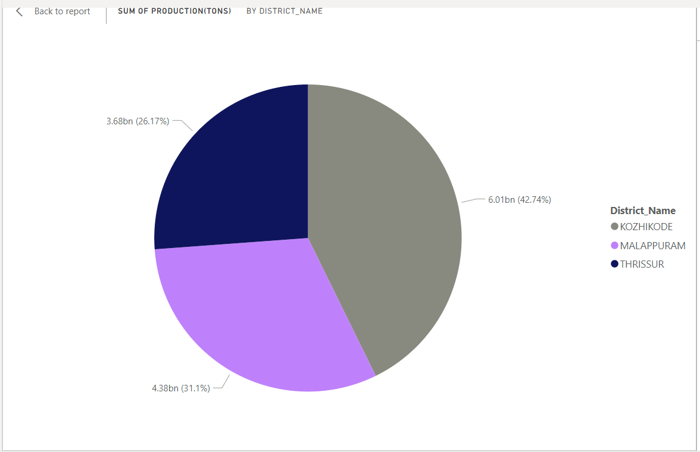
Top 3 Districts by production

Slide 5
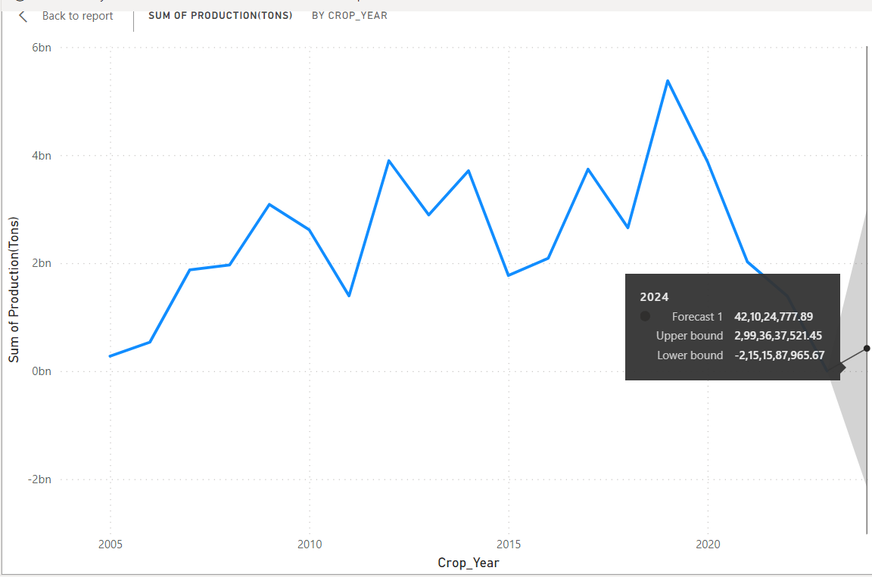
Production prediction for 1 Year

Slide 6
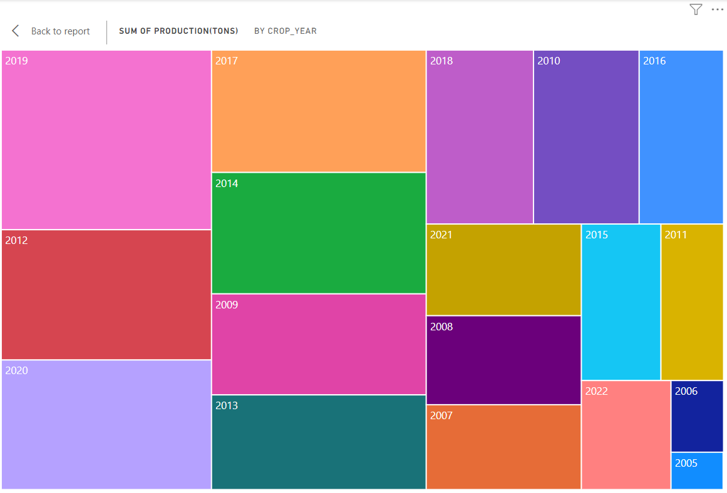
Production by each crop Year

Slide 7
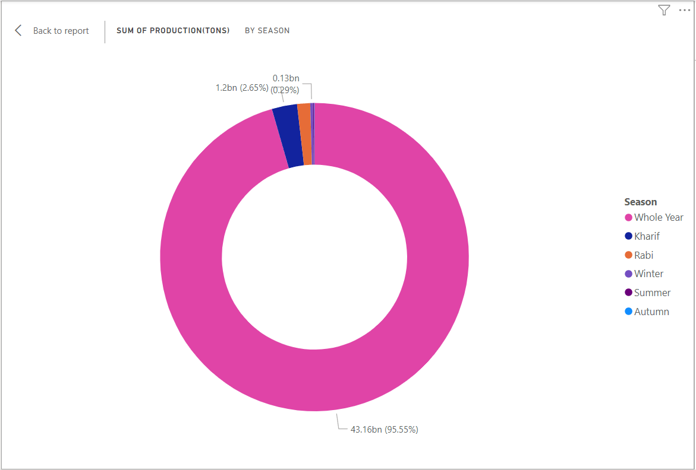
Production by each Season

Slide 8
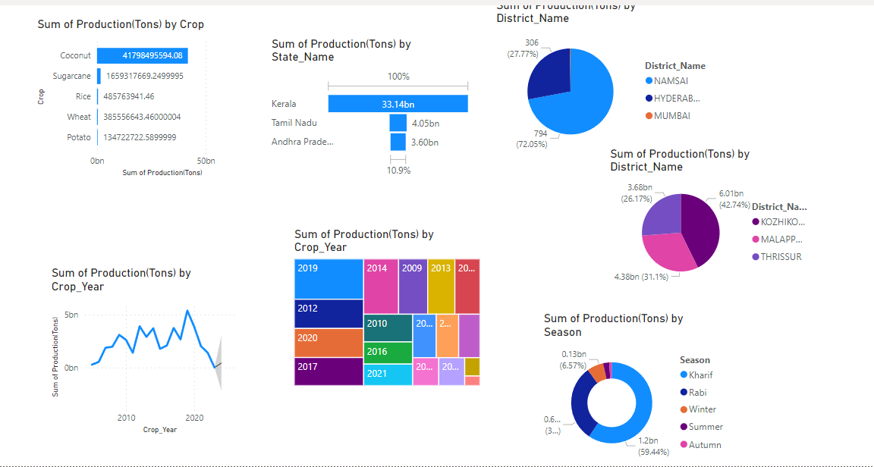
Production analysis for Indian crops

Slide 9
THANK YOU!

