Slide 1
SMART PARKING
Smart Parking Management System
ParkGrid: find, reserve and manage parking with a live slot map
Pakalapati Harini 2520030177
Pakkiru Sai Harshith Reddy 2520030375
Kairav Vashi 2520030582
Available Reserved Occupied
Guide: Dr Yerragudipadu Subbarayudu | K L (Deemed to be) University | 2026-27

Slide 2




The problem: parking is invisible
Availability unseen
No way to hold a slot
Drivers find out about a free slot only after they arrive, so they circle and queue.
Without bookings, two drivers can expect the same slot at the same time.
Entry and exit untracked
Operators fly blind
Operators cannot say which vehicle is inside, since when, or what fee is due.
Slots, occupancy and revenue sit in registers; peak hours are unknown.

Slide 3


Our solution: one platform, two roles
Driver (USER)
Operator (ADMIN)
See a live slot map per location
Register vehicles once
Reserve a slot for a time window
Record entry and exit, see the fee
View predicted busy hours
Manage locations and slots
View and filter all reservations
Cancel or record entry and exit
Dashboard: occupancy and revenue
Plan capacity from the prediction

Slide 4
Technology stack
Frontend
React 18, Vite, React Router
Role-aware pages, live slot map, booking form
Backend
Java 17, Spring Boot 3.3
REST API, JPA, Spring Security, JWT, BCrypt
Database
MySQL 8 (H2 for dev)
5 tables, foreign keys, unique keys, overlap index
Prediction
Python, FastAPI
Hourly occupancy and peak hour, Java fallback
Java Spring Boot is the primary backend; Python is a supporting component only.

Slide 5
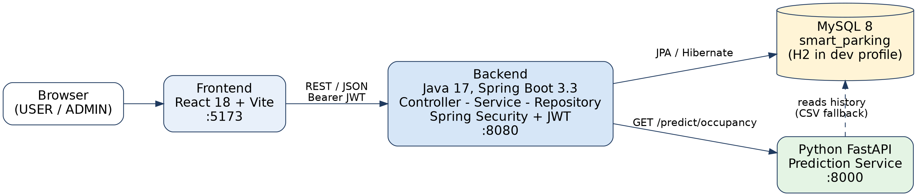
System architecture
Frontend talks only to the backend
The browser never calls Python or the database.
Backend owns all rules and writes
Booking, fees, status and security live in one place.
Python is read-only intelligence
If it stops, Java computes the same prediction.

Slide 6
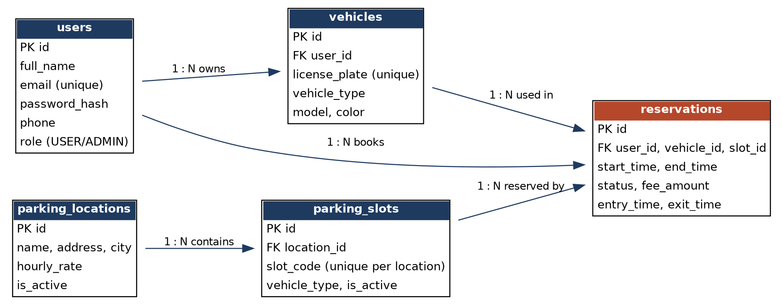
Database design: 5 tables
PK / FK
Foreign keys protect every link
Unique
email, licence plate, slot code per location
Index
(slot, start, end) speeds the overlap check
Demo data: 3 accounts, 2 locations, 32 slots, 56 reservations

Slide 7
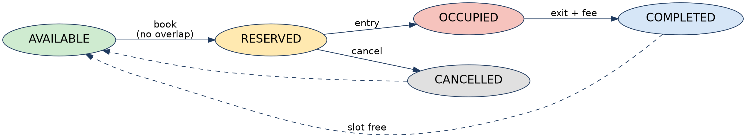
Slot status is derived, never stored
AVAILABLE
No active reservation on the slot
RESERVED
A reservation exists and has not ended
OCCUPIED
A vehicle has entered and not yet exited
Calculated from reservations on every request, so the live map can never go stale.

Slide 8
Booking without double-booking
1
2
3
4
5
Choose
Validate
Overlap check
Fee
Save
Slot, vehicle, start and end time
End after start; own vehicle; slot active
Any RESERVED or OCCUPIED booking in the window?
Hours rounded up, minimum 1, times hourly rate
Status RESERVED, fee stored
Conflict found
Request rejected with HTTP 409: slot already booked for that window.
Overlap rule
existing.start < new.end and existing.end > new.start, in one transaction.

Slide 9




Key features
Secure access
Live slot map
Reservations
JWT, BCrypt, USER and ADMIN roles, ownership checks
Colour-coded slots grouped by type, refreshed every 15 s
Book, cancel and list with overlap protection
Entry and exit
Automatic fee
Admin dashboard
RESERVED to OCCUPIED to COMPLETED with time stamps
Hours rounded up times the location rate, saved per booking
Slot counts, occupancy %, today's reservations and revenue

Slide 10
Peak-hour prediction (Python service)
18:00
predicted peak hour
88.8%
of 16 slots busy
If the Python service is down, Java computes the same result and the API still returns 200.

Slide 11
Testing and project at a glance
28
REST endpoints
5
database tables
30
test cases designed
2
roles: USER, ADMIN
How it is tested
Postman: every endpoint with USER and ADMIN tokens
Integration flows: book, conflict, cancel, entry, exit, dashboard
Rules: fee rounding, status transitions, 400 / 401 / 403 / 409 errors
pytest: prediction maths, response shape, HTTP endpoints

Slide 12
Limitations and future work
Current limitations
Future enhancements
Entry and exit are simulated in the app
No payment gateway; fee is calculated only
Fee not recalculated for overstay
No database lock for simultaneous bookings
Prediction is a simple hourly average
Online payments and receipts
ANPR cameras and QR gates
IoT slot sensors
E-mail and SMS notifications
Maps, dynamic pricing, mobile app

Slide 13
Thank you
Smart Parking Management System: live availability, safe booking and clear operator insight.
Questions?

