Slide 1

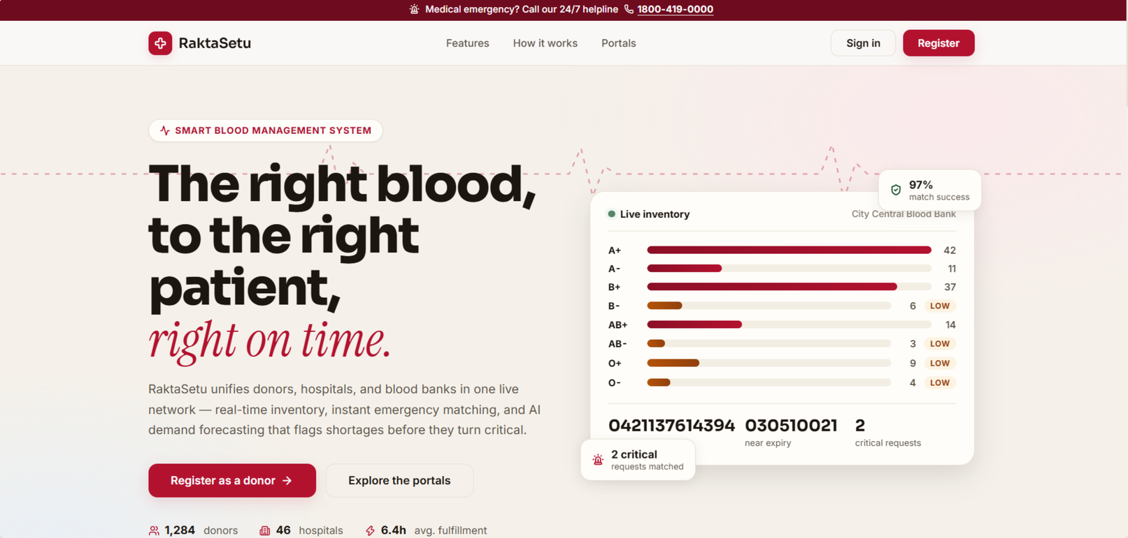
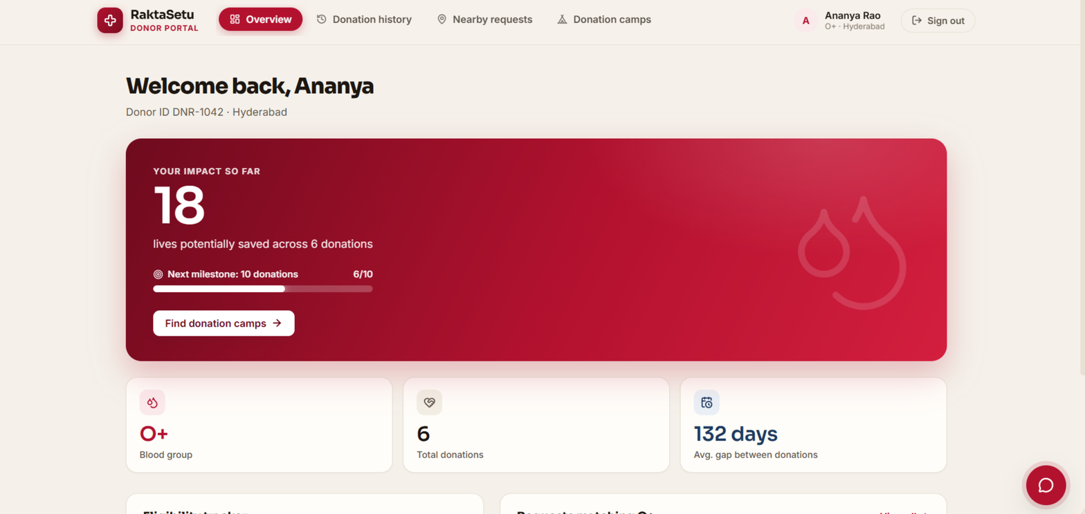
Blood Management System (RaktaSetu)
Team ID: 6 | Section: 7 | Members: Pakalapati Harini – 2520030177, Pakkiru Sai Harshith Reddy – 2520030375, Kairav Vashi – 2520030582 | Guide: Dr. Spandana. S
Database Systems Engineering and Distributed Backend Development (25CS1302E) | KLH Bachupally Campus, CSE | PBL 2026-27
Abstract
Tools & Technologies
RaktaSetu is a web-based blood management system for donors, hospitals and admins. One MySQL database holds donors, stock batches, requests, camps, cross-match records and alerts, exposed through a JWT-secured Express API to a React front end.
Outcome: faster requests, less wastage via expiry-first dispatch, early shortage warnings.
Front-End: React 19, Vite, React Router, Recharts
Back-End: Node.js + Express 4 REST APIs, JWT, bcryptjs
Database: MySQL 8 (InnoDB) via mysql2 connection pool
Tools: Git & GitHub, VS Code, MySQL Workbench, Postman, nodemon
Problem Statement & Objectives
Problem: Donor, stock and request data sit in separate manual records, so hospitals cannot quickly check availability or expiry.
Objective 1: Centralise donors, hospitals, stock, requests and camps in one database.
Objective 2: Reduce wastage by dispatching the oldest-expiring units first.
Objective 3: Speed up response: online requests, donor matching, critical alerts.
Scope: Donor, Hospital and Admin roles; 10 REST API modules.
System Architecture
React 19 + Vite
Login / Register
Donor, Hospital, Admin dashboards
Setu chatbot
Express API
JWT + role middleware
10 route modules
bcrypt, transactions
MySQL (InnoDB)
9 tables + 1 view
FKs, CHECK, indexes
Existing vs Proposed System
HTTP / JSON with Bearer JWT ↔ SQL through mysql2 connection pool
Feature | Existing System | Proposed System
Records | Manual registers and spreadsheets | Central MySQL database
Availability | Phone calls to each blood bank | Live stock by blood group
Expiry | Tracked by hand | Oldest-expiring units used first
Requests | Calls and paper forms | Online request with status tracking
Limitation / Gap | No single, current view | Role-based platform with alerts
/auth /donors /requests /inventory /donations /camps /crossmatch /alerts /admin /meta
ER Diagram & Database Design
donors
PK id, FK user_id
blood_group, lat/long
1:1
users
PK id
email, role
1:1
hospitals
PK id, FK user_id
name, lat/long
1:N
1:N
donations
PK id, FK donor_id,
request_id, batch_id
alerts
PK id
severity, is_resolved
blood_requests
PK id, FK hospital_id
urgency, status
creates
1:N
blood_batches
PK id, units
expiry_date, status
feeds
camps
PK id, camp_date
status, units_collected
crossmatch_records
PK id, FK donor_id,
request_id, result
Feasibility Study
Technical: React, Node.js/Express and MySQL are standard, well-documented tools; the full stack runs on a laptop.
Economic: Entirely open-source stack, so no licence cost.
Operational: Role-based dashboards with simple forms; the Setu assistant helps users navigate.
Schedule: Built in phases (schema, REST API, dashboards) within the semester timeline.
Implementation Screenshots
Landing page: live inventory preview
Donor portal: impact tracking
Results & Testing
Conclusion
Future Scope
CRUD across donors, requests, donations, camps, alerts and cross-match
Input validation plus DB CHECK constraints; JWT role-based access
Demo data: 126 stock units, 3 role logins
One platform now serves donor, hospital and admin workflows
Meets the objectives: expiry-first dispatch, auto critical alerts, forecast and reports
Mobile app with SMS / email notifications
Real-time location-based blood bank search
Online donation appointment scheduling
References: [1] React Documentation, react.dev [2] Express.js Documentation, expressjs.com [3] MySQL 8.0 Reference Manual, dev.mysql.com [4] RFC 7519, JSON Web Token (JWT), IETF
QR: GitHub

