Slide 1
MACHINE LEARNING · EDA REPORT
Heart Disease Prediction
A Refined Study: Literature Review, Research Gaps & Exploratory Data Analysis
Presented by
Fathima Qhibtiya Khader · 2520030155
Pakalapati Harini · 2520030177
Under the guidance of
Shaik Asif, Assistant Professor, CSE

Slide 2
OVERVIEW
Agenda
1
Problem Statement
2
Literature Review Approach
3
Reference Papers — Comparison
4
Paper Deep Dives (3 studies)
5
Research Gap & Motivation
6
Dataset Overview (Noisy Data)
7
Missing Data & Quality Checks
8
Exploratory Data Analysis
9
Key Findings & Next Steps
Heart Disease Prediction — Refined Study
Agenda
2

Slide 3
THE PROBLEM
Problem Statement
Cardiovascular disease remains one of the leading causes of death worldwide, and its progression is often silent until significant damage has occurred. Existing ML-based diagnostic studies report strong accuracy figures, but frequently struggle with overfitting, incomplete feature evaluation, and clinical data that is noisy or incomplete — the exact conditions a real deployment would face.
1
2
3
Accuracy vs. Generalization
Fragmented Benchmarking
Real-World Data Quality
Many prior models report high accuracy on clean data but haven't been stress-tested against missing values, duplicates, or outliers typical of real clinical records.
Individual studies compare only a handful of models each, on different dataset variants, making it hard to judge which approach is genuinely most reliable.
Our own dataset for this project intentionally includes ~13% missing values and outliers per feature — the goal is to build and evaluate a pipeline that survives this realism.
Heart Disease Prediction — Refined Study
Problem Statement
3

Slide 4
LITERATURE REVIEW
How We Reviewed the Literature
To ground this project, three peer-reviewed studies on ML-based heart disease prediction were reviewed in depth. For each, we examined the same four dimensions so results are genuinely comparable:
Proposal
Data
Methodology
Constraints
What the paper set out to build — the core model architecture or pipeline idea.
Which dataset(s), how many records/features, and how they were sourced.
Preprocessing, feature selection, models trained, and evaluation metrics used.
Limitations the authors themselves acknowledge, or gaps evident from the results.
The three papers span a spectrum: a foundational bar-plot comparison (Singh et al., 2024), a rigorous 15-model benchmark with cross-validation (Teja & Rayalu, 2025), and a genetic-algorithm-optimized stacked ensemble with SHAP explainability (Majumder et al., 2026).
Heart Disease Prediction — Refined Study
Literature Review
4

Slide 5
LITERATURE REVIEW
Reference Papers — At a Glance
Author(s) | Year | Title / Venue | Dataset | Best Result
Singh, Mahapatra, Biswal et al. | 2024 | Heart Disease Detection Using ML Models — Procedia Computer Science (ICMLDE 2023) | Framingham · 4,240 records, 15 attrs | Random Forest — 97% accuracy
Teja & Rayalu | 2025 | Optimizing Heart Disease Diagnosis with Advanced ML Models — BMC Cardiovascular Disorders | UCI merged (5 sources) · 1,190 records, 7 features | XGBoost / Bagged Trees — 93% acc, ROC-AUC 0.95 (RF)
Majumder, Gupta, Majumder et al. | 2026 | Prediction of CVD by Using a Genetic Algorithm over a Stacked Ensemble Model — Discover AI | UCI Cleveland · 14 → 7-8 features (LASSO) | GA-Optimized Stacked Ensemble — 88.52% acc, AUC 0.92
All three studies use UCI-family heart disease data but differ sharply in scale of comparison (4 vs. 15 vs. 4 models), feature-selection rigor, and validation depth — this spread is exactly what we drew on to design our own approach.
Heart Disease Prediction — Refined Study
Reference Papers
5

Slide 6
PAPER 1 OF 3
Singh et al. (2024) — Heart Disease Detection Using ML Models
Proposal & Data
Constraints & Limitations
Compares four supervised algorithms — Decision Tree, Random Forest, SVM, and PCA-based classification — on the Framingham Heart Study dataset.
Dataset: 4,240 records, 16 columns / 15 attributes, predicting 10-year CHD risk; contains missing values and an imbalanced target.
Preprocessing: random oversampling of the minority class, outlier detection/removal, correlation-based feature review.
Only 4 models compared — no ensembles like XGBoost, no boosting methods explored.
No k-fold cross-validation reported; single train/test evaluation risks an optimistic estimate.
No ROC-AUC, precision/recall breakdown beyond a summary table — accuracy is the primary lens.
Explicitly names overfitting as an open problem the authors set out to address, but doesn't quantify train-vs-test gap for each model.
Methodology & Results
Trained DT, RF, SVM and PCA-based classifiers and compared accuracy via bar plot. Random Forest achieved the best accuracy (97%), vs. Decision Tree (84%), PCA (79%), SVM (68%).
Heart Disease Prediction — Refined Study
Paper 1 — Singh et al.
6

Slide 7
PAPER 2 OF 3
Teja & Rayalu (2025) — Optimizing Heart Disease Diagnosis
Proposal & Data
Constraints & Limitations
Benchmarks 15 ML models (RF, KNN, LR, Naïve Bayes, GBM, AdaBoost, XGBoost, Bagged Trees, Neural Net, MANN, FDA, CIT, MARS, BGLM, BGGLM) side by side.
Dataset: merged UCI sources — Cleveland, Hungary, Switzerland, Long Beach VA, Statlog — 1,190 records; 7 of 12 attributes selected (sex, cp, fbs, restecg, exang, ST slope, target).
80:20 train/test split, plus 10-fold and 5-fold cross-validation for robustness.
Only 7 of 12 available attributes used — feature choice based on correlation + a prior paper, not a formal selection algorithm (e.g. LASSO).
Merging 5 heterogeneous sources (different countries/eras) risks population and measurement-protocol bias not discussed in depth.
15-model sweep increases compute cost substantially versus a focused comparison — authors note complexity trade-offs only briefly.
Real-world deployment / interpretability considerations flagged by the authors as under-explored in most prior work, including partly their own.
Methodology & Results
Evaluated via accuracy, precision, recall, F1, and — notably — ROC-AUC (absent in most prior work). XGBoost & Bagged Trees: 93% accuracy; Random Forest & Bagged Trees: 95% ROC-AUC. KNN accuracy dropped sharply under CV, revealing overfitting.
Heart Disease Prediction — Refined Study
Paper 2 — Teja & Rayalu
7

Slide 8
PAPER 3 OF 3
Majumder et al. (2026) — Genetic Algorithm over a Stacked Ensemble
Proposal & Data
Constraints & Limitations
Two-layer stacked ensemble: Ensemble 1 (SVM + Decision Tree, weighted voting), Ensemble 2 (Random Forest + Logistic Regression, weighted voting), stacked with Logistic Regression as meta-learner.
Dataset: UCI heart disease repository, 14 original features reduced to 7 via LASSO regression (sex, cp, thal, thalach, exang, oldpeak, ca).
75:25 train/test split; Genetic Algorithm (pop=80, mutation=10%, 10 generations) used post-stacking to optimize feature subsets.
Explicitly acknowledged by the authors: relies solely on structured clinical attributes — no imaging, ECG waveforms, genomic, wearable, or longitudinal EHR data.
Higher architectural complexity (2-layer ensemble + GA) increases training time and computational cost vs. simpler baselines.
GA hyperparameters (population, mutation rate, generations) were fixed by the authors, not tuned — may not generalize to other datasets.
Validated on a single dataset only; authors flag cross-dataset validation as future work.
Methodology & Results
Base stacked model: 81.53% accuracy, AUC 0.89. After GA optimization: 88.52% accuracy, 90% precision, AUC 0.92 — a statistically significant gain (paired t-test) over standalone SVM and Decision Tree. SHAP used for interpretability.
Heart Disease Prediction — Refined Study
Paper 3 — Majumder et al.
8

Slide 9
SYNTHESIS
Research Gap & What This Study Adds
1
2
3
No study tests on noisy data
Feature selection rigor varies
Validation depth is uneven
All three papers evaluate on relatively clean, curated datasets. None explicitly stress-tests a pipeline against realistic missing values, duplicates, and outliers of the kind clinical intake data actually has.
Paper 1 uses none; Paper 2 uses correlation + prior literature; only Paper 3 uses a formal method (LASSO). We adopt a systematic, reproducible EDA-first approach before any modelling choice.
Only Papers 2 & 3 use cross-validation; Paper 1 does not. We start from a rigorous EDA baseline so any future model choice can be validated the same way from day one.
Our contribution in this phase: a thorough, transparent EDA on a deliberately noisy heart-disease dataset (1,030 records, 13% missing data) — the necessary foundation before any model comparison can be trusted.
Heart Disease Prediction — Refined Study
Research Gap
9

Slide 10
THE DATA
Dataset Overview — heart_noisy_for_eda.csv
1,030
13
133
5
Patient Records
Clinical Features
Missing Values
Duplicate Rows
About This Dataset
Attributes
A deliberately "noisy" variant of the classic Cleveland-style heart-disease dataset: 1,030 patient records across the same 13 clinical attributes, with realistic missingness (~1% per column, ~13% of rows affected overall) and a handful of duplicate records — designed to test whether an EDA and modelling pipeline holds up under real-world conditions.
age · sex · cp (chest pain type) · trestbps (resting BP) · chol (cholesterol) · fbs (fasting blood sugar) · restecg · thalach (max heart rate) · exang (exercise angina) · oldpeak · slope · ca (major vessels) · thal
Target split: 529 disease-positive (51.4%) vs. 501 disease-negative (48.6%) — still well balanced.
Heart Disease Prediction — Refined Study
Dataset Overview
10

Slide 11
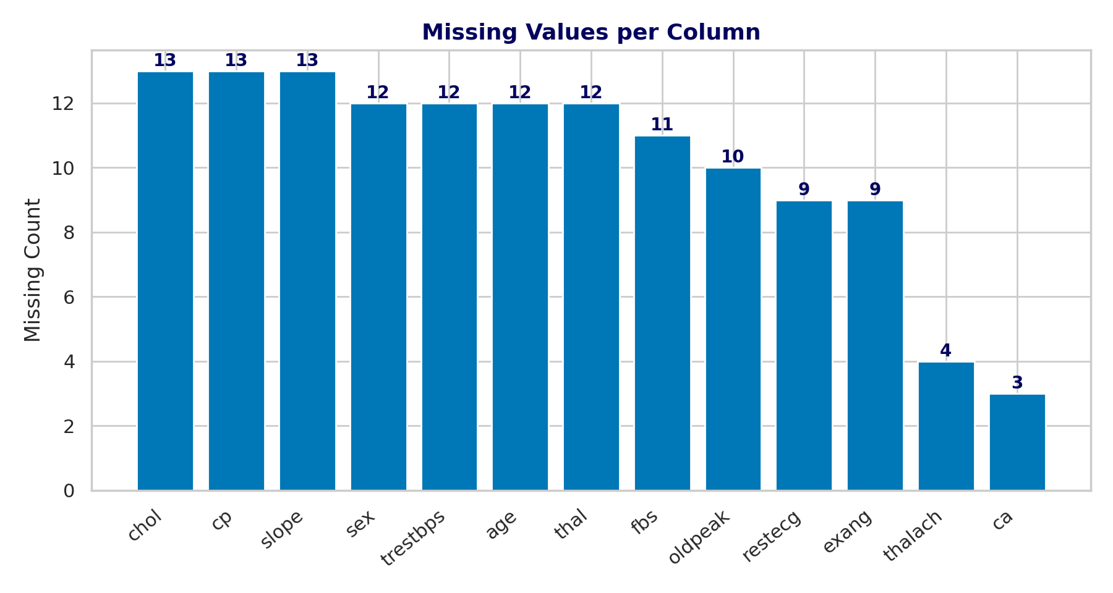
DATA QUALITY
Missing Data Analysis
What We Found
Missingness is spread fairly evenly (9–13 rows per column) — no single feature is disproportionately affected.
chol, cp and slope have the most gaps (13 each, ~1.26%); ca has the fewest (3, ~0.29%).
133 missing cells across 1,030 rows and 13 features — manageable with median/mode imputation rather than row deletion.
5 duplicate rows detected — small enough to drop safely without meaningfully shrinking the dataset.
Heart Disease Prediction — Refined Study
Missing Data
11

Slide 12
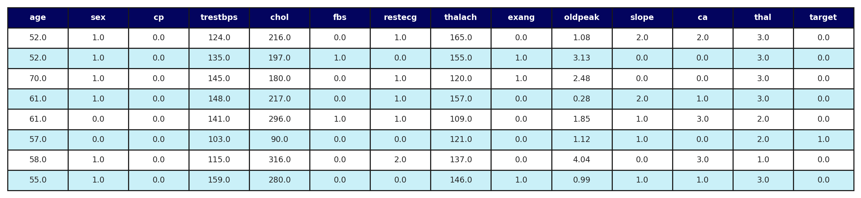
THE DATA
Dataset Snapshot
First 8 records loaded via pandas.read_csv("heart_noisy_for_eda.csv") — real values, unmodified.
Every column is numeric or already label-encoded, so no additional categorical encoding is needed once missing values are imputed. Rows with missing cells (highlighted in the full dataset) are scattered randomly rather than clustered, consistent with the synthetic noise injection.
Heart Disease Prediction — Refined Study
Dataset Snapshot
12

Slide 13
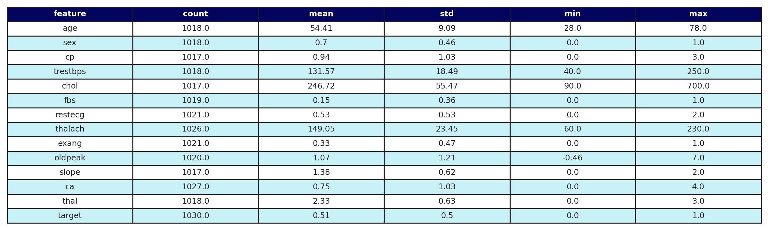
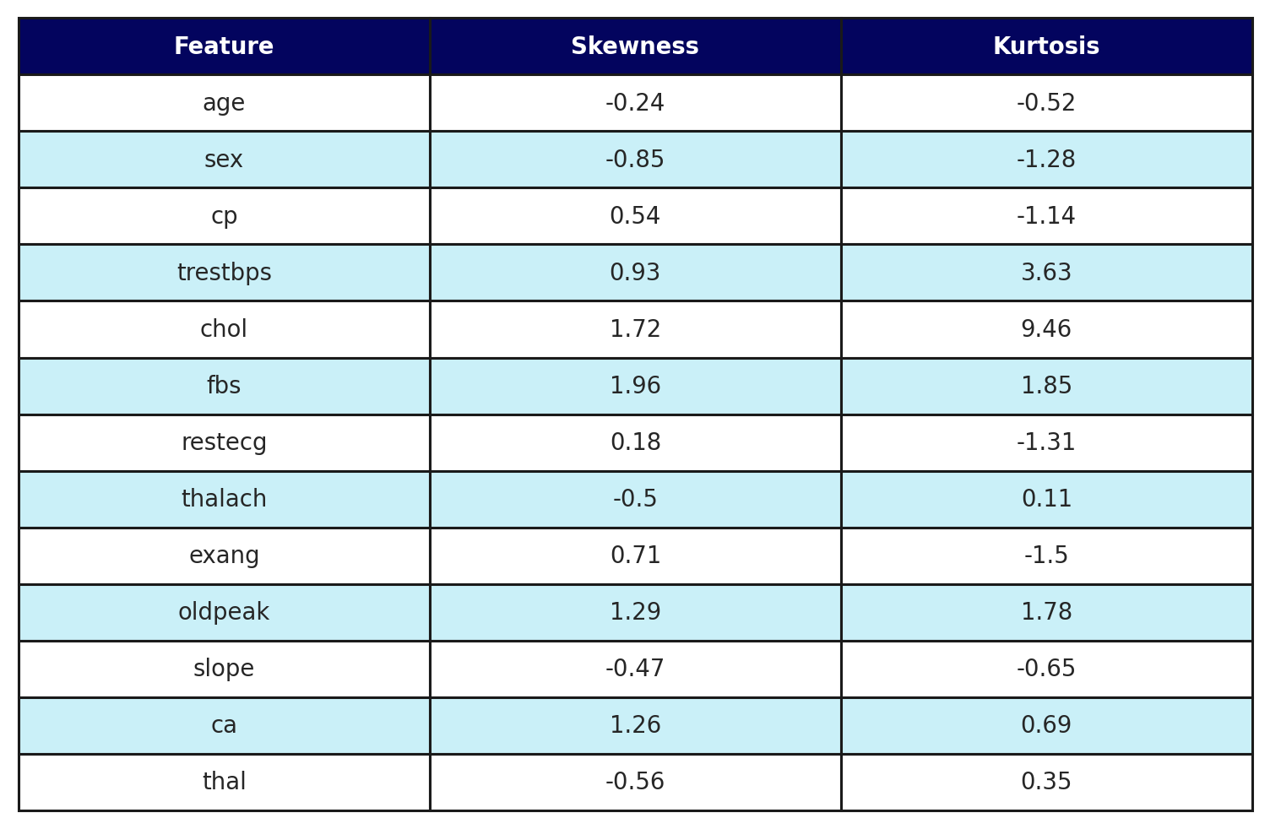
THE DATA
Descriptive Statistics, Skewness & Kurtosis
chol and fbs show the strongest right-skew (1.72 and 1.96) with high kurtosis (9.46 and 1.85) — driven by a small number of extreme cholesterol readings and the naturally imbalanced fbs flag. trestbps also has notably heavy tails (kurtosis 3.63). These signal the need for outlier-aware scaling before any regularized or distance-based model is trained.
Heart Disease Prediction — Refined Study
Descriptive Statistics
13

Slide 14
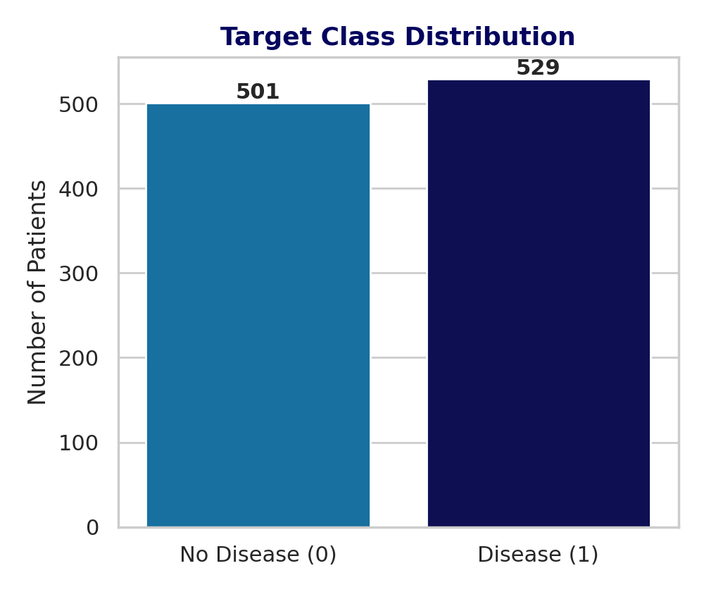
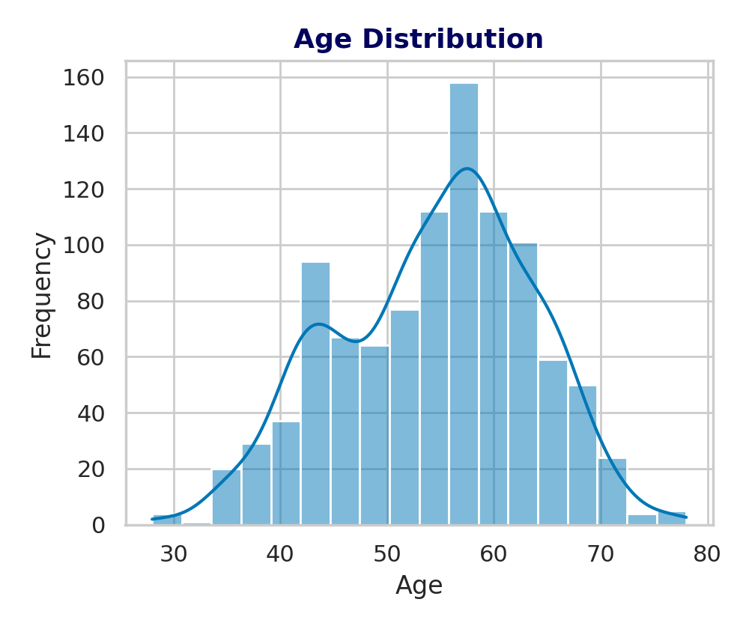
EXPLORATORY DATA ANALYSIS
Target & Age Distributions
Heart Disease Prediction — Refined Study
EDA
14

Slide 15
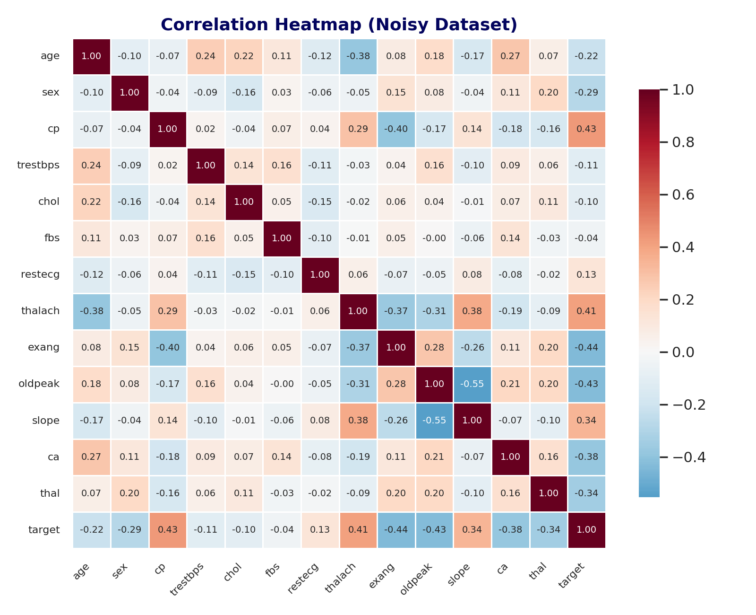
EXPLORATORY DATA ANALYSIS
Correlation Heatmap
Heart Disease Prediction — Refined Study
EDA
15

Slide 16
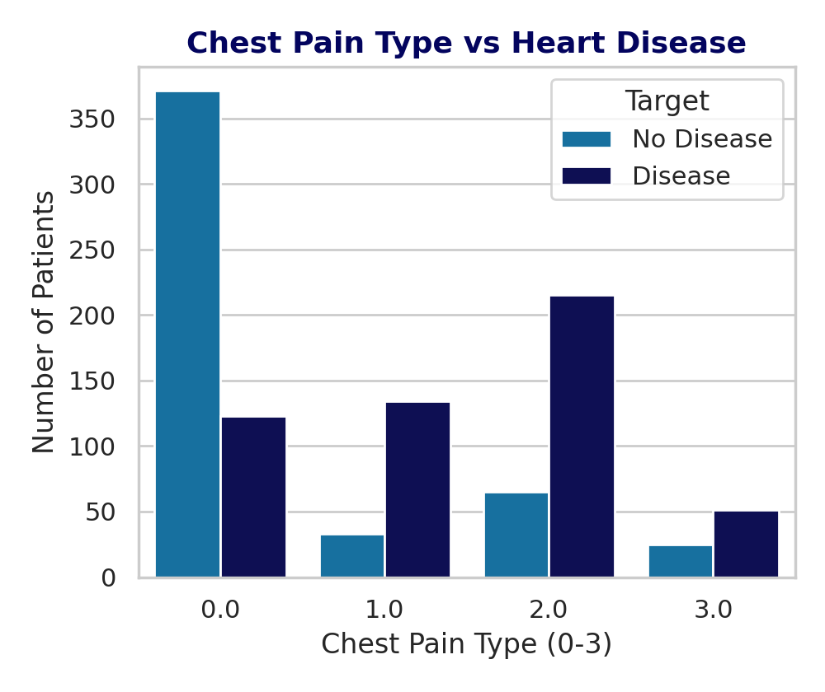
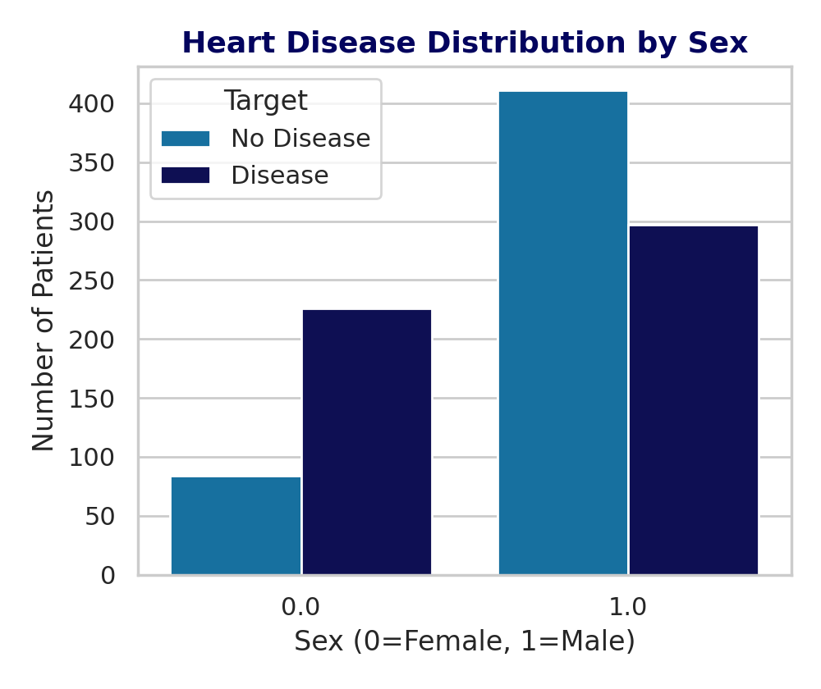
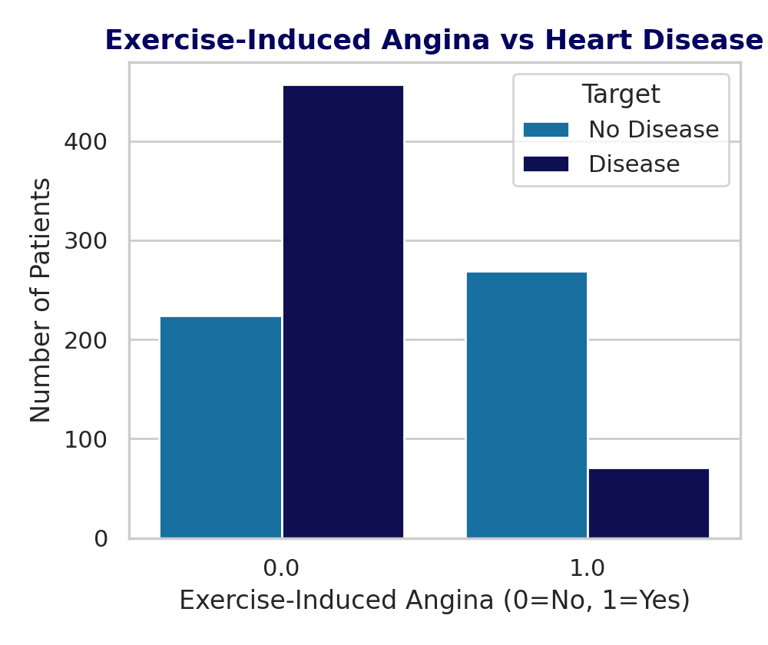
EXPLORATORY DATA ANALYSIS
Key Feature Relationships
cp (r = 0.43), exang (r = -0.44) and slope (r = 0.34) remain the strongest correlates of target even with noise present — consistent with the clean-dataset findings, which is a good sign that these relationships are genuinely robust and not an artifact of a particular data cut.
Heart Disease Prediction — Refined Study
EDA
16

Slide 17
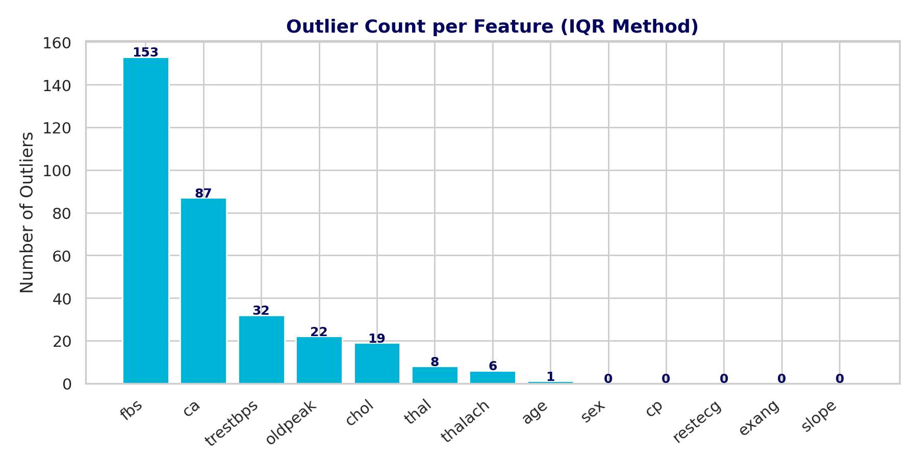
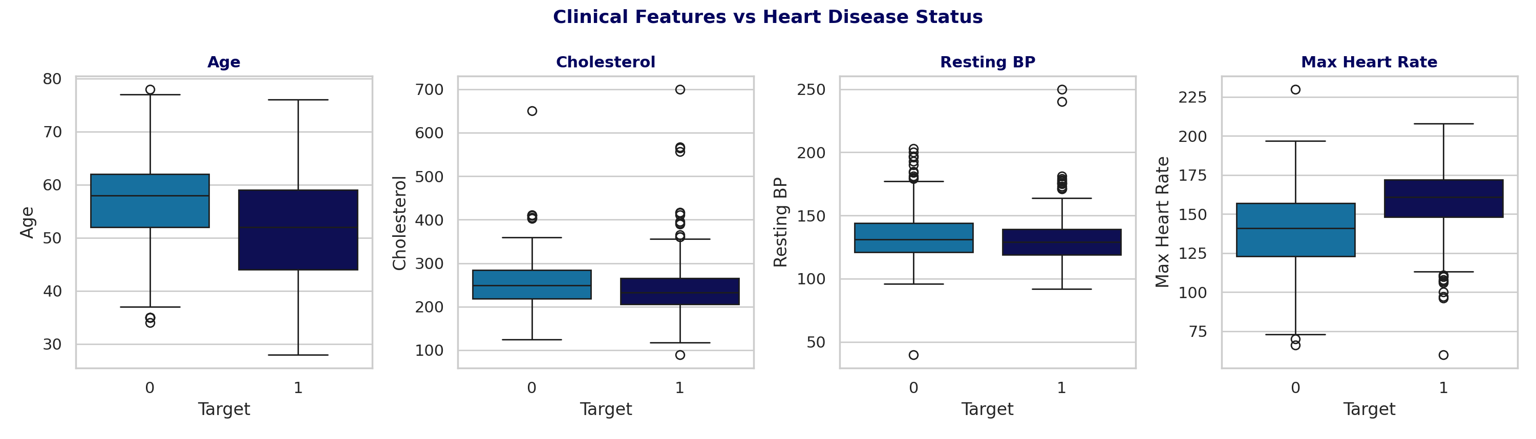
EXPLORATORY DATA ANALYSIS
Outlier Detection (IQR Method)
fbs and ca flag heavily because they're skewed binary/count fields, not true anomalies. trestbps, chol and oldpeak show genuine long-tail outliers worth capping or winsorizing.
Heart Disease Prediction — Refined Study
EDA
17

Slide 18
WRAP UP
Key Findings & Next Steps
Key EDA Findings
Next Steps
Missingness is mild (~1% per column) and evenly spread — safe to impute rather than drop rows.
cp, exang, slope and thalach are the strongest and most stable predictors of heart disease, even under noise.
chol, trestbps and oldpeak carry genuine outliers; fbs/ca flags are mostly artifacts of skewed binary/count distributions.
Target class remains well balanced (51% / 49%) — no resampling strategy is required before modelling.
Impute missing values (median for skewed numerics, mode for categoricals) and drop the 5 duplicate rows.
Apply LASSO-based feature selection, following Paper 3's approach, before model training.
Benchmark Logistic, Ridge/Lasso, Decision Tree, Random Forest and a boosting model with stratified k-fold CV, following Paper 2's rigor.
Report accuracy, precision, recall, F1 and ROC-AUC together — never accuracy alone — and add SHAP for interpretability.
Heart Disease Prediction — Refined Study
Key Findings
18

Slide 19
Thank You
Questions & Discussion
Fathima Qhibtiya Khader · 2520030155 | Pakalapati Harini · 2520030177

