Slide 1
Pyspark
Palani Karthikeyan

Slide 2
Apache Spark
Apache Spark is a general distributed in-memory computing framework.
It provides a unified platform for processing and analyzing big data.
PySpark is a Python library that allows us to easily interface with Apache Spark.
Apache Spark is written in Scala and provides APIs in Scala, Java, Python (PySpark), and R

Slide 3
PySpark
PySpark is the Python API for Apache Spark.
It allows you to interface with Spark’s distributed computation framework using Python.
It easier to work with big data.
PySpark is used for processing large-scale datasets in real-time across a distributed computing environment using Python.

Slide 4
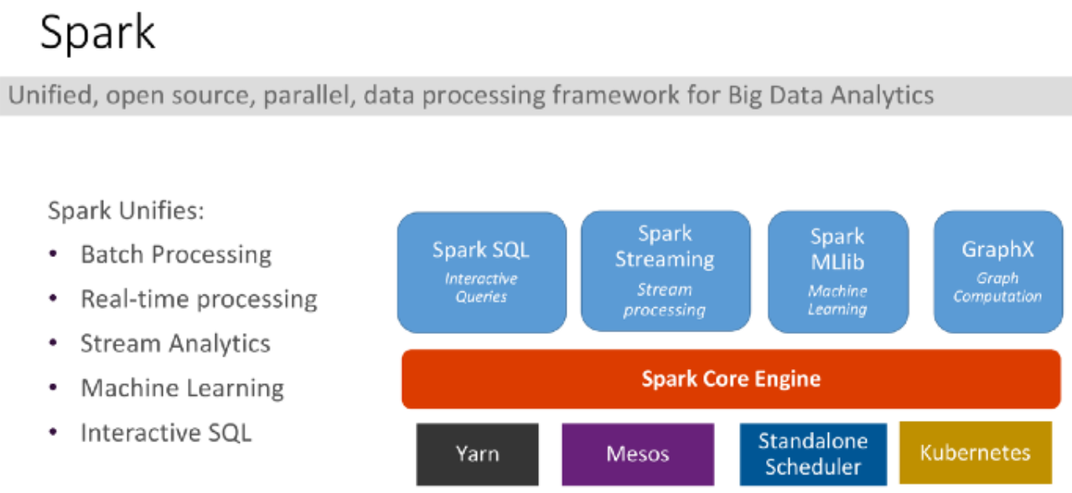

Slide 5
Features of PySpark
Integration with Spark
Real-time Processing with large-scale datasets
Ease of Use
Machine Learning
Data Sources − PySpark can read data from various sources, including HDFS, S3, HBase, and more.
Partitioning − Efficiently partitions data to enhance processing speed and efficiency.

Slide 6
Applications of PySpark
Data Analysis
Machine Learning
Data Streaming
Data Engineering

Slide 7
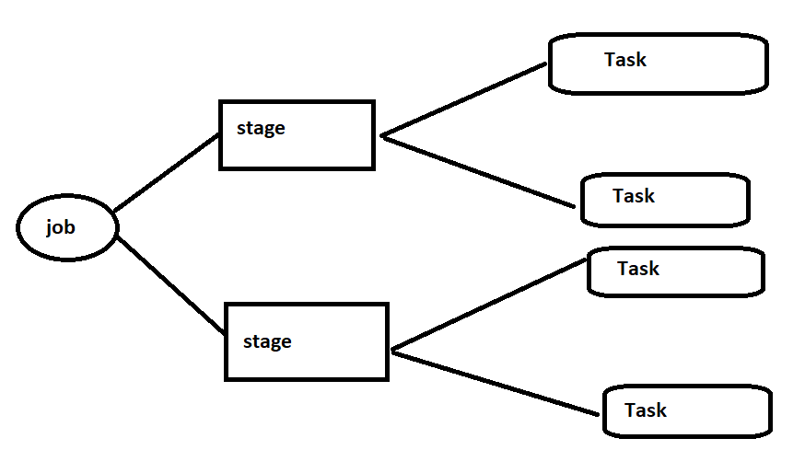
How Spark works?

Slide 9
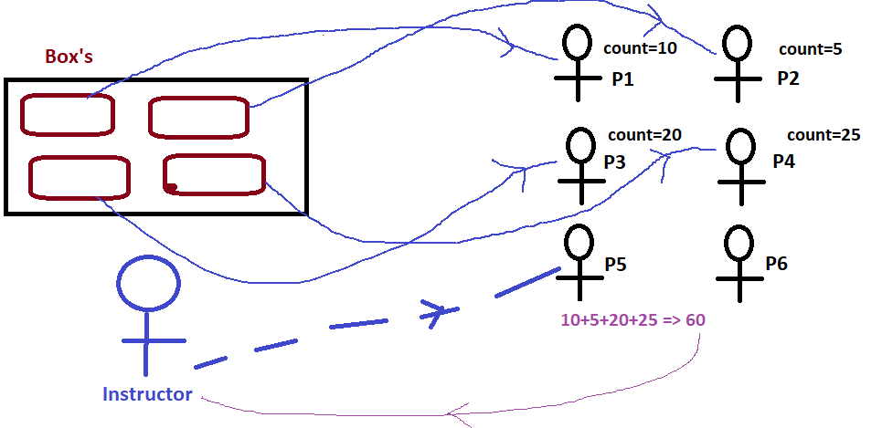

Slide 10
Instructor – Driver
Each Person(group) – Executor – executors are jvm
Count – task ( each individual task )
Count
|-> local count |->global count - 2 stages

Slide 11
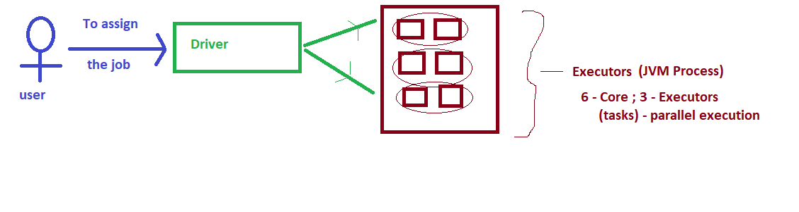

Slide 12
Partitions
To allow every executors to work parallelly, spark breaks down the data in to chunks - called partition
Last example - our Box is a partition – 4 Partitions
The 4 Partitions of data execute parallelly

Slide 13
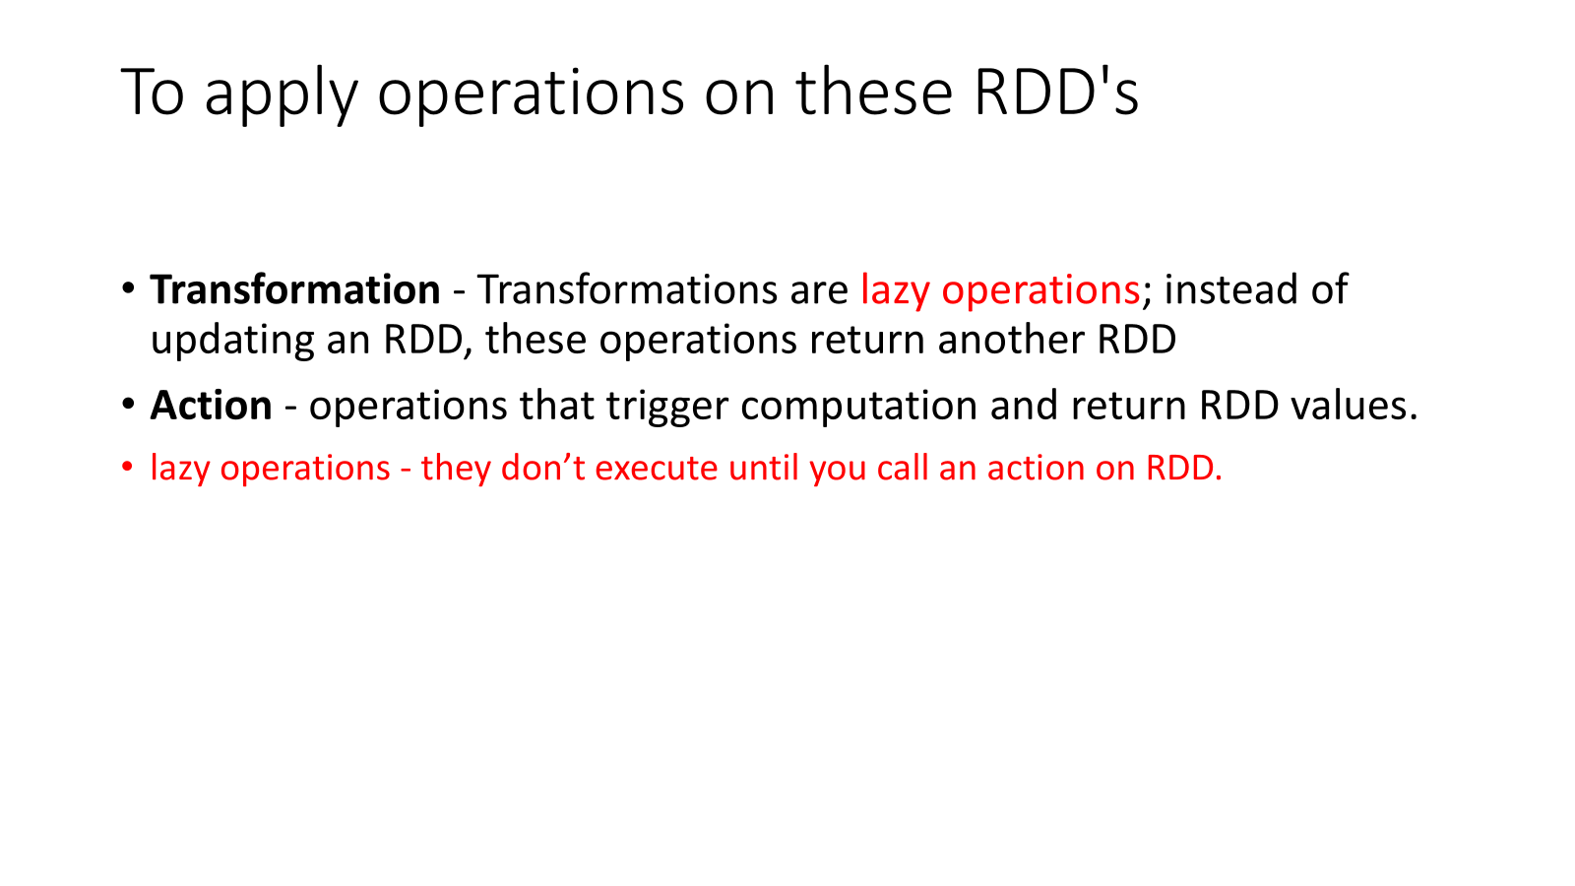

Slide 14
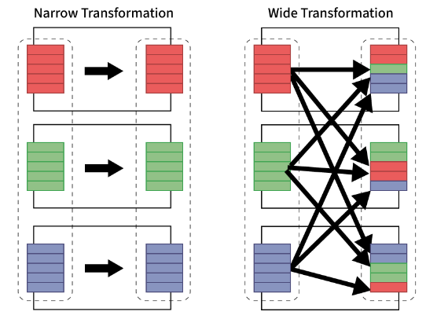
Transformation
Transformation is helps to build logical plan
There are two types of transformations
Narrow
Wide

Slide 15
Action
To Trigger the execution we need to call an action
Execute the plan created by transformation
Actions are 3 types:
View the data
Collect data to native language
Write data to output data sources

Slide 16
Key Components of PySpark
RDDs (Resilient Distributed Datasets)
Data Frames
Spark SQL
MLlib (Machine Learning Library)
Spark Streaming

Slide 17
Spark Session
The driver (Instructor) process is known as spark session
It is entry point for spark session
The spark session instance executes the code in the cluster
The relation 1 to 1 (i.e., 1 spark application have 1 spark session)

Slide 18
Structured API - DataFrame
DataFrame – Table
DataFrame has schema – meta data for columns
DataFrame are immutable

Slide 19
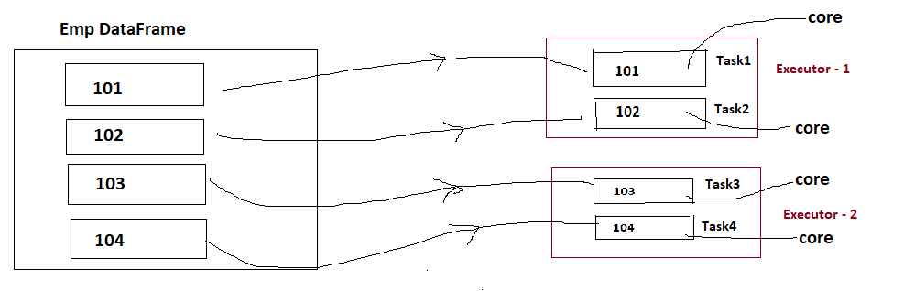
Data Frame

Slide 20
RDD
RDD (Resilient Distributed Dataset) is a core building block of PySpark.
It is a fault-tolerant, immutable, distributed collection of objects.
Immutable means that once you create an RDD, you cannot change it.
The data within RDDs is segmented into logical partitions, allowing for distributed computation across multiple nodes within the cluster.

Slide 21
PySpark – RDD
In-Memory Processing
Immutability
Fault Tolerance
Lazy Evolution
Partitioning
Notes:
PySpark loads the data from disk and processes it in memory, and keeps the data in memory; this is the main difference between PySpark and MapReduce (I/O intensive). In between the transformations, we can also cache/persists the RDD in memory to reuse the previous computations.

Slide 22
To create a PySpark RDD
# Create RDD from parallelize
data = [1,2,3,4,5,6,7,8,9,10,11,12,13,14,15]
rdd = spark.sparkContext.parallelize(data)
# Read entire file into a RDD as single record.
rdd = spark.sparkContext.wholeTextFiles("E://emp.csv")
Notes:
For production applications, we mostly create RDD by using external storage systems like HDFS, S3, HBase e.t.c.

Slide 23
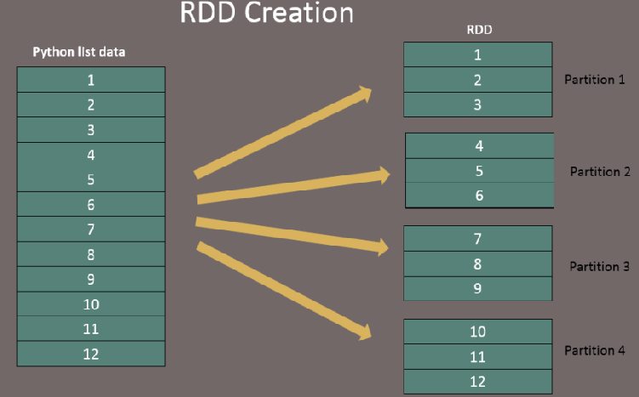

Slide 24
To get number of partitions
getNumPartitions()
rdd.getNumPartitions() => 4

Slide 25
Repartition and Coalesce
To repartition the RDD, PySpark provides two ways to repartition
1. repartition() - which shuffles data from all nodes also called full shuffle
2. coalesce() - which shuffles data from minimum nodes
for examples if you have data in 4 partitions and doing coalesce(2) moves data
from just 2 nodes

Slide 26
Repartition
reparRdd = rdd.repartition(4)
print("re-partition count:"+str(reparRdd.getNumPartitions()))
# Outputs:
re-partition count:4

