Slide 1
Advanced Data Architecture and Engineering Principles

Slide 2
Overview of Data Engineering vs. Data Science
Data Engineering
Build and maintain the data infrastructure and pipelines that make data accessible, reliable, and usable for analysis and machine learning.

Slide 3
Data Engineering
Skills Required:
Strong programming (Python, Java, Scala).
Data modeling & architecture.
SQL expertise.
ETL/ELT design.
Cloud platforms (AWS, Azure, GCP).
Big Data technologies (Hadoop, Spark, Kafka).
Common Tools:
Airflow, dbt (Data Build Tool)
Apache Spark, Kafka, Flink
SQL/NoSQL databases (PostgreSQL, MongoDB, Cassandra)
Data warehouses (Snowflake, Redshift, BigQuery)
CI/CD, Docker, Terraform

Slide 4
Data Science
Extract insights, build models, and support decision-making using data.

Slide 5
Key Responsibilities
Exploratory data analysis and visualization.
Statistical modeling and hypothesis testing.
Machine learning model development and deployment.
Communicate insights to stakeholders.
Collaborate with business and engineering teams.

Slide 6
Data Science
Skills Required:
Python/R for data analysis.
Statistics and probability.
Machine learning and deep learning.
Data visualization (Matplotlib, Seaborn, Plotly).
Knowledge of business domain.
Common Tools:
Jupyter Notebooks, Pandas, NumPy
Scikit-learn, TensorFlow, PyTorch
Tableau, Power BI
SQL for querying data
ML lifecycle tools (MLflow, Weights & Biases)

Slide 7
Key Differences
Aspect | Data Engineering | Data Science
Focus | Data pipelines and infrastructure | Data analysis and modeling
Primary Output | Usable and reliable data | Insights and predictions
Tech Stack | ETL tools, cloud infrastructure, databases | ML libraries, visualization tools
Programming | Python, Java, Scala, SQL | Python, R, SQL
Collaboration | Works closely with engineers & architects | Works with analysts, business, engineers

Slide 8
Data architecture
Data architecture includes the design and organization of data assets, enabling the management, storage, and use of data within an enterprise.
It creates a blueprint that defines data collection, storage, integration, and usage, ensuring that data can be used for business operations and decision-making processes.

Slide 9
Key principles of modern data architecture
Data Quality
Data Governance
Data Provenance
Data in Context
Granularity of Detail
Data Security

Slide 10
Key Responsibilities
Design, construct, and maintain scalable data pipelines.
Integrate data from multiple sources (APIs, databases, files, etc.).
Ensure data quality, governance, and lineage.
Manage and optimize data storage (e.g., data lakes, warehouses).
Work with batch and real-time data processing.

Slide 11
Data Lake
A Data Lake is a centralized storage system that allows you to store all your data—structured, semi-structured, and unstructured—at any scale.

Slide 12
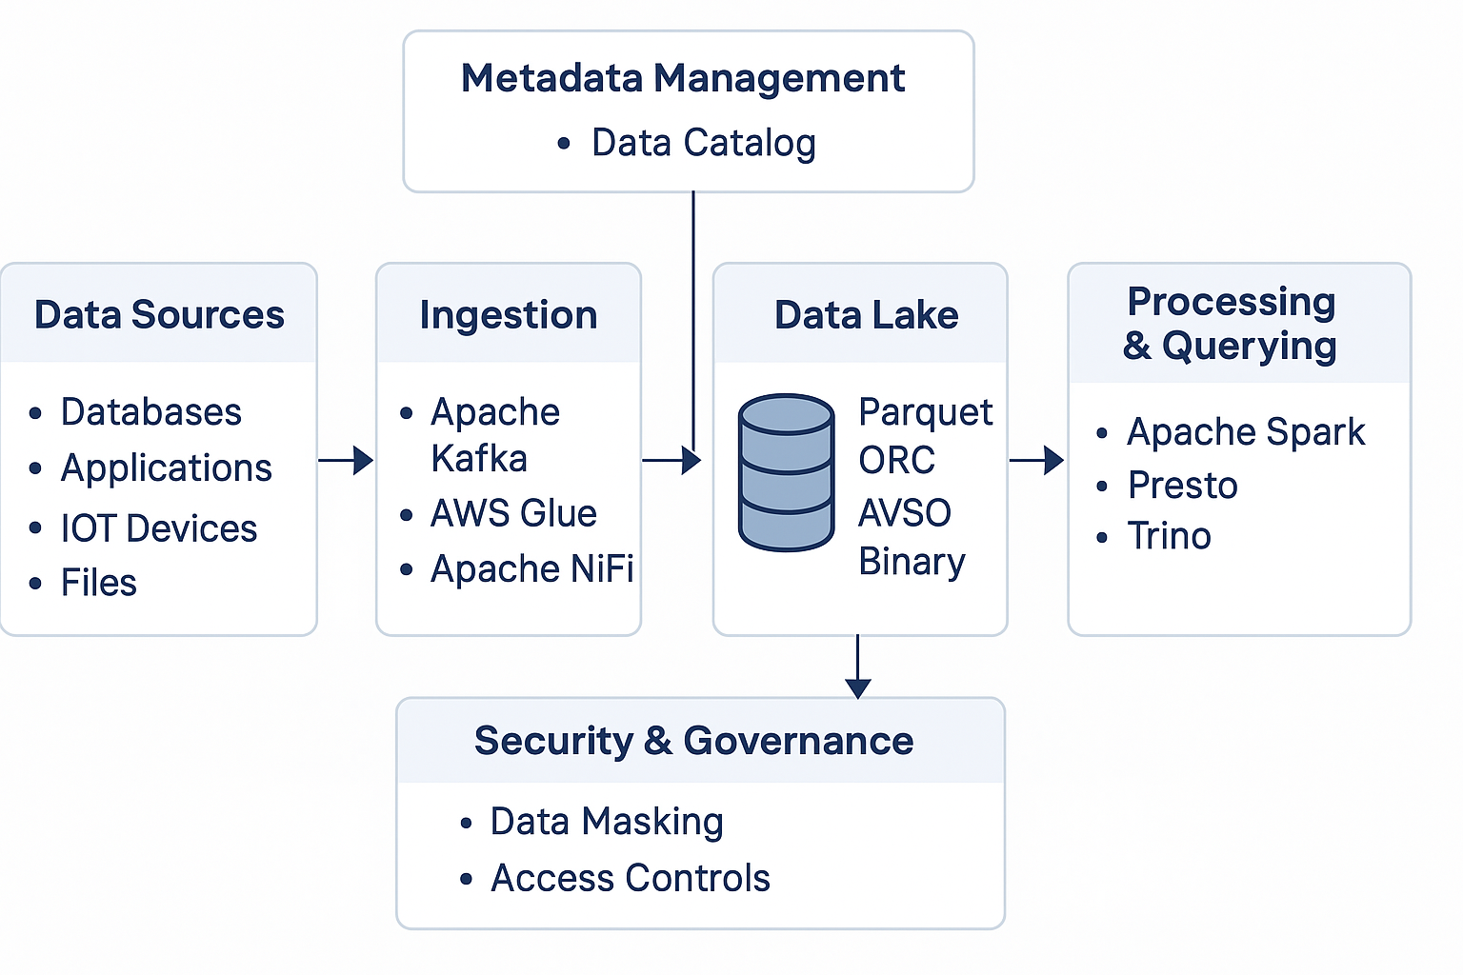
Architecture

Slide 13
Characteristics of a Data Lake
Feature | Description
Stores any data | Raw logs, CSVs, JSON, videos, sensor data, etc.
Schema-on-read | You define the structure when reading, not when storing
Scalable | Grows with your data, supports petabyte scale
Cost-effective | Store cheaply using object storage (e.g., S3, Azure Blob)
Flexible | Good for AI/ML, analytics, reporting, or archiving

Slide 14
Components of a Data Lake
Layer | Role
Storage | S3, HDFS, Azure Blob, GCS
Ingestion | Kafka, Apache NiFi, AWS Glue
Processing | Apache Spark, Flink, dbt, EMR
Cataloging | Hive Metastore, AWS Glue Catalog, Apache Atlas
Querying | Presto, Trino, Athena, Dremio
Security | IAM, lakeFS, encryption, data masking

Slide 15
Advantages of Data Lakes
Data Exploration and Discovery
Scalability
Cost-Effectiveness
Flexibility and Agility
Advanced Analytics

Slide 16
Challenges of Data Lakes
Data Quality
Security Concerns
Metadata Management
Integration Complexity
Skill Requirements

Slide 17
Hands on
Create Delta tables with versioning
Perform schema evolution
Use Time Travel with Delta Lake
Query raw CSV/JSON data using Spark
Do simple ETL: read → transform → write
Partition and optimize datasets

Slide 18
Data Warehouse vs. Data Lake
Features | Data Warehouse | Data Lake
Data Type | Primarily structured data | Structured, semi-structured and unstructured data
Storage Method | Optimized for structured data with predefined schema | Stores data in its raw, unprocessed form
Scalability | Limited scalability due to structured data constraints | Highly scalable, capable of handling massive data volumes
Cost Efficiency | Can be costly for large datasets due to structured storage | Cost-effective due to flexible storage options like object storage
Data Processing Approach | Schema-on-write (data must be structured before ingestion) | Schema-on-read (data is stored in raw form, schema applied during analysis)
Performance | Optimized for fast query performance on structured data | Can be slower due to raw, unprocessed data

Slide 19
Data Mart
A data mart is a specialized subset of a data warehouse focused on a specific functional area or department within an organization.
It’s optimized for fast access and specific analytics needs rather than storing all enterprise data.

Slide 20
Purpose of a Data Mart
Feature | Description
Targeted | For one team/function (sales, HR, etc.)
Fast | Smaller data = faster queries
Simpler | Easier to model & maintain than a full warehouse
Secure | Limits sensitive data access to the right people

Slide 21
Types of Data Marts
Type | Description
Dependent | Built from a central data warehouse (ETL pulls from there)
Independent | Built directly from source systems (no central warehouse)
Hybrid | Mix of both methods

Slide 22
Feature | Data Lake | Data Warehouse | Data Mart
Purpose | Store all data (raw & processed) | Store structured data for analysis | Store department-specific data
Data Types | Structured, semi-structured, unstructured | Mostly structured | Structured
Users | Data scientists, engineers | Business analysts, BI users | Specific departments (e.g., Sales)
Size & Scope | Enterprise-wide, huge scale | Enterprise-wide but curated | Limited to a department or team
Storage Cost | Lower (cheap storage like S3/HDFS) | Higher (optimized for performance) | Lower to moderate
Speed | Slower querying | Fast, optimized queries | Very fast (smaller data sets)
Schema | Schema-on-read | Schema-on-write | Schema-on-write
ETL Process | ELT (transform later) | ETL (transform before loading) | Derived from warehouse or sources
Examples | Amazon S3 + Delta Lake, Hadoop | Amazon Redshift, Snowflake, BigQuery | Sales Mart, Marketing Mart

Slide 23
Real-World Analogy
Data Lake | Like a big raw materials warehouse — store everything from logs to images, no matter the format.
Data Warehouse | Like a refined product inventory — only clean, structured data for analytics.
Data Mart | Like a mini shop inside the warehouse just for one team, like sales or HR.

Slide 24
Apache Iceberg
Apache Iceberg is an open table format for huge analytic datasets.
It's designed to work on data lakes and support features usually found only in databases.

Slide 25
Apache Iceberg
Feature | Description
ACID Transactions | Safe concurrent reads/writes
Time Travel | Query old versions of data
Schema Evolution | Change schema without breaking things
Partition Evolution | Update partition strategy without rewriting data
Hidden Partitioning | Simplifies partitioning logic for users

Slide 26
Apache Kafka
Apache Kafka is a distributed event streaming platform used to:
Ingest real-time data
Process and analyze streams
Build data pipelines and event-driven apps

Slide 27
How Kafka Works
Producer | Sends (publishes) messages to Kafka
Consumer | Reads (subscribes to) messages from Kafka
Topic | Named stream where messages are sent and stored
Partition | A topic is split into partitions to parallelize data
Broker | Kafka server that stores data and serves clients
Cluster | Group of brokers working together
Offset | Position of a message in a partition (like a message ID)

