Slide 1
Grafana & Prometheus
Palani Karthikeyan

Slide 2
DAY-1
Introduction about Grafana
Other Visualization tools – Overview
Grafana - Setup
Unit (or) service file & Grafana server daemon
Dash board setup
Grafana - features
Grafana panels
Deep dive into Grafana
Time series database
Influx DB with Grafana integration

Slide 3
DAY-2
Importing & Exporting Dashboards
Using variable - Dynamic Dash board creations
Annotations & alert
Administration
Grafana CLI
Plugin and admin commands

Slide 4
DAY-3
Introduction to Prometheus
Prometheus Installation
Basic Concepts
Prometheus Configuration
Monitoring Nodes (Servers) with Prometheus
Prometheus Architecture
Expression Browser
Client Libraries

Slide 5
DAY-4
Prom QL
Prom QL operations and Functions
Recording Rules
Scraping Pull and Pushing monitoring
Node Exporters
Service discovery
Introduction to Alerting
Alert Manager
Alerting Rules
Setting up Alerts

Slide 6
DAY-5
Prometheus internals
Prometheus Targets

Slide 7
Grafana
Grafana is an open-source data visualization and analysis tool which allows us to view our data in the form of beautiful graphs.
Grafana designed by Torkel Odegaard in January 2014.

Slide 8
Grafana
It enables us to create a dashboard for collecting, processing, storing, and analyzing data from various different sources.
It allows us to query, visualize, alert on, and understand our metrics.

Slide 9
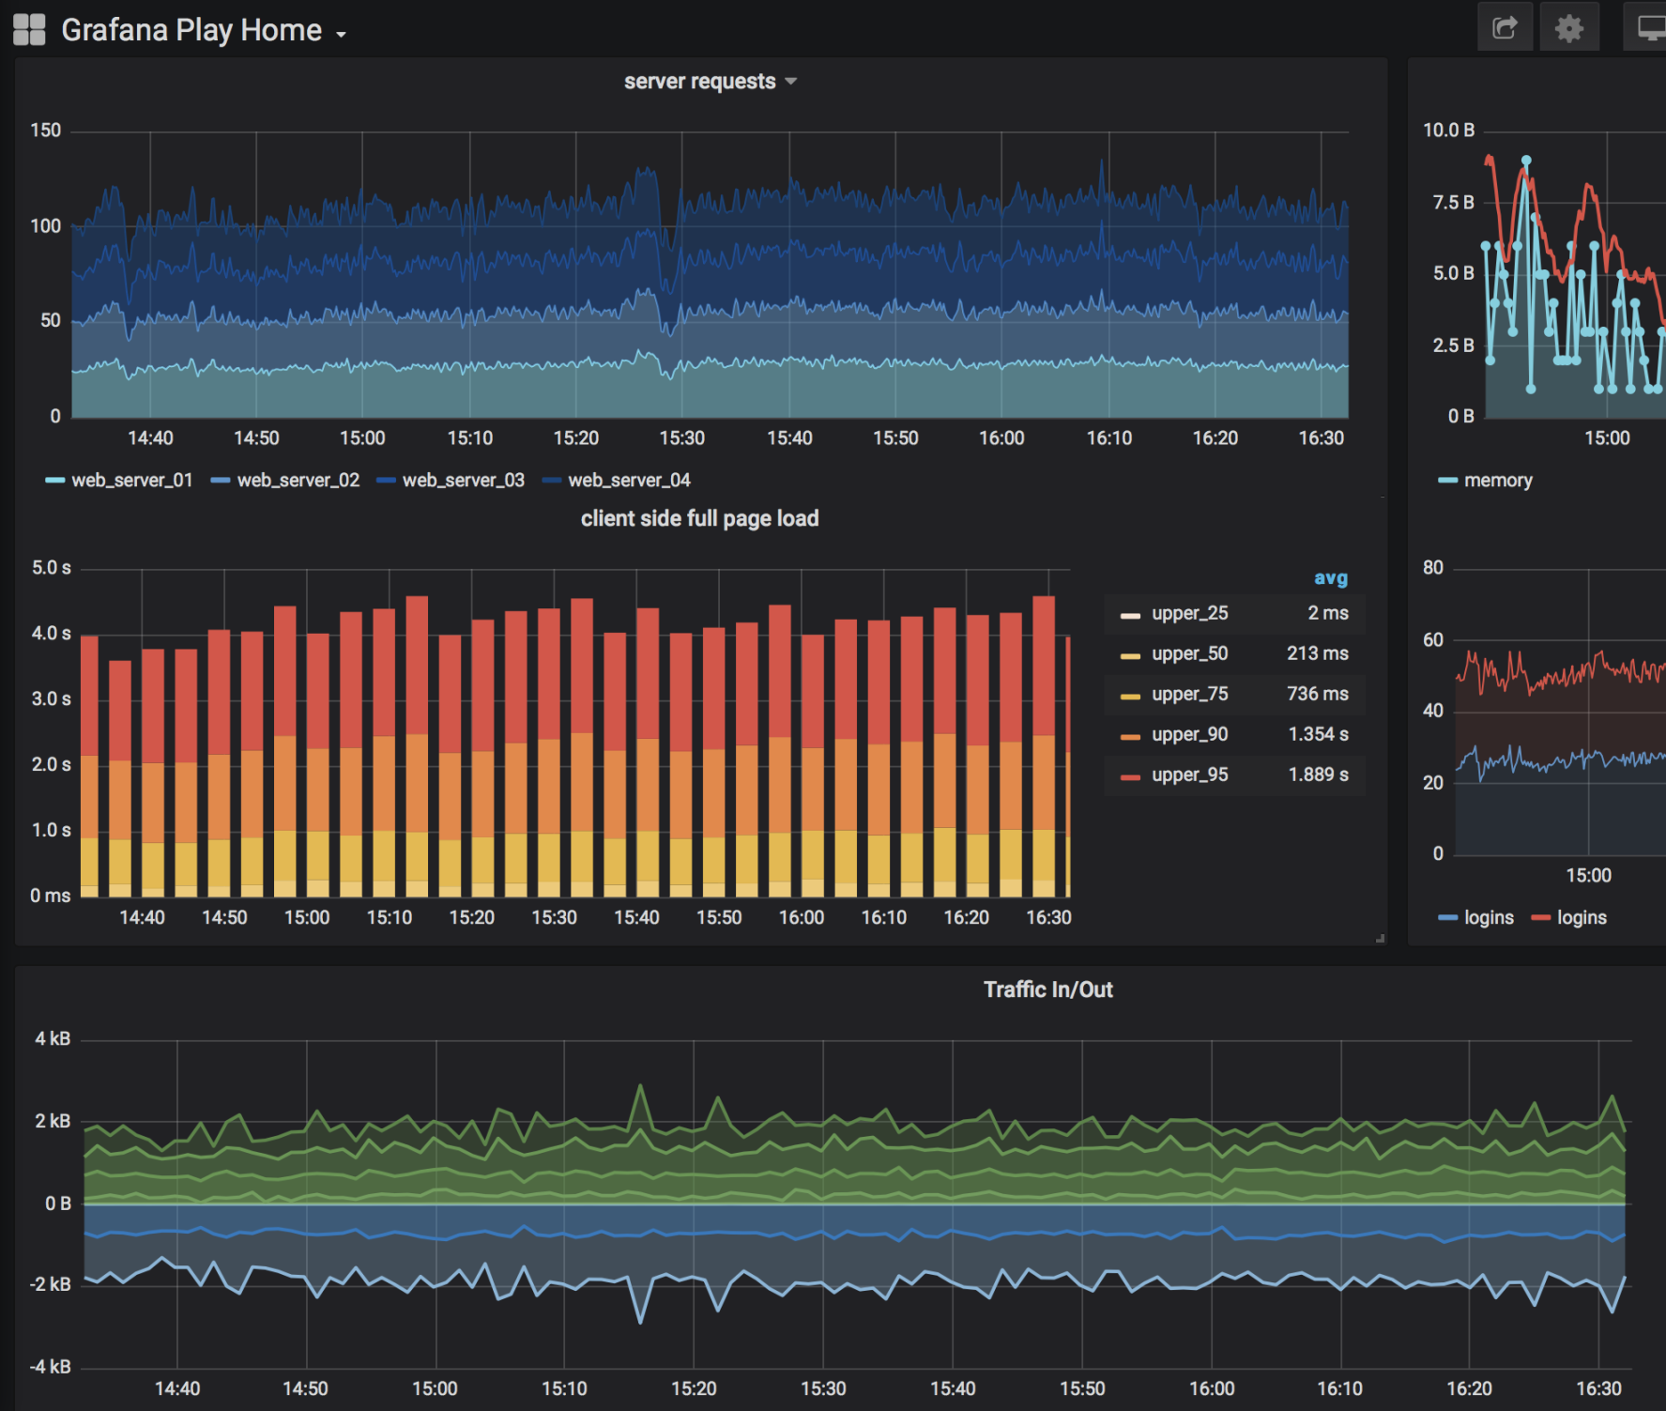

Slide 10
Grafana
It includes a variety of visualization option that helps us to understand our data, beautifully.
Grafana is written in Go and Node.js LTS language with a strong API (Application Programming Interface).

Slide 11
Grafana Dashboard
Grafana Dashboard is used to pull data from various data sources such as Prometheus, Influx DB, Graphite, ElasticSearch, MySQL, PostgreSQL, CloudWatch, Microsoft SQL Server, and many more.
A Grafana Dashboard contains various visualization options such as heat maps, geomaps, histograms, tables, free text panels, and different types of charts & graphs to study and understand business data easily.

Slide 12
Why Grafana?
Easy virtualization
Drag and Drop panels
Flexible to use
Supports different data source
Open source
Multi-platform support

Slide 13
Features of Grafana
Plugins Platform
Transformation
Dynamic Dashboards
Authentication
Explore metrics and Logs
Alerting
Annotations
Mixed data sources

Slide 14
Installing Grafana
To download the latest versions of Grafana, check out https://grafana.com/grafana/download

Slide 15
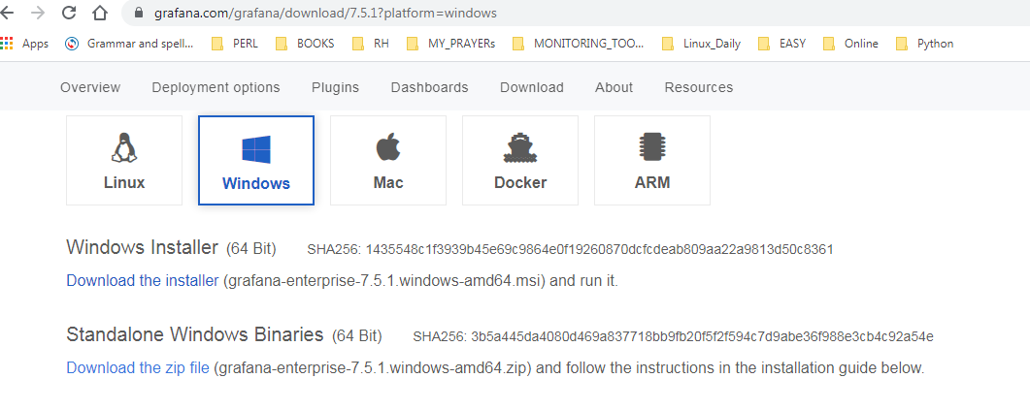
Install Grafana on Windows

Slide 16
Step 1: Go to any web browser, copy-paste the below link, or simply click on the below link.
https://grafana.readthedocs.io/en/latest/sources/installation/windows.html
Step 2: Once the link is opened, the below window appears on the screen, in which click on the grafana.4.4.1.windows-x64.zip.

Slide 17
Connecting to the Grafana server
Once you have installed and launched Grafana, open a browser page to access
the Grafana application. It can be found at http://localhost:3000

Slide 18
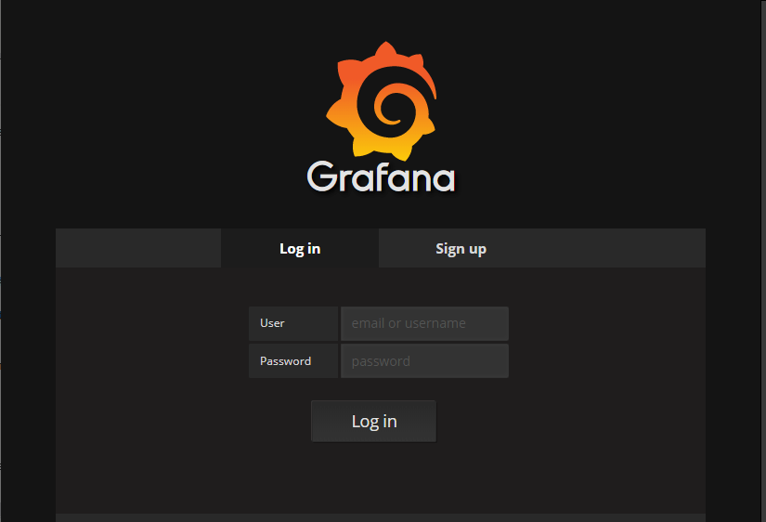
Log in with the admin username and the admin password

Slide 19
Grafana User Interface
The default Home dashboard
The sidebar menu.
Navigation hub, providing both quick access to simple creation pages and links to more complex functions, including data source creation, Explore mode, alert management, and server administration.

Slide 20
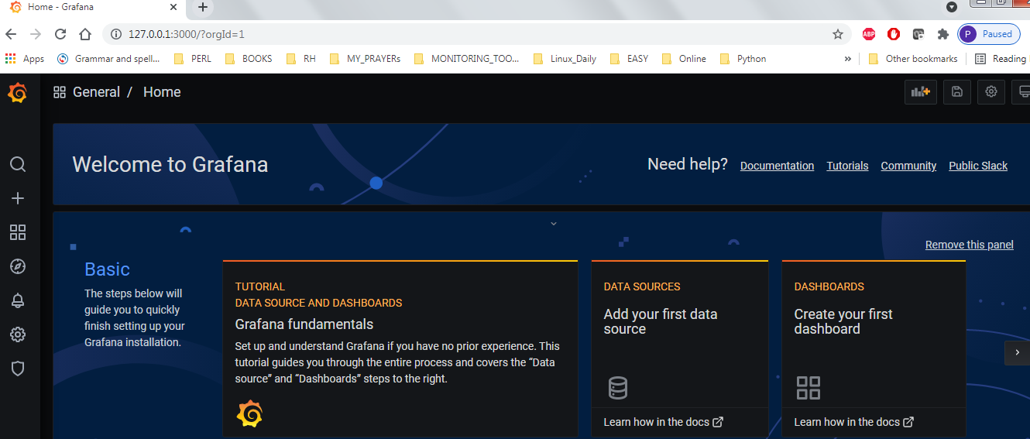

Slide 21
Grafana's left sidebar
To the left of the dashboard itself is the left sidebar.
These icons lead to some of the most powerful of Grafana's impressive features.
Search for dashboards
Create and import dashboards and folders
Find dashboards
Manage dashboards, dashboard playlists, and dashboard snapshots
Explore data sources in a free-form fashion
Manage alert rules and notification channels
Configure data sources, users, and teams, download plugins, set
preferences, and generate API keys
Administer Grafana users and organizations and view the server
settings and stats
Return to the Home dashboard
Set personal preferences
Get help
Notes:
Search for dashboards
Create and import dashboards and folders
Find dashboards
Manage dashboards, dashboard playlists, and dashboard snapshots
Explore data sources in a free-form fashion
Manage alert rules and notification channels
Configure data sources, users, and teams, download plugins, set
preferences, and generate API keys
Administer Grafana users and organizations and view the server
settings and stats
Return to the Home dashboard
Set personal preferences
Get help

Slide 22

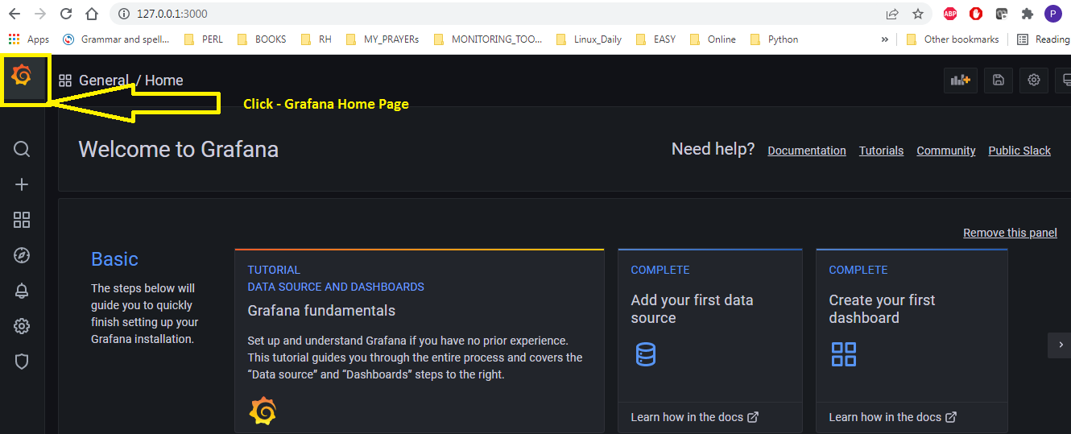
1
The Grafana logo

Slide 23
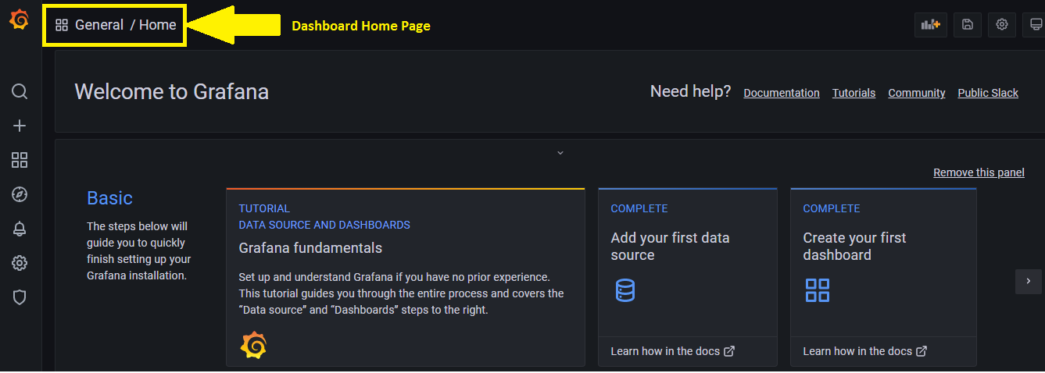
2

Slide 24
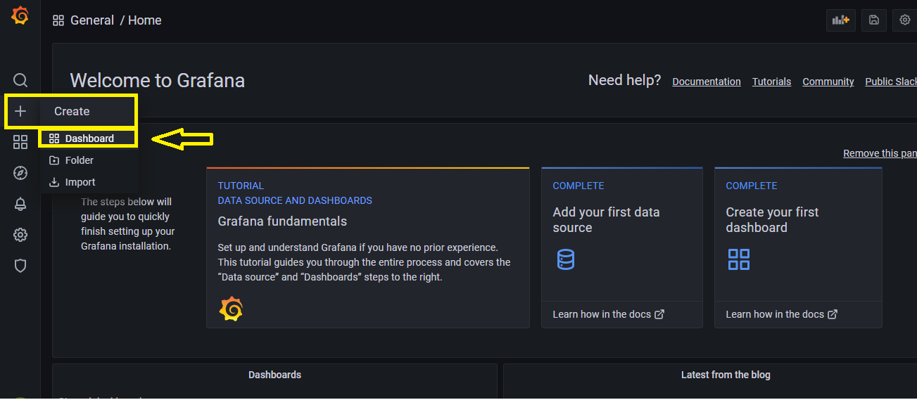
3

Slide 25
The panel's UI
The panel's UI can be broken down into roughly three main functional areas:
1. Panel display: Preview display, and time picker
2. Display settings: Panel visualization type, styles, and links
3. Data configuration: Data query, data transformation, and alerting

Slide 26
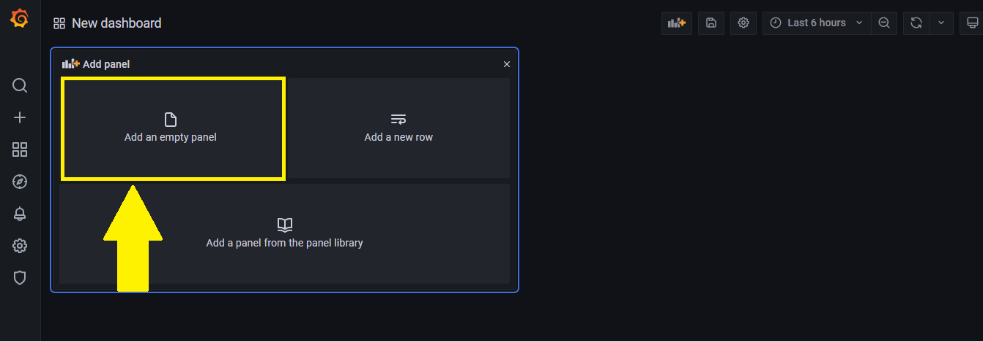
4

Slide 27
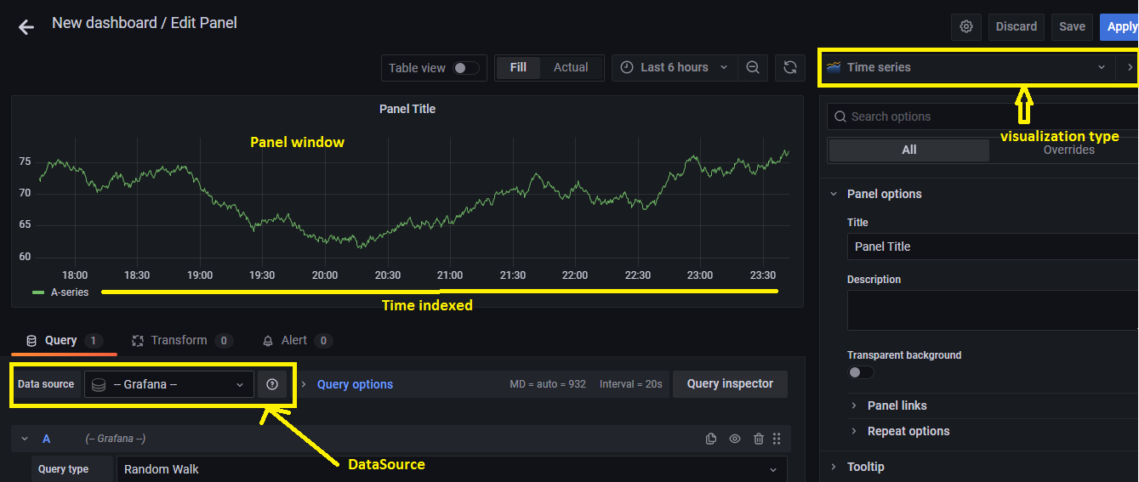
5

Slide 28
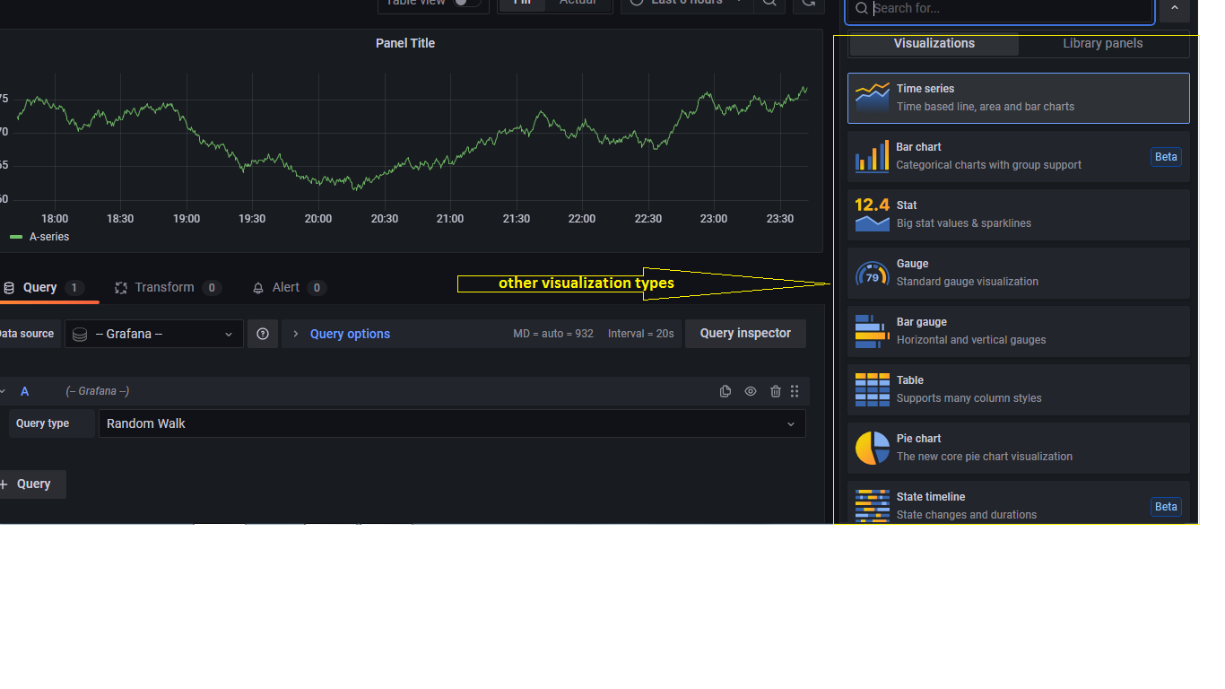
6

Slide 29
Dashboard
A dashboard is a kind of canvas upon which you can display one or more panels in a grid style arrangement.
It also serves as a web page, so you can bookmark or share it with a simple URL.
The entire dashboard can even be imported and exported in JSON text file format, making it easy to share, save, or transfer to another version of Grafana.

Slide 30
Unit (or) service file & Grafana server daemon
Windows: grafana-server.exe
Linux : grafana-server.service file
sudo systemctl daemon-reload
sudo systemctl start grafana-server
sudo systemctl status grafana-server
Configure the Grafana server to start at boot:
sudo systemctl enable grafana-server.service

Slide 31
Data Source
Grafana works with data, which must be stored in a database before it can be accessed by Grafana.
There are several different kinds of databases.
Additionally, some other systems can be used to store data, even though their main purpose is not focused on data storage.
A Grafana data source is any place from which Grafana can pull data.

Slide 32
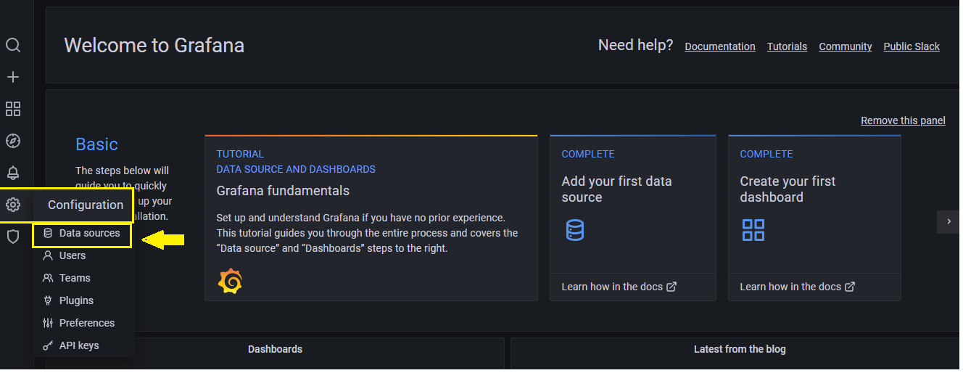
How to add a data source in Grafana

Slide 33
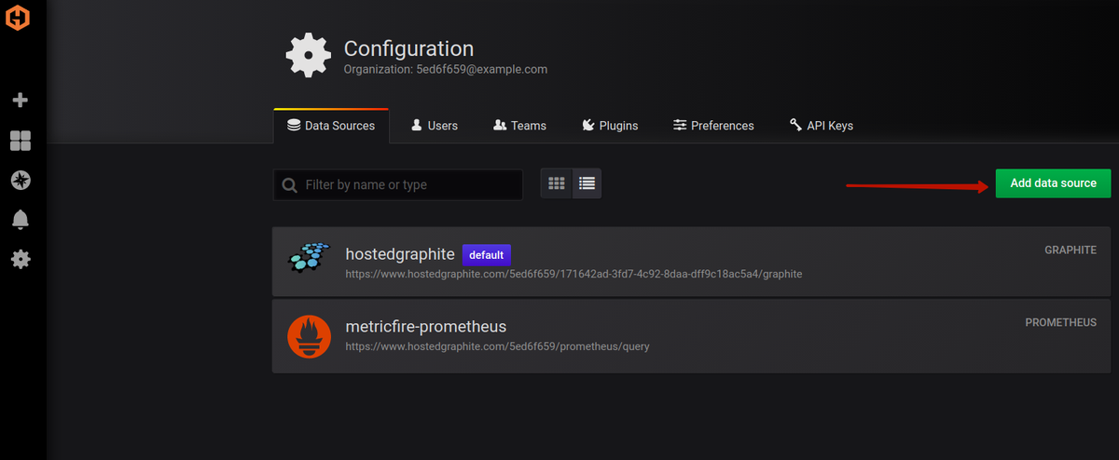
When you click the Add data sources button, you will see the list of officially supported data sources available for connection

Slide 34
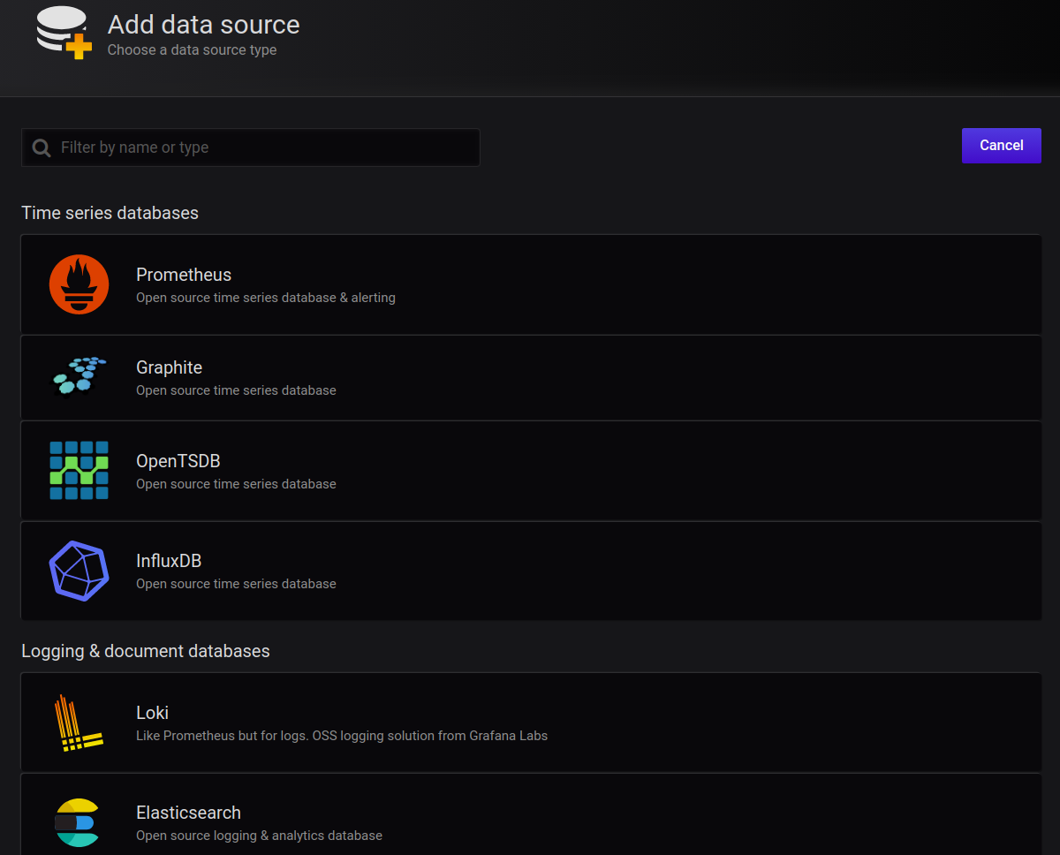

Slide 35
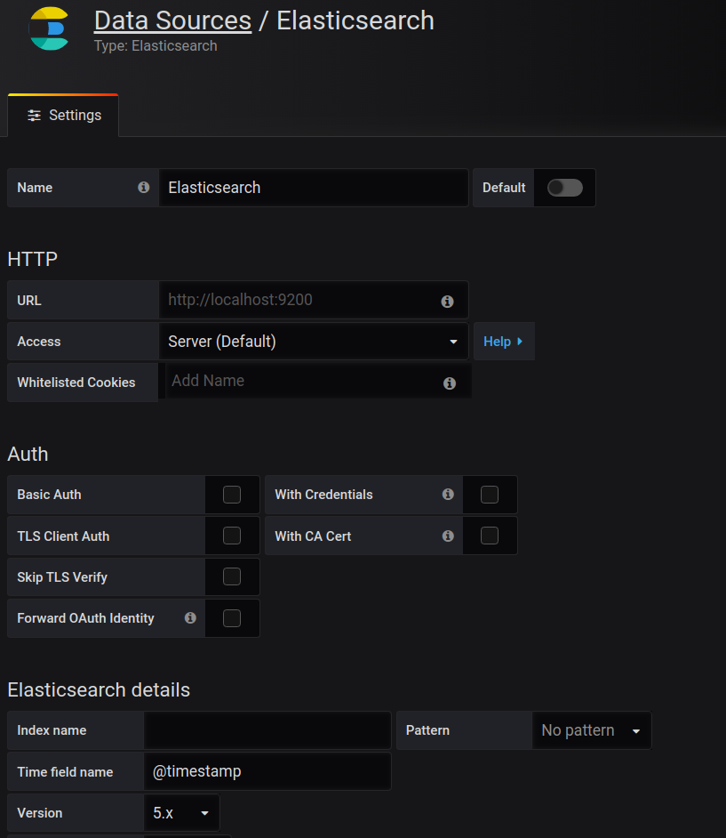

Slide 36
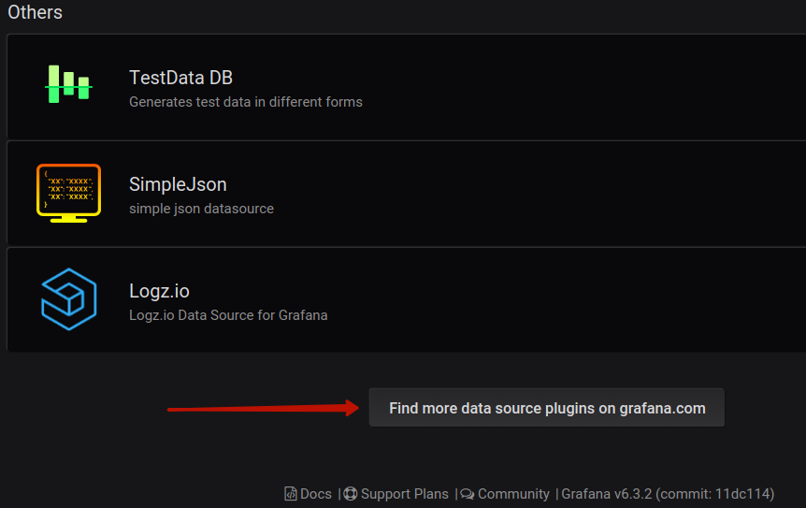
Installing third-party data sources

Slide 37
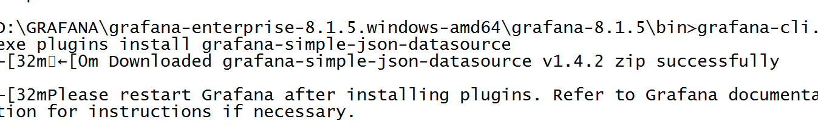
grafana-cli

Slide 38
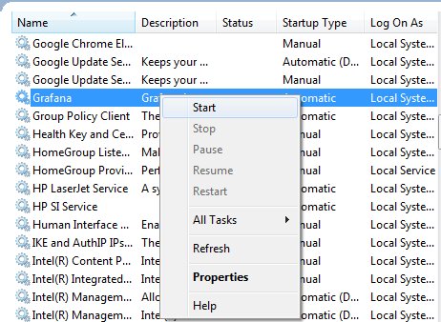

Slide 39
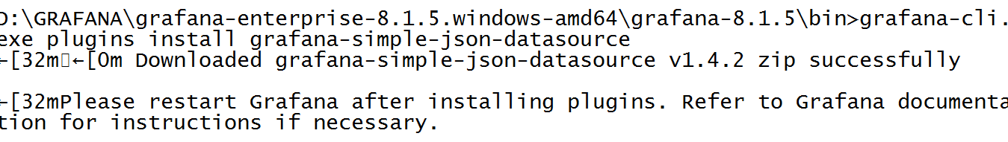

Slide 40
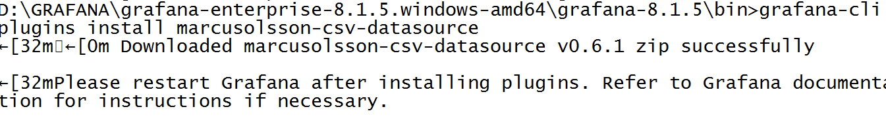

Slide 41
Time series
A time series database (TSDB) is a software system that is optimized for storing and serving time series through associated pairs of time(s) and value(s).
Time series datasets are relatively large and uniform compared to other datasets―usually being composed of a timestamp and associated data.

Slide 42
Time series
A Time Series Database is a database that contains data for each point in time.
.Time series data mean measurements or events that are tracked, monitored, collected, or aggregated over a period of time.
These could be data collected from heartbeats of motion tracking sensors, JVM metrics from the java applications, market trade data, network data, API responses, process uptime, etc

Slide 43
How Does a Time Series Database Work?
TSDBs work by capturing a set of fixed values along with a set of dynamic values.
Time series data is useful for tracking trends.
These records are written to a storage medium in a format that allows fast time-based reads and writes.

Slide 44
Examples-Time series data base(TSDB)
Influxdb
Timescaledb
openTSDB
Graphite
Prometheus

Slide 45
InfluxDB
InfluxDB is one of the most popular time series databases among DevOps, which is written in Go.
InfluxDB was designed from the ground up to provide a highly scalable data ingestion and storage engine.
It is very efficient at collecting, storing, querying, visualizing, and taking action on streams of time series data, events, and metrics in real-time.

Slide 46
Influxdata is a platform for storing, collecting, visualizing and managingtime-series data.
$ influx
Connected to http://localhost:8086 version 0.13.x
InfluxDB shell 0.13.x>

Slide 47
Features
High performance for time series data with high throughout ingest and real-time querying
InfluxQL to interact with data which is a SQL like a query language
Core component of the TICK (Telegraf, InfluxDB, Chronograf, and Kapacitor) stack.
Plugin support for protocols such as collectd, Graphite, OpenTSDB for data ingestion
Can handle millions of data points in just 1 second
Retention policies for automatically removing the stale data

Slide 48
To create a database
create database mydb
To view the list of all databases
show databases
To use a particular database
use mydb

Slide 49
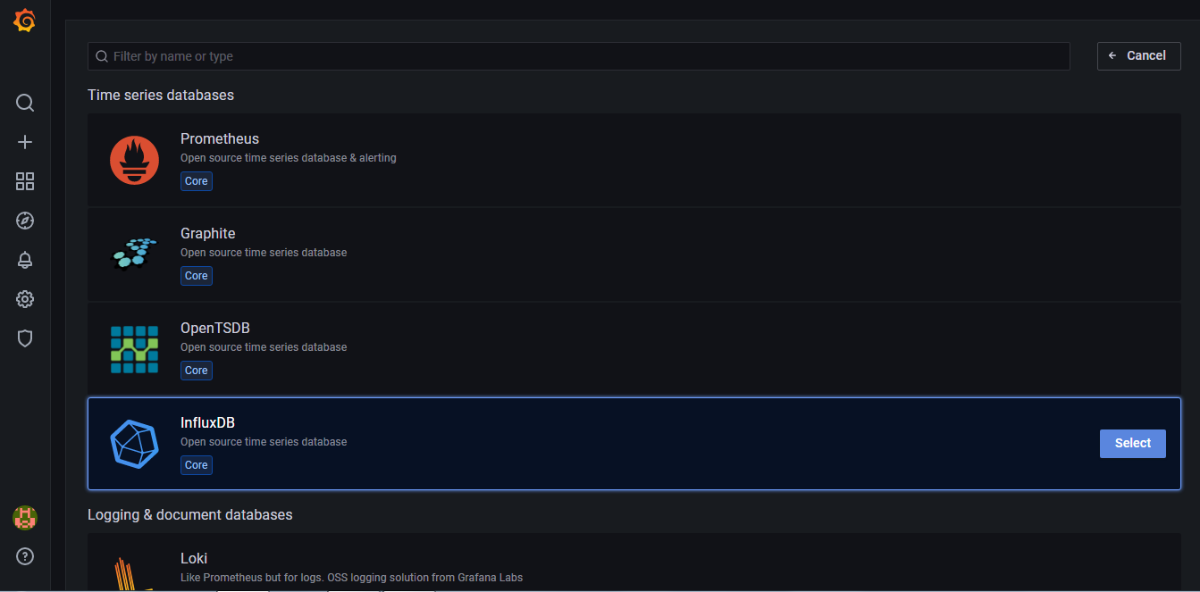
Influx DB with Grafana integration

Slide 50
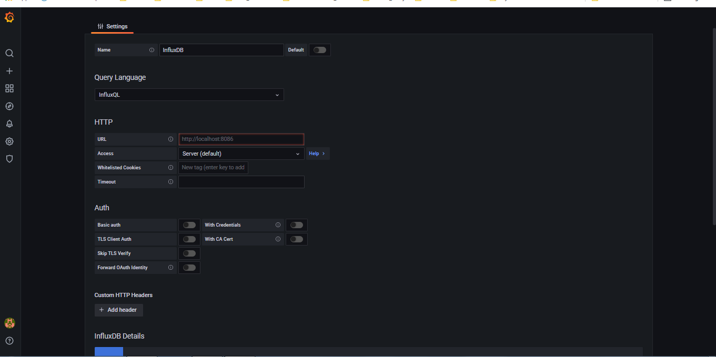

Slide 51
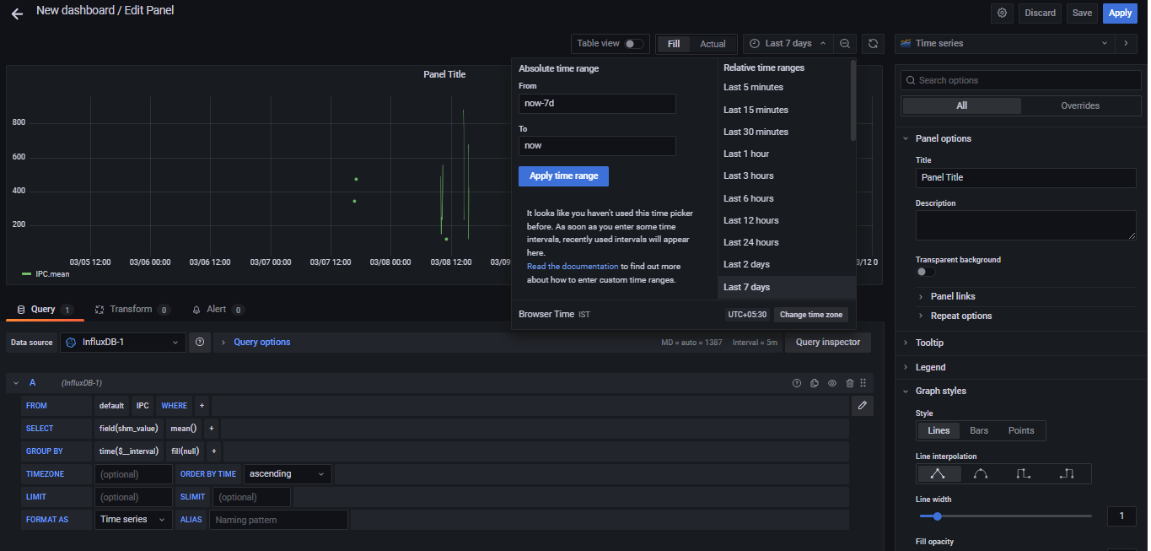

Slide 52
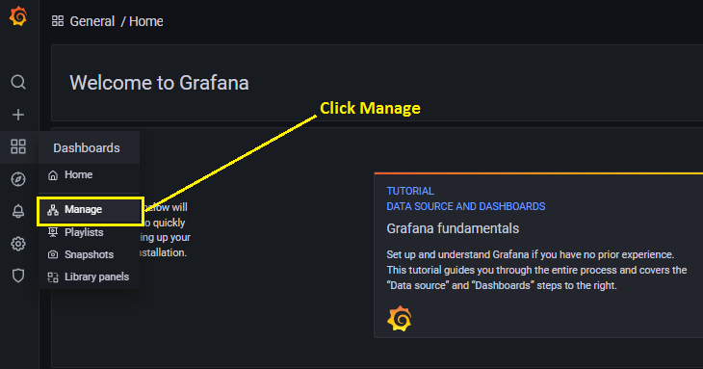
How to list out Dashboards?

Slide 53
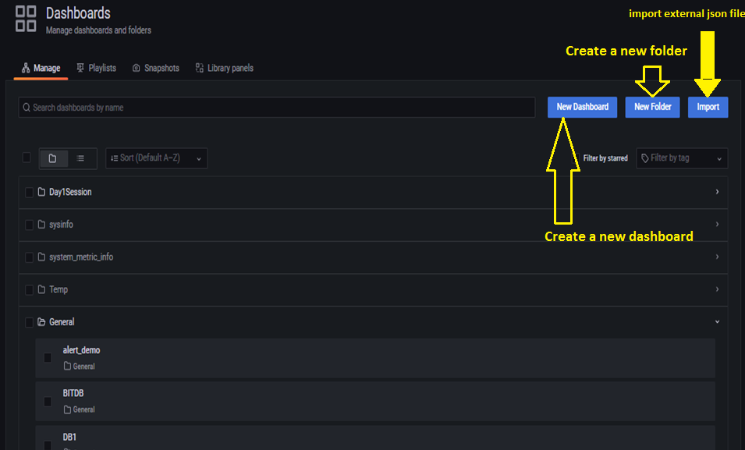

Slide 54
Grafana-Playlist
https://grafana.com/docs/grafana/latest/http_api/playlist/

Slide 55
Share a dashboard
share a dashboard as a direct link or as a snapshot.
To share a dashboard:
Go to the home page of your Grafana instance.
Click on the share icon in the top navigation. The share dialog opens and shows the Link tab.

Slide 56
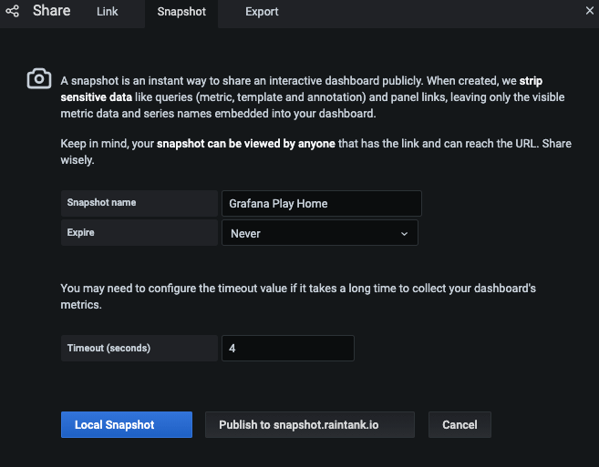

Slide 57
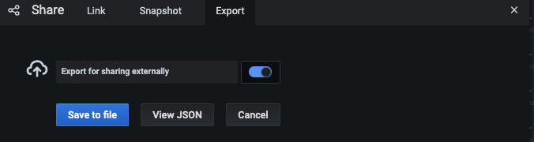
Dashboard export

Slide 58
Share a panel
share a panel as a direct link, as a snapshot or as an embedded link.
create library panels using the “Share” option for any panel.

Slide 59
To share a panel
Click a panel title to open the panel menu.
Click Share. The share dialog opens and shows the Link tab.

Slide 60
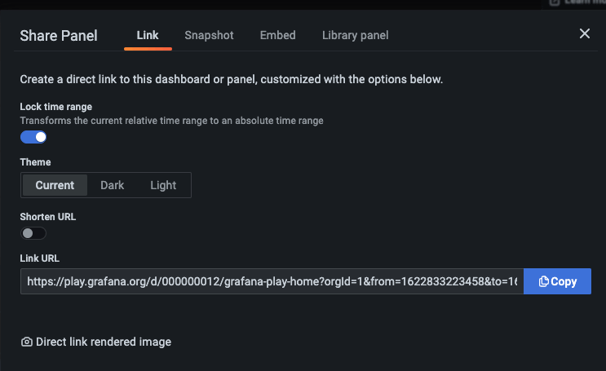

Slide 61
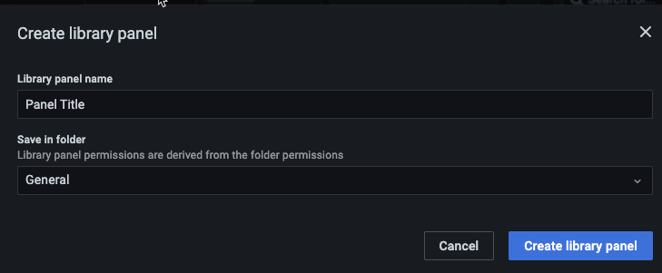
Library panel
Click Library panel.
In Library panel name, enter the name.
In Save in folder, select the folder to save the library panel. By default, the General folder is selected.
Click Create library panel to save your changes.
Save the dashboard.

Slide 62
Grafana alerts
Alerts allow you to learn about problems in your systems moments after they occur.
Grafana 8.0 introduced new and improved alerting that centralizes alerting information in a single, searchable view. It allows you to:
Create and manage Grafana alerts
Create and manage Cortex and Loki managed alerts
View alerting information from Prometheus and Alertmanager compatible data sources

Slide 63
Grafana alerting has four key components
Alerting rule - Evaluation criteria that determine whether an alert will fire. It consists of one or more queries and expressions, a condition, the frequency of evaluation, and optionally, the duration over which the condition is met.
Contact point - Channel for sending notifications when the conditions of an alerting rule are met.
Notification policy - Set of matching and grouping criteria used to determine where and how frequently to send notifications.
Silences - Date and matching criteria used to silence notifications.

Slide 64
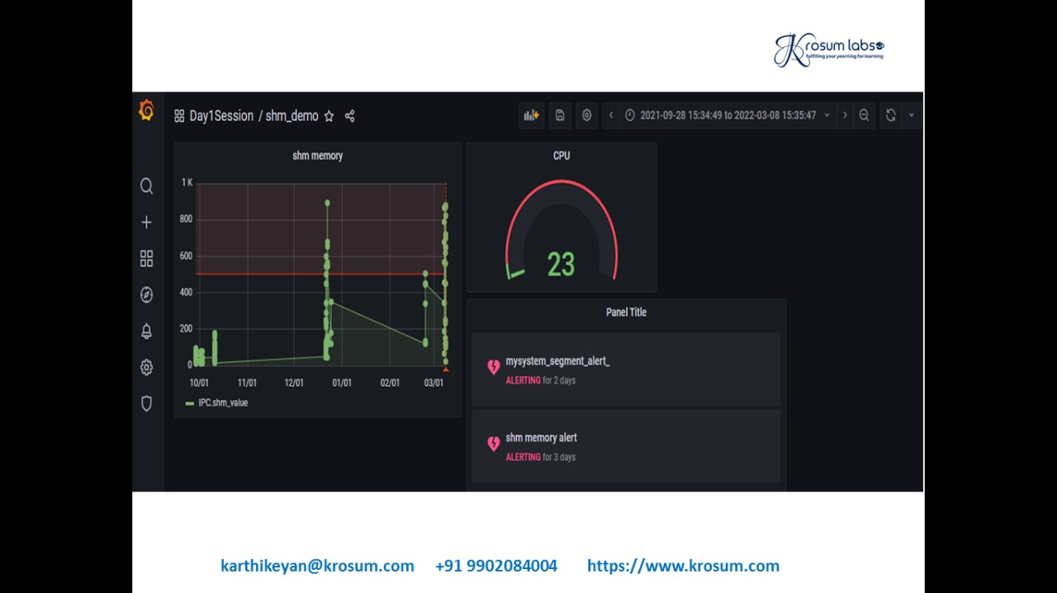

Slide 65
Grafana-Variables
A variable is a placeholder for a value.
We use variables in metric queries and in panel titles.
Variables allow you to create more interactive and dynamic dashboards.
Variables are displayed as dropdown lists at the top of the dashboard.

Slide 66
Grafana-Variables
These dropdowns make it easy to change the data being displayed in your dashboard.
Grafana viewers to quickly adjust visualizations but do not want to give them full editing permissions.
Grafana Viewers can use variables.

Slide 67
Grafana-Variables
Variable values are always synced to the URL using the syntax
var-<varname>=value.

Slide 68
Grafana-variables
To see variable settings, navigate to Dashboard Settings > Variables.
Click a variable in the list to see its settings.
Variables can be used in titles, descriptions, text panels, and queries.
Queries with text that starts with $ are templates.

Slide 69
Variable types
There are three different types of Template variables:
Query
Custom
Interval
Notes:
Query
------
Query is the most common type of Template variable. Use the Query template type to generate a dynamic list of variables, simply by allowing Grafana to explore your Data Source metric namespace when the Dashboard loads.
For example a query like prod.servers.* will fill the variable with all possible values that exists in that wildcard position (in the case of the Graphite Data Source).
You can even create nested variables that use other variables in their definition. For example apps.$app.servers.* uses the variable $app in its own query definition.
You can utilize the special All value to allow the Dashboard user to query for every single Query variable returned. Grafana will automatically translate All into the appropriate format for your Data Source.
Interval
----------
Interval
Use the Interval type to create Template variables around time ranges
(eg. 1m,1h, 1d).
There is also a special auto option that will change
depending on the current time range,
you can specify how many times the current time range
should be divided to calculate the current auto range.
Custom
--------
Use the Custom type to manually create Template variables
around explicit values that are hard-coded
into the Dashboard, and not dependent on any Data Source.

Slide 70
Variable-examples
https://grafana.com/docs/grafana/latest/variables/variable-examples/

Slide 71
Grafana Loki
Grafana Loki is a set of components that can be composed into a fully featured logging stack.
Unlike other logging systems, Loki is built around the idea of only indexing metadata about your logs: labels (just like Prometheus labels).
Log data itself is then compressed and stored in chunks in object stores such as S3 or GCS, or even locally on the filesystem.
A small index and highly compressed chunks simplifies the operation and significantly lowers the cost of Loki.

Slide 72
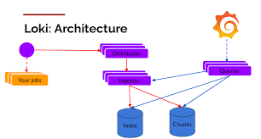
Loki architecture

Slide 73
General process
Download and install both Loki and Promtail.
Download config files for both programs.
Start Loki.
Update the Promtail config file to get your logs into Loki.
Start Promtail.

Slide 74
A Loki-based logging stack consists of 3 components
promtail is the agent, responsible for gathering logs and sending them to Loki.
loki is the main server, responsible for storing logs and processing queries.
Grafana for querying and displaying the logs.

Slide 75
Installing Loki and Promtail
wget https://raw.githubusercontent.com/grafana/loki/master/cmd/loki/loki-local-config.yaml
./loki-linux-amd64 -config.file=loki-local-config.yaml
./promtail-linux-amd64 -config.file=promtail-local-config.yaml

Slide 76
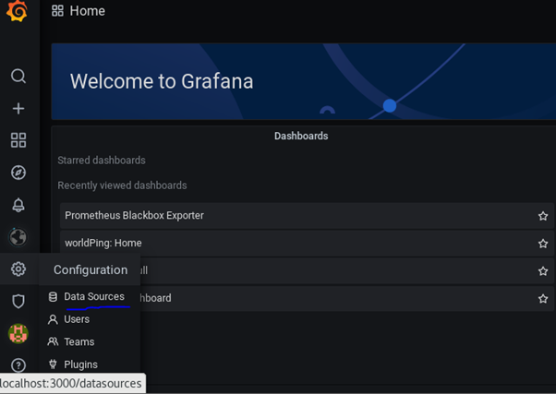
Visualize Log using Loki and Grafana
Step 1: Go to Grafana Configurations and Click on “Data Sources”.

Slide 77
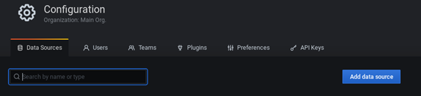
Step 2: In Data Sources, you can search the source by name or type.

Slide 78
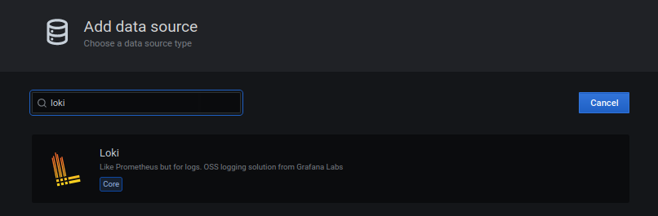
Step 3: Search by the name Loki.

Slide 79
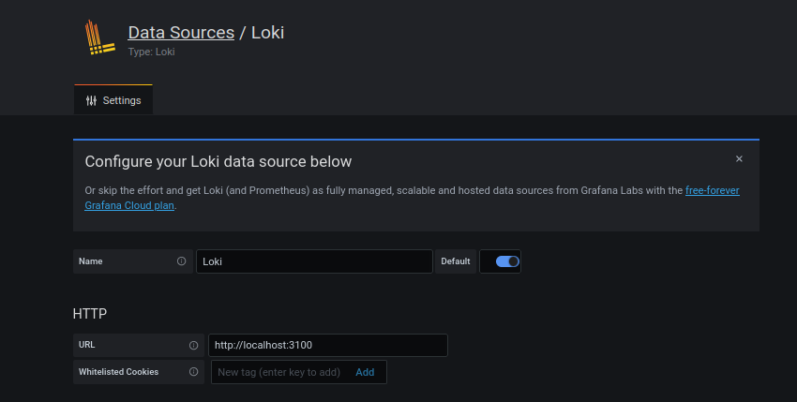
Step 4: Enter the name you want to give to the data source and put http://localhost:3100 (change this to server IP if Loki is running on a different server than Grafana) in the URL because we have started Loki on port 3100

Slide 80
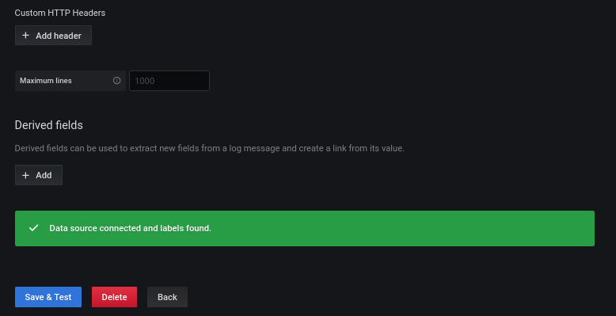

Slide 81
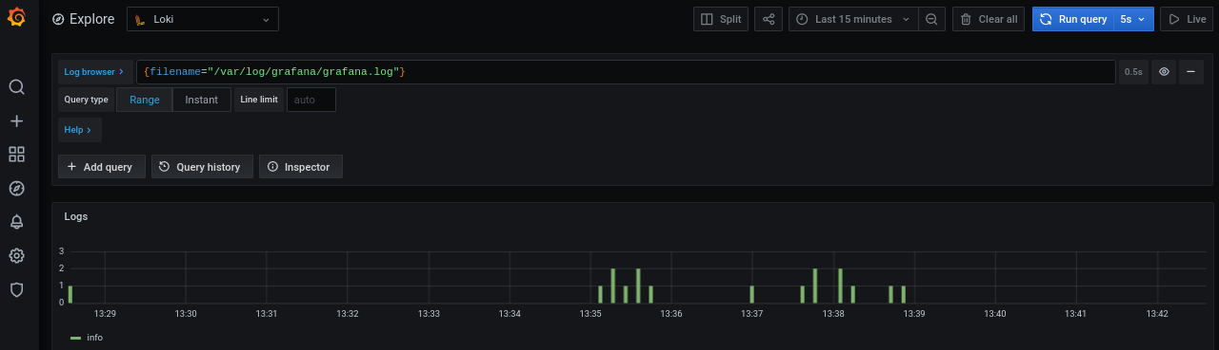

Slide 82
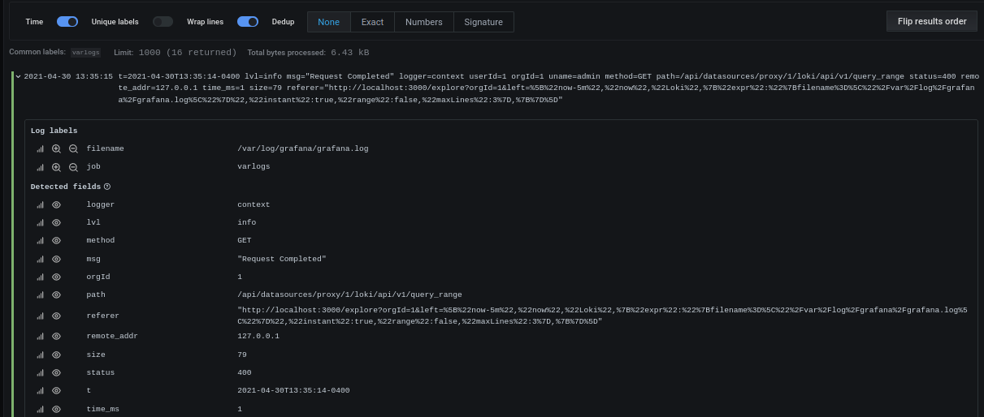

Slide 83
END – DAY1 & DAY2

