Slide 1
Prometheus & Grafana Loki

Slide 2
Prometheus
Prometheus is an open source, metrics-based monitoring system.
Prometheus is primarily written in Go and licensed under the Apache 2.0 license.
In 2016 the Prometheus project became the second member of the Cloud Native Computing Foundation (CNCF).

Slide 3
Monitoring
Alerting
Debugging
Trending

Slide 4
Categories of Monitoring
Receiving a HTTP request
Sending a HTTP 400 response
Entering a function
Reaching the else of an if statement
Leaving a function
A user logging in
Writing data to disk
Reading data from the network
Requesting more memory from the kernel

Slide 5
A simple text format makes it easy to expose metrics to Prometheus.
For instrumenting your own code, there are client libraries in all the popular languages and runtimes, including Go, Java/JVM, C#/.Net, Python, Ruby, Node.js, Haskell, Erlang, and Rust.

Slide 6
A simple text format makes it easy to expose metrics to Prometheus.
The data model identifies each time series not just with a name, but also with an unordered set of key-value pairs called labels.
The PromQL query language allows aggregation across any of these labels, so you can analyse not just per process but also per datacenter and per service or by any other labels that you have defined.

Slide 7
Prometheus ­ main features
A multi­dimensional data model with time series data identified by metric name and key/value pairs.
A flexible query language to leverage this dimensionality.
No reliance on distributed storage; single server nodes are autonomous.

Slide 8
Prometheus ­ main features
Time series collection happens via a pull model over HTTP
Targets are discovered via service discovery or static configuration
Pushing time series is supported via an intermediary gateway.
Multiple modes of graphing and dashboarding support

Slide 9
Prometheus ­ main components
The Prometheus server which scrapes and stores time series data.
Client libraries for instrumenting application code.
The Alertmanager.
A push gateway for supporting short­lived jobs (optional)

Slide 10
Prometheus ­ data model
Prometheus fundamentally stores all data as time series: streams of time stamped values belonging to the same metric and the same set of labeled dimensions.
Besides stored time series, Prometheus may generate temporary derived time series as the result of queries.

Slide 11
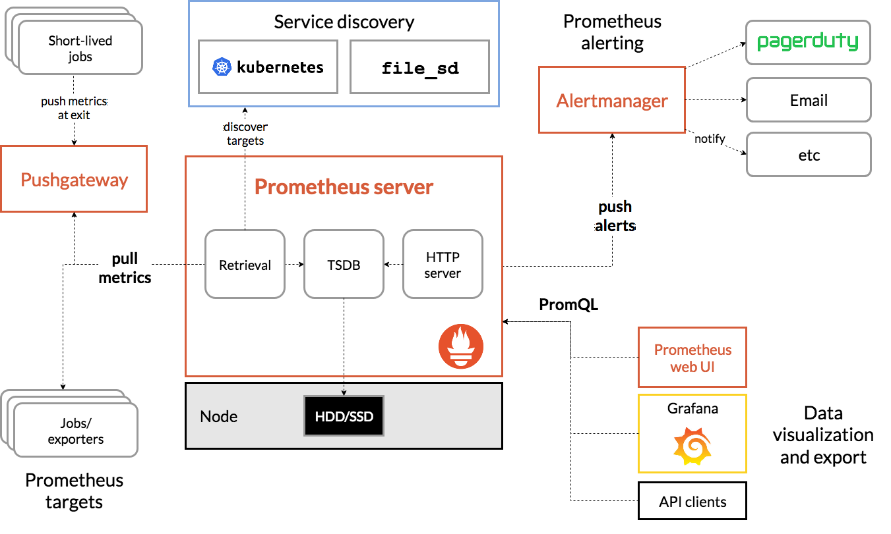
Prometheus Architecture

Slide 12
Prometheus ­ monitoring
In Prometheus terms, the main monitoring service is referred to as the Prometheus Server and the services Prometheus monitors are called targets.
A target can be a host, a network equipment or a specific service.
Typically, the Prometheus server/daemon collects metrics from targets by making HTTP[s] requests to the Prometheus exporters. In Prometheus terms, that process is called scarping.

Slide 13
Prometheus ­ exporters
An Exporter is a piece of software that fetches metrics from a given system and exports them in a format that the Prometheus server can understand.
There are a number of libraries that can be used to write custom exporters but there are also many existing FOSS exporters, written and maintained by the Prometheus team, third party vendors and community members.

Slide 14
Prometheus ­ monitoring your app
In order to monitor your application, you'll need to write code that retrieves the desired metrics and exports it in a format Prometheus can interpret.
Prometheus offers several official client libraries that can make the task easier:
Go
Java
Scala
Python
Ruby
Additional third party clients are also available.
For a full list, see: https://prometheus.io/docs/instrumenting/clientlibs/

Slide 15
Prometheus ­ Alert Manager
The Promtheus Alertmanager handles alerts sent by client applications such as the Prometheus server.
It takes care of de­-duplicating, grouping, and routing them to the correct receiver integration such as email, PagerDuty, or OpsGenie.

Slide 16
Prometheus ­ Alert Manager
AlertManager is also capable of silencing and inhibition of alerts.
In this context, inhibition means suppressing notifications for certain alerts if certain other alerts are already firing.

Slide 17
promQL
PrometheusQueryLanguage(promQL)
Provides built in operators and functions
vector-based calculations like Excel
Expressions over time-series vectors

Slide 18
Expression
Instant Vector-set of time series containing
single sample for each time series, all sharing same timestamp.
Examples:-
http_request_count
http_request_count {status = "200"}
http_request_count {status != "200"}

Slide 19
Range Vector - set of time series containing a range of data points over time for each series
http_request_count[5m]
scalar - as a literal and as result of an expression
string - only currently as a literal in an expression

Slide 20
Time Series Selectors
Instant Vector Selectors
num_nodes
num_nodes{role="backend"}
Range Vector Selectors(s,m,h,d,w,y)
num_nodes{role="backend"}[5m]
Offset Modifier
num_nodes{role="backend"}[5m} offset 1w

Slide 21
Operators: Binary
Arithmetic: +,-,*,/,%,^
- scalar/scalar
- vector/scalar
- vector/vector

Slide 22
Comparison: ==, !=, >,<,>=,<=
- filters results unless bool operator provided(coverts 0 or 1)
- scalar/scalar requires bool operator
- vector/scalar & vector/vector drops elements unless bool operator provided
Logical/Set Binary: only defined between Instant Vectors
- and = intersection between vector1 and vector2
- or = union of vector1 and vector2
- unless = elements of vector1 for which no matches in vector2

Slide 23
Operators: Vector Matching
Label Matching
- ignoring keyword
- on keyword

Slide 24
Operators:Aggregation
Aggregate elements of a single Instant Vector resulting in a new vector of fewer elements aggregated values.
- sum,avg
- min,max
- stddev,stdvar
- count, count_values
- bottomk,topk
- quantile

Slide 25
without clause remove listed labels from resulting vector.
by clause drops labels not listed from the resulting vector.

Slide 26
Functions
time() - number of seconds since unix epoch when the expression is run
vector(s scalar) – returns a vector from a scalar.
scalar(v vector) – returns scalar value of a single sampled vector or NaN

Slide 27
sort() - These ones sort by value, ascending or descending.

Slide 28
Prometheus metric types
The four Prometheus metric types
Counters
Gauges
Histograms
Summaries

Slide 29
counters
Counters are a fundamental way for tracking how often an event occurs within an application or service.
They are used to track and measure Prometheus metrics with continually increasing values (i.e. monotonically increasing values) which get exposed as time series.
An example of a counter metric is http_requests_total, which reports the running total of HTTP requests to an endpoint on an application or service.
The rate() function is applied to counters at query time in order to measure or calculate how many requests happen at a given time per second.

Slide 30
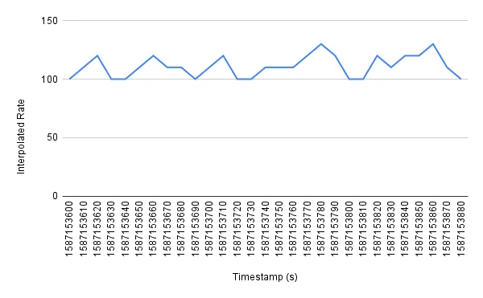
counters
Counters are running or cumulative counts with metric client libraries that keep an ever increasing total sum of the number of events for the lifetime of the application.

Slide 31
Gauges
Gauges are used to periodically take measurements or snapshots of a metric at a single point in time.
A gauge is similar to a counter, however, their value can arbitrarily increase or decrease over time (e.g. CPU utilization and temperature).

Slide 32
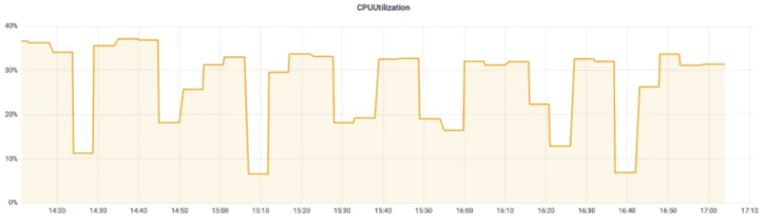
Gauge
Gauges are useful for when you want to query a metric that can go up or down.
The below graph shows an example of a gauge metric measuring CPU utilization as a percent over time.

Slide 33
Histograms
Histograms sample observations by their frequency or count, placing the observed values in pre-defined buckets.
If you don’t specify buckets, the Prometheus client library will use a set of default buckets (e.g. for the Go client library, it uses .005, .01, .025, .05, .1, .25, .5, 1, 2.5, 5, 10).
These buckets are used to track the distribution of an attribute over a number of events (i.e. event latency).
Note: the default buckets can be overridden if more or different values are needed, but it’s important to note the potential increase in costs and/or cardinality when doing so as each bucket has a corresponding unique time series.

Slide 34
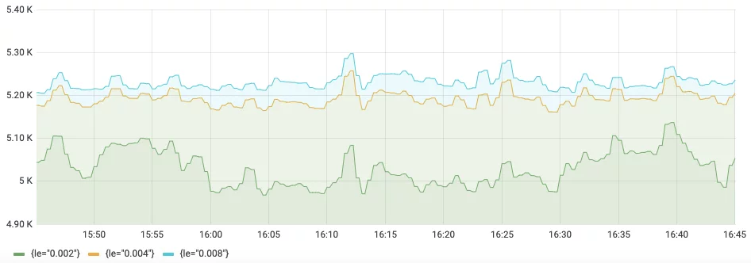
The below graph is measuring the event count at various latencies (le as 0.002, 0.004, and 0.008 seconds) over the time of a histogram.
Notes:
Overall, histograms are known to be highly performant as they only require a count per bucket, and can be accurately aggregated across time series and instances (provided they have the same buckets configured). This means that you can accurately aggregate histograms across multiple instances or regions without having to emit additional time series for aggregate views (unlike computed percentile values with summaries).
There are a couple of downsides to histograms, the main one being that you need to pre-define boundary values for your histogram buckets. Because code modifications are needed to change the buckets, you need to think about the expected latency ranges ahead of time and configure the buckets accordingly. Additionally, if you want to read your histograms as percentiles or quantiles to better understand the distribution, then you would need to apply the histogram_quantile() function to estimate the requested quantile.

Slide 35
Summaries
Summaries are similar to histograms in that they also track distributions of an attribute over a number of events, but they are different in that they expose quantile values directly (i.e. on the client side at collection time vs. on the Prometheus monitoring service at query time).

Slide 36
Summaries
They are most commonly used for monitoring latencies (e.g. P50, P90, P99), and are best for use cases where an accurate latency value or sample is desired without configuration of histogram buckets.

Slide 37
In general, summaries are not recommended for use cases where a histogram can be used instead. This is because quantiles cannot be aggregated, and it can be difficult to deduce what timeframe the quantiles cover. Note: this is defined by each client library independently (e.g. Prometheus Go client library uses 10 minutes by default).

Slide 38
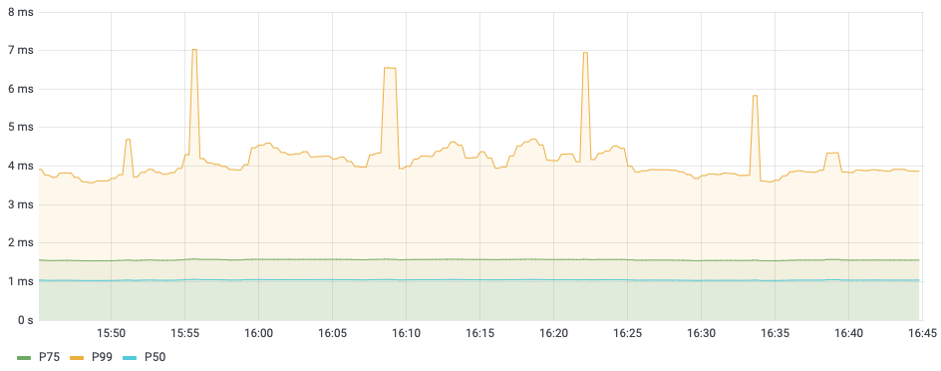
Summaries
In the below graph, event latency is measured by estimating pre-defined quantiles (P50, P75, P99) from a set of client side observations.

Slide 39
Client Libs
Java client for counters
a Counter.build() builder method
public void inc() to increment the counter by 1
public void inc(double amt) to increment the counter by whatever double value you specify

Slide 40
Counter code example
package com.tom.controller;
import io.prometheus.client.CollectorRegistry;
import io.prometheus.client.Counter;
import org.springframework.web.bind.annotation.GetMapping;
import org.springframework.web.bind.annotation.RestController;
@RestController
public class CounterController {
private final Counter requestCount;
public CounterController(CollectorRegistry collectorRegistry) {
requestCount = Counter.build()
.name("request_count")
.help("Number of hello requests.")
.register(collectorRegistry);
}
@GetMapping(value = "/hello")
public String hello() {
requestCount.inc();
return "Hi!";
}
}

Slide 41
a constructor which initialises an instance of Counter and binds it to the Spring Boot default CollectorRegistry.
You can think of the CollectorRegistry as the central place where all the metrics are stored.
a call to inc() when we want to increment the counter

Slide 42
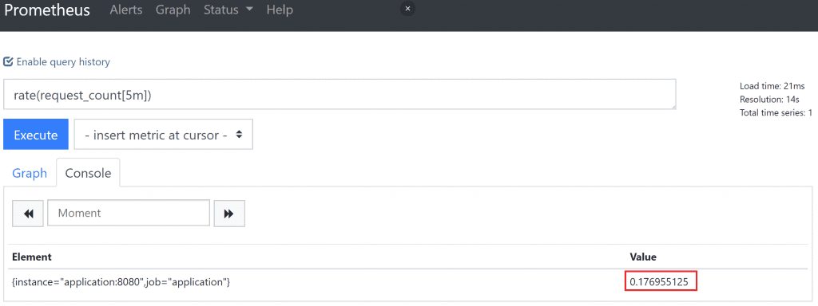
rate(request_count[5m])

Slide 43
Node exporter
Set up and configured Node Exporter to collect Linux system metrics like CPU load and disk I/O.
Node Exporter will expose these as Prometheus-style metrics.
Configured Prometheus to scrape Node Exporter metrics and optionally ship them to Grafana Cloud.
Set up a preconfigured and curated set of recording rules to cache frequent queries.
Imported Grafana dashboards to visualize your metrics data.
Set up Prometheus alerting rules to alert on your metrics data.

Slide 44
Installation
Step 1: Setting up Node Exporter
In this step you’ll set up Node Exporter on your Linux machine to collect and expose system metrics.
To begin, log in to your machine and download the relevant Node Exporter binary. In this guide we’ll use linux-amd64 but you should choose the one corresponding to your system’s OS and architecture:
wget https://github.com/prometheus/node_exporter/releases/download/v1.1.1/node_exporter-1.1.1.linux-amd64.tar.gz
https://prometheus.io/docs/guides/node-exporter/

Slide 45
Unzip the tarball and cd into the directory:
tar xvfz node_exporter-*.*-amd64.tar.gz cd node_exporter-*.*-amd64 Run the Node Exporter binary:
./node_exporter
If you see the above output, you successfully ran Node Exporter.
Node Exporter publishes your system metrics in Prometheus format on port 9100.
You can test this using curl. You will need to open a new SSH session or background the Node Exporter process to use curl.
curl http://localhost:9100/metrics

Slide 46
Step 2: Scraping Node Exporter using Prometheus
Node Exporter is up and running on your machine, you can configure a Prometheus scrape job to collect and store Node Exporter metrics.
Add the following scrape job config to the scrape_configs section of your prometheus.yml configuration file:
- job_name:
node static_configs:
- targets:
['linux_machine_IP_address:9100']

Slide 47
Prometheus Pushgateway
The Prometheus Pushgateway exists to allow ephemeral and batch jobs to expose their metrics to Prometheus.
Since these kinds of jobs may not exist long enough to be scraped, they can instead push their metrics to a Pushgateway.
The Pushgateway then exposes these metrics to Prometheus

Slide 48
pushgateway
The Pushgateway is explicitly not an aggregator or distributed counter but rather a metrics cache.
The metrics pushed are exactly the same as you would present for scraping in a permanently running program.
The Pushgateway is not an event store. While you can use Prometheus as a data source for Grafana annotations, tracking something like release events has to happen with some event-logging framework.

Slide 49
Install Prometheus PushGateway by executing following commands
sudo useradd -M -r -s /bin/false pushgateway
wget https://github.com/prometheus/pushgateway/releases/download/v1.2.0/pushgateway-1.2.0.linux-amd64.tar.gz
tar xvfz pushgateway-1.2.0.linux-amd64.tar.gz
sudo cp pushgateway-1.2.0.linux-amd64/pushgateway /usr/local/bin/
sudo chown pushgateway:pushgateway /usr/local/bin/pushgateway

Slide 50
/etc/systemd/system/pushgateway.service
Create a systemd unit file named /etc/systemd/system/pushgateway.service with following content:
[Unit] Description=Prometheus Pushgateway Wants=network-online.target After=network-online.target[Service] User=pushgateway Group=pushgateway Type=simple ExecStart=/usr/local/bin/pushgateway[Install] WantedBy=multi-user.target

Slide 51
Start PushGateway service by executing following commands:
sudo systemctl enable pushgateway sudo systemctl start pushgateway sudo systemctl status pushgateway

Slide 52
To configure Pushgateway as a Scrape Target for Prometheus Server.
Add following lines at the end of /etc/prometheus/prometheus.yml file
- job_name: 'Pushgateway' honor_labels: true static_configs: - targets: ['localhost:9091']

Slide 53
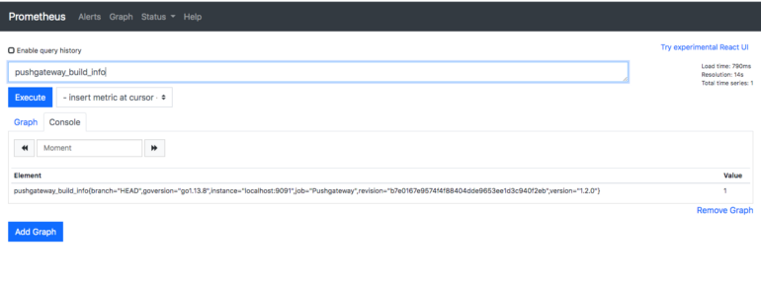
pushgateway_build_info query in Prometheus expression browser.

Slide 54
Service discovery is designed to integrate with the machine and service databases.
Prometheus 2.2.1 has support for Azure, Consul, DNS, EC2, OpenStack, File, Kubernetes, Marathon, Nerve, Serverset, and Triton service discovery in addition to the static discovery you have already seen.

Slide 55
A good service discovery mechanism will provide you with metadata.
Metadata is what you will convert into target labels.

Slide 56
scrape_configs:
- job_name: prometheus
static_configs:
- targets:
- localhost:9090
scrape_configs:
- job_name: node
static_configs:
- targets:
{% for host in groups["all"] %}
{{ host }}:9100
{% endfor %}

Slide 57
File
File service discovery, usually referred to as file SD, does not use the network.
It reads monitoring targets from files you provide on the local filesystem.
We can provide files in either JSON or YAML formats.

Slide 58
Filesd.json
[
{
"targets": [ "host1:9100", "host2:9100" ],
"labels": {
"team": "infra",
"job": "node"
}
},
{
"targets": [ "host1:9090" ],
"labels": {
"team": "monitoring",
"job": "prometheus"
}
}
]
prometheus.yml using file service discovery
scrape_configs:
job_name: file
file_sd_configs:
- files:
- '*.json‘
http://localhost:9090/service-discovery

Slide 59
scrape_configs:
- job_name: file
file_sd_configs:
- files:
- '*.json'
relabel_configs:
- source_labels: [team]
regex: '(.*)ing'
replacement: '${1}'
target_label: team
action: replace

Slide 60
scrape_configs:
- job_name: file
file_sd_configs:
- files:
'*.json‘
relabel_configs:
- source_labels: []
regex: '(.*)'
replacement: '${1}'
target_label: team
action: replace

Slide 61
cAdvisor
Container deployments are becoming more common with technologies such as Docker and Kubernetes.
cAdvisor is an exporter that provides metrics about cgroups.
Cgroups are a Linux kernel isolation feature that are usually used to implement containers on Linux, and are also used by runtime environments such as systemd.

Slide 62
cAdvisor with Docker
docker run \
--volume=/:/rootfs:ro \
--volume=/var/run:/var/run:rw \
--volume=/sys:/sys:ro \
--volume=/var/lib/docker/:/var/lib/docker:ro \
--volume=/dev/disk/:/dev/disk:ro \
--publish=8080:8080 \
--detach=true \
--name=cadvisor \
google/cadvisor:v0.28.3
http://localhost:8080/metrics
The container metrics are prefixed with container_

Slide 63
prometheus.yml
scrape_configs:
- job_name: cadvisor
static_configs:
- targets:
- localhost:8080

Slide 64
Metrics for container CPU
container_cpu_usage_seconds_total
container_cpu_system_seconds_total
container_cpu_user_seconds_total

Slide 65
Metrics for container Memory
container_memory_usage_bytes
container_spec_memory_limit_bytes
container_memory_working_set_bytes

Slide 66
scrape_configs:
- job_name: cadvisor
static_configs:
- targets:
- localhost:9090
metric_relabel_configs:
- regex: 'container_label_.*'
action: labeldrop

Slide 67
Kubernetes
Kubernetes is a popular platform for orchestrating containers.
Like Prometheus, the Kubernetes project is part of the Cloud Native Computing Foundation (CNCF).

Slide 68
Running in Kubernetes
wget https://storage.googleapis.com/minikube/releases/v0.24.1/minikube-linux-amd64
mv minikube-linux-amd64 minikube
chmod +x minikube
./minikube start

Slide 69
Downloading and tesing kubectl
wget https://storage.googleapis.com/kubernetes-release/release/v1.9.2/bin/linux/amd64
/kubectl
chmod +x kubectl
./kubectl get services

Slide 70
prometheus-deployment.yml contains permissions so that your Prometheus can access resources such as pods and nodes in the cluster.
$./kubectl apply -f prometheus-deployment.yml
$./minikube service prometheus --url

Slide 71
https://raw.githubusercontent.com/prometheus-up-and-running/examples/master/9/prometheus-deployment.yml

Slide 72
There are currently five different types of Kubernetes service discoveries
node, endpoints, service, pod, and ingress

Slide 73
Node
Node service discovery is used to discover the nodes comprising the Kubernetes cluster, and you will use it to monitor the infrastructure around Kubernetes.
The Kubelet is the name of the agent that runs on each node, and you should scrape it as part of monitoring the health of the Kubernetes cluster

Slide 74
prometheus.yml fragment to scrape the Kubelet
scrape_configs:
- job_name: 'kubelet'
kubernetes_sd_configs:
- role: node
scheme: https
tls_config:
ca_file: /var/run/secrets/kubernetes.io/serviceaccount/ca.crt
insecure_skip_verify: true
Notes:
shows the configuration being used by Prometheus to scrape the Kubelet.
I’m going to break down the scrape config:
job_name: 'kubelet'
A default job label is provided, and as there are no relabel_configs, kubelet will be
the job label:3
kubernetes_sd_configs:
- role: node
A single Kubernetes service discovery is provided with the node role. The node role
discovers one target for each of your Kubelets. As Prometheus is running inside the
cluster, the defaults for the Kubernetes service discovery are already set up to authenticate
with the Kubernetes API.
scheme: https
tls_config:
ca_file: /var/run/secrets/kubernetes.io/serviceaccount/ca.crt
insecure_skip_verify: true

Slide 75
prometheus.yml fragment to scrape the Kubelet’s embedded cAdvisor
scrape_configs:
- job_name: 'cadvisor'
kubernetes_sd_configs:
- role: node
scheme: https
tls_config:
ca_file: /var/run/secrets/kubernetes.io/serviceaccount/ca.crt
insecure_skip_verify: true
metrics_path: /metrics/cadvisor
Notes:
Node service discovery can be used for anything you want to monitor that runs on
each machine in a Kubernetes cluster. If the Node exporter was running on your
Minikube node you could scrape it by relabelling the port, for example.

Slide 76
Service
Node service discovery is useful for monitoring the infrastructure of and under Kubernetes, but not much use for monitoring your applications running on Kubernetes.
There are several ways that you can organise your applications on Kubernetes, and no single clear standard has emerged yet. But you are likely using services, which is how applications on Kubernetes find each other.

Slide 77
Endpoints
Prometheus should be configured to have a target for each application instance, and the endpoints role provides just that.
Services are backed by pods.
Pods are a group of tightly coupled containers that share network and storage.

Slide 78
prometheus.yml fragment used to scrape the Kubernetes API servers
scrape_configs:
- job_name: 'k8apiserver'
kubernetes_sd_configs:
- role: endpoints
scheme: https
tls_config:
ca_file: /var/run/secrets/kubernetes.io/serviceaccount/ca.crt
insecure_skip_verify: true
bearer_token_file: /var/run/secrets/kubernetes.io/serviceaccount/token
relabel_configs:
- source_labels:
- __meta_kubernetes_namespace
- __meta_kubernetes_service_name
- __meta_kubernetes_endpoint_port_name
action: keep
regex: default;kubernetes;https

Slide 79
prometheus.yml fragment to scrape pods backing all Kubernetes services, except the API servers
scrape_configs:
- job_name: 'k8services'
kubernetes_sd_configs:
- role: endpoints
relabel_configs:
- source_labels:
- __meta_kubernetes_namespace
- __meta_kubernetes_service_name
regex: default;kubernetes
action: drop
- source_labels:
- __meta_kubernetes_namespace
regex: default
action: keep
- source_labels: [__meta_kubernetes_service_name]
target_label: job

Slide 80
Relabelling using Kubernetes service annotations to optionally configure the scheme, path, and port of targets
relabel_configs:
- source_labels: [__meta_kubernetes_service_annotation_prometheus_io_scheme]
regex: (.+)
target_label: __scheme__
- source_labels: [__meta_kubernetes_service_annotation_prometheus_io_path]
regex: (.+)
target_label: __metrics_path__
- source_labels:
- __address__
- __meta_kubernetes_service_annotation_prometheus_io_port
regex: ([^:]+)(:\d+)?;(\d+)
replacement: ${1}:${3}
target_label: __address__

Slide 81
Pod
scrape_configs:
- job_name: 'k8pods'
kubernetes_sd_configs:
- role: pod
relabel_configs:
- source_labels: [__meta_kubernetes_pod_container_port_name]
regex: metrics
action: keep
- source_labels: [__meta_kubernetes_pod_container_name]
target_label: job
Notes:
Discovering endpoints is great for monitoring the primary processes backing your
services, but it won’t discover pods that are not part of services.
The pod role discovers pods. It will return a target for each port of every one of your
pods. As it works off pods, service metadata such as labels and annotations are not
available as pods do not know which services they are members of. But you will have
access to all pod metadata. How you use this boils down to a question of what conventions
you want to use. The Kubernetes ecosystem is rapidly evolving, and there is
no one standard yet.
You could create a convention that all pods must be part of a service, and then use
the endpoint role in service discovery. You could have a convention that all pods
have a label indicating the (single) Kubernetes service they are a part of, and use the
pod role for service discovery. As all ports have names, you could base a convention
off that and have ports named with a prefix of prom-http be scraped with HTTP, and
prom-https be scraped with HTTPS.
One of the components that comes with Minikube is kube-dns, which provides DNS
services. Its pod has multiple ports, including a port named metrics that serves
Prometheus metrics. Example 9-10 shows how you could discover this port and use
the name of the container as the job label

Slide 82
Ingress
An ingress is a way for a Kubernetes service to be exposed outside the cluster.
As it is a layer on top of services, similar to the service role the ingress role is also basically a load balancer.
If multiple pods backed the service and thus ingress, this would cause you problems when scraping with Prometheus.

Slide 83
kube-state-metrics
Using Kubernetes service discovery you can have Prometheus scrape your applications and Kubernetes infrastructure, but this will not include metrics about what Kubernetes knows about your services, pods, deployments, and other resources.
$./kubectl apply -f kube-state-metrics.yml
$./minikube service kube-state-metrics --url

Slide 84
Recording Rules
Recording rules go in separate files from your prometheus.yml, which are known as rule files.

Slide 85
prometheus.yml scraping two targets and loading a rule file
global:
scrape_interval: 10s
evaluation_interval: 10s
rule_files:
- rules.yml
scrape_configs:
- job_name: prometheus
static_configs:
- targets:
- localhost:9090
- job_name: node
static_configs:

Slide 86
Rule files themselves consist of zero1 or more groups of rules
groups:
- name: example
rules:
- record: job:process_cpu_seconds:rate5m
expr: sum without(instance)(rate(process_cpu_seconds_total[5m]))
- record: job:process_open_fds:max
expr: max without(instance)(process_open_fds)

Slide 87
The group has a name.
This must be unique within a rule file, and is used in the Prometheus UI and metrics.
expr is the PromQL expression to be evaluated and output into the metric name specified by record.

Slide 88
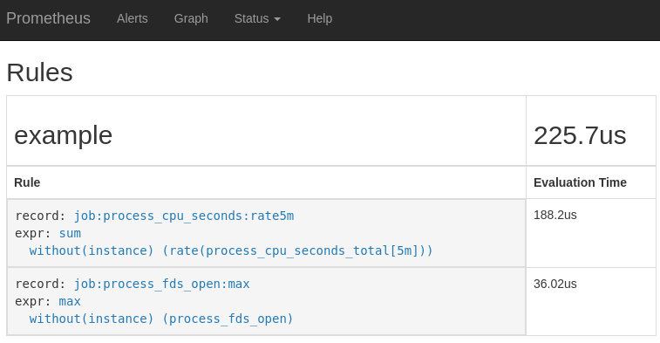
http://localhost:9090/rules

Slide 89
Alerting
Prometheus is where your logic to determine what is or isn’t alerting is defined.
Once an alert is firing in Prometheus, it is sent to an Alertmanager, which can take in alerts from many Prometheus servers.
The Alertmanager then groups alerts together and sends you throttled notifications

Slide 90
Alerting
First, adding alerting rules to Prometheus, defining the logic of what constitutes an alert.
Second, the Alertmanager converts firing alerts into notifications, such as emails, pages, and chat messages.

Slide 91
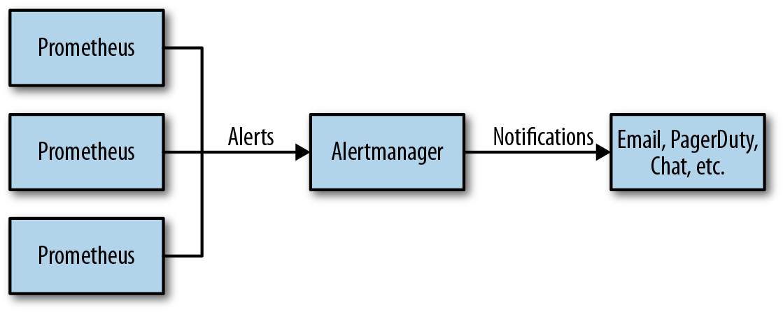

Slide 92
Alerting rules
groups:
- name:<><NodeNAME>
rules:
-<>alert:<><<user defined title>
expr:<>QUERY (promQL)
for:<>duration
labels:
<>severity:<>critical/warning
annotations:
<>summaray:<><user defined message>

Slide 93
Alerting Rules
alerting rules in the same rule groups as recording rules.
groups:
- name: node_rules
rules:
- record: job:up:avg
expr: avg without(instance)(up{job="node"})
- alert: ManyInstancesDown
expr: job:up:avg{job="node"} < 0.5

Slide 94
An alert is identified across evaluation cycles by its labels and does not include the metric name label __name__, but which does include an alertname label with the name of the alert.

Slide 95
Alertmanager
The Alertmanager does more for you than blindly convert alerts into notifications on a one-to-one basis.
While this is a stretch, the Alertmanager tries to get you there by providing you with a controllable pipeline for how your alerts are processed as they become notifications.

Slide 96
Inhibition
On occasion, even when using symptom-based alerting, you will want to prevent notifications for some alerts if another more severe alert is firing, such as preventing alerts for your service if a datacenter it is in is failing but is also receiving no traffic. This is the role of inhibition.

Slide 97
Silencing
If you already know about a problem or are taking a service down for maintenance, there’s no point in paging the oncall about it. Silences allow you to ignore certain alerts for a while, and are added via the Alertmanager’s web interface.

Slide 98
Configuration File
The Alertmanager is configured via a YAML file often called alertmanager.yml.
As with Prometheus, the configuration file can be reloaded at runtime by sending a SIGHUP or sending a HTTP POST to the /-/reload endpoint.

Slide 99
global:
smtp_smarthost: 'localhost:25'
smtp_from: 'youraddress@example.org'
route:
receiver: example-email
receivers:
- name: example-email
email_configs:
- to: 'youraddress@example.org'

Slide 100
Slack – config steps
file: /etc/prometheus/ab.yml
groups:
- name:<>host01d
rules:
-<>alert:<>cpuUtitlization
expr:<>(avg by (instance)(irate(node_cpu_seconds_total{job="node_exporter",mode="idle"}[5m]))*100) >95
for:<>1m
labels:
<>severity:<>critical
annotations:
<>summaray:<>host01 m/c under critical stage
----------------------------------------------------------------------------------------------------
systemctl restart alertmanager
systemctl status alertmanager

Slide 101
Storage
prometheus has a very efficient time series data storage method, and each sampling data occupies only 3.5 bytes of space.
By default, prometheus stores the collected data in the local TSDB database.
Notes:
By default, prometheus stores the collected data in the local TSDB database. By default, the path is the data directory of prometheus installation directory. In the data writing process, first write the data into the wal log and store it in memory, and then save the data in memory to a new block block after 2 hours. At the same time, write the newly collected data into memory and save it to a new block after 2 hours, and so on

Slide 102
Storage
we can use the default local on-disk storage (or) optionally the remote storage system.
local storage: a local time series database in a custom prometheus format.
Remote storage: you can read/write samples to a remote system in standard format.

Slide 103
Local storage
Good – Simple, Avoid Clustering
But ..
Not durable
Not long term
Not scalable
Not flexible
Prometheus
storage

Slide 104
Introduction to block
Each directory is starts with block.
Block blocks compress and merge historical data blocks and delete expired data blocks.

Slide 105
Compression
Compression process
Regularly perform compression
Merge small blocks into large blocks
Cleanup expired blocks

Slide 106
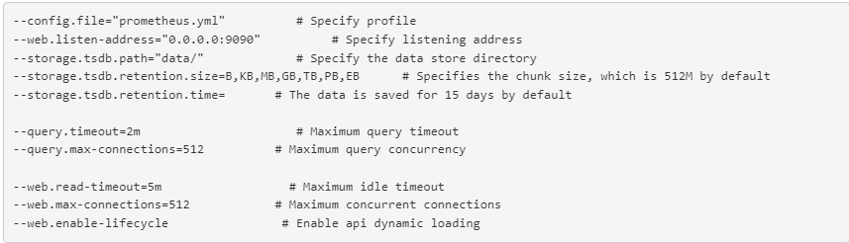
Local storage configuration parameters

Slide 107
End of the Prometheus

Slide 108
Grafana loki
About Loki
Loki is a horizontally scalable, highly available, multi-tenant log aggregation system inspired by Prometheus.
It is designed to be very cost-effective and easy to operate.
It does not index the contents of the logs, but rather a set of labels for each log stream.
The Loki project was started at Grafana Labs in 2018 and announced at KubeCon Seattle.
Loki, which is released under the Apache 2.0 License, reached GA with v1.0.0 in November 2019.

Slide 109
Traditional log management tools
Hard to operate at scale
Expensive
Doesn’t correlate well with Prometheus metrics

Slide 110
Loki
does not do full-text indexing on logs. By storing compressed, unstructured logs and only indexing metadata, Loki is simpler to operate and cheaper to run.
indexes and groups log streams using the same labels you’re already using with Prometheus, enabling you to seamlessly switch between metrics and logs using the same labels that you’re already using with Prometheus.

Slide 111
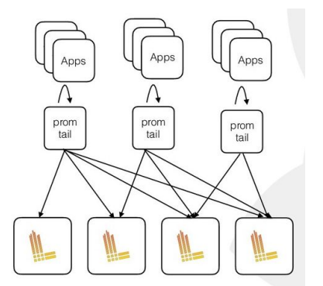
How Loki work

Slide 112
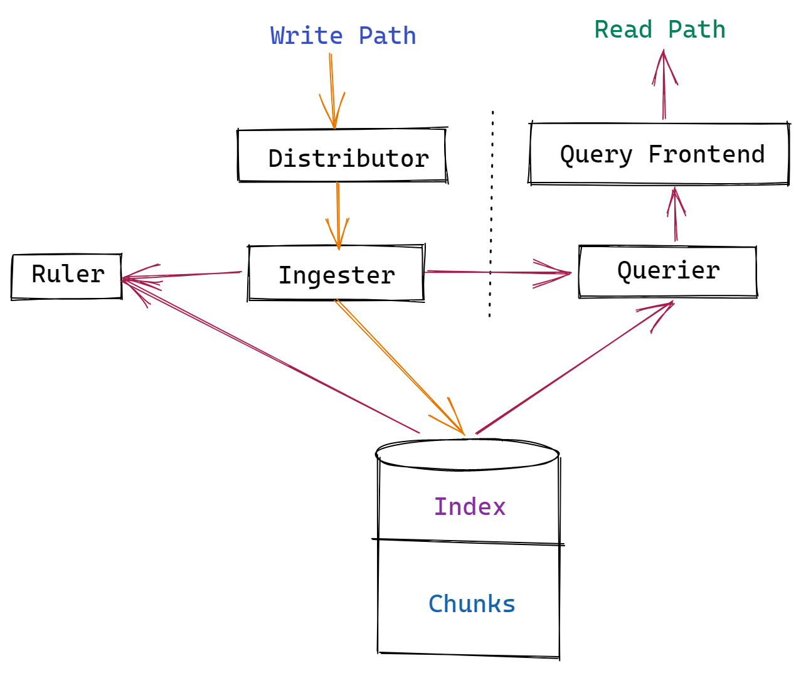
The Architecture of Grafana Loki

Slide 113
Loki's service was created using a set of components (or modules).
Distributor, ingester, querier, and query frontend are the four components accessible for use.

Slide 114
Distributor
Client data streams are handled and validated by the distributor module. Valid data is chunked and transmitted to several ingesters for processing in parallel.
To check log data in the distributor and process it in different downstream modules, the distributor uses Prometheus-like labels. Grafana Loki cannot construct the index it needs for searching without labels.
Let's say you don't have the right labels on your logs. In that situation, if you're loading logs from sources other than Prometheus, the Loki architecture might not be the best option.

Slide 115
Ingester
The data is written to long-term storage via the ingester module. Loki indexes metadata rather than storing the log data it ingests. AWS S3, Apache Cassandra, or local file systems are examples of flexible object storage.
For in-memory searches, the ingester also returns data. Unflushed data is lost when Ingester crashes. With poor user setup assuring redundancy, Loki can irreversibly lose logs from ingesters.

Slide 116
Querier
The querier module is used by the Loki project to handle user queries on the ingester and object storage.
Queries are conducted against local storage first, followed by long-term storage.
Since it queries many areas, the querier must deal with duplicate data, and the ingesters do not discover duplicate logs during the writing process. Because of an internal mechanism, the querier only returns data with the same timestamp, label data, and log data once.

Slide 117
Query Frontend
The query frontend module can optionally provide API endpoints for queries, allowing huge queries to be parallelized.
The query frontend still employs queries, but it divides large searches into smaller ones and performs log reads in parallel.
This feature is useful if you're just getting started with Loki and don't want to set up a querier in detail just now.

Slide 118
Object Stores
Loki requires long-term data storage to keep track of queryable logs.
It needs an object store to store both the compressed chunks written by the ingester and the chunk data's key-value pairs.
Data from long-term storage can take longer to retrieve than data from local storage.

Slide 119
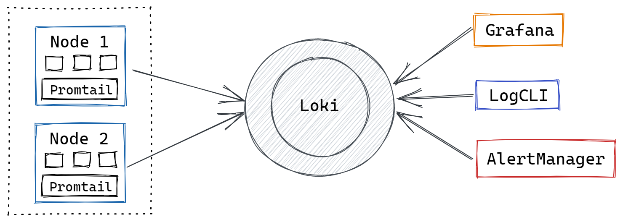
How does Grafana Loki Work?

Slide 120
How Promtail work
Log file discovery
Loki push API
Receiving logs from syslog
Labeling and parsing
Shipping
API
Promtail web server config
Notes:
Pull Logs with Promtail Promtail is a log collector made just for Loki. It uses the same Prometheus service discovery and has similar features for tagging, converting, and filtering logs before ingestion into Loki.
Store Logs in Loki The text of logs is not indexed by Loki. Instead, entries are categorized into streams and labeled. This not only saves money but also means that log lines can be queried within milliseconds of being received by Loki.
Use LogQL to Explore To explore your logs, use Loki's advanced query language, LogQL. Run LogQL queries from within Grafana to see your logs alongside other data sources, or use LogCLI if you prefer the command line.
Alert Logs Set up alerting rules for Loki to use while it evaluates your Loki Syslog data. Loki configuration is a must to transmit the warnings generated to a Prometheus Alertmanager, where they will be routed to the appropriate team.

Slide 121
Promtail
Promtail is an agent which ships the contents of local logs to a private Loki instance or Grafana Cloud. It is usually deployed to every machine that has applications needed to be monitored.
It primarily:
Discovers targets
Attaches labels to log streams
Pushes them to the Loki instance.
Currently, Promtail can tail logs from two sources: local log files and the systemd journal (on AMD64 machines only).

Slide 122
Features of Grafana Loki
Open-source
Horizontally Scalable
Quick Querying
Inexpensive Log Storage and Querying

Slide 123
Install and run Grafana Loki locally
Download the Loki and Promtail .zip files that correspond to your system.
wget https://raw.githubusercontent.com/grafana/loki/main/cmd/loki/loki-local-config.yaml
wget https://raw.githubusercontent.com/grafana/loki/main/clients/cmd/promtail/promtail-local-config.yaml

Slide 124
Enter the following command to start Loki:
Windows
.\loki-windows-amd64.exe --config.file=loki-local-config.yaml
Linux
./loki-linux-amd64 -config.file=loki-local-config.yaml

Slide 125
Loki runs and displays Loki logs in your command line and on http://localhost:3100/metrics.

Slide 126
Reference
https://grafana.com/docs/loki/latest/clients/promtail/

Slide 127
End of the Loki

