Slide 1
Agentic AI

Slide 2
What We'll Cover Today
Foundations of Agentic AI
Understanding what makes AI "agentic"
LLM vs Agent: Key differences
Reasoning loops, action loops, and autonomy
Agents vs Chatbots vs RAG systems
Agentic AI Architectures
Hands-on: Building a Calculator Agent

Slide 3
Part 1: Foundations of Agentic AI

Slide 4
What is Agentic AI?
Agentic AI refers to AI systems that can:
Act autonomously toward goals
Make decisions without constant human intervention
Perceive their environment and take actions
Learn and adapt from outcomes
Break down complex tasks into manageable steps

Slide 5
Key Characteristics
Autonomy
Goal-Oriented
Adaptability
Contextual awareness
Action-oriented
Self-improving
Collaboration
Tool Utilization

Slide 6
Core Agentic AI Terms
Term | Where it appears in workflow
Goal | Start (User/Goal)
Perception | Collect inputs, context
Context | Used in reasoning & planning
Reasoning Loop | Think → Act → Observe
Planning | Task decomposition + sequencing
Task Decomposition | Inside planning stage
Tool Calling | Tool selection stage
Execution | Tool execution stage
Observation | Tool output stage
Reflection | Validation stage
Retry / Self-correction | Replan stage
Memory | Supports perception + context
Guardrails | Always active across workflow
Environment | Tools + external systems
Multi-agent | Many such loops cooperating

Slide 7
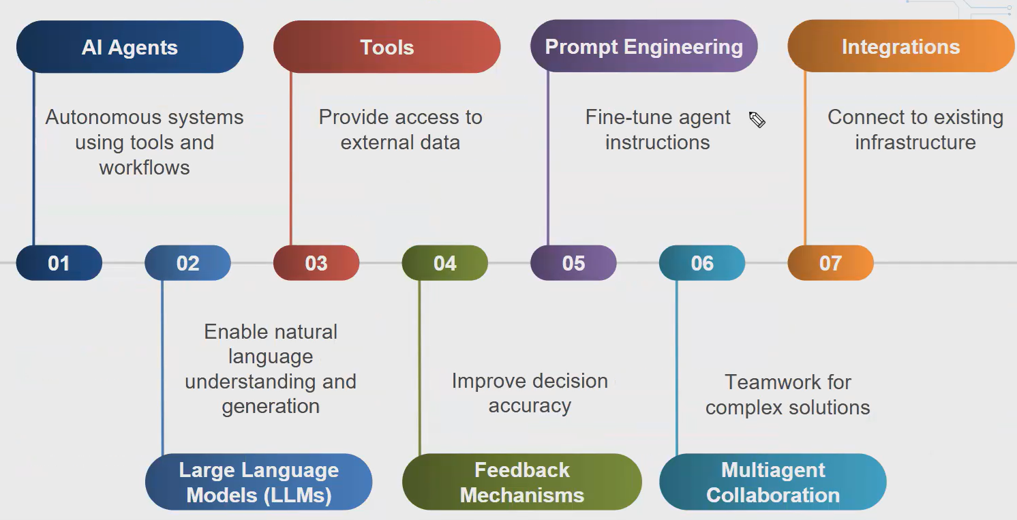
Agentic Workflow

Slide 8
The Evolution to Agents
From Static to Agentic
Traditional AI/ML
Fixed input → Fixed output
No decision-making
Task-specific

Slide 9
The Evolution to Agents
LLMs (Large Language Models)
Natural language understanding
Generation capabilities
Still reactive (prompt → response)

Slide 10
The Evolution to Agents
Agentic AI
Goal-oriented behavior
Multi-step reasoning
Tool use and environment interaction
Self-directed task completion

Slide 11
LLM vs Agent
Aspect | LLM | Agent
Interaction | Single-turn response | Multi-step execution
Decision Making | Limited to response generation | Strategic planning & execution
Tool Use | No direct tool access | Can use external tools/APIs
Memory | Context window only | Can maintain state & memory
Autonomy | Reactive | Proactive
Goal Handling | Answers questions | Achieves objectives

Slide 12
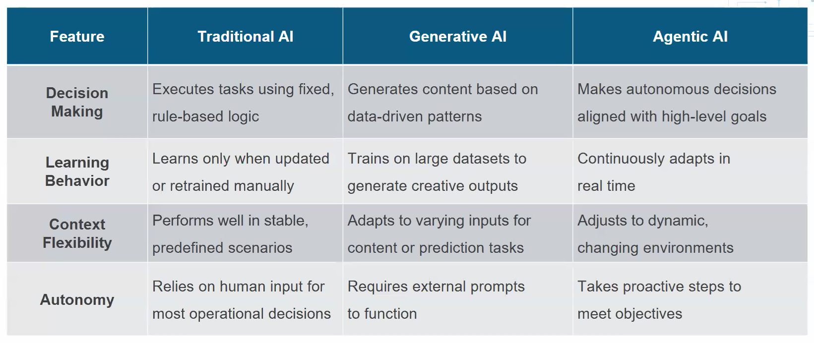

Slide 13
Reasoning Loops
How Agents Think
The Reasoning Loop (ReAct Pattern)

Slide 14
Observe — Perceive current state and context
Think — Reason about what action to take
Act — Execute the chosen action
Reflect — Evaluate the outcome
Repeat — Continue until goal is achieved

Slide 15
Action Loops
From Thinking to Doing
Action Loop Components:
Planning Phase
Task decomposition
Strategy formulation
Resource identification

Slide 16
Action Loops
Execution Phase
Tool selection and invocation
API calls and integrations
Data retrieval and processing

Slide 17
Action Loops
Verification Phase
Result validation
Error handling
Success criteria checking
Agents iterate through these phases until task completion or failure conditions are met.

Slide 18
Autonomy in Agentic AI
Levels of Agent Autonomy
Level 1: Assisted
Human approves each action
Agent suggests next steps.

Slide 19
Autonomy in Agentic AI
Level 2: Semi-Autonomous
Agent executes routine tasks independently
Human intervention for critical decisions

Slide 20
Autonomy in Agentic AI
Level 3: Fully Autonomous
End-to-end task completion
Self-correction and adaptation
Human oversight optional
Consideration: Higher autonomy requires robust safety measures and guardrails

Slide 21
Agents vs Chatbots vs RAG
Understanding the Spectrum
Chatbots
Conversational interface
Predefined response patterns or LLM-based
Limited context retention
Use case: Customer support FAQs
RAG (Retrieval-Augmented Generation)
Combines LLM with information retrieval
Accesses knowledge base for grounded responses
No action-taking capability
Use case: Document Q&A systems
Agents
Goal-oriented task execution
Tool use and API integration
Multi-step planning and reasoning
Use case: Automating workflows, data analysis

Slide 22
When to Use What?
Use Chatbots when:
Simple Q&A interactions
Predetermined conversation flows
No external actions needed

Slide 23
When to Use What?
Use RAG when:
Need accurate, grounded information
Working with large knowledge bases
Reducing hallucinations is critical

Slide 24
When to Use What?
Use Agents when:
Complex, multi-step tasks
Need to interact with external tools
Require autonomous decision-making
Task decomposition is necessary

Slide 25
Agentic AI Architectures

Slide 26
Single Agent Architecture
The Standalone Worker
Structure:
User Input → Agent (LLM + Tools + Memory) → Output

Slide 27
Characteristics:
One agent handles the entire workflow
Direct tool access
Simpler to implement and debug
Limited by single LLM's capabilities

Slide 28
Multi-Agent Architecture
Collaboration and Specialization
Structure:
User Input → Agent 1 (Specialist) ↔ Agent 2 (Specialist) ↔ Agent 3 (Specialist) → Output

Slide 29
Multi-Agent Architecture
Characteristics:
Each agent has specialized capabilities
Agents communicate and collaborate
Parallel processing possible
More complex orchestration
Best for:
Complex, multi-domain problems
Tasks requiring different expertise
Scenarios benefiting from parallel work

Slide 30
Supervisor/Worker Architecture
Hierarchical Task Management Structure:
User Input → Supervisor Agent
├→ Worker Agent 1
├→ Worker Agent 2
└→ Worker Agent 3
→ Aggregated Output

Slide 31
Supervisor/Worker Architecture
Characteristics:
Supervisor delegates and coordinates
Workers execute specific subtasks
Clear hierarchy and responsibility
Supervisor synthesizes results

Slide 32
Architecture Comparison
Architecture | Complexity | Scalability | Use Case
Single Agent | Low | Limited | Simple workflows
Multi-Agent | High | High | Complex, collaborative tasks
Supervisor/Worker | Medium | Very High | Hierarchical, divisible tasks

Slide 33
Decision Factors
Task complexity and divisibility
Need for specialization
Coordination requirements
Development resources available

Slide 34
Calculator Agent Overview
Building Your First Agent
Objective: Create an agent that can perform mathematical calculations using a calculator tool

Slide 35
Calculator Agent Overview
Agent Flow:
User Query → Agent analyzes → Selects tool → Executes calculation → Returns result

Slide 36
Calculator Agent - Components
Architecture Breakdown
Component 1: LLM Core
Understands natural language math queries
Decides when to use calculator tool
Formats responses
Component 2: Calculator Tool
Performs arithmetic operations
Handles various mathematical functions
Returns computed results
Component 3: Agent Logic
Reasoning loop implementation
Tool selection and invocation
Response generation

Slide 37
Calculator Agent - Implementation Steps
Building the Agent
Step 1: Define the calculator tool
Functions: add, subtract, multiply, divide, power, square root
Input validation
Error handling
Step 2: Create the agent prompt
System instructions
Tool description and usage
Output format specification

Slide 38
Calculator Agent - Implementation Steps
Step 3: Implement the reasoning loop
Parse user query
Determine if calculation is needed
Invoke tool with parameters
Return formatted result
Step 4: Test and refine
Edge cases (division by zero, invalid input)
Complex queries (multiple operations)
Natural language variations

Slide 39
Calculator Agent - Code Structure
Tool Definition:
calculator_tool = {
"name": "calculator",
"description": "Performs mathematical calculations",
"parameters": {
"operation": "add|subtract|multiply|divide",
"operands": [numbers]
}
}

Slide 40
Agent Loop:
Receive user input
Generate reasoning with LLM
Extract tool call if needed
Execute tool function
Return result to LLM for final response
Present answer to user

Slide 41
What We Learned Today
Foundations:
Agentic AI = autonomous, goal-oriented systems
Agents use reasoning and action loops
Different from chatbots and RAG systems
Architectures:
Single Agent: Simple, focused tasks
Multi-Agent: Collaborative, specialized
Supervisor/Worker: Hierarchical coordination
Practical Skills:
Built a functional calculator agent
Understood tool integration
Implemented reasoning loops

Slide 42
### End of Day1 ###

