Slide 1
LLM

Slide 2
LLM
LLM stands for Large Language Model.
LLM is designed to understand, generate, and reason with human language (text).

Slide 3
LLM
Examples:
GPT-4, GPT-5 (by OpenAI)
Gemma, Llama, Mistral, Claude, Falcon, etc.
These models are called large because they have:
Billions (or even trillions) of parameters (like neurons in the brain)
Trained on huge text datasets (books, articles, code, web pages)

Slide 4
How does an LLM work?
Training Data Collection
Tokenization
Neural Network Learning (Transformer Architecture)
Training Objective — Next Word Prediction
Inference (When You Use It)

Slide 5
Where It’s Used
Chatbots (like ChatGPT)
Translation systems
Text summarization
Code generation
Sentiment analysis
Knowledge extraction

Slide 6
Embedding Model
An embedding model converts text into vectors (numbers) that represent semantic meaning.
It doesn’t generate text — it understands and represents meaning.

Slide 7
Embedding Model
Input text:
"Apple is a technology company."
Output (vector):
[0.21, -0.98, 0.45, ..., 0.72] ← hundreds or thousands of numbers
This vector captures semantic similarity:
"Apple Inc." and "Google" → have similar vectors
"Apple" (fruit) → has a different vector

Slide 8
Embeddings are used for
Semantic search
Text similarity
Document clustering
Retrieval-Augmented Generation (RAG)

Slide 9
How it works
Step | Process
1 | Tokenize input text
2 | Pass tokens into a small transformer (embedding model)
3 | Output = dense vector (embedding)
4 | Use these vectors for comparison or search

Slide 10
Examples of Embedding Models
text-embedding-3-small, text-embedding-3-large (OpenAI)
all-MiniLM-L6-v2 (SentenceTransformers)
nomic-embed-text, bge-large-en (Ollama / HuggingFace)

Slide 11
Embedding Model vs LLM Model
Feature | Embedding Model | LLM Model
Purpose | Converts text → vector | Converts text → text
Output | Embedding vector (list of numbers) | Natural language sentence
Training Objective | Semantic similarity | Next-word prediction
Use Cases | Search, similarity, clustering, retrieval | Chat, writing, summarizing, reasoning
Example Input/Output | “AI is great” → [0.12, -0.88, ...] | “Explain AI” → “AI stands for Artificial Intelligence…”
Complexity | Smaller, faster | Larger, more powerful
Used In | RAG pipelines | Generative AI apps

Slide 12
Embedding Model vs LLM Model
Task | Embedding Model | LLM
Text-to-Vector | ✅ Yes | ✅ Internally (but hidden)
Semantic Similarity | ✅ Yes | ⚠️ Possible, but inefficient
Text Generation | ❌ No | ✅ Yes
Retrieval/Search | ✅ Yes | ✅ Used with embeddings (RAG)
Q&A Generation | ❌ No | ✅ Yes

Slide 13
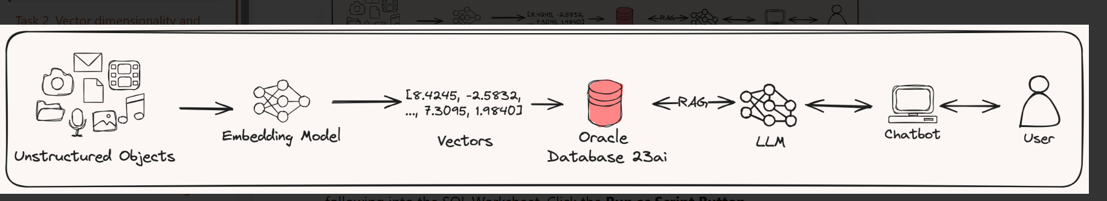
How They Work Together (RAG Example)

Slide 14
Embedding model use case activities
Text Similarity
Semantic Search

Slide 15
LangChain
LangChain is a Python framework
Its designed to build applications powered by Large Language Models (LLMs) (like GPT, LLaMA, Mistral, etc.).
Note
It’s not an LLM itself — it’s a toolkit that helps you connect your LLM with External data,APIs

Slide 16
LangChain Core Components
LLMs
Prompt Templates
Chains
Document Loaders
Text Splitters
Embeddings
Vector Stores
RetrievalQA (RAG)
Agents
Memory

Slide 17
LangChain Ecosystem Overview
LLMs
Data sources
Tools
Memory
Agents
Storage

Slide 18
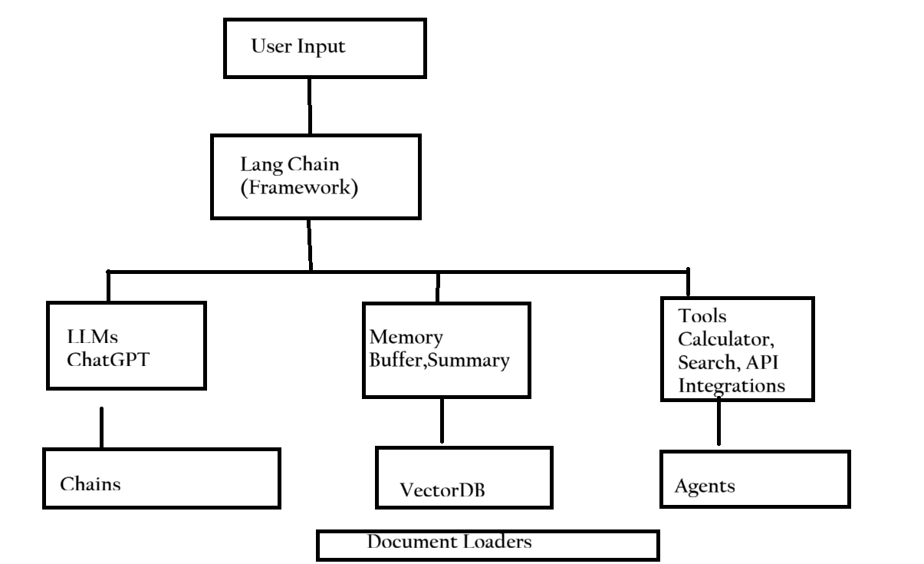
Lang chain Ecosystem

