Slide 1

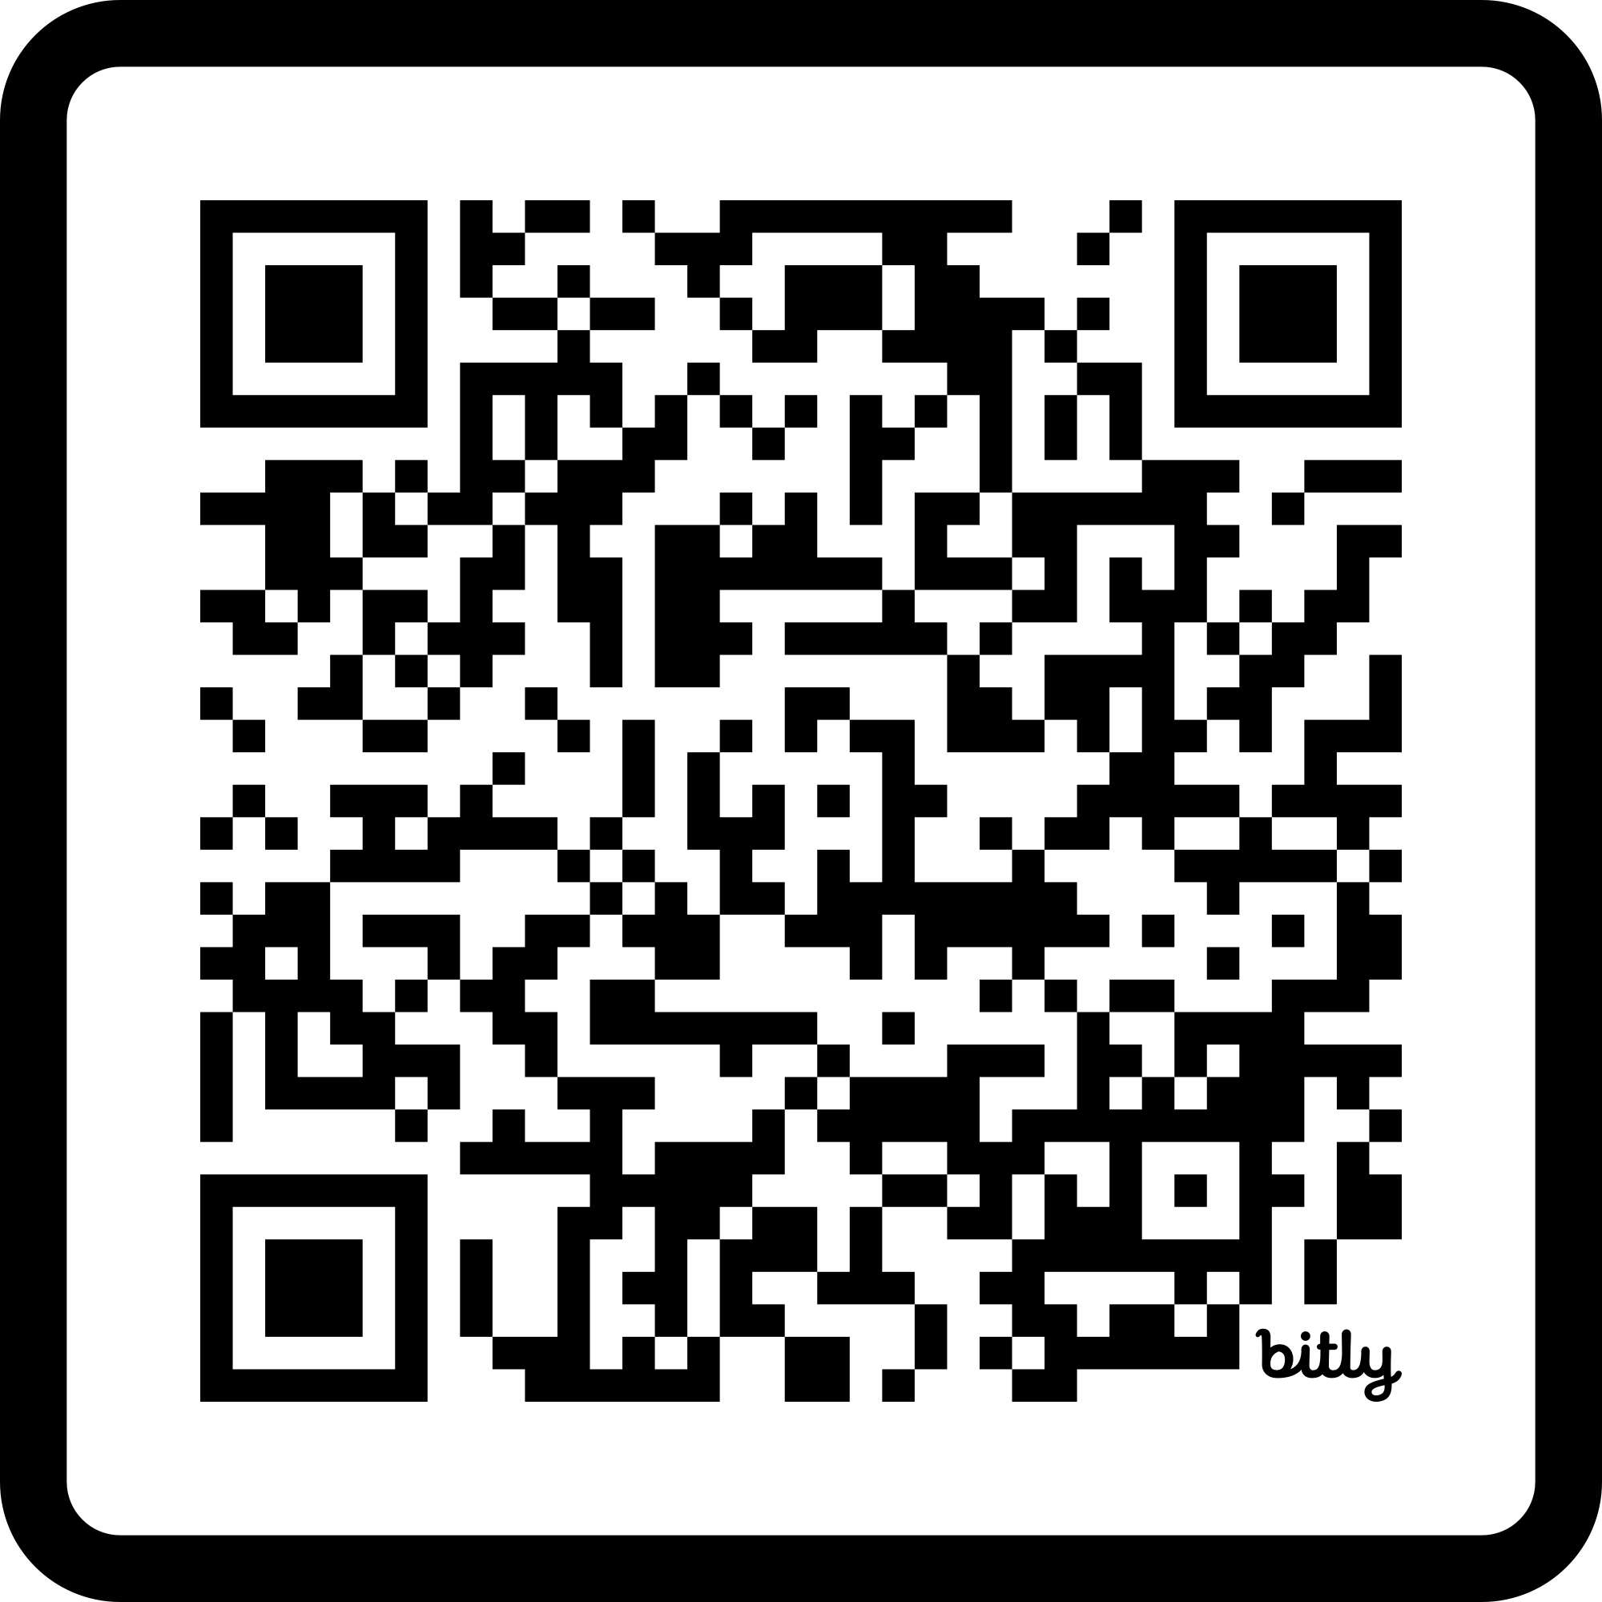


Vibe Coding 101
From Idea to Code
https://bit.ly/vibe-coding-101
Asst Prof Dr Naruemon Pratanwanich (Ploy)

Slide 2

Build a Diabetes Risk Scoring System
Challenge: Vibe Code in 15 minutes
No framework. No planning. Just prompt the AI and build.
Notes:
15 Mins

Slide 3

Software Development Life Cycle (SDLC)
CLO1 Recognize the key stages of the Software Development Life Cycle (SDLC) and how AI can support each stage.

Slide 4
The Risks of “Vibe Coding” with Vague Prompts
When you replace precise engineering constraints with vague "vibes," AI guesses the implementation details.
Architectural Spaghetti: Non-modular code that is impossible to scale.
Context Blindness: Redundant, chatty code rewrites rapidly exhaust the AI's memory limit.
Hidden Technical Debt: Missing edge cases, absent error handling, and severe security gaps.
Loss of the Mental Map: Hard to debug when it inevitably breaks.
The Hallucination Loop: Vague error reporting creates a spiral of progressively broken code.

Slide 5
The 7 Phases of the Software Development Life Cycle (SDLC)
# | PHASE | GOAL | WHAT HAPPENS
1 | Planning & Requirement Analysis | Figure out what we are building and why. | Meet stakeholders, calculate costs, define the audience, identify risks, and test feasibility.
2 | Defining Requirements | Document everything the software must do. | Translate user needs into technical requirements and compile the SRS as the team’s source of truth.
3 | Architectural Design | Figure out how we are going to build it. | Choose the tech stack, database design, system architecture, modules, and APIs.
4 | Software Development | Actually build the thing. | Developers write code from the design blueprint, usually through smaller tasks or sprints.
5 | Testing & Quality Assurance | Find what is broken before users do. | QA tests bugs, security vulnerabilities, performance bottlenecks, and fit to Phase 2 requirements.
6 | Deployment | Release the software to the world. | Stable code is pushed to production all at once, as a beta, or through a rolling release.
7 | Maintenance & Operations | Keep the software alive and well. | Fix new bugs, optimize performance, and release updates or features from user feedback.

Slide 6
The 7 Phases of the Software Development Life Cycle (SDLC)
# | PHASE | GOAL
1 | Planning & Requirement Analysis | Figure out what we are building and why.
2 | Defining Requirements | Document everything the software must do.
3 | Architectural Design | Figure out how we are going to build it.
4 | Software Development | Actually build the thing.
5 | Testing & Quality Assurance | Find what is broken before users do.
6 | Deployment | Release the software to the world.
7 | Maintenance & Operations | Keep the software alive and well.
BEFORE BUILD
Plan + Define
Phases 1–2
Agile cycles
DURING BUILD
AFTER BUILD
Design + Code
Test & Debug
Phases 3–4
Phases 5–7
Release
Operate
Phases 6–7

Slide 7

Software Development Pipeline
┌────────────────────────────┐ │ • Clinical Problem │ │ • Target Users │ │ • Medical Guidelines │ └────────────────────────────┘
BEFORE BUILD
┌────────────────────────────┐ │ • SRS Document (The What) │ │ • UI Text Wireframe │ └────────────────────────────┘
Plan + Define
Business Analyst
(BA)
Phases 1–2
┌────────────────────────────┐ │ • Technical Design Document│
│ (The How - Modular) │ └────────────────────────────┘
DURING BUILD
┌────────────────────────────┐ │ • Executable Code │ │ with Comments │ │ └────────────────────────────┘
Design + Code
Phases 3–4
Software Developer
(Dev)
┌────────────────────────────┐ │ • 3-Tier Test Suite │ │ • Runtime Error Logs │ └────────────────────────────┘
AFTER BUILD
┌────────────────────────────┐ │ • Automated Test Scripts │ │ • ECG Logic Patches │ └────────────────────────────┘
Test + Debug
Phases 5
Quality Assurance
Engineer
(QA)

Slide 8
SRS: Software Requirement Specification
Business Goals & Scope ("Why")
Problem statement, success metrics, and budget/deadlines.
Strict boundaries on what is in-scope vs. out-of-scope.
User Roles & Audience ("Who")
Detailed personas (Primary users, Admins, Third-party actors).
Role-Based Access Control (RBAC) and permission matrices.
Functional Requirements ("What")
Step-by-step user workflows and core feature capabilities.
Data inputs, processing rules, and expected system outputs.
Error handling, validation rules, and automated notification triggers.
Non-Functional Requirements ("How Well")
Performance: Maximum page load times and API latency limits.
Availability: Target uptime percentages (e.g., 99.9% for medical apps).
Scalability & Usability: Storage growth plans and accessibility compliance.
Security & Compliance (The Guardrails)
Regulatory requirements (HIPAA, GDPR, PCI-DSS).
Data encryption protocols (at-rest and in-transit).
Permanent audit logging for sensitive user actions.
System Integrations ("Connections")
Third-party API dependencies and legacy system connections.
Target deployment environments, hardware dependencies, and browser support.
Notes:
What questions do you need me to answer so you can give me the best possible result

Slide 9
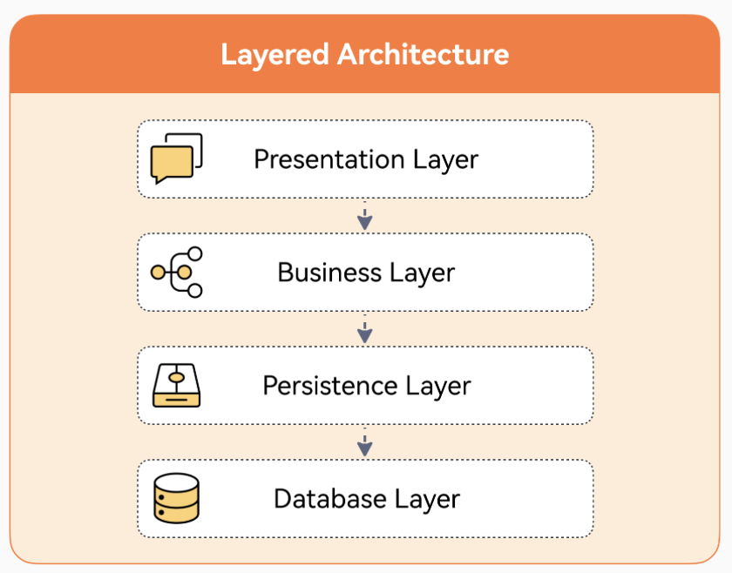
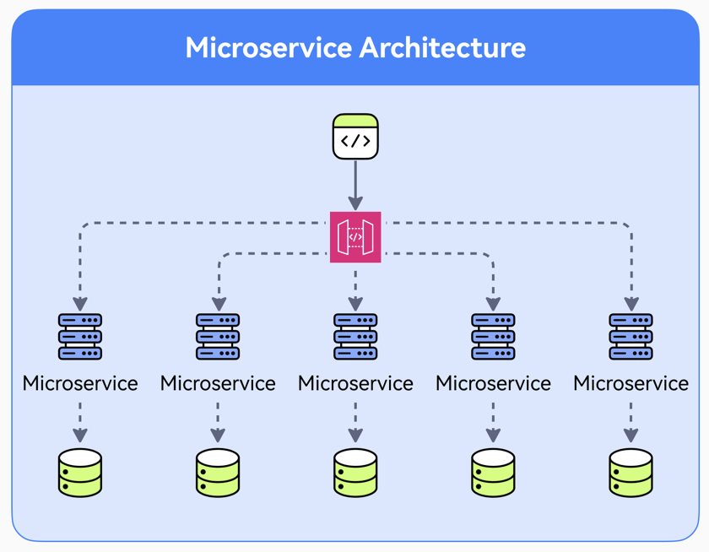
TDD: Technical Design Document
Modular
Architectural Design

Slide 10
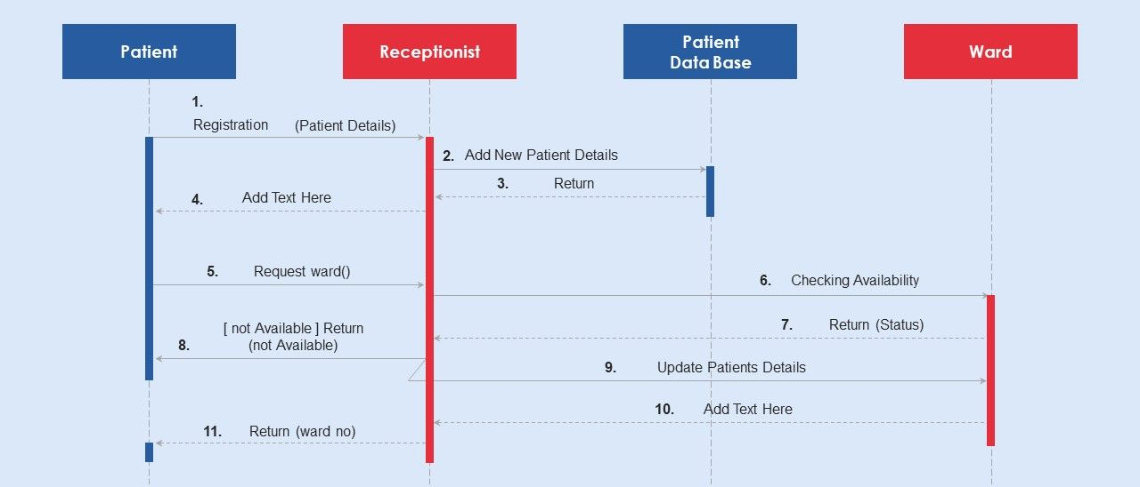
TDD: Technical Design Document
Sequence Diagram

Slide 11
TDD: Technical Design Document
Method Specification
Input
WardID
Process
Open ward timetable
Output
Find availabe slots
Stop if found
Available datetime

Slide 12
3-Tier Test Suite
Unit Test
Verifies that an individual function or component behaves correctly in isolation
E2E Test
Verifies that the complete system works correctly by testing the entire user workflow from start to finish
Performance Test
Evaluates execution time and memory usage under large data loads or heavy workloads

Slide 13
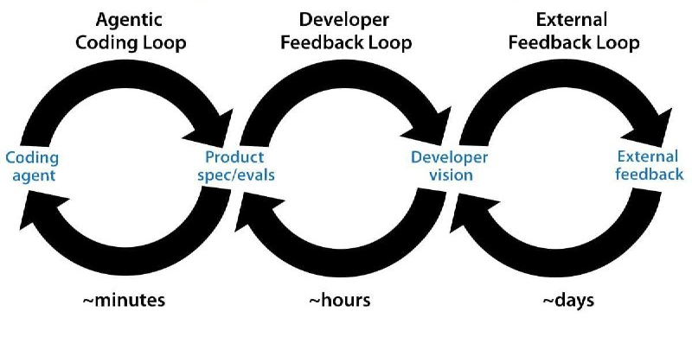
AI-Assited Software Development Loops
Advice by Andrew Ng

Slide 14
Diabetes Risk Scoring App
Vibe Coding 101
A clinical decision-support tool that processes metabolic data points (Glucose, BMI, Blood Pressure) to instantly classify patient diabetes risk profiles.

Slide 15

AI Coding Loop
CLO2 Use structured prompts to guide AI in designing and building console and GUI applications using layered architecture with a basic 3-tier testing suite.

Slide 16
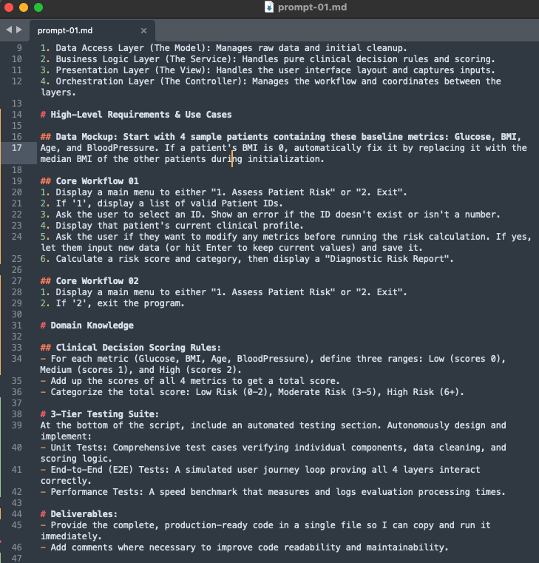
SRS Based Prompt
Role
Context
Architecture
High-Level Requirements & Use Cases
Data Mockup
Core Workflow #1
Core Workflow #2
…
Domain Knowledge / Rules
Deliverables
One Recommended Prompt Structure
-- There Is No Single Best Prompt--

Slide 17
SRS Based Prompt
# Role
Act as an expert software architect and developer.
# Context
I need to build a "Diabetes Risk Scoring System". I want you to design, structure, and fully implement a complete, working Python program based on the 4-Tier Architecture as follows.

Slide 18
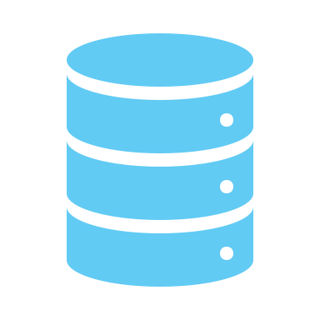
Layered Architecture
User Interface (UI)
Presentation Layer
# Architecture
Separate the code cleanly into these 4 distinct layers:
1. Data Access Layer: Manages raw data and initial cleanup.
2. Business Logic Layer: Handles pure clinical decision rules and scoring.
3.1 Presentation Layer: Handles the user interface layout and captures inputs.
3.2 Orchestration Layer: Manages the workflow and coordinates between the layers.
Orchestration Layer
Business/Domain Logic Layer
Data Access Layer
Database

Slide 19
SRS Based Prompt
# High-Level Requirements & Use Cases
## Data Mockup: Start with 4 sample patients containing these baseline metrics: Glucose, BMI, Age, and BloodPressure. If a patient's BMI is 0, automatically fix it by replacing it with the median BMI of the other patients during initialization.
## Core Workflow 01:
1. Display a main menu to either "1. Assess Patient Risk" or "2. Exit".
2. If '1', display a list of valid Patient IDs.
3. Ask the user to select an ID. Show an error if the ID doesn't exist or isn't a number.
4. Display that patient's current clinical profile.
5. Ask the user if they want to modify any metrics before running the risk calculation. If yes, let them input new data (or hit Enter to keep current values) and save it.
6. Calculate a risk score and category, then display a "Diagnostic Risk Report".
## Core Workflow 02:
1. Display a main menu to either "1. Assess Patient Risk" or "2. Exit".
2. If '2', exit the program.

Slide 20
SRS Based Prompt
# Domain Knowledge
## Clinical Decision Scoring Rules:
- For each metric (Glucose, BMI, Age, BloodPressure), define three ranges: Low (scores 0), Medium (scores 1), and High (scores 2).
- Add up the scores of all 4 metrics to get a total score.
- Categorize the total score: Low Risk (0-2), Moderate Risk (3-5), High Risk (6+).
# 3-Tier Testing Suite
At the bottom of the script, include an automated testing section. Autonomously design and implement:
- Unit Tests: Comprehensive test cases verifying individual components, data cleaning, and scoring logic.
- End-to-End (E2E) Tests: A simulated user journey loop proving all 4 layers interact correctly.
- Performance Tests: A speed benchmark that measures and logs evaluation processing times.
Any further improvements?

Slide 21
SRS Based Prompt
# Deliverables
- Provide the complete, production-ready code in a single file so I can copy and run it immediately.
- Include a RUN_TEST_SUITE switch to toggle between running the 3-tier testing suite and launching the application.
- Add comments where necessary to improve code readability and maintainability.
Action required: Try prompt01-SRS.md > Run in Colab

Slide 22

Developer Feedback Loop
CLO3 Verify AI-generated code using structured Technical Design Documents (TDDs) generated via AI prompts.

Slide 23
Three Essential Programming Concepts
1. Algorithm: The step-by-step to complete a task
Data
Variables: Labeled storage boxes used to hold data in memory.
x = {“BMI”:25.1,“Age”:39}
Types:
Number: int/float
1
Text: String
“1”
List: Collection of items in order
[1,2,3,4]
Dictionary: Collection of key-value pairs
{“BMI”:25.1,“Age”:39}
Selection: Making decisions in code
if user is logged in
show dashboard
else
show login screen
Repetition (Loops): Repeating an action multiple times until a specific condition is met.
sum(for x in range(1,5))

Slide 24
Three Essential Programming Concepts
2. Function/Method: A reusable block of code designed to perform a specific action
Parameter(s): The input slots or placeholders a function requires to do its job
Return Value(s): The final output or result that the function spits back out to the main program after it finishes running.
Function / Method Calling: Triggering or executing that specific block of code to run when needed.
def f(x):
y = x+1
return y
def mean(x:list, w:list) -> float:
for i in range(len(x)):
weighted_sum += x[i]*w[i]
return weighted_sum/sum(w)
mean([10,20,30],[1,2,1])

Slide 25
Three Essential Programming Concepts
3. Class: A custom blueprint or template used to define the properties and behaviors of a specific real-world concept.
class Car:
def __init__(mpg,fuel_level,make=‘Tesla’):
self.make = make
self.fuel_level = fuel_level
self.mpg = mpg # miles per gallon
self.pos = [0,0]
def move(self,v,t):
self.pos[0] += v[0]*t
self.pos[1] += v[1]*t
def calculate_range(self):
range_miles = self.fuel_level*self.mpg
my_car = Car(20,30) # Object Instantiation
my_car.move(110.5,30)
Data (Attributes): The information an object holds or remembers
Behaviour (Methods): The actions an object can perform or the operations it can execute on its data
Object: A real, live instance created from a Class blueprint
Object Instantiation: The act of using a Class blueprint to actually create a live, concrete instance of that object in the program.

Slide 26
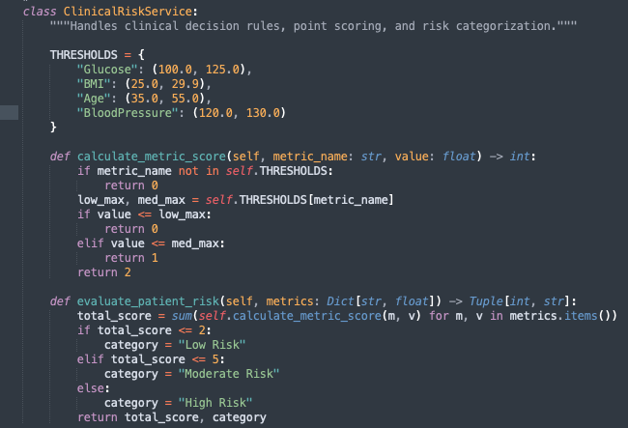


Business Logic Layer (The Service)
# Usage

Slide 27
Business Logic Layer (The Service)
# Usage

Slide 28

AI-Assisted Developer Feedback Loop
The Blueprint (TDD Generation)
AI analyzes code to build a Technical Design Document (TDD).
Includes Sequence Diagrams (workflow) and Method Specsification (input-process-output).
The Reality Check (Alignment)
Developer reviews and updates the TDD to match the code.
Ensures the high-level design stays aligned with the actual Source of Truth (the codebase).
Code Review
AI inspects the code to generate a Code Review Report.
Flags Code Smells (poorly written code) and Technical Debt (messy fixes that cause future issues).
The Auto-Repair (Refactoring)
AI uses the core review report to clean and optimize the codebase.
Performs Refactoring—improving internal code structure without changing how the software behaves.
Action required:
Try prompt02-TDD.md > Review Sequence Diagrams and Method Specification
Try prompt03-code-review.md > Review Issues

Slide 29

Basic GitHub
CLO4 Version and manage your application code and documentation using the basic features of GitHub.

Slide 30
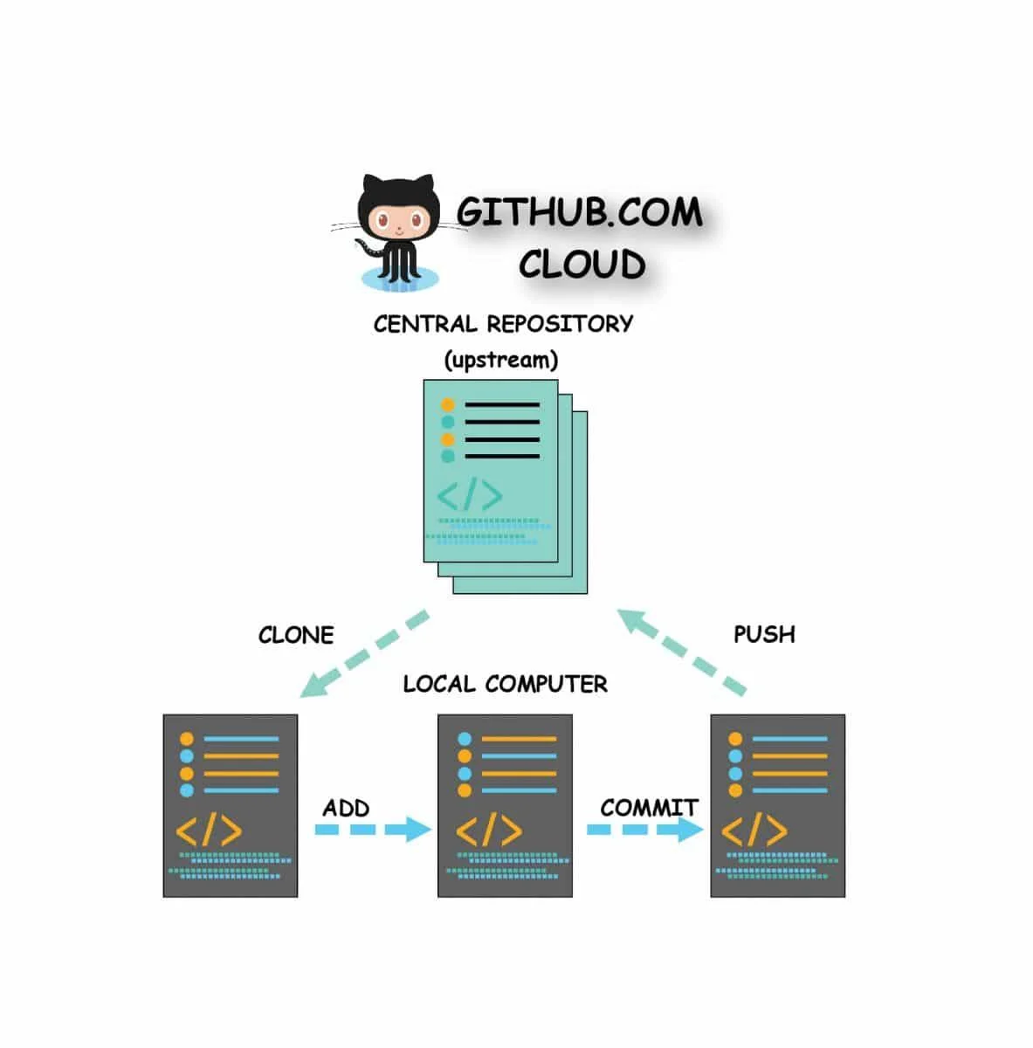
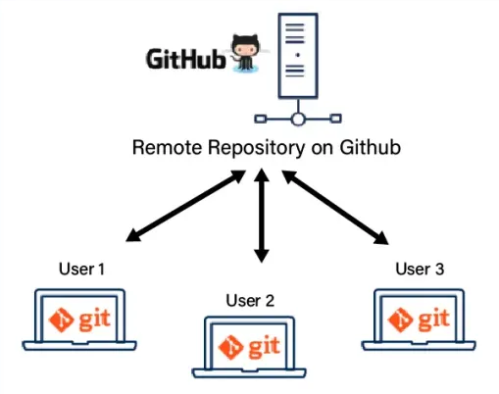
Basic Github: Collaboration & Versioning
Action required:
Create your own GitHub Repository
Push your initial code and doc
Fix and test the code according to the issues in the code review report
Commit changes with proper comment

Slide 31

Iterative Application Improvements
CLO5 Iteratively improve applications through feedback-driven interactions with AI, enabling feature enhancements while preserving the existing codebase.

Slide 32
Making Changes I: Prompt Targeted Feature Updates and Refinement
TDD
Code
Review
# Role Act as an expert software developer.
# Context I am updating the "Diabetes Risk Scoring" code we built. I only want to modify the specific function(s) responsible for the according to the user request below.
# Instructions
1. Review the User Request below.
2. Locate the relavant function(s).
3. Update only that specific function(s) to match the requested visual style.
4. Output ONLY the updated function code. Do not reprint the rest of the application.
# User Request <PLACEHOLDER>
One Recommended Prompt Structure
-- There Is No Single Best Prompt--

Slide 33
Exercise I
🟢 Easy: Single Method Change
User Request:
"I really like the application, but the diagnostic risk report printout at the end looks a bit plain. Can we make it look more like an official medical receipt? Add some extra decorative borders (like rows of hyphens or asterisks) and clearly print a 'CONFIDENTIAL' warning at the bottom so it stands out on the screen."
Action required:
Try prompt04-feedback-ex1.md
Test in Colab
Commit changes in GitHub

Slide 34
Exercise II
🟡 Medium: Multiple Methods, Single Class
User Request:
"Right now, the system just spits out a final score and a risk category. As a clinician, a single label isn't enough for me to explain things to my patients. I need the app to also give me a quick text summary explaining why they got that score—specifically, a breakdown showing which exact health metrics (like their Glucose or BMI) were actually outside the healthy boundaries."
Notes:
The Business Tier

Slide 35
Exercise III
🔴 Hard: Cross-Tier Modification
User Request:
"When looking at a patient's risk profile, seeing just a final category isn't completely informative. We need to see how their metrics compare to the average of our entire clinic clinic database. Can you modify the system to calculate the clinical average for each metric across all registered patients, and then display whether this specific patient is 'ABOVE', 'BELOW', or 'EQUAL' to that clinic average next to their numbers?"

Slide 36



Making Changes II: Prompt Evolving the Architecture with Layered Changes
User Interface (UI)
Presentation Layer
ConsoleView
ConsoleController
ClinicalRiskService
PatientModel
Orchestration Layer
StreamlitView
ClinicalRiskService
PatientModel
Business/Domain Logic Layer
Data Access Layer
StreamlitView
ClinicalRiskService
SQLitePatientModel
Database

Slide 37
Exercise IV
🟡 Presentation Layer Modification
User Request:
"The current system works well, but interacting through the console is not very user-friendly. Can you convert the existing console-based interface into a graphical user interface (GUI) application? The new interface should provide visual components such as input fields, buttons, and display panels while preserving all existing functionalities and keeping the underlying business logic unchanged."
Action required: Prompt and run in Streamlit Playground

Slide 38
Exercise V
🔴 Data Access Layer Modification
User Request:
"The current system stores all patient information in memory, which means the data is lost whenever the application is closed. We need a more reliable way to manage patient records. Can you modify the system to store and retrieve patient data using a database instead of in-memory storage? The system should preserve all existing functionalities while replacing the current data storage mechanism with persistent database operations."
Action required: Prompt and run in Streamlit Cloud

Slide 39
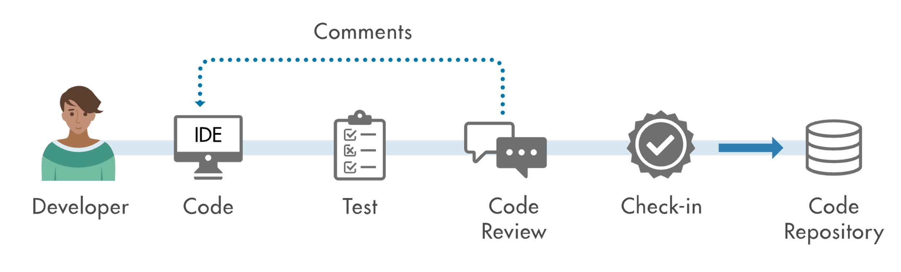
Wrap-Up
Visual Studio Code + CoPilot / Codex
Unit Test
E2E Test
Performance Test

