Slide 1


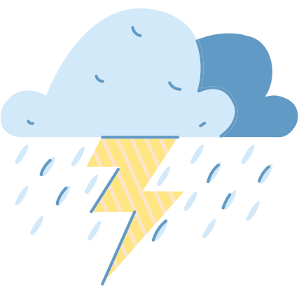

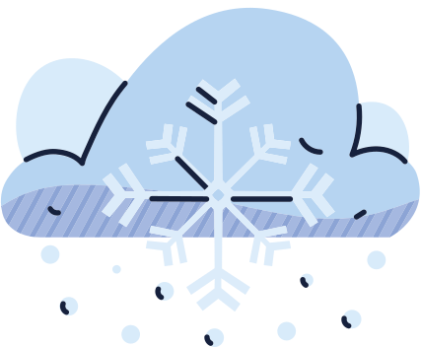

Weather dashboard
project
Pak Elina
202255631

Slide 2
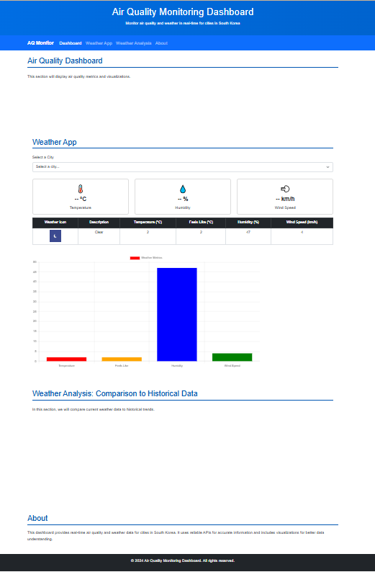
What sections did I use?
How does my project look so far?

Slide 3
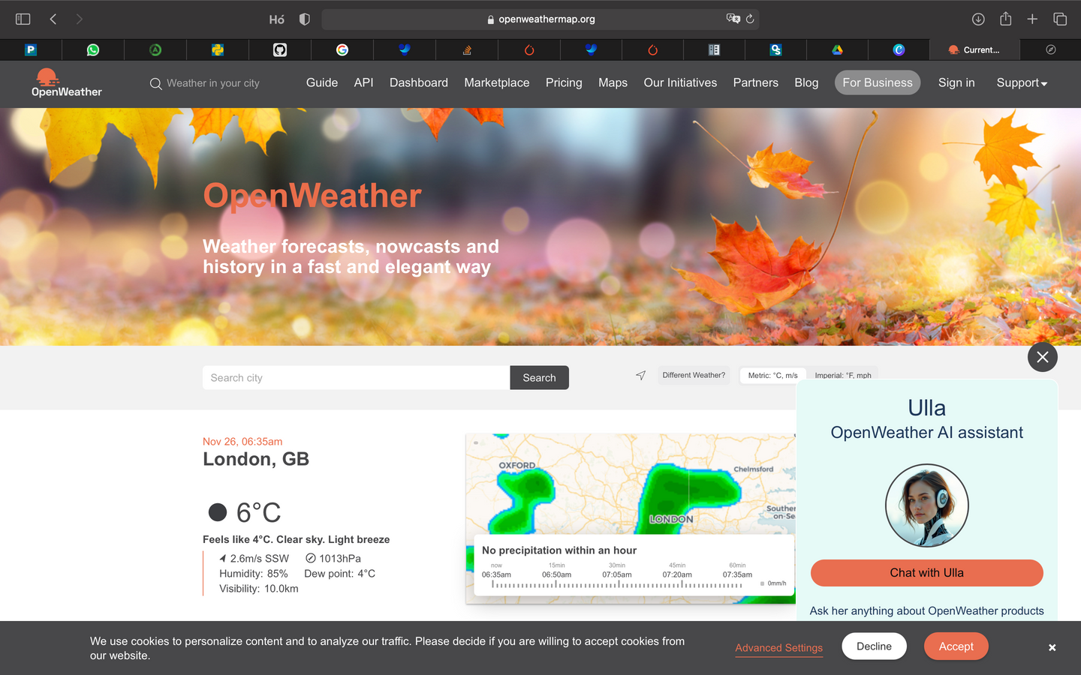
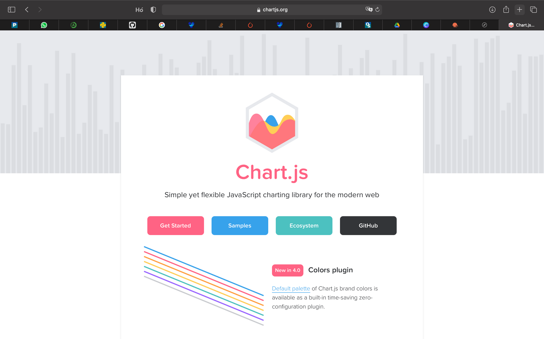
What I used:

Slide 4
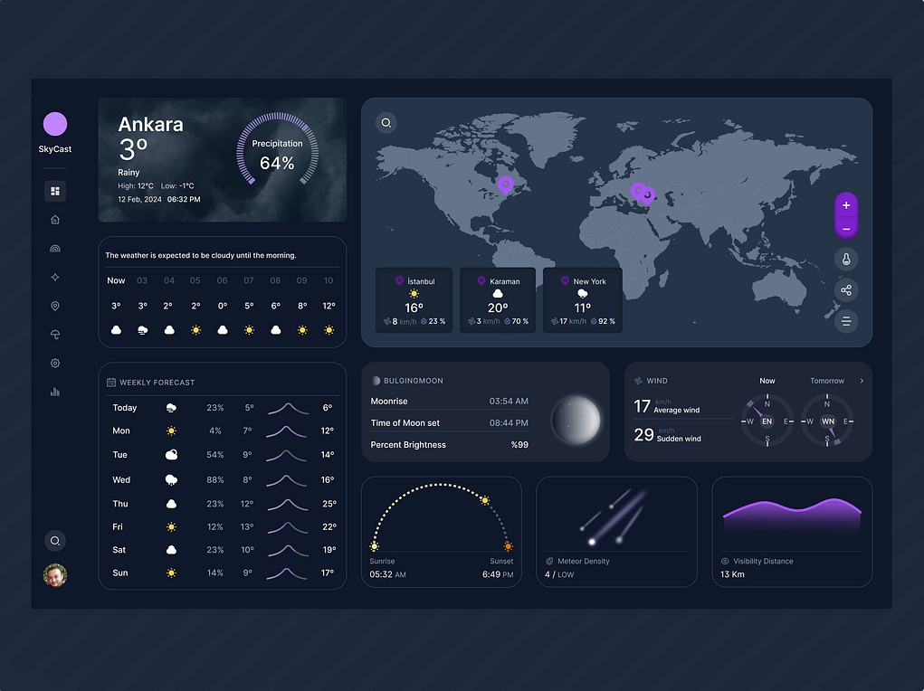
Inspiration

Slide 5


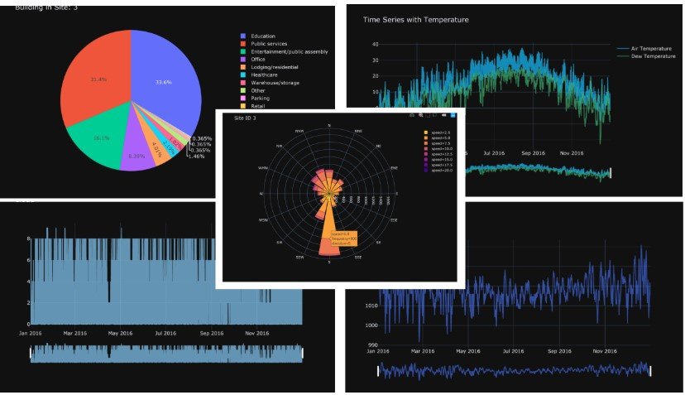
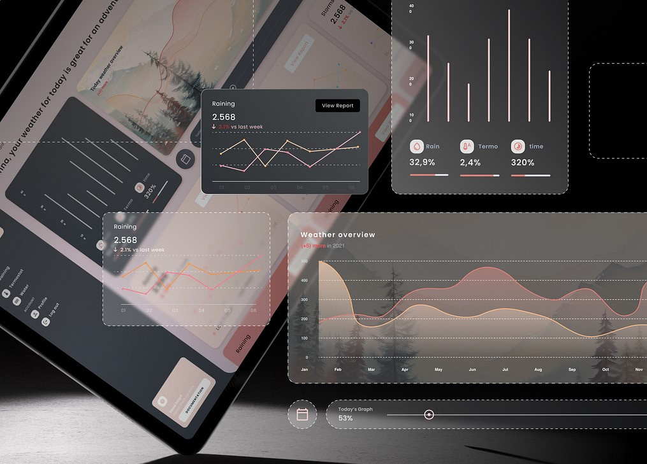
AQ dasboard

Slide 6


Weather app

Slide 7



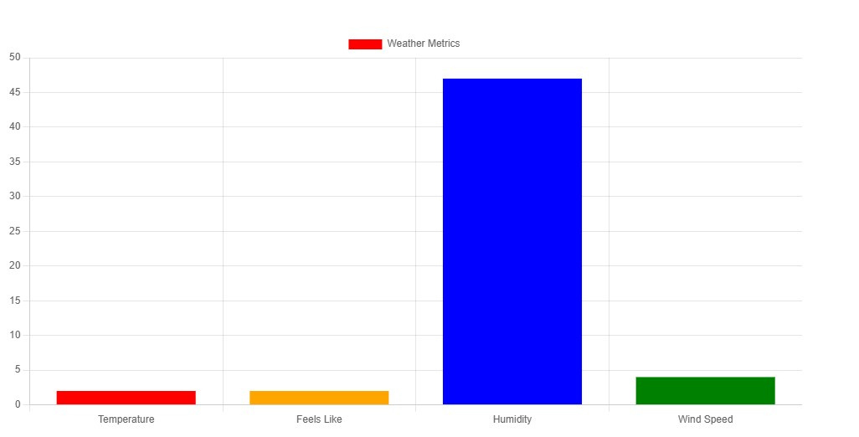
Weather app

Slide 8
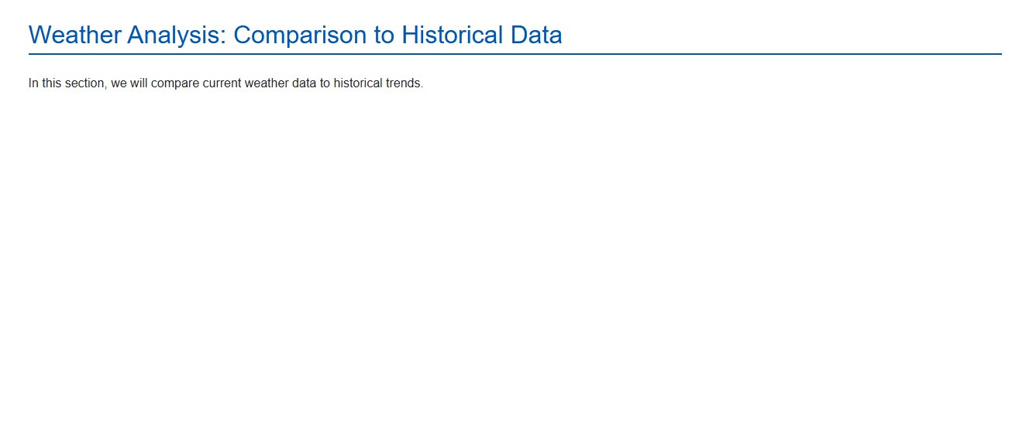
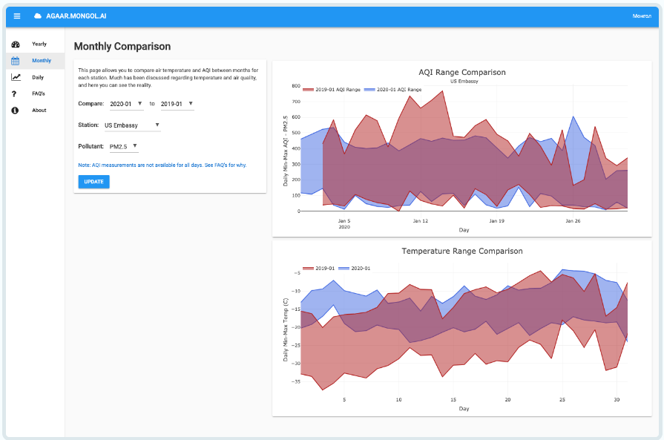
Weather analysis

Slide 9

Is that all?
Future Enhancements:
Geolocation
Detailed View
Search Bar
Interactive Map
Severe Weather Alerts
Air Quality Index (AQI)
Sunrise/Sunset and Moon Phases

Slide 10
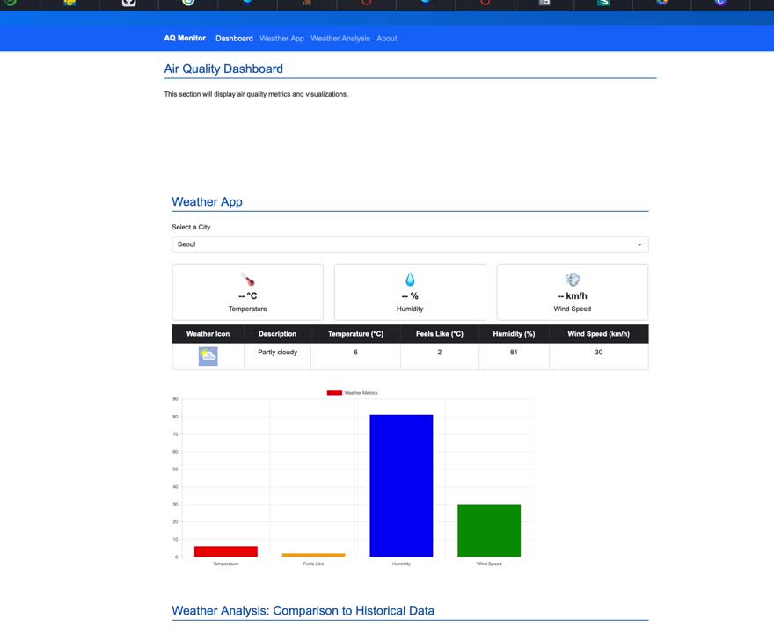
Demo

Slide 11
Thank you!
Pak Elina

