Slide 1
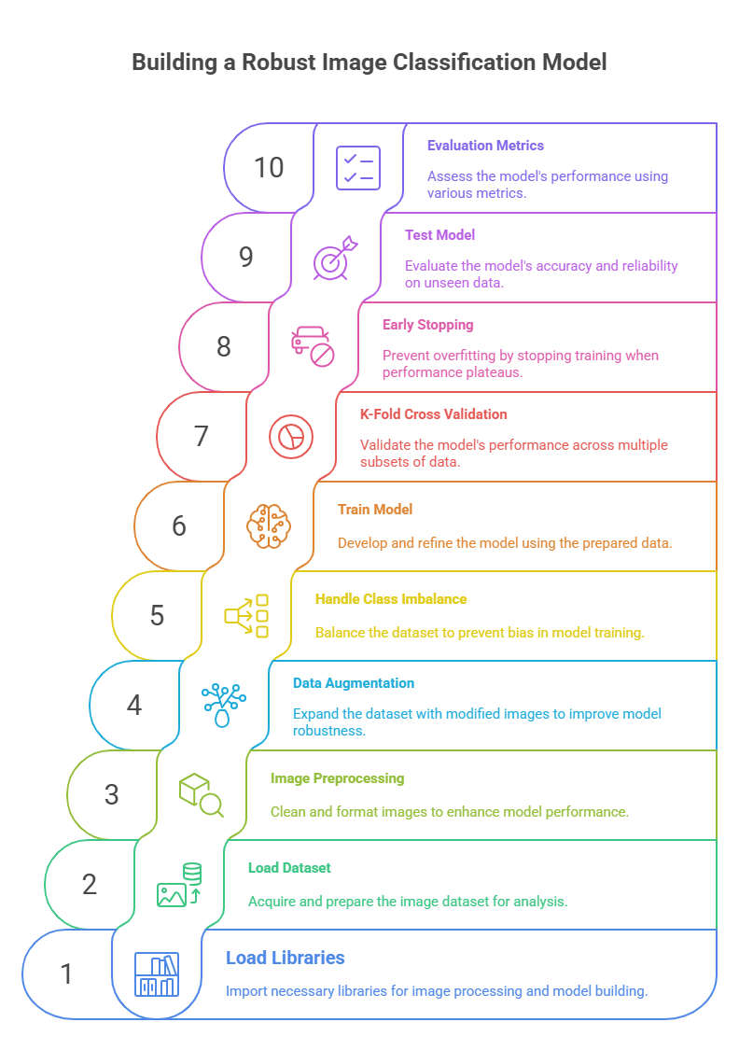
Problem & Approach
Objective: Early and accurate binary classification of pneumonia from chest X-ray images.
Low-resolution images limit model learning.
Class imbalance can bias model toward majority class.
Need for robust evaluation via cross-validation.
Approach Used
Challenges

Slide 2
Model Architecture & Workflow
Input Dataset: 28×28 grayscale → resized to 299×299, 3 channels
Data Augmentation: Random flips, rotations
Imbalance handling (WeightedRandomSampler)
Cross-Validation (5-fold)
Testing
Early Stopping (Validation AUROC)
Backpropagation
(Optimizer: Adam)
Compute Loss
(Loss Function: CrossEntropyLoss)
Evaluation Metrices
Base Model Architecture: InceptionV3
Final FC layer replaced: model.fc = nn.Linear(2048, 2)
aux_logits=True: adds auxiliary classifier head for better gradient flow

Slide 3
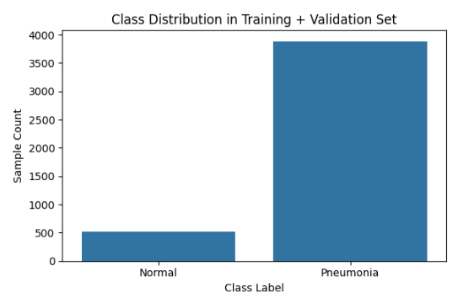
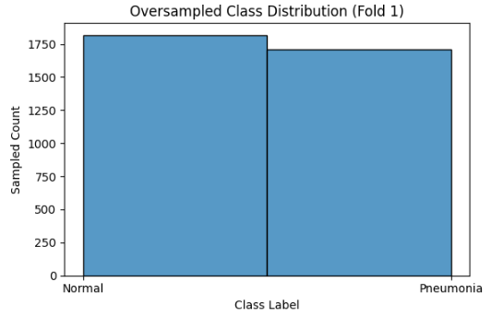
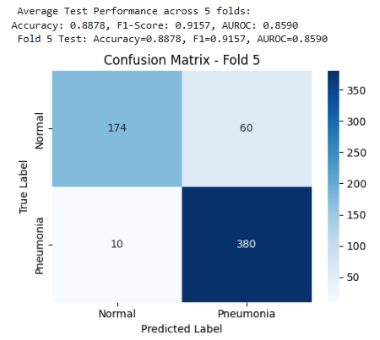
Results & Insights
Final Test scores:
Accuracy: 88.78%
F1 Score: 0.9157
AUROC: 0.8590
Before Oversampling
After Oversampling
Fold | Epochs | Max Val Acc | Max F1 | Max AUROC
1 | 8 | 0.9683 | 0.9823 | 0.9151
2 | 9 | 0.9671 | 0.9811 | 0.9451
3 | 10 | 0.9637 | 0.9792 | 0.9515
4 | 10 | 0.9739 | 0.9852 | 0.9699
5 | 10 | 0.9762 | 0.9865 | 0.9675
Model Training

