Slide 1
KAVIKULGURU INSTITUTE OF TECHNOLOGY AND SCIENCE RAMTEK - 441 106 DEPARTMENT OF INFORMATION TECHNOLOGY 2020-2021
Project Seminar Title: - A Medical Chatbot
Name of Projectees and Roll no.
NAME | ROLL NO.
Pakhi Pardhi | IT17021
Sanjeevani Burchunde | IT17015
Pravin Rahangdale | IT16003
Abhishek Singh | IT16012
Project Supervisor:-
Dr. Dinesh Patil
(Assistant Professor. ITD)

Slide 2

Design and Implementation of A MEDICAL CHATBOT
By
Pakhi Pardhi(IT17021)
Sanjivani Burchunde(IT17015)
Pravin Rahangdale(IT16003)
Abhishek Singh(IT16012)
Under guidance of
Dr. Dinesh Patil
(Asst. Professor)
2020 – 2021
DEPARTMENT OF INFORMATION TECHNOLOGY
KAVIKULGURU INSTITUTE OF TECHNOLOGY & SCIENCE
RAMTEK – 441 106

Slide 3
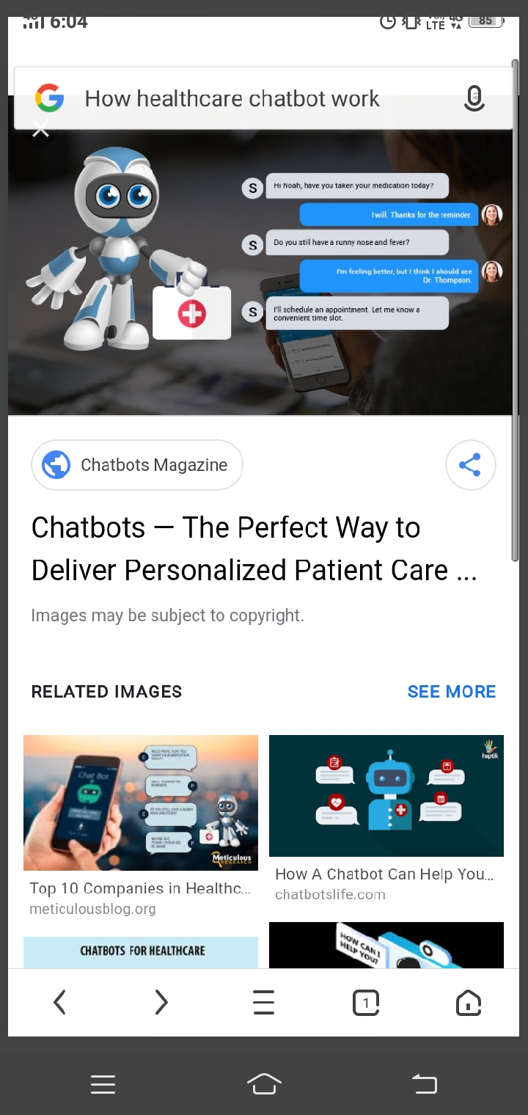
^{CONTENTS}
Abstract
Problem Statement
Chatbot Tasks
Modules
System Architecture
Software Architecture
UML Diagrams
Implementation Technology
Dataset Details
Python Library
Advantages and Disadvantages

Slide 4
ABSTRACT
To start a good life healthcare is very important. But it is difficult to obtain the consultation with the doctor in case of any health issues. The proposed idea to present a design for a medical Chatbot that provides diagnosis and remedies based on the symptoms provided to the system. The system will be able to measure the seriousness of the diagnosis and if needed, it will connect the user to a doctor available online. This Chat-bot also gives information about the hospitals situated near-by to the user and other necessities. The system provides text (or) voice assistance you can communicate with the bot like user friendly.
Keywords: Health, Patient, diseases, medical

Slide 5
Problem statement
This project aims to present a design for a medical Chatbot that provides diagnosis and remedies based on the symptoms provided to the system.
Chat bots can be programmed to respond the same way each time, to respond differently to messages containing certain keywords and even to use machine learning to adapt their responses to fit the situation. A developing number of hospitals, nursing homes, and even private centers, presently utilize online Chat bots for human services on their sites. These bots connect with potential patients visiting the site, helping them discover specialists, booking their appointments, and getting them access to the correct treatment.

Slide 6
Chatbot will perform following tasks:
providing health-related information to users
guidance for patient
doctor’s link
FAQ-type queries (contact details, directions, opening hours and service/treatment details)

Slide 7
Proposed Approach and System Architecture:
MODULES:
A. Conversation of user with Chatbot : Users can ask the health related problems to the chatbot. Chatbots are intended to provide health and therapy information to users, provide services to patients, as well as suggest diagnoses and recommend treatments based on user symptoms. It will also provide nearby hospital address link to them.
B. Communication of Chatbot and its Database : Upon receiving personal queries like problems of the users, symptoms, etc. the input text is processed to extract keywords. Based on the keywords, information required by the user is understood and the information is stored in the database. Other data provided to the chatbot such as username, gender, etc. are also saved. This is done by Chatterbot and Chatterbot library in the python.
C. NLP Response System : If the user is trying to make a conversation with the bot, the input is matched with the data present in database using NLP Algorithm. If the response is available, it is sent to the chatbot.
D. Responding to the user : When a user wants some information pertaining to their health, the response will be provided through this module. If the input matches a with the dataset in the NLP, the appropriate response will be sent to the user. An algorithm to check sentence similarity (NLP) is applied to the modified input to check its similarity with the questions of a predefined question-set, whose answers are available. Also, a random response is sent to the user suggesting “Answer not available” if the input is not matched with the data set.

Slide 8
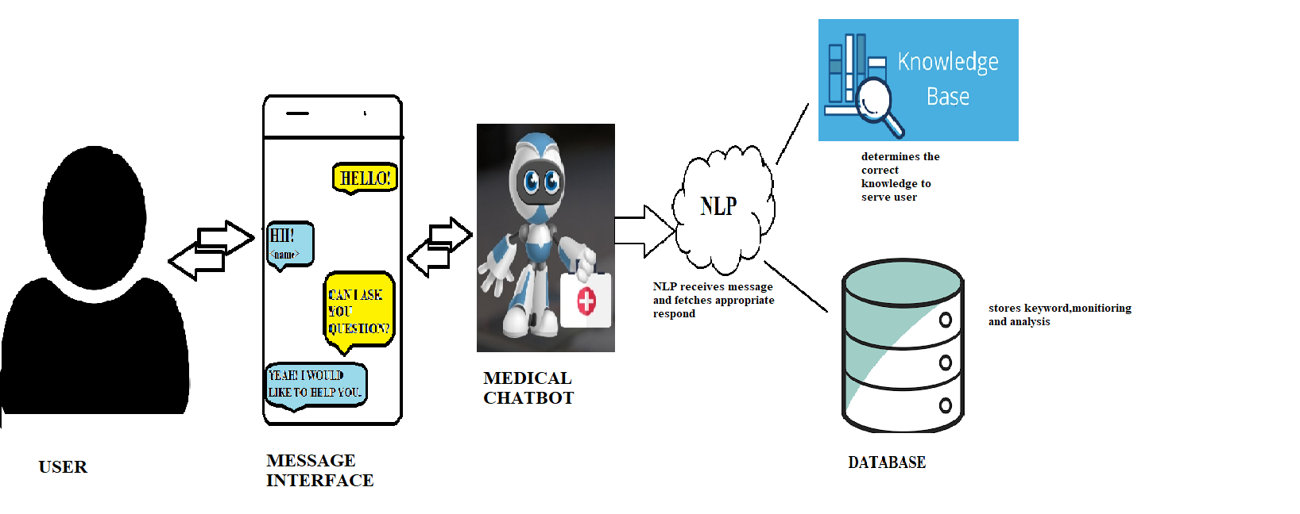
SYSTEM ARCHITECTURE:

Slide 9
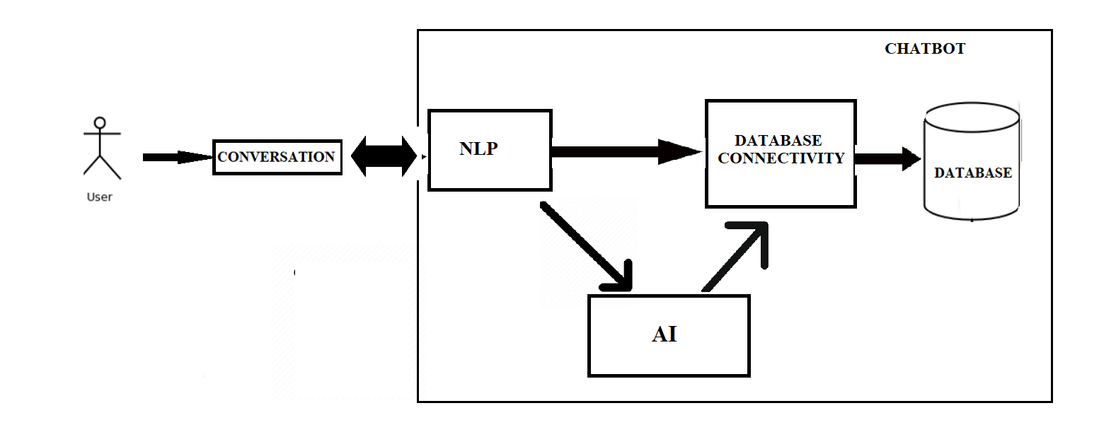
SOFTWARE ARCHITECTURE:

Slide 10

USE CASE DIAGRAM:
READ
POST
CHATBOT
VERIFY
USER
PREDICT THE DIEASES
STORE

Slide 11
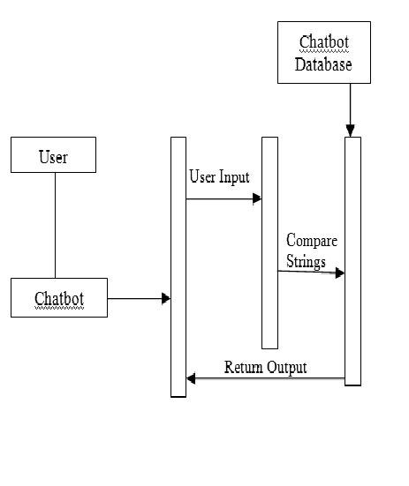
SEQUENTIAL DIAGRAM:

Slide 12
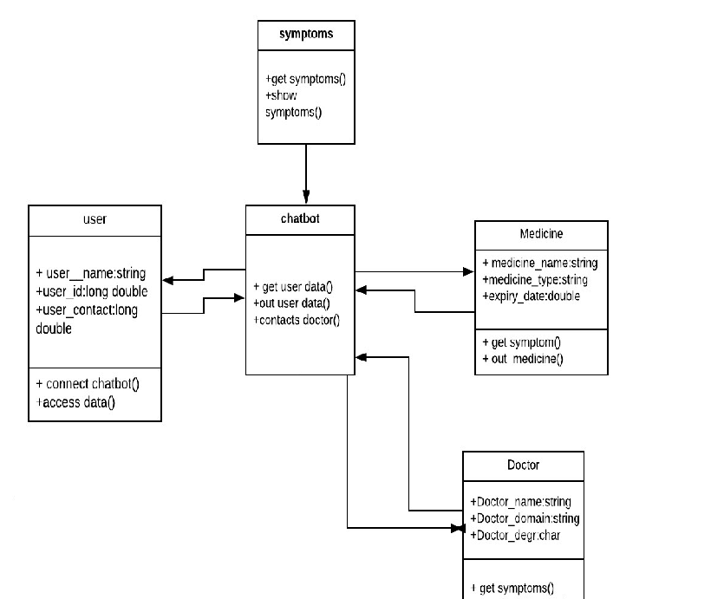
CLASS DIAGRAM:

Slide 13
Implementation Technology
Hardware Requirement:
Processor - Intel Core @1.60GHz
RAM - 8.00 GB
Monitor with minimum screen resolution of 1024x768.
Software Requirement:
Windows XP & above.
MacOS 8.0 & above.
Browsers:
Google Chrome, Mozilla Firefox, IE(Internet Explorer),
Microsoft Edge

Slide 14
Python Library
tkinter
os
numpy
pandas
matplotlib

Slide 15
Dataset Details
The data set is collected from Kaggle Machine Learning Repository. It is a public set of diseases collected for doctoral research. It has three datasets composed by numbers of real disease extracted from all the doctors that are among the top doctors in their feild. Thus, it will collect those diseases and doctors from a dataset according to the symptoms categories such as fatigue, sneezing, cold and others.

Slide 16
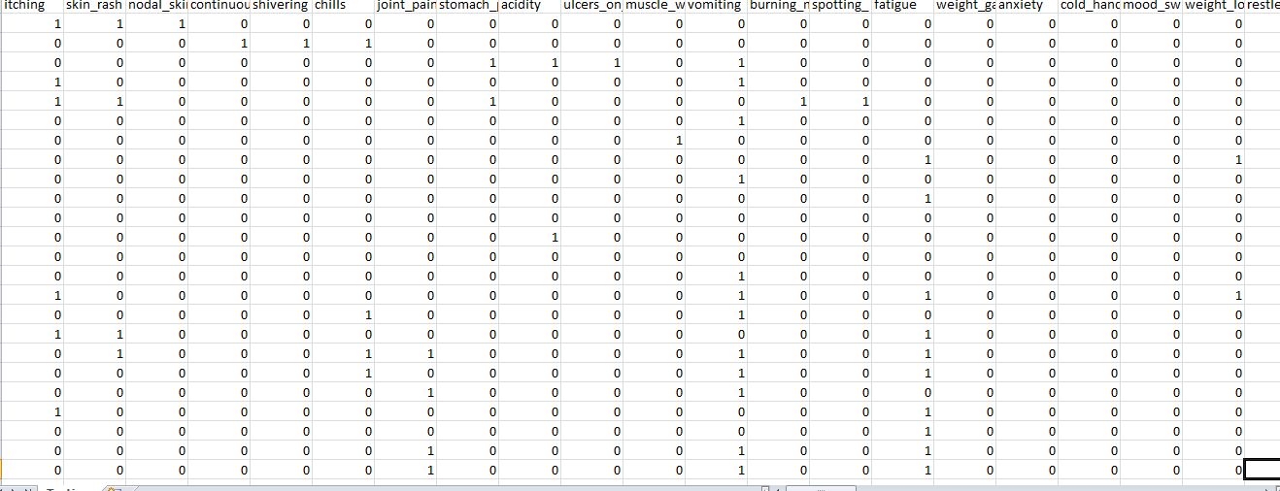
Testing Dataset

Slide 17
ADVANTAGES
1. Accessible anytime:
I’m sure most of you are always kept on hold while operators connect you to a customer care executive. On an average people spend around 7 minutes until they are assigned to a person. Gone are the frustrating days of waiting in a queue for the next available operative. They are replacing live chat and other forms of slower contact methods such as emails and phone calls. Since chat bots are basically virtual robots they never get tired and continue to obey your command. They will continue to operate every day throughout the year without requiring to take a break
2. Handling Capacity:
Unlike humans who can only communicate with one human at a time, chat bots can simultaneously have conversations with thousands of people. No matter what time of the day it is or how many people are contacting you, every single one of them will be answered immediately

Slide 18
ADVANTAGES
3. Omni-capable
The chat bot converses seamlessly across multiple digital channels and retains data and context for a seamless experience. In best cases, even passing that information to a live agent if needed.
4. Free to Explore
The chat bot can reach, consume, and process vast amounts of data– both structured and unstructured–to surface insights from any source - to gather relevant data to solve customer issues quickly.
5. Pre-Trained
The chat bot is pre-trained to understand brand-specific or industry-specific knowledge and terms. Even better, it’s pre-configured to resolve common customer requests of a particular industry.
6. User Interface
A user friendly interface which is engaging and easy to access.

Slide 19
Disadvantages
1.Complex Interface
Chatbots are often seen to be complicated and require a lot of time to understand user’s requirement. It is also the poor processing which is not able to filter results in time that can annoy people.
2. Inability to Understand
Due to fixed programs, chatbots can be stuck if an unsaved query is presented in front of them. This can lead to customer dissatisfaction and result in loss. It is also the multiple messaging that can be taxing for users and deteriorate the overall experience on the website.
3. Time-Consuming
Chatbots are installed with the motive to speed-up the response and improve customer interaction. However, due to limited data-availability and time required for self-updating, this process appears more time-taking and expensive. Therefore, in place of attending several customers at a time, chatbots appear confused about how to communicate with people.

Slide 20
Disadvantages
4.Zero decision-making
Chat bots are known for being infamous because of their inability to make decisions. A similar situation has landed big companies like Microsoft etc. in trouble when their chat bot went on making a racist rant. Therefore, it is critical to ensure proper programing of your chat bot to prevent any such incident which can hamper your brand.
5.Poor Memory
Chat bots are not able to memorize the past conversation which forces the user to type the same thing again & again. This can be cumbersome for the customer and annoy them because of the effort required. Thus, it is important to be careful while designing chat bots and make sure that the program is able to comprehend user queries and respond accordingly.

Slide 21
Conclusion & Future Scope
Chat bots are a thing of the future which is yet to uncover its potential but with its rising popularity and craze among companies, they are bound to stay here for long. Machine learning has changed the way companies were communicating with their customers. With new platforms to build various types of chat bots being introduced, it is of great excitement to witness the growth of a new domain in technology while surpassing the previous threshold.

Slide 22
References
[1] WHO. WHO Health alert brings COVID-19 facts to billions via whatsapp. WHO https://web.archive.org/web/20200323042822/https://www.who.int/news-room/ feature-stories/detail/who-health-alert-brings-covid-19-facts-to-billions-viawhatsapp (2020).
[2] CDC. Coronavirus disease 2019 (COVID-19)—symptoms. Centers for Disease Control and Prevention https://www.cdc.gov/coronavirus/2019-ncov/symptomstesting/symptoms.html (2020).
[3]. Lucas, G. M., Gratch, J., King, A. & Morency, L. P. It’s only a computer: virt https://www.shodganga.inflibnrt.ac.in/, accessed on 07-01-19 12:30 PM.
[3]https://www.tutorialspoint.com/python/
[4]https://www.jdbc-tutorial.com/
[5] International Research Journal of Engineering and Technology (IRJET)

Slide 23
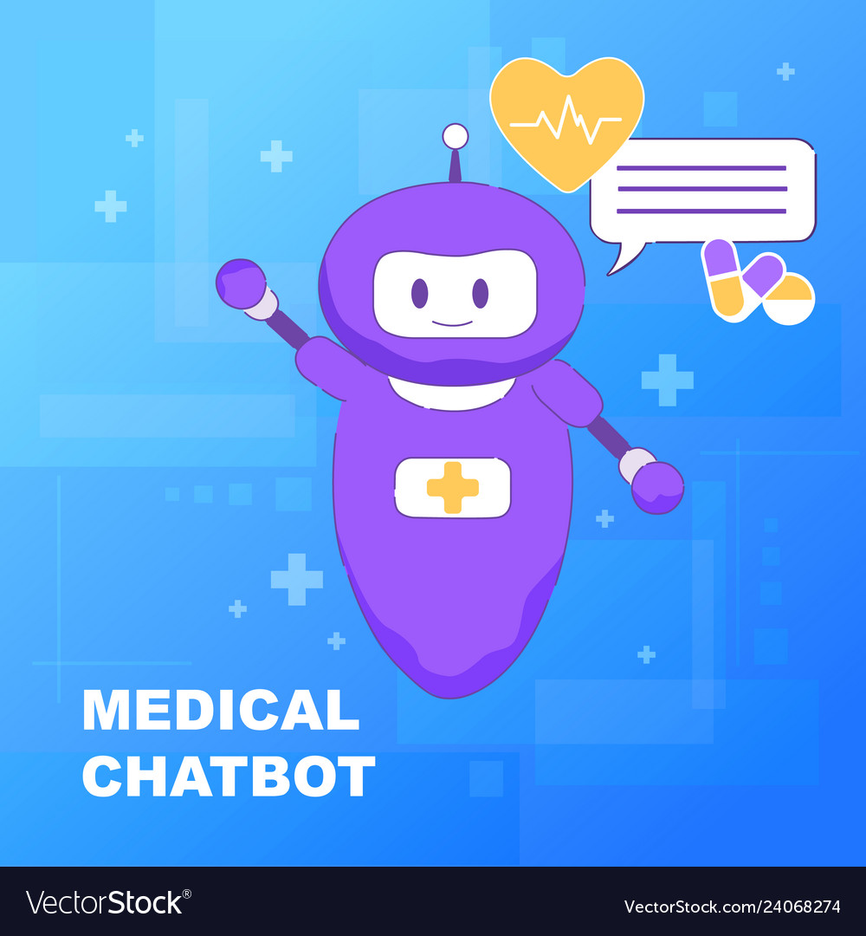
THANK YOU

