Slide 1
AEFI

Slide 2
What AEFI stand for ?

Slide 3
Adverse Events Following Immunization (AEFI)
Definition:
  An AEFI is a medical incident that takes place after an immunization, causes concern and is believed to be caused by the immunization
Types:
  Vaccine reaction: caused by the inherent properties of the vaccine. e.g. fever or febrile convulsion after immunization with whole cell pertussis vaccine.
  Programmatic error: caused by error in vaccine preparation, handling or administration. e.g. abscess at the injection site due to contamination of the needle/syringe, sepsis etc.
  Coincidental: happens after immunization but not caused by the vaccine – a chance association. e.g. common cold after vaccination.
  Injection reaction: caused due to the injection rather than the vaccine. e.g. pain, anxiety etc.
  Unknown: cause can’t be determined

Slide 4
Program errors leading to AEFI
Programme Errors | Adverse Event
Non-sterile injection: Contaminated vaccine or diluents Use of reconstituted vaccine after 6 hours Improperly sterilized syringe or needle Reuse of disposable syringe or needle | Infection e.g. local suppuration at injection site, abscess, cellulitis, systemic infection, sepsis, toxic shock syndrome, transmission of blood borne virus (HIV, hepatitis-B or hepatitis-C)
Vaccine reconstituted incorrectly: Vaccine reconstituted with wrong diluents or inappropriate amount Drugs substituted for vaccine or diluent (e.g. muscle relaxant, insulin) | Local reaction or abscess Effects of drug
Vaccine injected in wrong route/site: Subcutaneous instead of intra-dermal for BCG Too superficial for toxoid vaccine (DPT, DT, TT) Administration in the buttocks. | Local reaction or injection site abscess Sciatic nerve damage
Vaccine transported/stored incorrectly | Increased local reaction from frozen vaccine (and ineffective vaccine)
Contraindications ignored: DPT given ignoring convulsion history with previous dose | More severe convulsion

Slide 5
Common minor vaccine reactions
Vaccine | Local reaction (pain, swelling, redness) | Fever | Irritability, malaise and non-specific symptoms
BCG | Common | Rare | Rare
Hepatitis B | Children up to 5% | 1-6% | Rare
Measles | ~10% | 5-15% | 5% rash
OPV | None | Less than 1% | Less than 1% *
IPV | <5% | >1/10,000 | <1/1,000
Penta | Up to 50% | Up to 50% | Up to 60%
PCV | Up to 50% | ~5% | Very common
TT | ~10% ¥ | ~10% | ~ 25%

Slide 6
Reportable AEFIs
Severe local reaction
Injection site abscess
BCG lymphadenitis
High fever (more than 101⁰ F) within 48 hours
Seizures within 14 days
Encephalitis/encephalopathy within 14 days
Loss of consciousness / shock-like state within 48 hours
Anaphylaxis within 1 hour
Toxic - shock syndrome
Acute flaccid paralysis (occurs extremely rare with OPV)
Hospitalisation believed to be related to vaccination
Death believed to be related to vaccination
Other severe or unusual health events that community thinks was caused by the vaccine and causes serious community concern

Slide 7
Serious AEFIs
Hospitalisation believed to be related to vaccination
Death believed to be related to vaccination
Other severe or unusual health events that community thinks was caused by the vaccine and causes serious community concern
Clustering of events

Slide 8
Actions suggested following a serious AEFI
Immediate preliminary notification of the event to the higher office – local authority
Verification of the event – local HF I/C
Confirmation of the event – local HF I/C
Notification of an official investigation team – DHO
Request for support in investigation to higher office and/or WHO
Investigation of the AEFI
Submission of the report to the AEFI Expert Review Committee for final conclusion

Slide 9
Suggested composition of the investigation team
District surveillance focal person
A senior pediatrician
EPI coordinator
Local HF I/C
DSV/TSV
Representative from provincial EPI (if requested)
Representative from WHO (if requested)

Slide 10
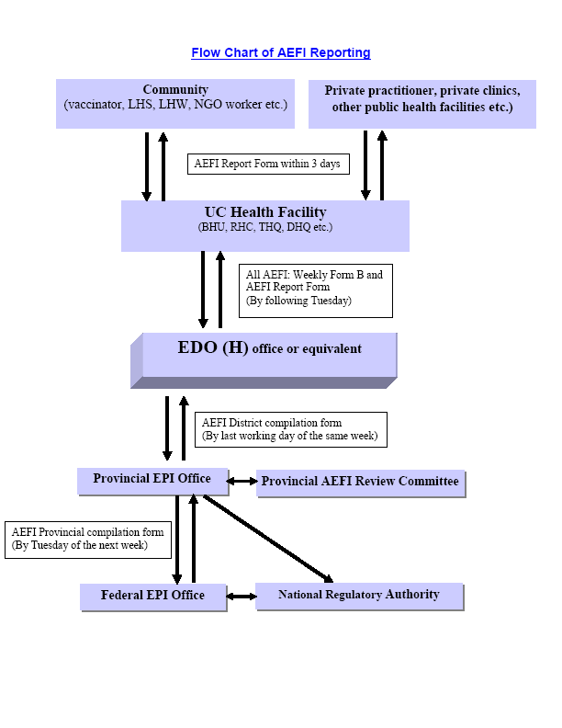

Slide 11
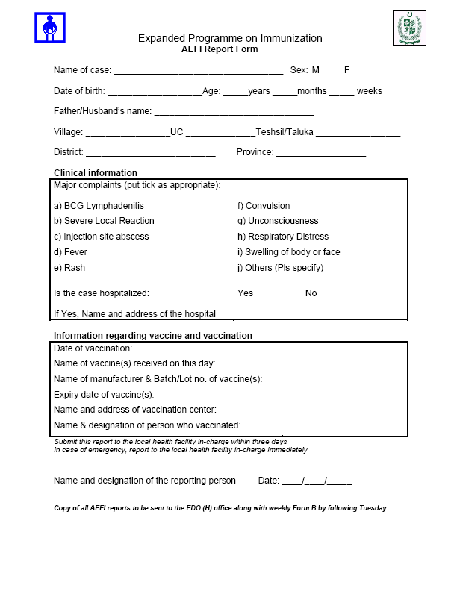

Slide 12
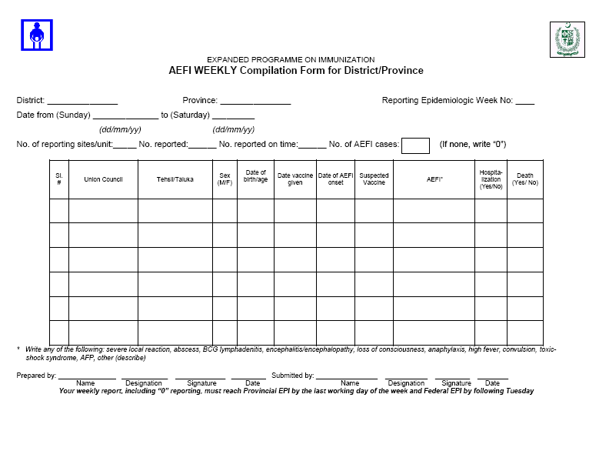

Slide 13

Thank You

