Slide 1
eStop
Digital Bus Stop

Slide 2




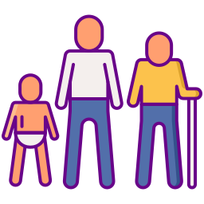

SURVEY
Daily 7k to 8k People Travel from
Islamabad to Gujar Khan
320 to 350 Transporting Vehicles
Normally People And Drivers wait
40 to 50 minutes
For Each other.
20% to 25% women
10 %to 15% Old age
The number of 3G and 4G users in Pakistan reached 55.47 million by the end of May 2018
Pakistan Telecommunication Authority (PTA).
Sources include: United Nations

Slide 3


PROBLEMS
Time wasting procedure / no scheduling
No predefined route
No Security and comfort
Fare fluctuation on fertival and events

Slide 4

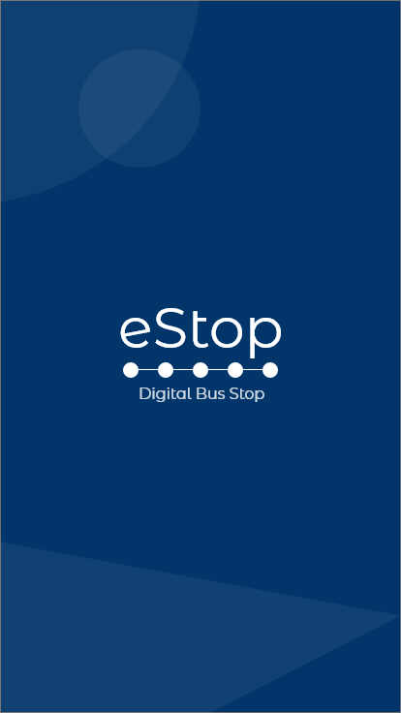
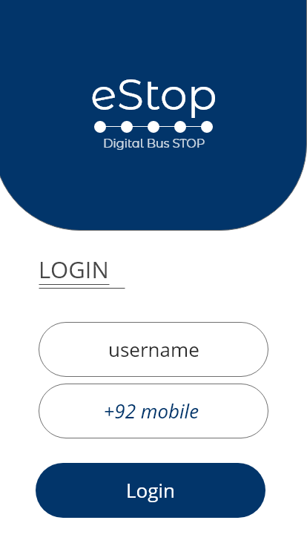
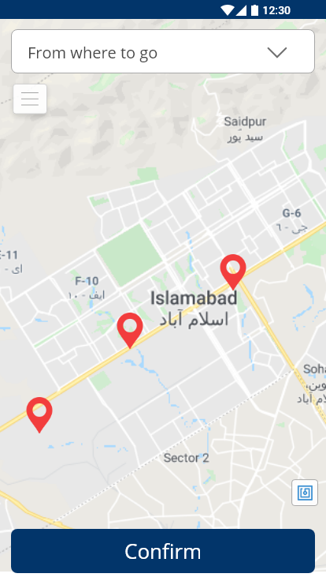
OVERVIEW
Mobile App with simple UI/UX Design

Slide 5

SOLUTION
Reservations are easily and quickly made on time
Serve Countrywide
Secured Transport
Predefined routes
Fare Adjustment
https://isbhacks2019.devpost.com/submissions

Slide 6


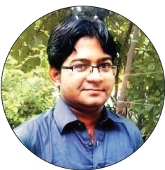

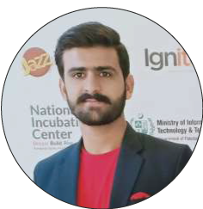
TEAM
Imran Qamar
CEO
Toqeer Haider
Designer
Usama Hadi
Data Analyst
Naveed Ishfaq
Technical Director

Slide 7


Questions & Answers

