Slide 1

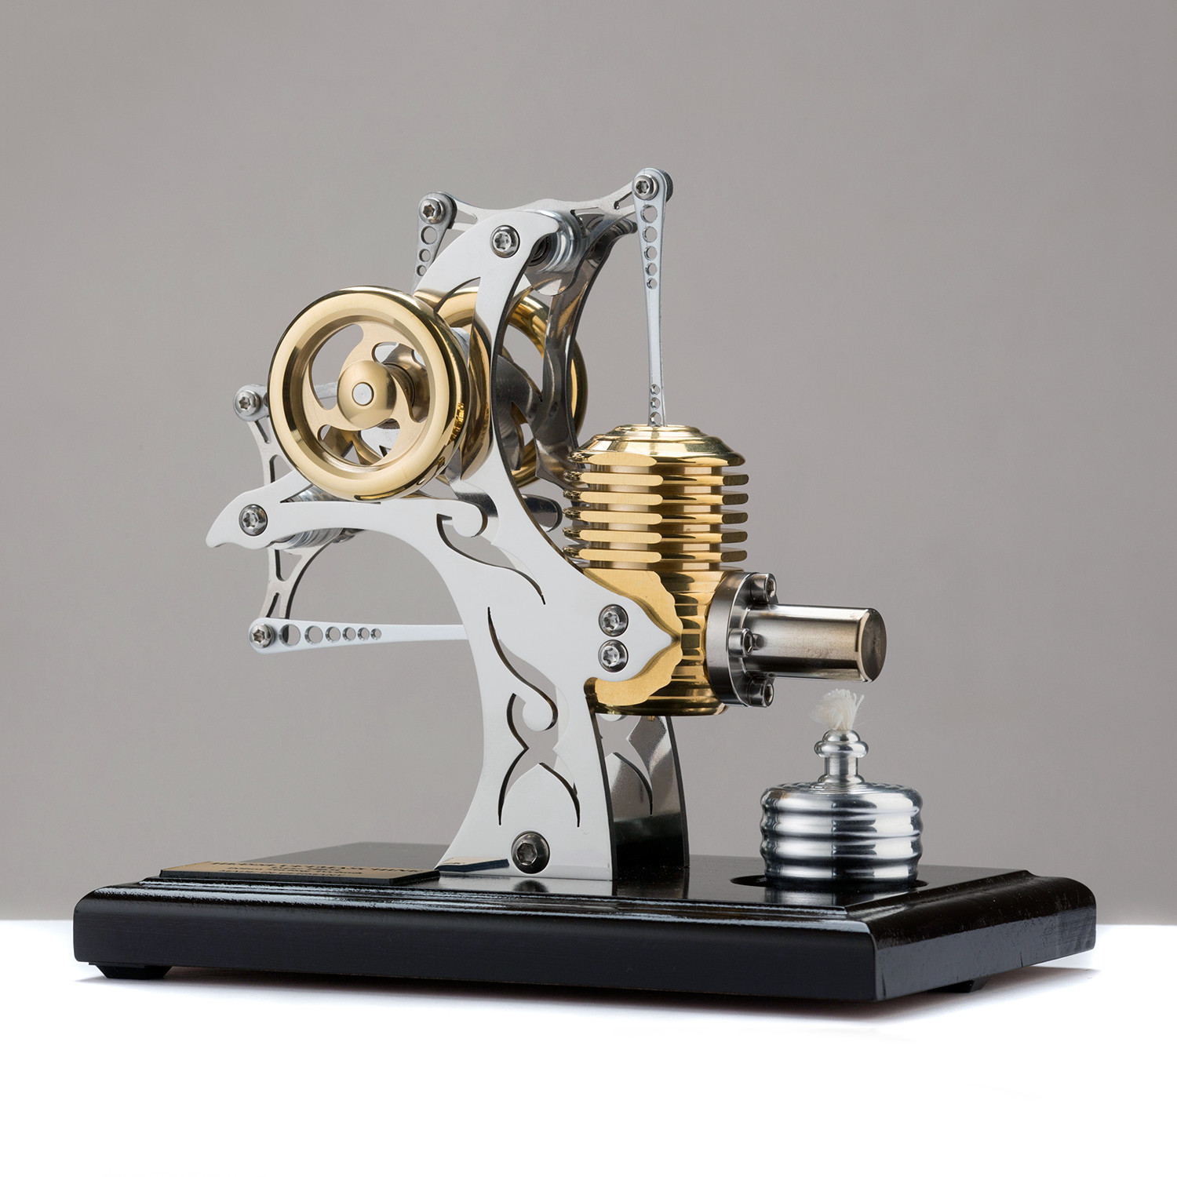
The aesthetics of designing an AI system.

Slide 2
“What is beautiful is usable”
Source: https://www.touchofmodern.com/sales/boehm-stirling-d89dd4ed-63ab-4d56-833a-61584dff2c96/small-tattoo-motor-ebbe6f19-a230-407a-94f3-4cdf8fd43edd?open=1

Slide 3
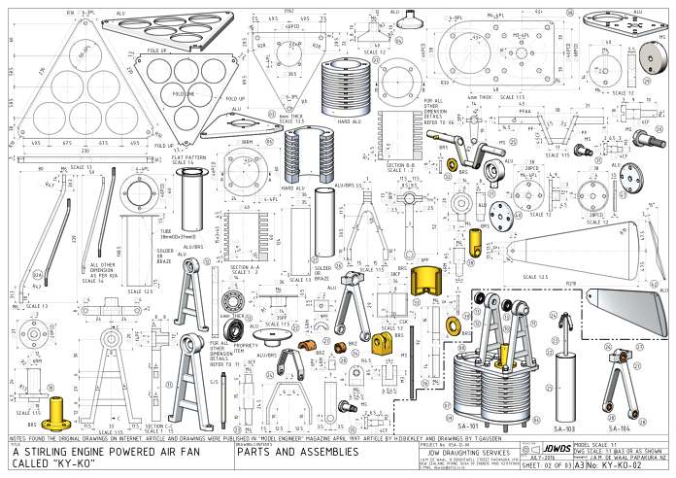
The explosion of knowledge and data.
Source: https://modelengineeringwebsite.com/Ky-ko_fan_files/KY-KO-A3-SHEET-02.pdf

Slide 4
Learning outcomes
To ignite critical creative thinking about your next AI design project.
What is the principle of self explaining design, and how it applies to AI?
Can we use old templates / blue-prints for new design projects?

Slide 5
“What is beautiful is usable”
(But it is not always the case!)
  Tractinsky, et al. (2000)
In the UI / Mechanical design, research suggests that visual aesthetics affects user’s perception of the system.
An aesthetically pleasing design is perceived as
  More usable
  More trustworthy
  More tolerant to user mistakes
In a world of fast model inference via an API this is highly important.
Its also important if your product is an AI system.
  A beautiful API of an AI product will have an immediate advantage over its rivals.

Slide 6
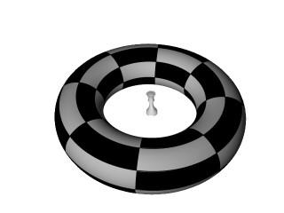
Design Quiz: what is being asked here?
Is this question self explanatory???

Slide 7
Design Quiz: what is being asked here?
Domain = Extremely difficult IQ tests.
Source: The Eureka Test - Opus of N. Lygeros
And now???

Slide 8
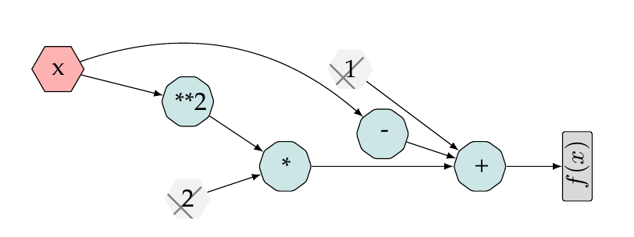
Design Quiz: what is being asked here?
Is this question self explanatory???

Slide 9
Design Quiz: what is being asked here?
Domain = Automatic Differentiation
And now???

Slide 10
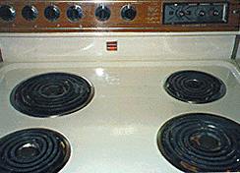
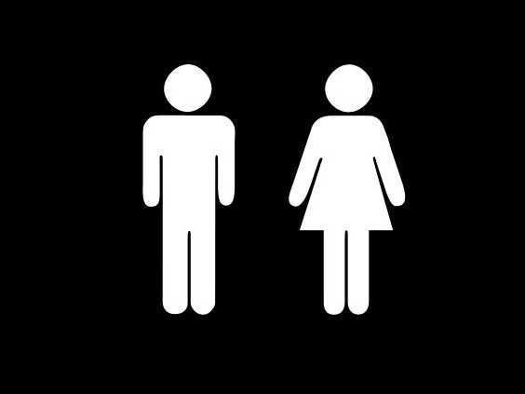

Design Quiz: what is wrong here?
Domain = Male Vs female design
Which design is better? The second unless you want to burn your hands!

Slide 11
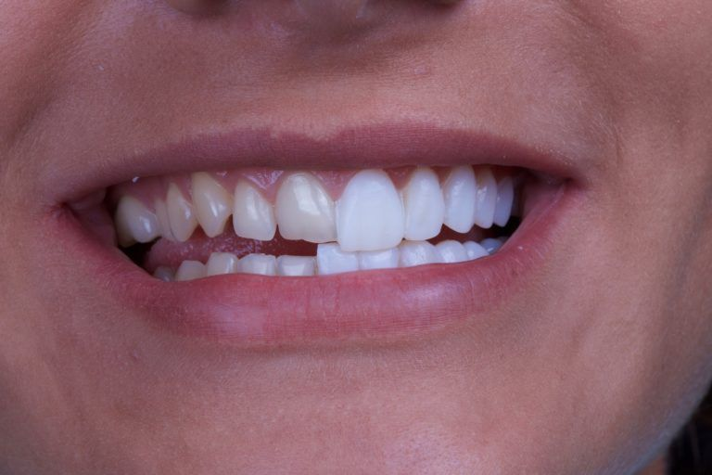
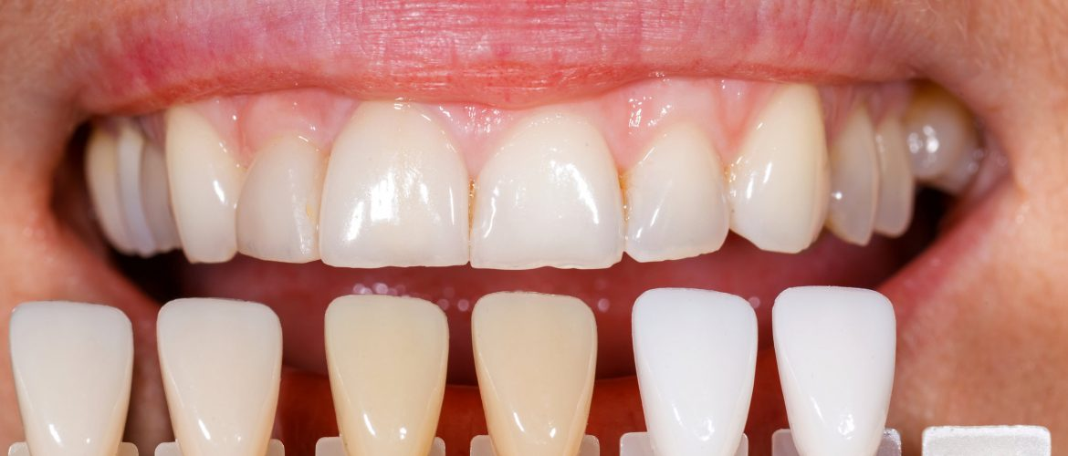
Design Quiz: Would you let your dentist choose a colour without examining your mouth?
Domain = Dental Veneers
ResNet
SeNet
DPN
VGG11
So why would you design an AI system without examining several models?

Slide 12
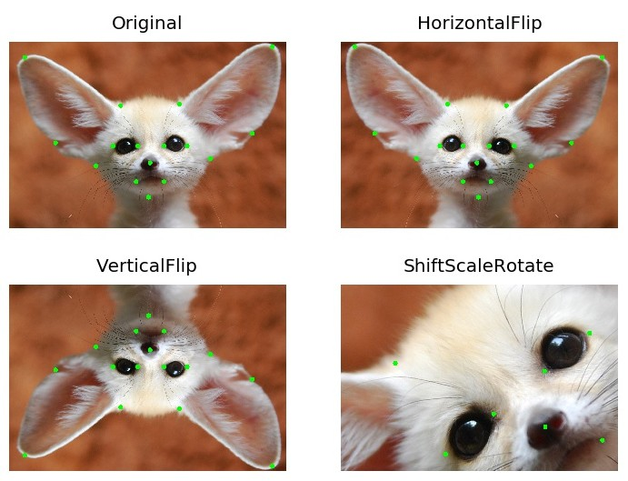
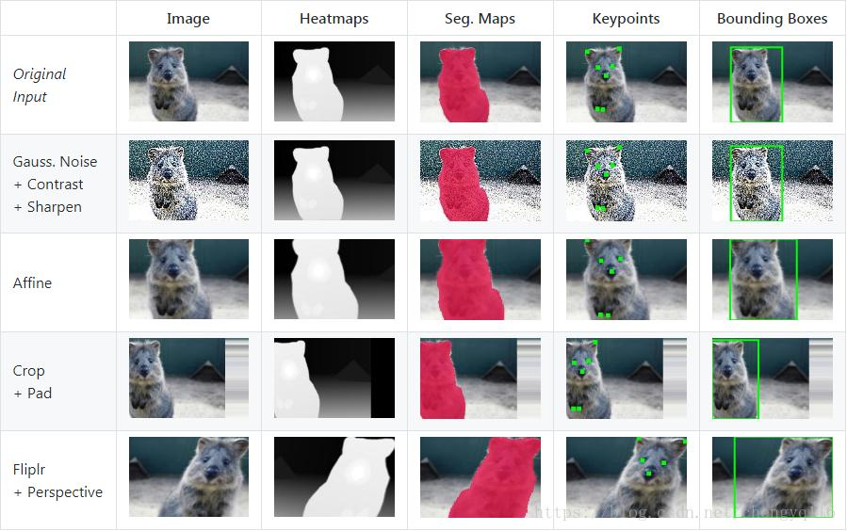
Make sure your model generalises well by using augmentations.
Domain = Face Detection
Albumentations + ImgAug are Widley adopted in the industry

Slide 13
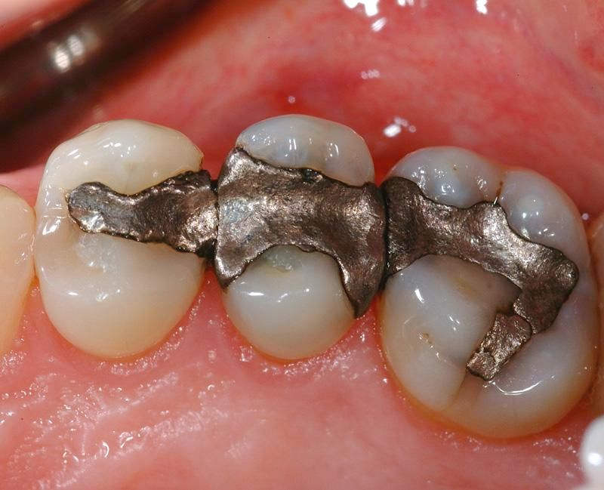
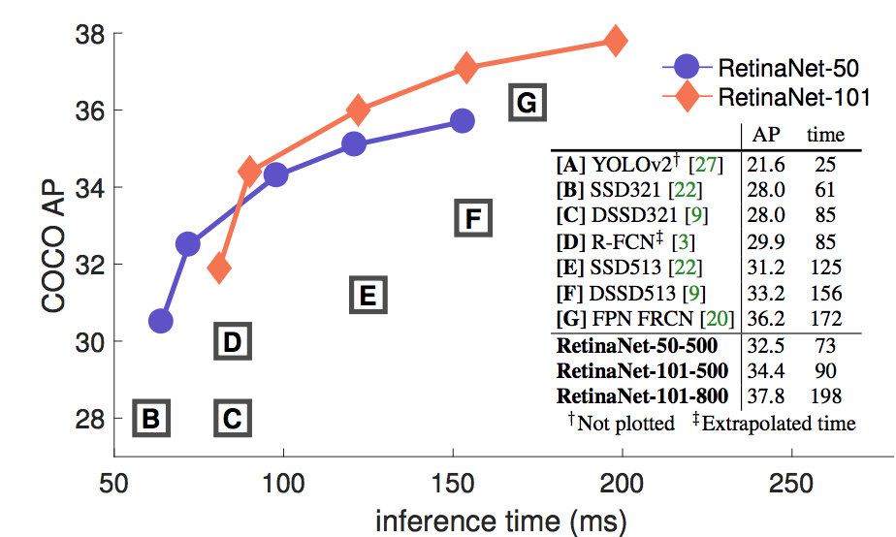
Design Quiz: Is functionality important? Yes but … toxicity is too
Domain = Dental Amalgams
There is never a “one size fits all” model -- we want a good model without drawbacks (Mercury ), white fillings cost much more but are not toxic.
Functionally, these will last for a lifetime but there is a single design flow here … (Mercury) (2 minutes)

Slide 14
What guides an AI design?
Principles
Principles of design are concepts used to organize or arrange the components in an AI system design
Several important principles:
  Clear set of requirements
  Highly detailed literature review with alternative models
  Modular code (VS and not Jupyter)
  Intuitive API and a minimal UI

Slide 15
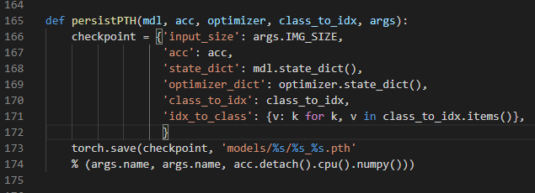
Is this a good design for persisting AI models?
Is there anything missing?

Slide 16
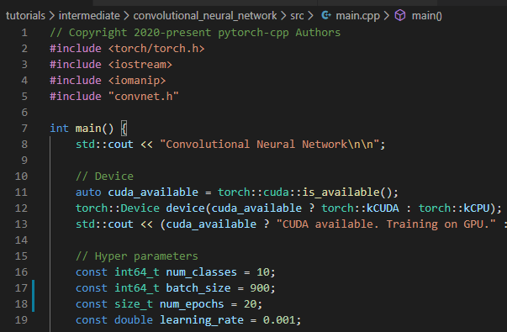
Is this a good design for defining an AI model?
What is the design flow?

Slide 17
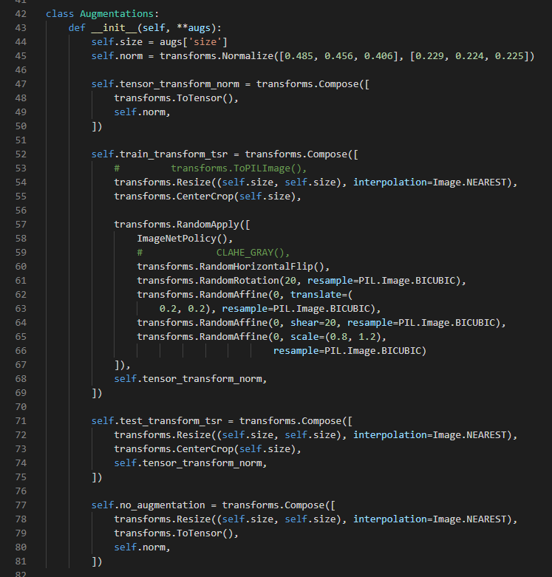
Is this a good design for defining augmentations for AI models?
What is the design flow?

Slide 18
Further reading
Alice Rawsthorn’s: Pirates, nurses and other rebels .

