Slide 1
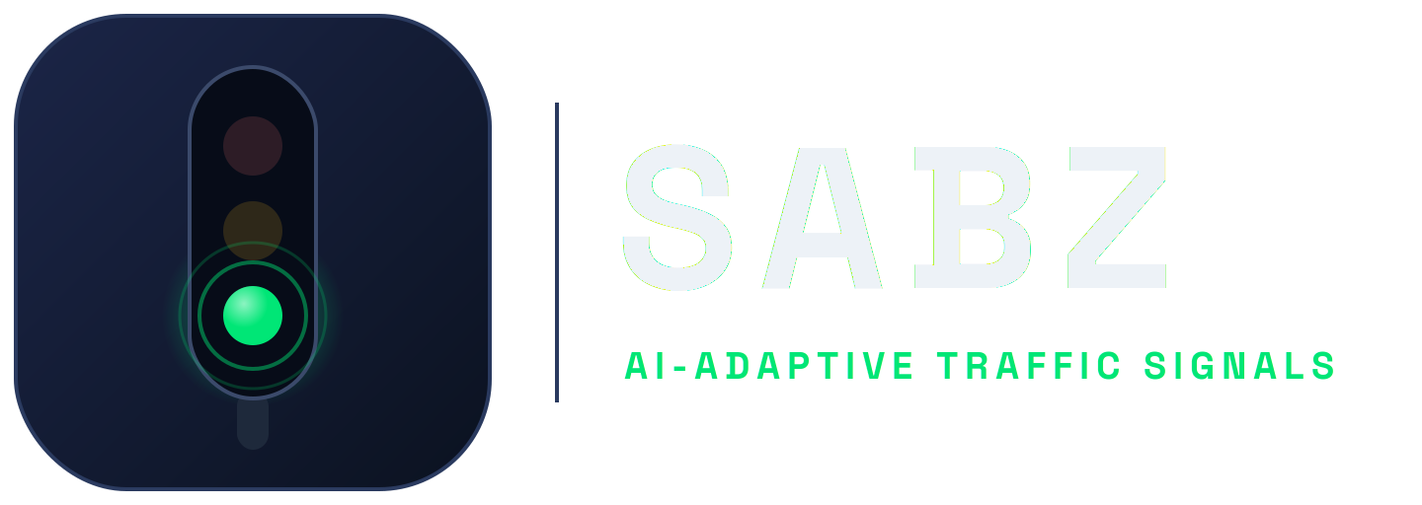
THE PROBLEM
Traffic lights that cannot see
• Lahore moves 4.1 million vehicles through signals that follow a clock, not the traffic.
THE BLIND CYCLE
• The average commute takes 34.8 minutes, much of it spent idling at red lights.
NS GREEN · 30s
EW GREEN · 30s
Then repeat. The same split at rush hour and at 3 AM, whatever the road looks like.
• Fixed timers run blind cycles: an empty road can hold green while a long queue burns time and fuel on the cross street.
4.1M
34.8 min
• The signal never sees which road actually needs the green.
vehicles in Lahore
average commute
Result: green time is wasted where nobody is waiting, and missing where queues are longest.
SABZ · AI-ADAPTIVE TRAFFIC SIGNALS
1

Slide 2
THE SOLUTION
SABZ: signals that see, think, and adapt
SEE
THINK
ACT
Cameras count vehicles on every approach, in real time. No new roadworks: SABZ reads the cameras an intersection already has.
A trained DQN brain reads an 18-feature state of the junction and decides, every second, which road gets green.
Signals hand green to the road that needs it, then re-check a second later. One road open at a time.
HARD-CODED SAFETY, NEVER LEARNED AWAY
Green is never cut under a car inside the 70 m dilemma zone. A starvation guard means no road waits forever. Max-green keeps every split fair.
5,506
1 s
2 of 3
7.3 s
model parameters
decision cycle
benchmark scenarios won
best average delay
SABZ · AI-ADAPTIVE TRAFFIC SIGNALS
2

Slide 3
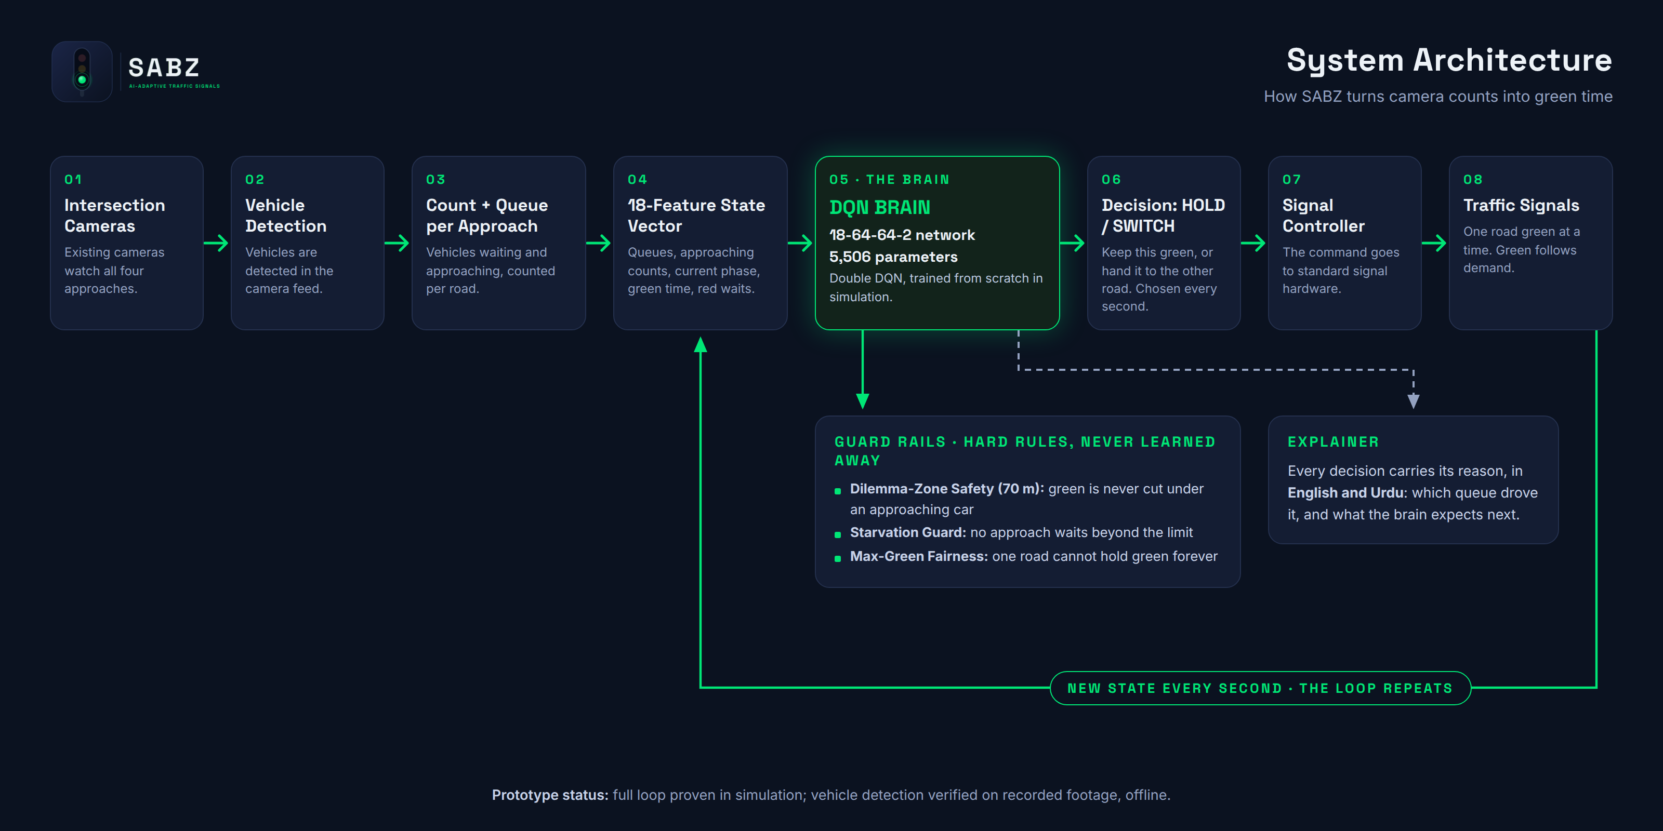
System Architecture
SABZ · AI-ADAPTIVE TRAFFIC SIGNALS
3

Slide 4
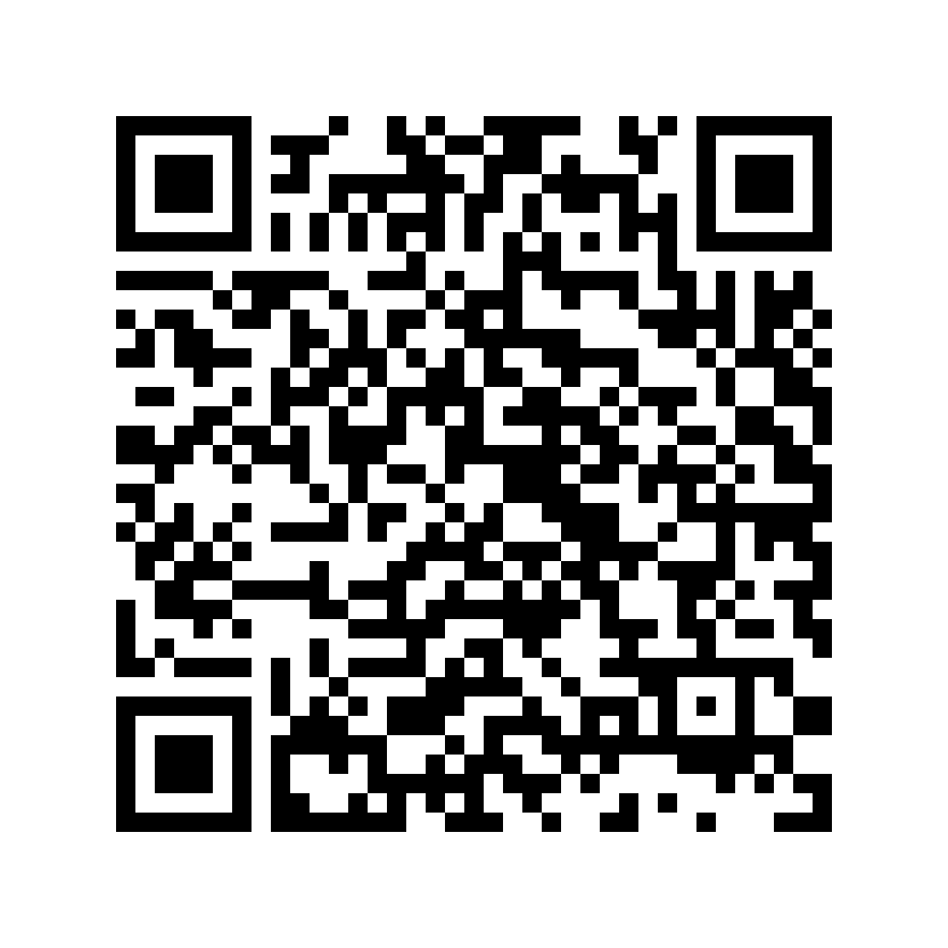
LIVE DEMO · RESULTS
Watch it beat the fixed timer, live
Two identical intersections. Same rush-hour traffic, same start. One runs a blind 30-second fixed timer. The other runs the real trained SABZ brain, deciding every second, one road open at a time.
• Identical traffic generated live on both sides
• Real trained weights: the same 5,506-parameter brain from our benchmarks
• Every decision explained on screen, in English and Urdu
SCAN FOR THE LIVE DEMO
2/3
7.3 s
47%
Run the battle on your phone: fixed timer vs the SABZ brain.
scenarios won against actuated control
best average delay per vehicle
less delay in the best live battle
github.com/pakmultilinks-dot/sabz
SABZ · AI-ADAPTIVE TRAFFIC SIGNALS
4

