Slide 1
Food Buddy
Client team : Group 18
Developer Team : Group 14

Slide 2
Summary OF PROJECT
The project aims to develop a standalone Web app that enables effective shared grocery and expense management. The app automates inventory management and sends notifications when supplies run low, reducing the risk of running out of essential items. It also facilitates expense management by allowing users to split grocery bills and track expenses in real-time. The app further aims to reduce food waste and expenses through monthly usage analysis, providing users with insights into their consumption patterns and enabling them to make informed decisions about their shopping habits. Overall, the app offers a convenient and efficient solution to grocery and expense management for individuals and households.

Slide 3
MEETING’S WITH CLIENT
9
5
7
20
With client team
With Dev team
With TA’s
Internal Meetings

Slide 4
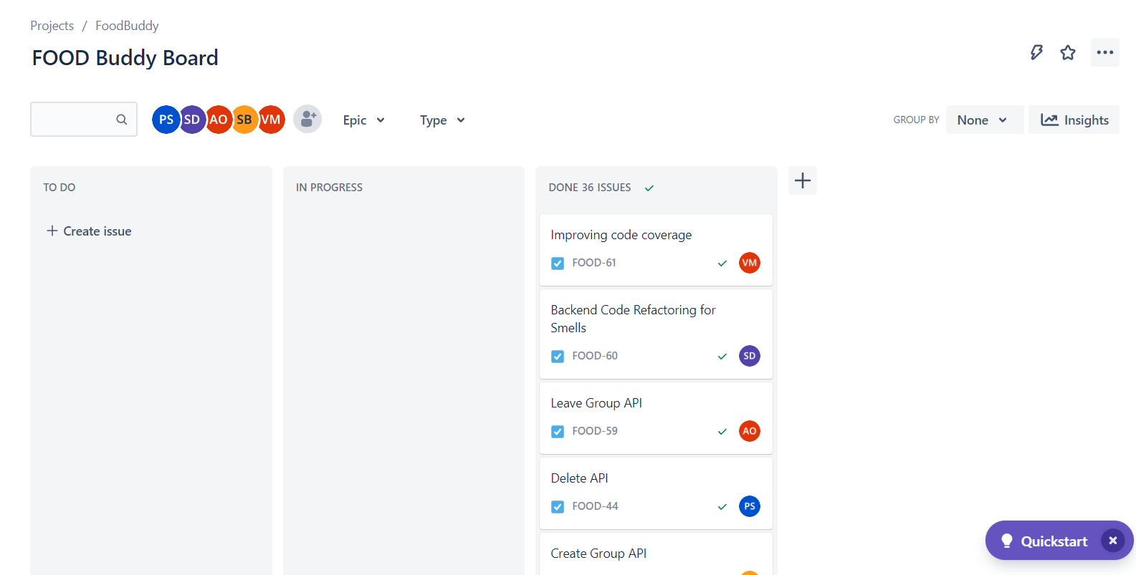
JIRA DASHBOARD

Slide 5
PROJECT STATUS (100%)
DELIVERABLES
STATUS
LOGIN FUNCTIONALITY
HOME PAGE
GROUP MANAGEMENT
EXPENSE MANAGEMENT
INVENTORY MANAGEMENT
RECIPIE SUGGESTION
EMAIL NOTIFICATION (After Mid-Term)
LEAVE GROUP (After Mid-Term)
DELIVERED
DELIVERED
DELIVERED
DELIVERED
DELIVERED
DELIVERED
DELIVERED
DELIVERED

Slide 6
DEMO TIME

Slide 7
Learning from the project
Clearly understand project requirements, goals, and scope before starting development.
Break down the project into smaller manageable tasks and Use agile methodology to manage the project and ensure progress.
Assign roles and responsibilities to team members based on their skills and expertise.
Use version control to manage code changes and ensure that the latest version is being used.
Conduct regular code reviews to ensure code quality and prevent bugs.
To apply Test driven development to project.
Understanding how to write clean and Readable code.
Analyze and improve existing code through refactoring.
Continuously monitor the software before deployment to catch any issues and ensure that it is running smoothly.

Slide 8
THANK YOU

