Slide 1
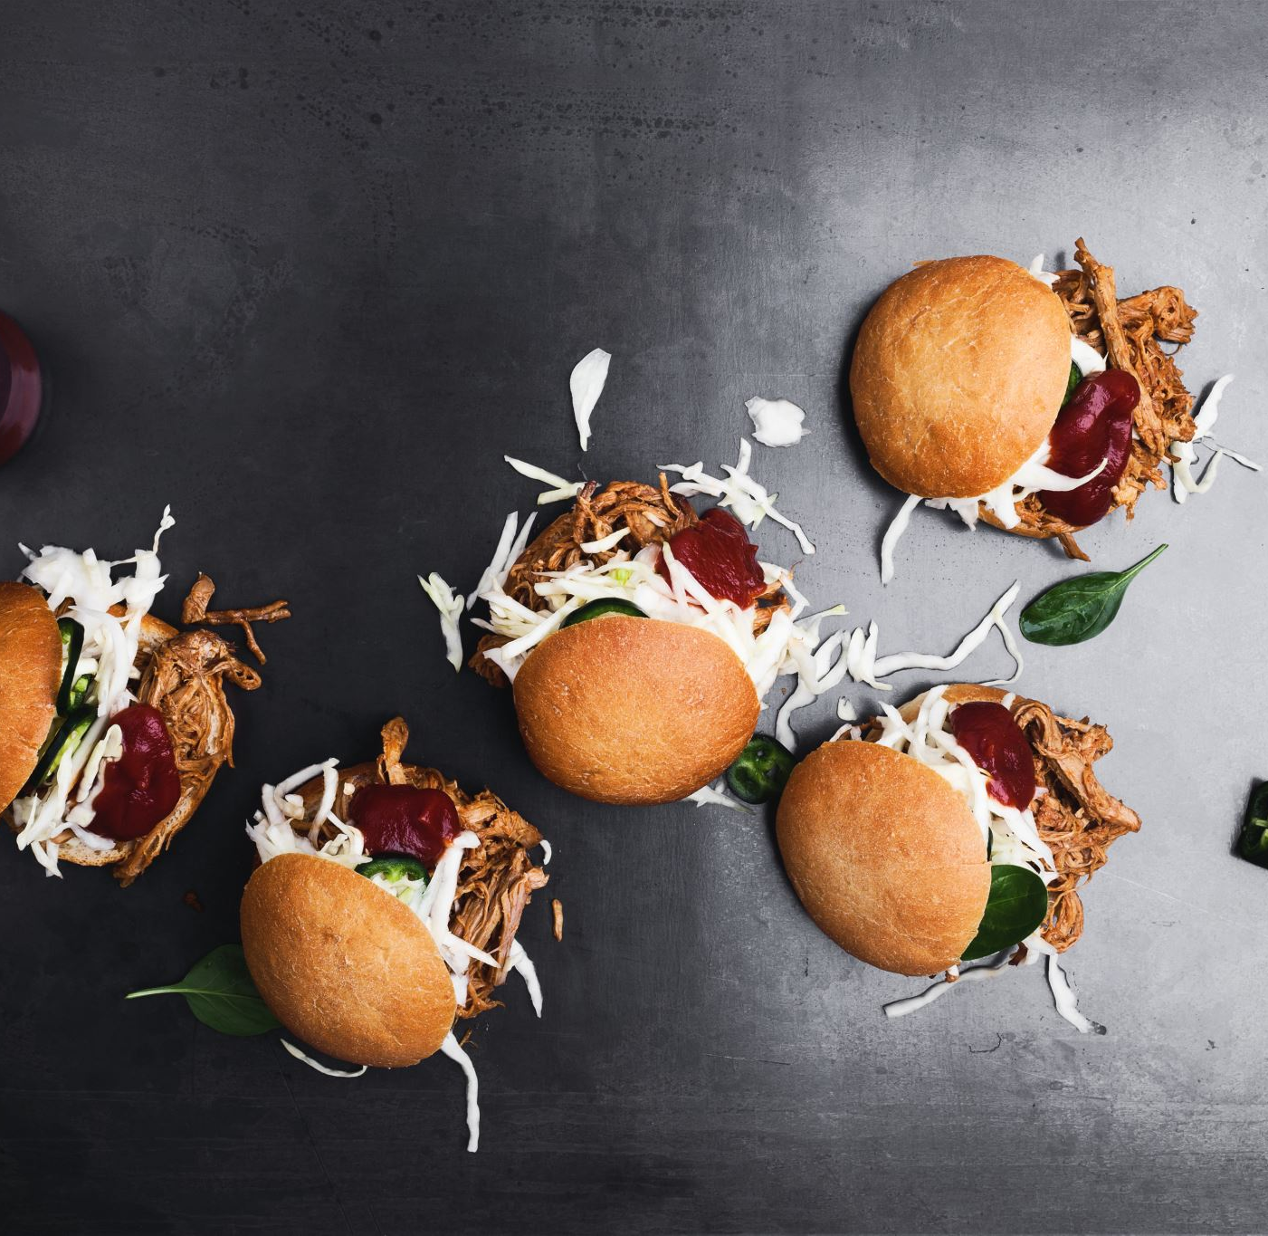
Food Buddy By group 18

Slide 2

Objective
Standalone app for effective shared grocery and expense management
Automating inventory management and notifications
Reducing food waste and expenses through monthly usage analysis

Slide 3
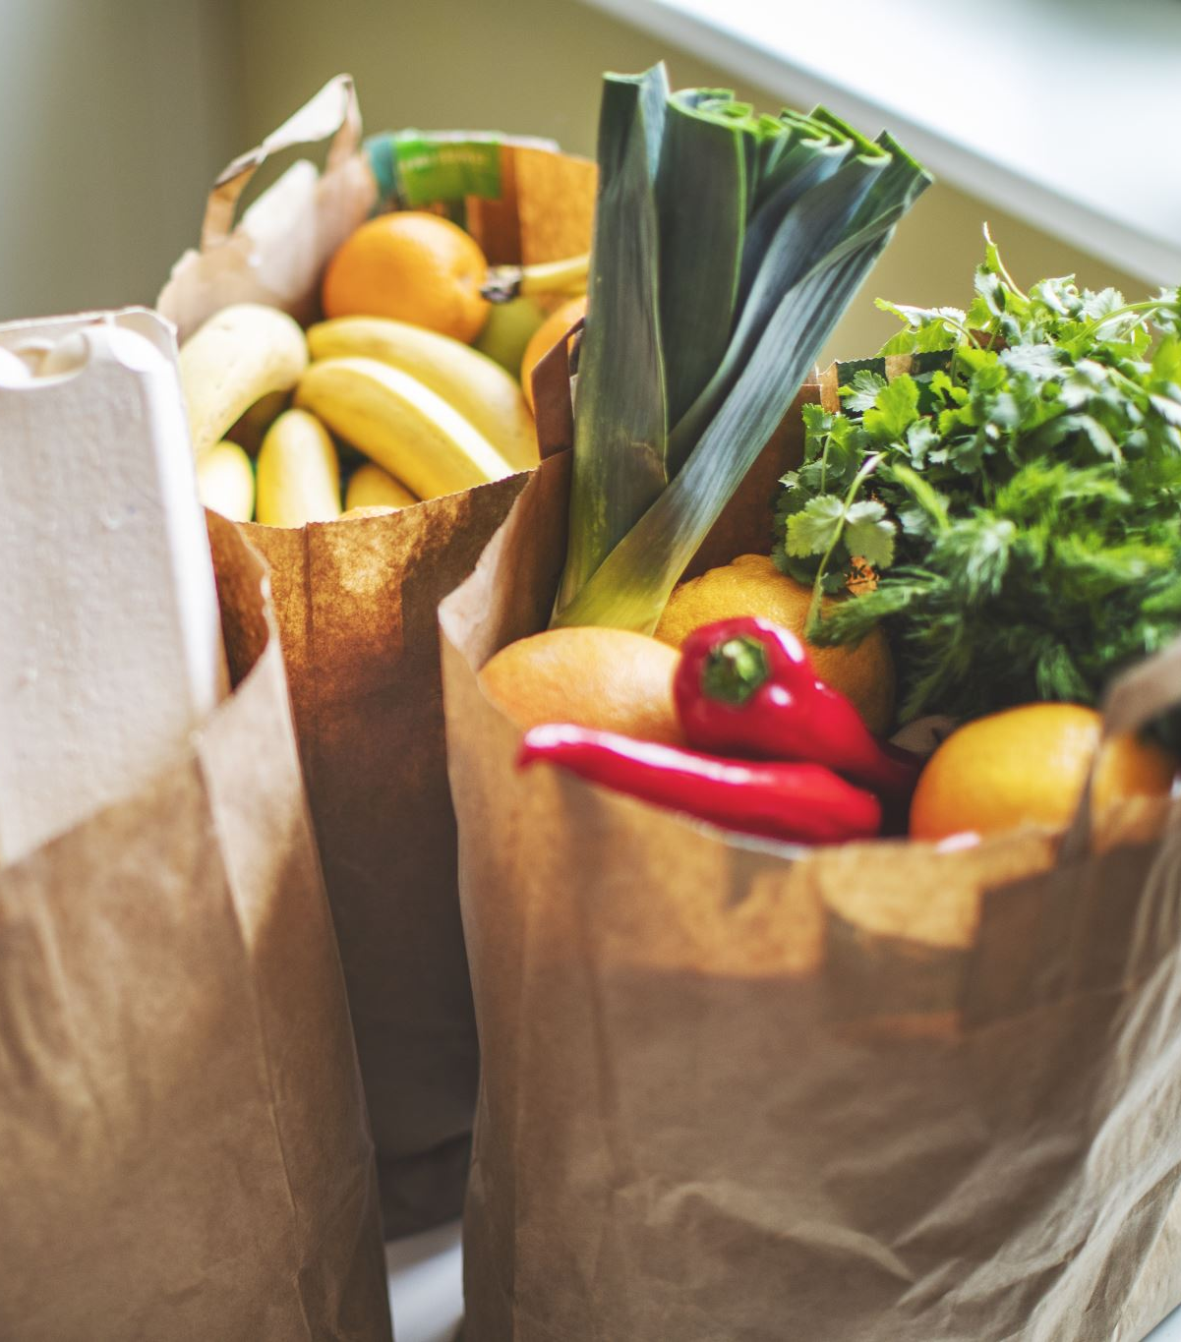
What's the problem?
Keeping track of expenses and grocery shopping
Keep the supply of consumable groceries.
Recipes that can be prepared using the available grocery stock

Slide 4
How it's done today?
Many applications available for managing grocery and tracking expense.
Searching the recipe using the ingredients that are available.

Slide 5

What's new?
Integrated functionality for managing expenses and grocery stocking
Grocery stock suggestions and reminder
Recipe suggestion

Slide 6

Who cares?
Individuals residing in shared housing
Group of users facing difficulty in managing their shared grocery list
User who want to utilize available ingredients to prepare meals
User who want to keep track of monthly usage of groceries

Slide 7
Risks
A large and comprehensive dataset is needed for better recommendations of recipes.
Depends on constant user input.
Difficulty in customer retention.

Slide 8

Plans/Milestones
Planning – 1 week
User management – 2 weeks
Grocery inventory management – 3 weeks
Grocery expense management – 3 weeks
Recipe suggestion – 2 weeks
Testing and deployment – 1 week

Slide 9
Thank you

