Slide 1
YourDoc
One stop destination for your medical problems!

Slide 2
What’s the problem
No one-stop destination.
Patient & Doctor profile (complete history).
Hospital/ Doctor authenticity.(Admin approval)
Search and book.

Slide 3
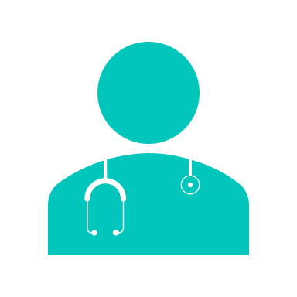
How is it done today ?
Apps and Websites to find a clinic near by.
No centralization of Patient’s medical record.
No one stop solution

Slide 4

What's new in our Proposal ?
Digital Doctor’s prescription/observations/scans/reports.
Doctors' authenticity.
Easy Search and book/manage appointments.
Centralized patients' records.

Slide 5

Who Cares ?
Patient.
Doctor.
Better treatment.
R&D.
Dieticians.

Slide 6
Risks
Patient's medical history sensitivity.
Doctor’s Authenticity.
Profile Security .

Slide 7
Plans/Milestones
Researching and data collection on the project – 1 week
Planning and wireframing – 1 week
Building login / registrations functionalities for Patient, Doctor & Admin – 1 weeks
Building Admin functions – 2 weeks
Implementing search functionalities for patients- 1 weeks
Creating a patient profile( Uploading documents) – 2 weeks
Booking Appointments – 1 week
Creating a dashboard for the doctor where he can view bookings and prescribe medications– 1 week
Integrating the project – 1 week
Deployment & testing – 1 week

