Slide 1
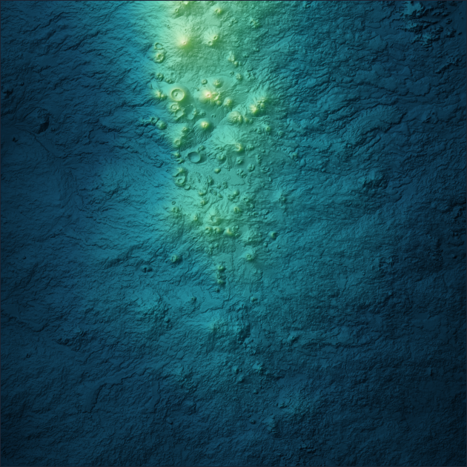
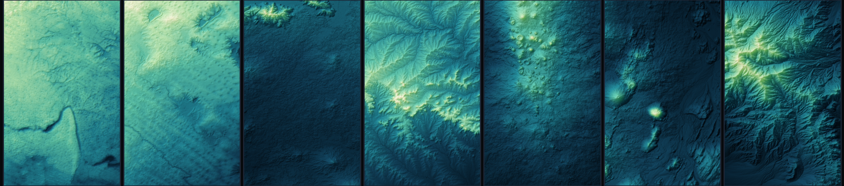
TerraTrace
Earth terrains that answer to the Moon and Mars
Submitted to the NASA Space Apps Challenge 2026 challenge “Identify Earth Locations that
Analog the Permanent Moon Base Locations and Mars”. Published as open prior art, built and
gated weeks before the event — stated openly rather than dressed up as event work.
terratrace.fit
github.com/pal-123456789/terratrace
Harrat Khaybar, Saudi Arabia · real Copernicus GLO-30 terrain
Seven Earth candidates, one light direction and one vertical scale across every panel — nothing contrast-stretched, so flat terrain reads as flat.

Slide 2
Which Earth terrains are morphologically comparable — and at what scale?
THE QUESTION
One narrow, measurable question. TerraTrace answers it with measured distance between real elevation models, and with the scale at which the comparison is honest. It does not answer “where should we land”, and it says so everywhere it could be misread.
What it does
What it refuses
Reprojects every terrain onto its own body's metric grid.
Aggregates to a common support, so no unit is compared below its source resolution.
Ranks by Pareto dominance over declared axes — never a composite score.
Traversability, autonomy, mission readiness.
Geological equivalence between two bodies.
Site access, permitting or ecology.
Any single “Mars-likeness” score.
Five result states, three of them refusals — including BLOCKED, when a unit cannot be compared at all. A tool that will not say “this is a safe place to land” is more trustworthy for saying so.

Slide 3
Five worlds, one method, no black box
WHAT IT IS BUILT ON
5
40
891
51
planetary bodies: Earth, Mars, the Moon, Mercury, Ceres
cited descriptor families (~290 scalar values)
offline tests, 0 network required to run them
scientific-correctness oracles over the operators
Real data, keyless
Depth where it is cited, restraint where it is not
Mars MOLA · Moon LOLA · Mercury MESSENGER · Ceres Dawn.
Earth: ESA Copernicus GLO-30, read straight from the public AWS COG mosaic — no account, no key.
15 catalogued products, each with coverage, licence, vertical accuracy and a per-file SHA-256.
Slope, relief, ruggedness, connectivity, curvature, roughness/Hurst, openness, geomorphons, anisotropy.
Every descriptor carries a definition, a unit, a window and a citation — and a stated claim boundary.
A mechanical guard fails the build if any published number stops matching the code.

Slide 4
It caught its own false analog
RESULT 1 · MARS · PROTOCOL V3
An earlier exploratory run favoured “Craters of the Moon, Idaho” — a famous basalt analog. We tested that under a protocol frozen before the data, and withdrew it ourselves.
S
SUPPORTED
smoothness tracks the class
Read it honestly
v3 is pre-specified but not fully pre-registered — the rules and config were frozen before the data, the protocol document was committed after the run. We say so on every surface rather than letting a reader discover it.
V
NOT SUPPORTED
volcanic origin adds nothing
R
SUPPORTED
no candidate reversal under resolution matching
15 / 15 confirmatory cells accounted for. Every resolution-change class is reported, including the two that are zero: 11 unchanged, 0 stabilised, 1 destabilised, 0 reversed, 3 membership changed, 0 error.
Within this panel and lens: roughness tracks the class, origin does not.

Slide 5
The other half of the challenge, run on real lunar data
RESULT 2 · THE MOON · REAL LOLA TERRAIN · EXPLORATORY
All six published south-polar candidate regions from the NASA Goddard 5 m/pixel LOLA products, screened against the same Earth roster at a declared 500–1000 m support.
18 / 18
6 / 6
2 of 6
site × support cells where the same single Earth candidate is non-dominated
published error realisations in which that membership survives
sites with no candidate within 50% on every axis — screened, not matched
The honest shape of it
Ordering is decisive everywhere; closeness almost nowhere. For Shackleton rim and Malapert massif the surviving candidate is 44–71% away on some axis — the least-dissimilar member of a weak shortlist, which is the exact failure mode we withdrew a Mars claim over. Naming that is the point. Mars itself is excluded from this regime by arithmetic, not convenience: MOLA's effective floor is above every support a 16 km tile can carry.

Slide 6

Every number has a receipt
EVIDENCE & REPRODUCIBILITY
891
51
4
0
offline tests across 96 modules, 0 failures
scientific-correctness oracles, stable hash
frozen artifact hashes, re-asserted after every change
credentials needed for the headline Earth data path
Reproduce the headline result
What keeps it honest
pip install numpy rasterio
python -m terratrace.cli study \
--config config/matched_footprint_v3.yml --source cog
A guard computes every published count from the source and fails the build if prose drifts.
A frozen claim ledger maps each claim to the evidence that would falsify it.
The site's links, fragments and markup are checked before deployment.
Offline once the tiles are cached. The engine re-derives two descriptors through an independent GIS toolchain, and validates its reprojection against closed-form geodesy rather than against a second wrapper around the same library.
Repository

Slide 7
Named first, not buried
LIMITS, AND WHAT WOULD HELP MOST
Open, and stated plainly
The honest ask
The lunar work is exploratory: six nearby sites are not six independent tests.
The error-ensemble check uses 6 of the 100 published realisations.
No external reviewer has examined the independent reproduction.
No demo video; the shot-by-shot script is in the repository.
The engine is prior art, built weeks before the event. What a team adds from here is the part that counts: a second terrain family it has never seen, an independent re-derivation by a different GIS toolchain, or a validation set drawn by someone with planetary field experience. If you would rather find the place where this quietly overclaims than add a feature, that is the most useful thing you could do to it.
terratrace.fit
Method write-up, frozen protocols, claim ledger,
validation report and limitations — all public.
github.com/pal-123456789/terratrace

