Slide 1
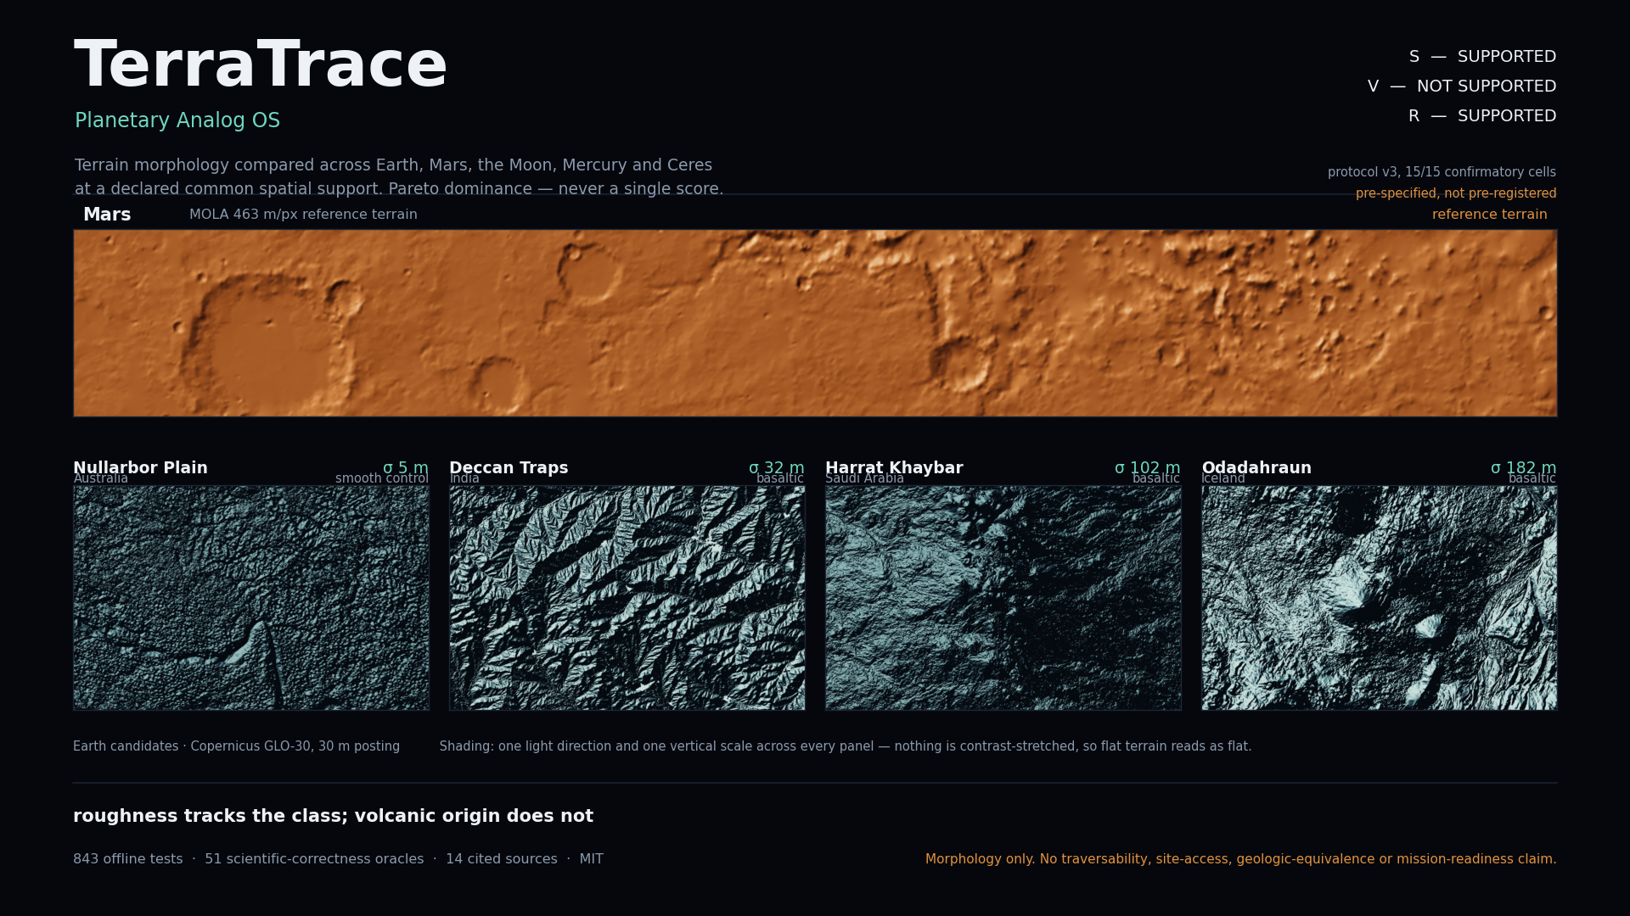

Slide 2
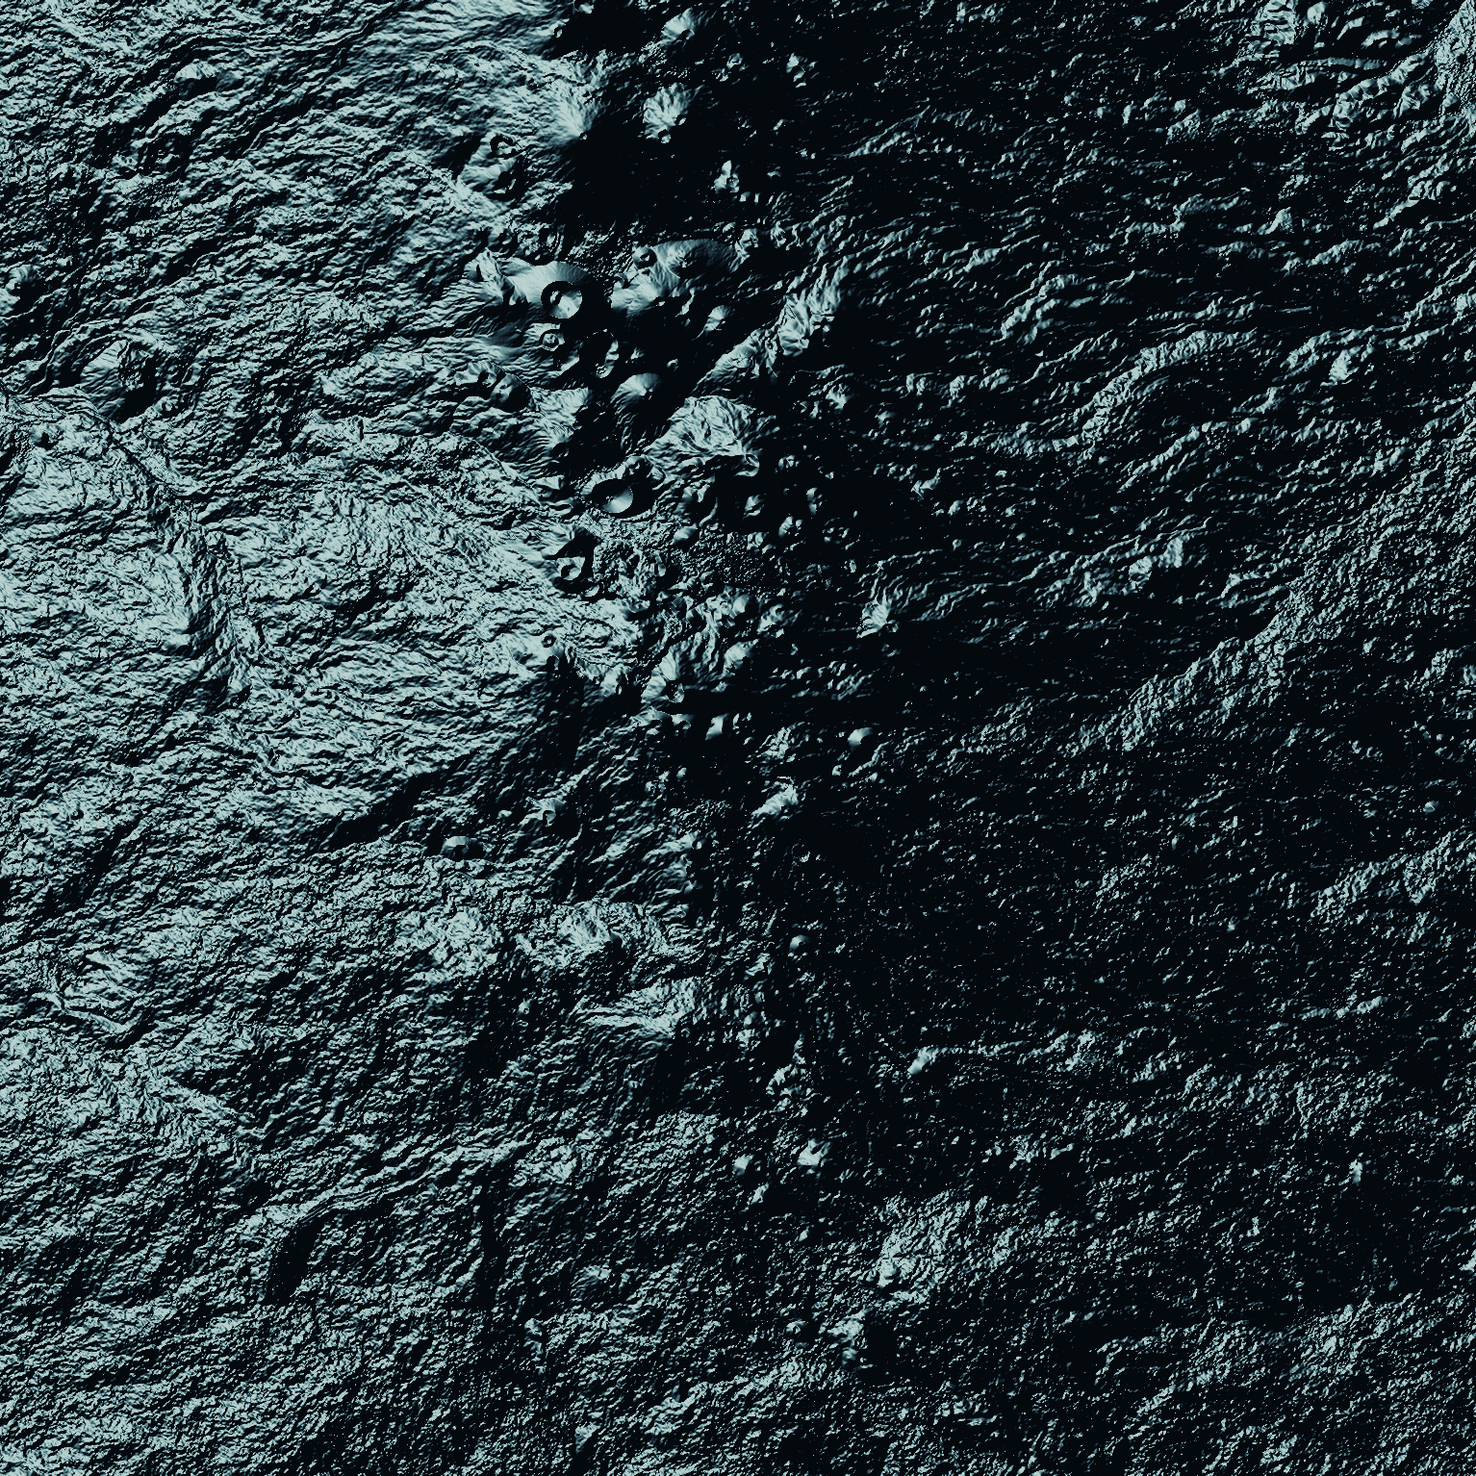
Earth terrain that answers to Mars and the Moon
NASA SPACE APPS CHALLENGE 2026
TerraTrace asks one narrow, measurable question: **which Earth terrains are morphologically comparable to a given planetary reference, at a declared common spatial support?** It answers with measured distance, uncertainty and a gap ledger — and nothing else.
Challenge
“Identify Earth Locations that Analog the Permanent Moon Base Locations and Mars”
Published as open prior art, deliberately, weeks ahead of the event — stated openly rather than dressed up as event work.
Harrat Khaybar, Saudi Arabia · σ 102 m · real Copernicus GLO-30 terrain

Slide 3
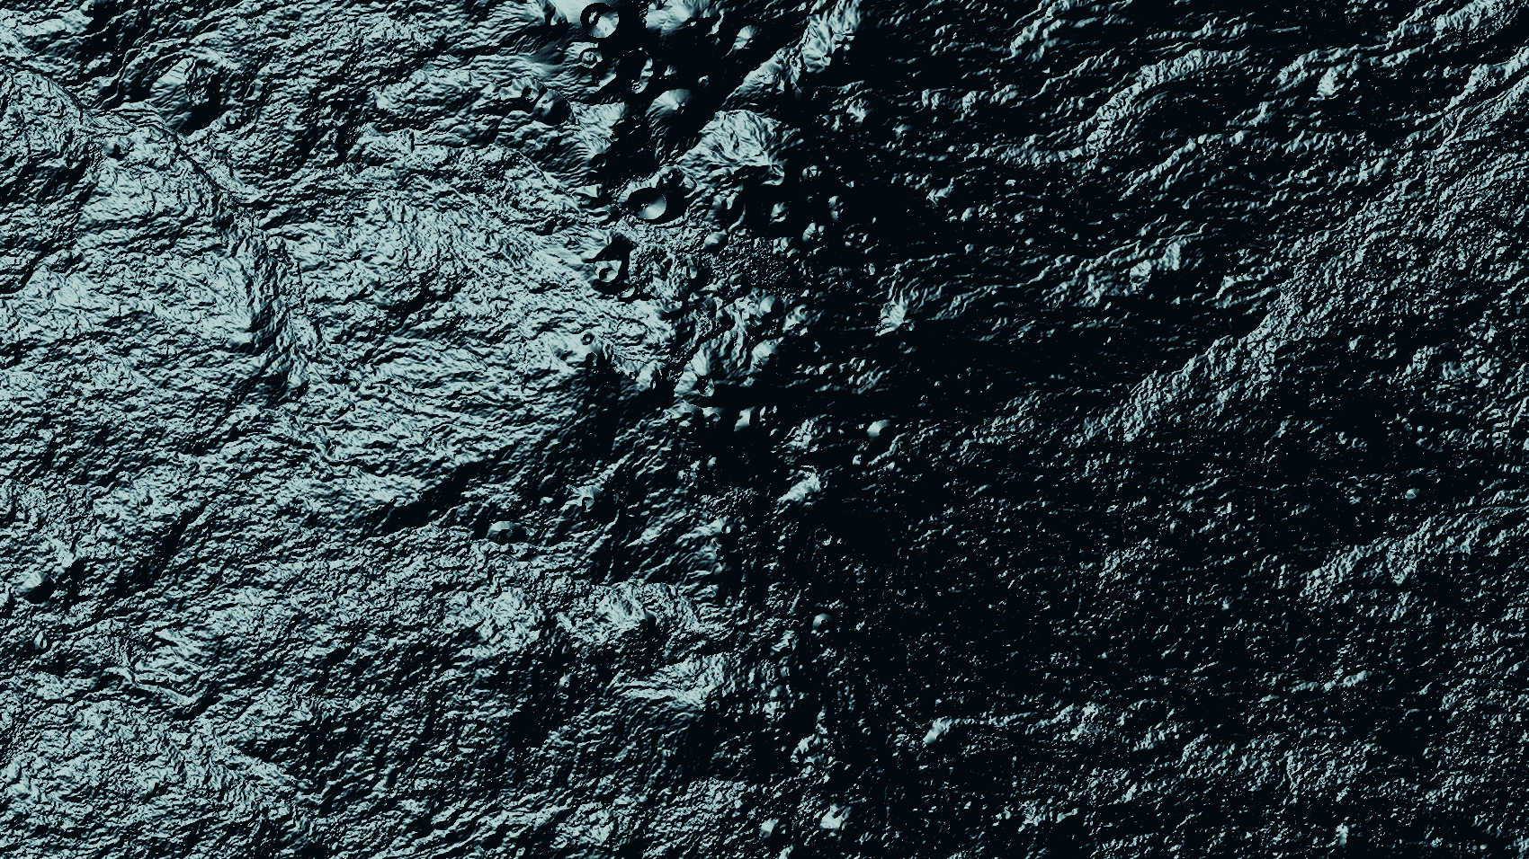
Real elevation to a defensible comparison
PIPELINE
Five stages, each one a place where an analog study usually overclaims.
01
02
03
04
05
Catalog
Support
Describe
Compare
Refuse
14 products with coverage, licence and vertical accuracy — body, CRS and datum asserted by tests.
Each window reprojected onto its own body's metric grid, then compared only at a common effective support.
40 cited descriptor families — 200 scalar outputs — computed in pure NumPy.
Pareto dominance across axes chosen per lens. A single composite score does not exist in the code.
Eligibility filters run first; a gap ledger and a provenance graph travel with every result.
Earth
Mars
Moon
Mercury
Ceres
Input is real map data, not a synthetic stand-in — shown here at 30 m posting.
Five bodies, one method.

Slide 4
Depth where it is cited, restraint where it is not
THE MEASUREMENT LAYER
Every descriptor carries a definition, a unit, a window and a citation — and a stated claim boundary.
40
200
6
0
descriptor families, each cited to the literature it comes from
scalar outputs emitted by the descriptor bank
decision lenses — five by default, hydro opt-in
composite scores anywhere in the codebase
Axes, not a verdict
Four result states, two of them honest refusals
Slope, relief, ruggedness, connectivity, curvature, vector ruggedness, roughness/Hurst, openness, geomorphons, power spectrum, anisotropy.
The decision is Pareto dominance over a small declared set per lens — so a candidate that wins on roughness cannot be quietly traded against one that wins on relief.
RECOMMEND_FOLLOW_UP and TIE, plus INDETERMINATE (insufficient evidence) and NOT_COMPARABLE.
BLOCKED is a real outcome: a water or flat tile is filtered out before it can be scored.
A study that cannot separate candidates is allowed to say so.

Slide 5
We withdrew our own headline finding
THE BENCHMARK, INCLUDING THE PART THAT WENT AGAINST US
Three acts, each one published before the next was run — so the record shows the order in which we knew things.
Act I · exploratory
Act II · pre-registered
Act III · measured why
A real multi-region atlas suggested an analog we liked.
A matched-footprint test to falsify it.
Protocol v3 asked what actually explained the match.
Screened as a hypothesis, not a result.
It failed. The claim was withdrawn.
Roughness, not volcanic origin.
Protocol v3, confirmatory cells
15 / 15
15/15 honest cells · 0 comparability-gate violations · 11 unchanged, 3 membership-changed, 0 reversed
Pre-specified, not fully pre-registered: the rules and config predate the run, the protocol document does not. We say so everywhere the verdicts appear.

Slide 6
Roughness tracks the class; volcanic origin does not
THE RESULT
S — SUPPORTED
A smooth non-volcanic control holds Pareto layer 1 at every honest support (1500, 2000, 3000 m), for all three volcanic-plains references.
V — NOT SUPPORTED
Basaltic origin buys nothing beyond roughness.
R — SUPPORTED
Class-level membership survives a change of support; 0 of 15 confirmatory cells reversed.
Where it is soft
The single top pick is a near-tie: it reverses on a 6-px crop shift. The class result is robust; the ranking is not.
σ = measured roughness of each Earth candidate at 60 km support. Teal = smooth non-volcanic controls, amber = basaltic, grey = neither. Log scale.

Slide 7
Claims are cheap; these are checked
EVIDENCE
Every number below is produced by a command in the repository, and the documentation guard fails the build if the prose disagrees with the code.
843
51
2
offline tests — no network, no fixtures downloaded, run by a dependency-free runner
scientific-correctness oracles over analytic surfaces with known answers
independent runs that reproduce the canonical artifact hash
What the gates actually do
Continuous integration on three Pythons
A comparability gate refuses to display any value below the scale that supports it.
A claim-firewall test fails the build if a forbidden claim appears in the output.
A documentation-consistency guard recomputes every published count from source and names the file when prose drifts.
3.10, 3.11 and 3.12 with NumPy only — the suite, an optional-dependency hygiene check that runs every test mentioning an optional package, the 51 oracles, and the doc guard.
An end-to-end job builds the study and the viewer and uploads the bundle.

Slide 8
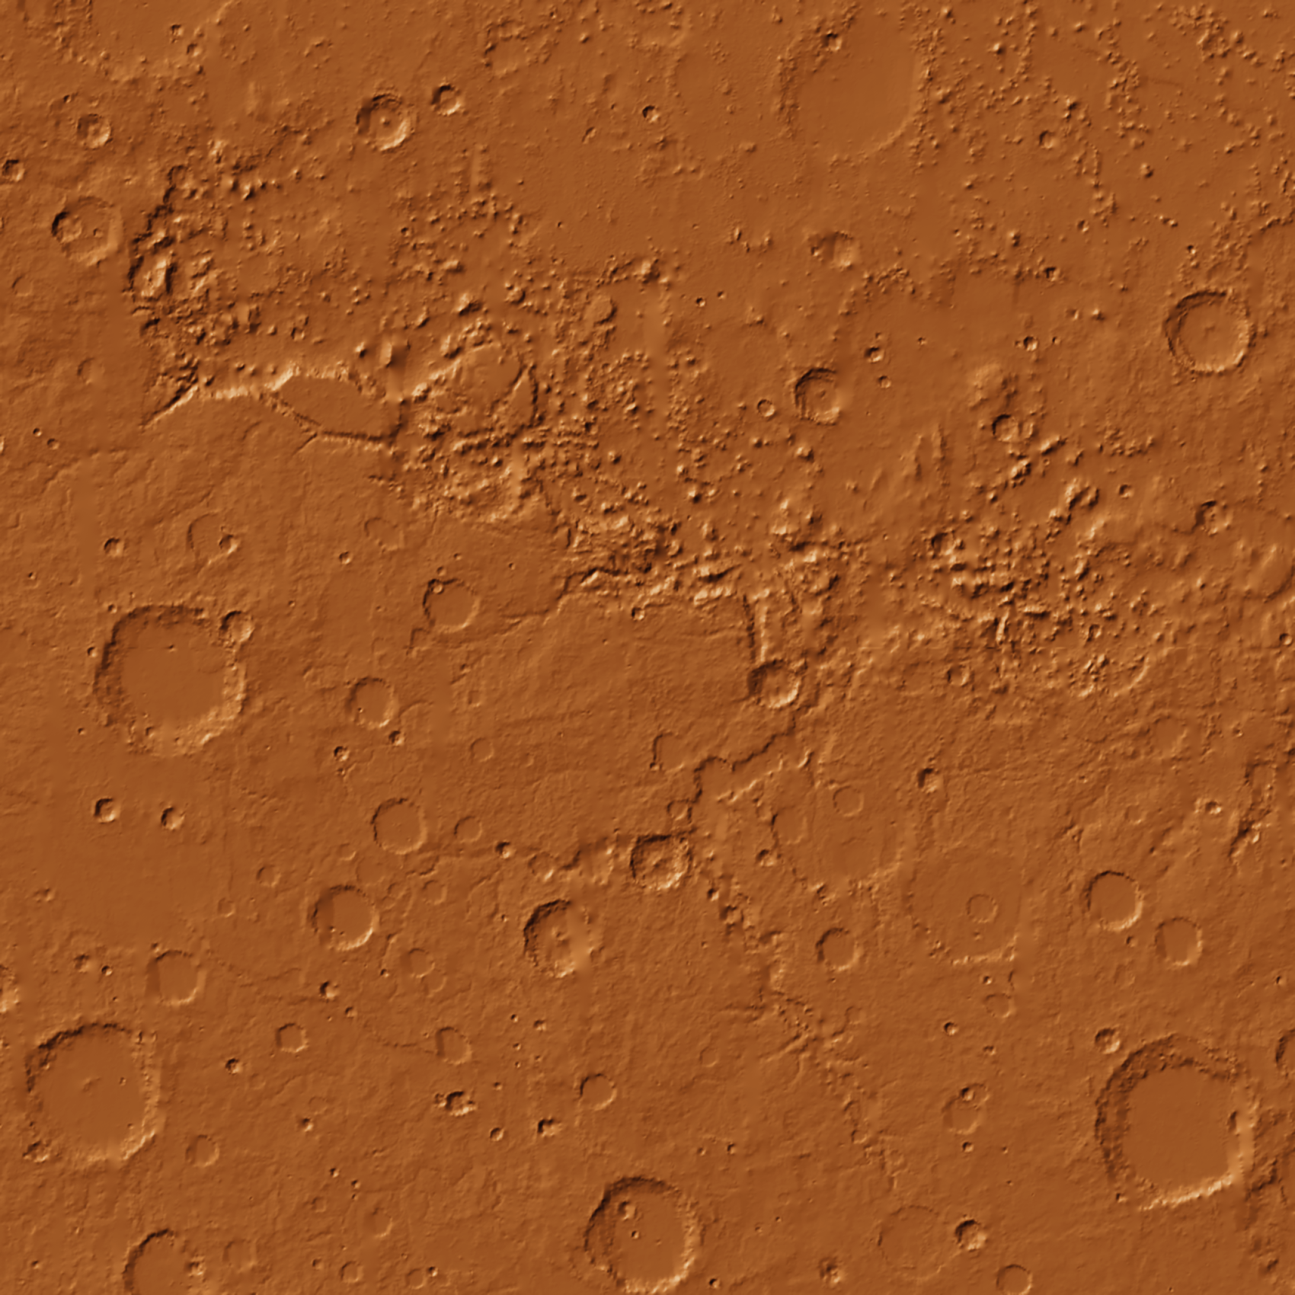
A keyless path to real 30 m Earth data
DATA AND PROVENANCE
The benchmark runs with no credentials at all, and the artifact carries the trail back to the source.
Copernicus GLO-30 on AWS Open Data
Proven bit-identical to the OpenTopography COP30 product — maximum absolute difference 0.00 m, 100 % of pixels identical. The API key is now optional, not required.
One command, no credential.
14 catalogued products, each with coverage geometry, licence and terms, vertical accuracy and nodata policy — and a per-file SHA-256 in a source lock.
An evidence graph records every source, transform and unit behind every visible number.
The whole canonical flow runs offline; no live dependency sits in the demo path.
Mars reference terrain · MOLA, 463 m/px
Five bodies, each on its own metric grid.

Slide 9
The firewall is the feature
WHAT IT REFUSES TO CLAIM, AND WHAT IS NOT FINISHED
Never claimed, by design
Open, and named rather than hidden
Rover traversability, autonomy or mission readiness.
Geological equivalence between two bodies.
Site access, permitting, ecology or community impact.
Any single “Mars-likeness” score.
No external user walkthrough yet — the claim boundary is argued, not user-tested.
No independent GIS re-derivation of a sample window.
No demo video; the script for it is in the repository.
This is an analog-screening instrument. It narrows a search; it does not certify a site.
All six open items are listed first in the traceability page, not buried.
Why this matters for the challenge
A shortlist is only useful if the person reading it can see exactly how far the evidence goes. A tool that will not say “this is a safe place to land” is more trustworthy for saying so than one that quietly implies it.

Slide 10
Everything is public, offline, and reproducible
WHERE TO FIND IT
Reproduce the headline result
Read it
pip install numpy rasterio
python -m terratrace.cli study --config config/matched_footprint_v3.yml --source cog
The site, the v3 results page, the generated study viewer.
The paper, validation report and limitations.
The traceability page against the project's own master plan.
No API key, no account, no network beyond the public AWS bucket.
The honest ask
The engine is prior art, built weeks ahead of the event. What a team adds from here is the part that counts: a second terrain family it has never seen, an independent re-derivation of one window by a different GIS toolchain, or a validation set drawn by someone with planetary field experience. If you would rather find the place where this quietly overclaims than add a feature, that is the most useful thing you could do to it.

