Slide 1
Hotel Booking Analysis
Starter deck created on 2025-09-25

Slide 2
Key Metrics
Total Bookings: 36,275
Canceled Bookings: 11,885 (32.76%)
Total Revenue (est.): 11,347,278.74
Average Price per Room: 103.42
Median Lead Time: 57.0 days

Slide 3
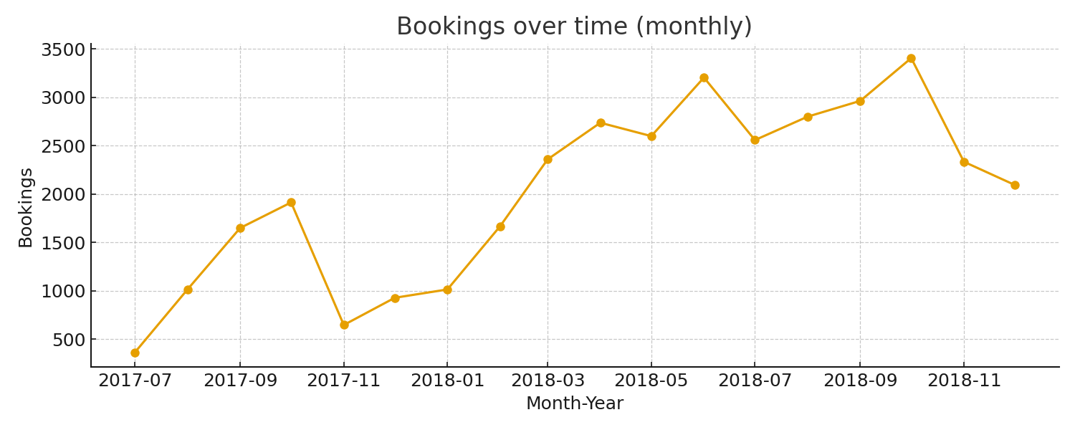
Bookings Trend (Monthly)
Notes:
Monthly bookings trend. Highlight peaks and dips.

Slide 4
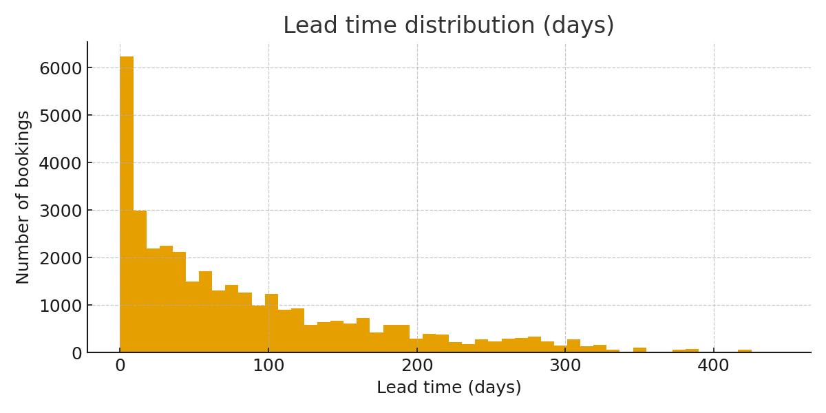
Lead Time Distribution
Notes:
Lead time distribution. Most bookings have short lead times.

Slide 5
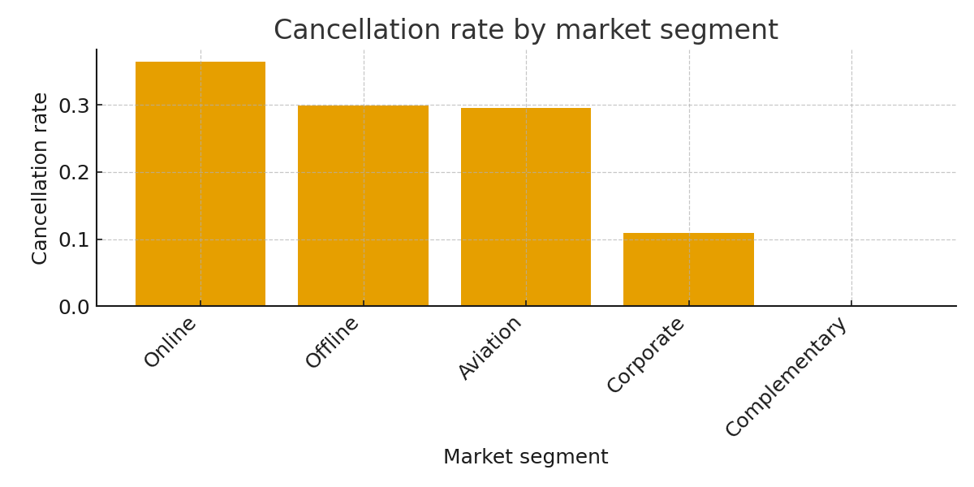
Cancellation Rate by Market Segment
Notes:
Target segments with high cancellation rates for interventions.

Slide 6
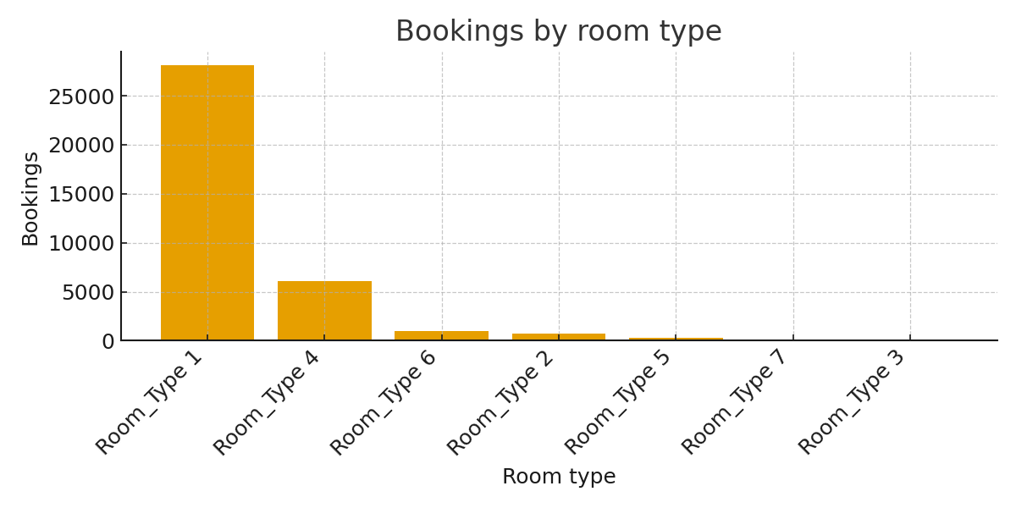
Bookings by Room Type
Notes:
Shows popular room types and opportunities for pricing.

Slide 7
Top Recommendations
1. Address high cancellation rate (~32.8%) with deposit or non-refundable options.
2. Use lead time (median 57 days) to design tiered cancellation policy.
3. Optimize ADR in peak months; test small increases with A/B pricing.
4. Offer incentives to high-cancellation segments (e.g., online/aviation) to convert reservations.
Notes:
These are starter recommendations. Add supporting slides with drilldowns.

