Slide 1
Optimal Choice Analysis of Buying House in Nashua, NH. USA
By : Parul Agarwal
Date : April 18th 2019

Slide 2
Factors to be considered for buying the house in Nashua.
Budget for the purchase is around $350,000.
House should be in good Elementary school zone with high rating .
It should have at least 3 bedrooms.
And should have nearby grocery stores and restaurants.

Slide 3
Data Acquisition
Collected data from following websites.
https://www.ColdwellBankerHomes.com
For details of houses such as price, number of bedrooms, location (Latitude, Longitude), Area (Sq. Ft.), zip code and more.
https://www.nashua.edu
For details of school zone.
https://foursquare.com
Coordinates data is taken from

Slide 4
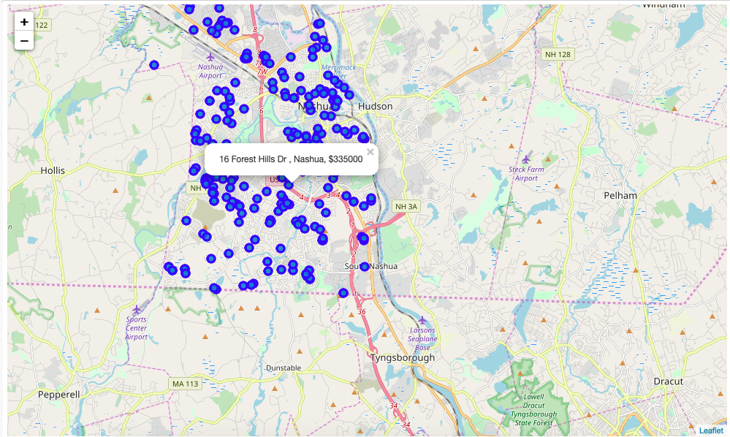
Map of Nashua with available houses for sale

Slide 5
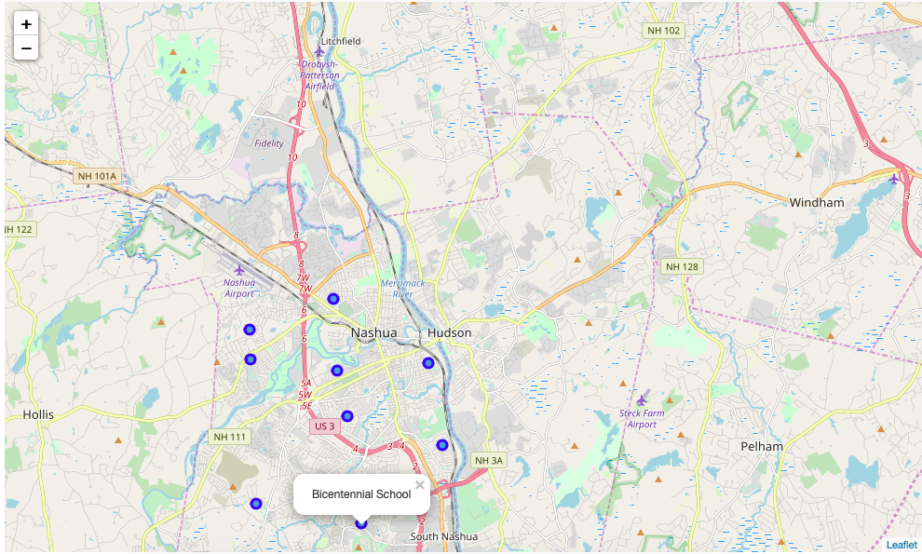
Map of Nashua showing Elementary school with their rating.

Slide 6
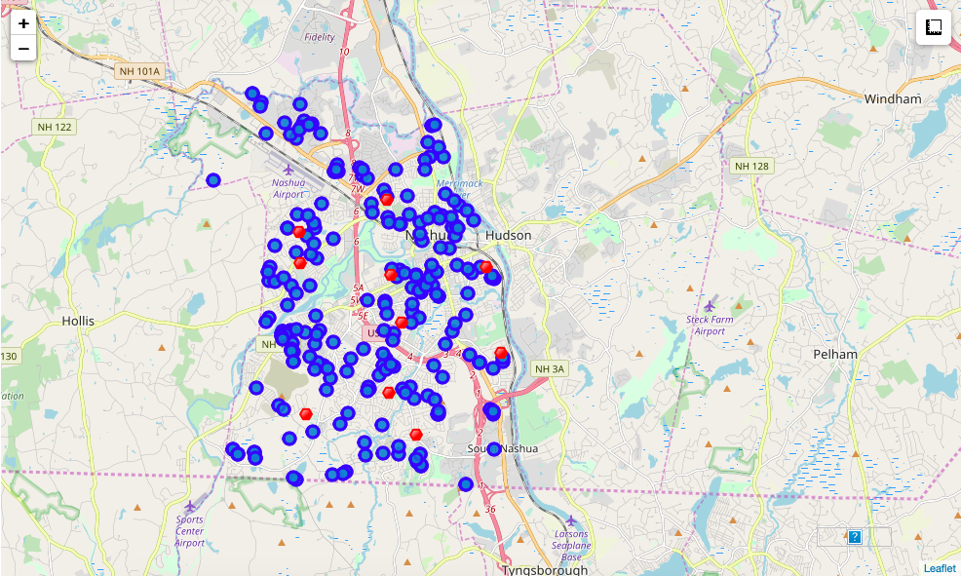
Map of Nashua showing houses for sale and the school locations nearby

Slide 7
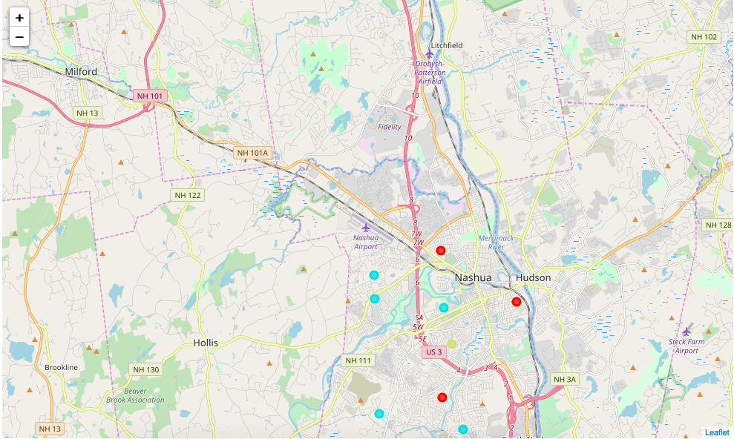
Cluster Neighborhoods of Nashua

Slide 8
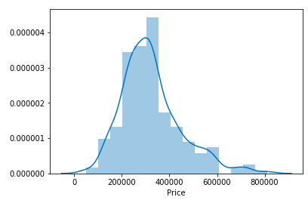
Nashua houses for sale statistics Sale price of houses in Nashua
Plot showing that most of the houses for sale in Nashua is around $350,000.

Slide 9
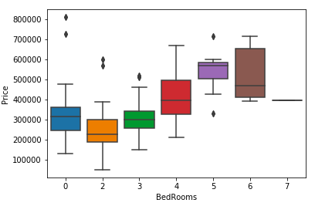
Nashua houses for sale statistics Number of bedrooms in houses for sale
Plot showing that houses in range of price $350,000 have 3 to 4 bedrooms.

Slide 10
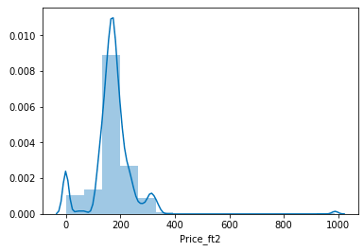
Nashua houses for sale statistics Price per sq. ft
Plot showing that houses price is around 200 per sq. ft.

Slide 11
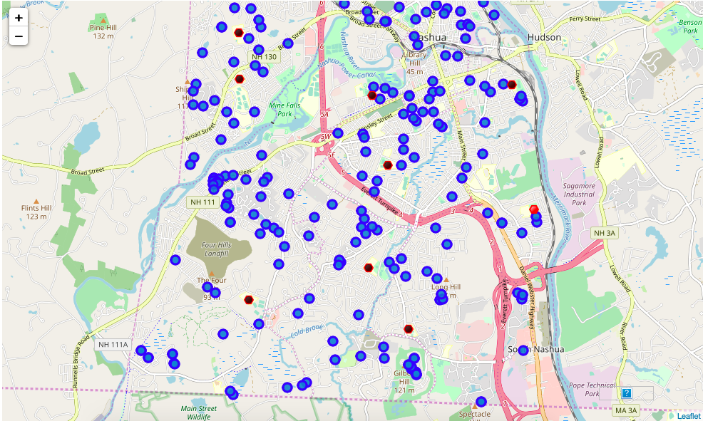
Map with houses for sale, their elementary school zone with nearby venues.

Slide 12
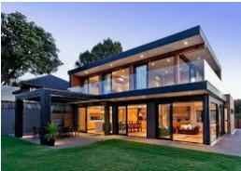
Conclusion
Above maps conclude that best area to purchase a house in budget of price range $350,000 with 3-4 bedrooms and good Elementary school rating is area around Bicentennial School with all venues like playground, grocery, restaurants nearby.

