Slide 1





Sentinel
Detect
Pipeline Agent spots the failed run
Autonomous Data Pipeline Incident Management
Diagnose
Diagnosis Agent finds the root cause
A multi-agent system that detects a pipeline failure, finds the root cause, plans a fix, and waits for a human to approve it.
Plan
Remediation Agent proposes a fix
Problem statement
Retail data pipelines (Bronze → Silver → Gold) fail silently or need manual triage. Engineers check logs, guess a root cause, decide on a fix and run it by hand. That is slow, costly, and dependent on a few people.
Approve
A human approves or rejects
FastAPI · LangGraph · LangChain (Groq) · ChromaDB · Reflex · PostgreSQL
Notes:
Sentinel automates detection, root-cause diagnosis and remediation planning for data pipeline failures, with a human approving before anything executes.

Slide 2



Tech stack and tenant isolation
AiDiagnosis :8000
DataPipeline :8001
capstone-ui :3000 / :8003
FastAPI
LangGraph
LangChain + langchain-groq (openai/gpt-oss-20b)
ChromaDB, local persistent vector store
New Relic NerdGraph for logs
FastAPI mock retail source APIs
PySpark (retail-spark-pipeline)
AWS S3 data lake
New Relic OTLP telemetry
New Learning: New Relic
Reflex (frontend and backend)
Separate FastAPI backend
PostgreSQL with SQLAlchemy
httpx for service-to-service calls
New Learning: Reflex
Notes:
Every incident is scoped by tenant_id across all three services.

Slide 3



Pipeline failures are found late and fixed by hand
Today: manual triage
1 Notice the failure
2 Read the logs
3 Guess the root cause
4 Decide and run a fix
Cost
People
Risk
Downtime while engineers investigate
Stale or bad data reaches Gold reports
Every failure restarts triage from zero
On-call engineers pulled off planned work
Log reading and guesswork eat engineer time
Fixes depend on who remembers the last one
Silent failures go unnoticed
A rushed manual fix can make things worse
No consistent record of what was done
Notes:
Frame the problem in terms of cost and people before introducing the agents.

Slide 4
How agents cut cost and people effort
Today (manual)
With Sentinel agents
Detect
Someone notices a failed run or an alert
Pipeline Agent polls the run and raises an incident when it fails
Diagnose
An engineer reads logs and guesses the cause
Diagnosis Agent reads New Relic logs and similar past incidents, then names the root cause
Plan the fix
The fix is chosen ad hoc from memory
Remediation Agent proposes actions only from a pre-approved list
Approve
Whoever is on call decides and acts
A human reviews the plan and approves or rejects it
Cost Diagnosis starts the moment a run fails, so there is less downtime and fewer wasted engineer-hours.
People Engineers review a ready plan instead of investigating from scratch, and past incidents are remembered.
Notes:
Each stage of manual triage maps to an agent. Humans stay in control at the approval step.

Slide 5
End-to-end flow: UI, pipeline and agents
DataPipeline
:8001
capstone-ui
Reflex :3000 · FastAPI :8003
AiDiagnosis
FastAPI :8000
Flow, step by step
FastAPI mock retail API
/products /sales /inventory
8
Reflex Dashboard
operator UI
Chroma vector memory
per-tenant incident history
1
Operator runs the pipeline for a tenant from the Reflex dashboard.
2
Orchestrator calls POST /pipeline/run with X-Tenant-ID, then polls /status.
1
3
Spark job runs Bronze → Silver → Gold into S3 and sends telemetry to New Relic.
Spark pipeline runner
/api/v1/pipeline/run · /status
Frontend orchestrator
Pipeline Agent · /incidents /pipeline /tenants
6
5
LangGraph workflow
diagnose → remediate → validate
4
A failure (poll result or New Relic alert) reaches the orchestrator.
2
7
5
Incident is saved in PostgreSQL; POST /ai-diagnosis goes to the AI service.
S3 Data Lake
Bronze · Silver · Gold
PostgreSQL
incidents + payloads
New Relic log fetch
NRQL by pipeline_id
6
LangGraph reads logs, recalls Chroma history, diagnoses, remediates, validates.
3
4
7
DiagnosisResponse returns: root cause, remediation plan, confidence.
New Relic (observability) pipeline telemetry and logs
8
Operator approves or rejects; the decision is recorded.
Notes:
Walk the numbered arrows 1 to 8. Three services: DataPipeline :8001, capstone-ui (Reflex :3000, FastAPI :8003), AiDiagnosis :8000.

Slide 6


Retail Multi Tenant data pipeline: why we need it
Objective Build a reliable pipeline that collects data from multiple retail systems and produces a clean, business-ready dataset for pricing and promotion decisions.
Data sources
Business output
Product Database
Sales Database
Inventory System / API
Promotion System / API
Supplier API
Pricing-ready dataset
Promotion information
Inventory availability
Sales insights
Key challenge Data comes from different systems and can fail or contain invalid, inconsistent records.
Three tenants: tenant_001 RetailMart India, tenant_002 SuperStore India (seeded with ~20% invalid records, so Silver-stage failures are reproducible), tenant_003 QuickBuy India.
Notes:
The pipeline collects data from several retail systems and produces one clean, business-ready dataset for pricing and promotion decisions.

Slide 7
End-to-end architecture: Bronze → Silver → Gold
Retail Sources
Ingestion
Bronze
Silver
Gold
Consumption
Product, Sales, Inventory, Promotion and Supplier systems
Collects data and adds tenant_id, run_id and ingestion timestamp
Stores source data in its raw form, unchanged
PySpark: validate, clean, standardize and deduplicate
PySpark: join datasets and apply business rules
Pricing, analytics and dashboards
Bronze = raw Silver = trusted Gold = business-ready
Output lands in the S3 data lake. Every stage sends telemetry to New Relic tagged PIPELINE_ID=retail_data_pipeline, the evidence the Diagnosis Agent queries later.
Notes:
Bronze keeps the raw data, Silver is validated and cleaned by PySpark, Gold joins the datasets and applies business rules.

Slide 8
Raw data → Bronze → Validation
Scenario: retail pricing for Samsung TV (P101)
PRODUCT DB
SALES DB
INVENTORY DB
PROMOTION DB
product_id: P101
name: Samsung TV
base_price: 50000
category: Electronics
transaction_id: T9001
product_id: P101
quantity: 8
selling_price: 50000
product_id: P101
warehouse_id: WH01
stock: 25
promotion_id: PR20
product_id: P101
discount: 10%
active: YES
BRONZE · raw, as received (+ tenant_id, run_id, ingestion_timestamp)
Product: P101, Samsung TV, 50000
Sales: T9001, P101, 8, 50000
Inventory: P101, WH01, 25
Promotion: PR20, P101, 10%, YES
Source-aligned, nothing changed yet
PYSPARK · validation and cleaning
product_id present; IDs match across datasets
Price numeric, quantity valid
Discount between 0 and 100
Duplicate transactions removed
Dates valid
Types converted, values standardized
Notes:
Worked example: pricing for a Samsung TV, product P101.

Slide 9
Silver → Transformation → Gold
Four clean datasets become one business-ready record
SILVER · clean
PYSPARK · transform
GOLD · business-ready
CONSUMED BY
Standardized records:
P101 | Samsung TV | 50000
P101 | Sales | 8
P101 | Stock | 25
P101 | Discount | 10
Steps:
JOIN datasets
Apply business rules
Calculate metrics
Enrich data
One integrated record:
product_id: P101
product: Samsung TV
base_price: ₹50,000
discount: 10%
discount_amount: ₹5,000
final_price: ₹45,000
units_sold: 8
inventory: 25
promotion_active: YES
Pricing Engine
Analytics
Dashboard
ML Models
Join key: product_id = P101
Discount amount = ₹50,000 × 10% = ₹5,000
Final price = ₹50,000 − ₹5,000 = ₹45,000
Notes:
Four clean datasets become one business-ready record.

Slide 10

UI, Reflex, PostgreSQL and Agent
Reflex dashboard
Orchestrator + Agent
PostgreSQL
Sentinel · operator UI · :3000
FastAPI :8003 · asyncio, not LangGraph
incidents and run state
Run Pipeline for a chosen tenant
Live run status as polling ticks
Pipeline Run history: root cause, logs and remedies
Approve & Execute and Reject buttons
start_workflow() launches a run in DataPipeline
Polls status every N seconds and backs off on errors
On FAILED or timeout, creates incident INC‑xxxxxxxx
Calls the AI service once and stores the reply
reconcile_on_startup() resumes in-flight runs after a restart
IncidentDB + IncidentPayloadDB: the incident and its payload
WorkflowRunDB: poll state, attempts, deadlines
AgentEventDB: audit trail
DiagnosisDB + RemediationPlanDB: root cause, plan, approval_status
Run pipeline
Poll status
FAILED detected
Incident saved
AI diagnosis + plan
AWAITING_APPROVAL
Notes:
The operator-facing side: the Reflex dashboard, the FastAPI orchestrator that hosts the Pipeline Agent, and PostgreSQL where incidents and run state are stored.

Slide 11
Sentinel: three agents and one human gate
AGENT 1
AGENT 2
AGENT 3
HUMAN
Pipeline Agent
Diagnosis (RCA) Agent
Remediation Agent
Approval
capstone-ui · asyncio
AiDiagnosis · LangGraph
AiDiagnosis · LangGraph
Sentinel dashboard
Starts and polls pipeline runs, detects FAILED or timeout, and creates the incident.
Fetches logs, recalls similar incidents, and uses an LLM to find the root cause.
Proposes fix actions and validates them against the pre-approved list.
An operator reviews the plan and approves or rejects it.
One call to the AI service
Pipeline Agent calls POST /api/v1/incidents/ai-diagnosis once. The reply is split into DIAGNOSIS_COMPLETED and REMEDIATION_PLAN_READY events.
Nothing auto-executes today
Approval records the decision. An execution agent that acts on approved plans is the next step on the roadmap.
Notes:
Agents 2 and 3 live in one LangGraph graph behind one endpoint; the pipeline agent is plain asyncio.

Slide 12
LangGraph: agents, nodes and the human gate
One endpoint: POST /api/v1/incidents/ai-diagnosis · LLM: ChatGroq (openai/gpt-oss-20b) · Memory: ChromaDB · Logs: New Relic
Diagnosis / RCA Agent
validate_trigger
checks input, builds the incident
fetch_logs
New Relic logs via NRQL
validate_incident
stops if there is no evidence
retrieve_similar_incidents
RAG over Chroma, per tenant
diagnose_failure
LLM: root cause + confidence
Remediation / Planning Agent
Human approval
approve or reject in the UI
build_response
assembles DiagnosisResponse
store_incident_memory
saves incident to Chroma
validate_remediation
guardrail: allowed actions only
generate_remediation
LLM: proposes fix actions
outside the graph, in capstone-ui
Setup and wrap-up
Diagnosis / RCA Agent
Remediation / Planning Agent
Human approval
Notes:
Two agents share one compiled StateGraph. Diagnosis agent: fetch_logs to diagnose_failure. Remediation agent: generate_remediation and validate_remediation. The human gate sits after the graph, in capstone-ui.

Slide 13
What each LangGraph node does
Node | Part of | What it does
validate_trigger | Support | Checks the trigger payload and builds the Incident
fetch_logs | Diagnosis Agent | Queries New Relic NerdGraph (NRQL, filtered by pipeline_id) for log lines
validate_incident | Diagnosis Agent | Fails fast (400) if New Relic returned no evidence
retrieve_similar_incidents | Diagnosis Agent | Tenant-scoped similarity search in ChromaDB (RAG, top-k)
diagnose_failure | Diagnosis Agent | LLM call (ChatGroq, structured output): root cause, confidence, evidence
generate_remediation | Remediation Agent | LLM call limited to the allowed fix actions
validate_remediation | Remediation Agent | Rejects any action outside the allow-list; lowers confidence if no evidence
store_incident_memory | Support | Saves the incident to Chroma for future retrieval
build_response | Support | Assembles the final DiagnosisResponse for the UI
Human approval | Human (capstone-ui) | Operator approves or rejects the plan before anything is executed
Notes:
The two LLM calls are diagnose_failure and generate_remediation; everything else is deterministic.

Slide 14

Human approval and the audit trail
The single gate
Audit trail (AgentEventDB)
1
Plan is ready and the incident status becomes AWAITING_APPROVAL
PipelineAgent
PIPELINE_FAILED
DiagnosisAgent
DIAGNOSIS_COMPLETED
2
Operator opens Pipeline Run history on the Sentinel dashboard: root cause, logs and proposed remedies
RemediationAgent
REMEDIATION_PLAN_READY
3
Operator clicks Approve & Execute or Reject
Human
APPROVAL_GRANTED / REJECTED
4
POST /api/v1/incidents/{incident_id}/remediation/approve | reject records the decision
PostgreSQL tables
IncidentDB
IncidentPayloadDB
Nothing executes automatically, by design. Approval only records the decision; an execution agent is on the roadmap.
WorkflowRunDB
AgentEventDB
DiagnosisDB
RemediationPlanDB
approval_status: PENDING → APPROVED | REJECTED
Notes:
Approval is the single gate. Today it records the decision only; no execution agent exists yet.

Slide 15
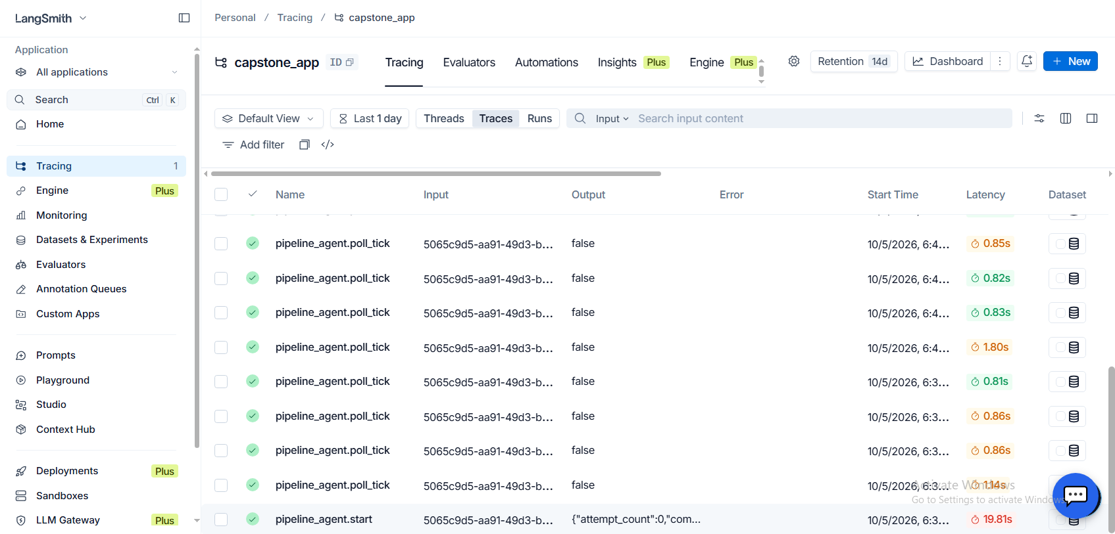

Observability with LangSmith
One incident, one trace (illustrative)
incident run (incident_id, tenant_id)
├─ validate_trigger
├─ fetch_logs
├─ validate_incident
├─ retrieve_similar_incidents
├─ diagnose_failure
│ └─ ChatGroq call
├─ generate_remediation
│ └─ ChatGroq call
├─ validate_remediation
├─ store_incident_memory
└─ build_response
LangSmith project capstone_app: live traces of pipeline_agent.start and pipeline_agent.poll_tick
New Relic: telemetry
Each Spark stage emits logs tagged with PIPELINE_ID. The Diagnosis Agent queries them as evidence.
LangSmith: agent traces
Enabled with env vars only (LANGSMITH_TRACING, API_KEY, PROJECT). Runs and LLM calls are traced with no code change.
PostgreSQL: audit trail
AgentEventDB records each step, from PIPELINE_FAILED to the human decision.
Notes:
Three layers: New Relic for pipeline telemetry, LangSmith for agent traces, PostgreSQL for the audit trail. The screenshot shows live traces in the capstone_app project.

