Slide 1
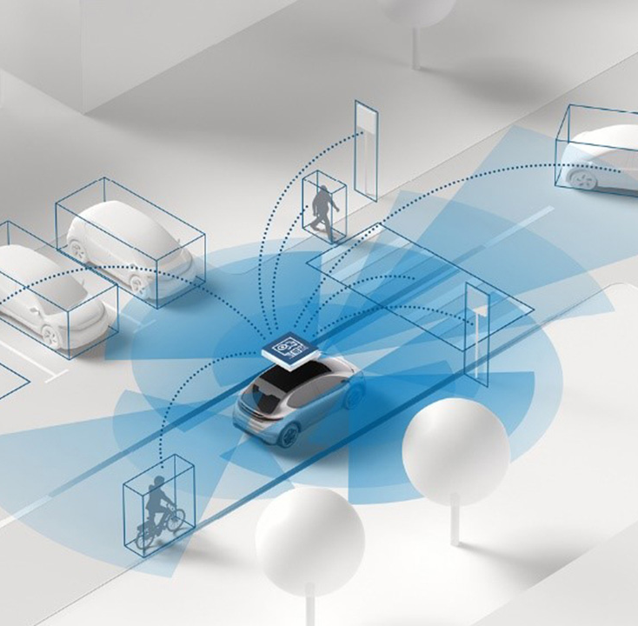
AI-Based Road User Detection Using Traffic-Monitoring Radar
Furukawa Electric Institute of Technology (FETI)

Slide 2
Agenda
13:15 | Biztonsági táj., Fun Lab tour |  | Auditorium ,Fun Lab
13:45 | CX60 test car, doppler generator |  | Aut Lab
14:00 | Coffee break |  | Big in Hall
14:15 | Presentation: measurements, deliverables, June 1st., QnA |  | Big in Hall
14:45 | Measurements |  | FETI road
16:00 | Closing

Slide 3
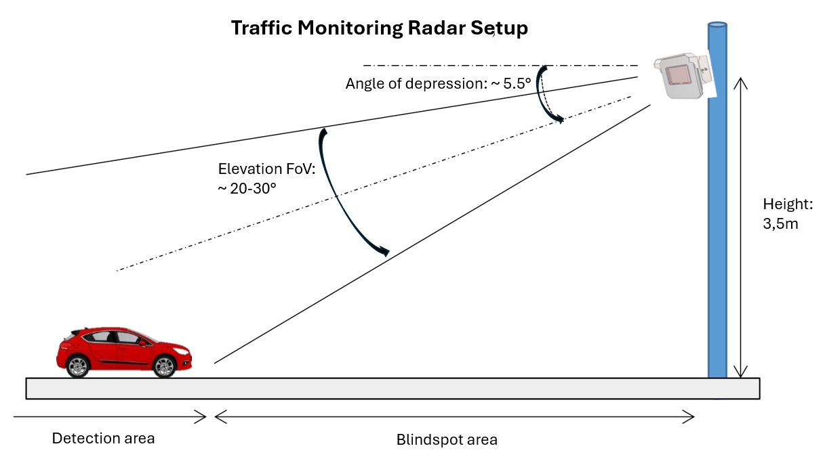
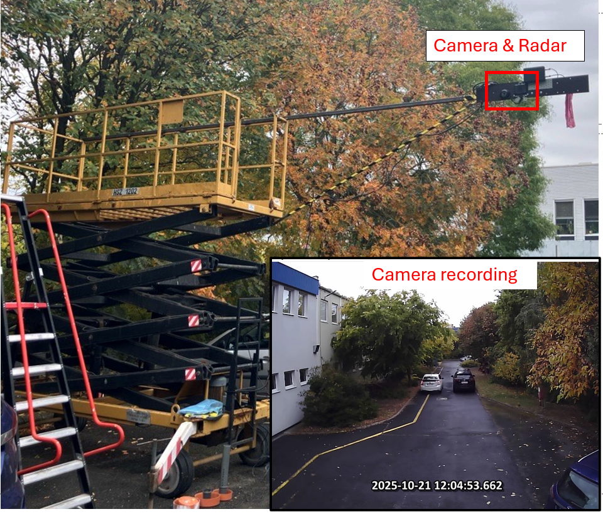
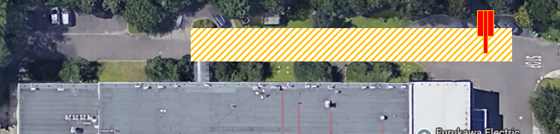
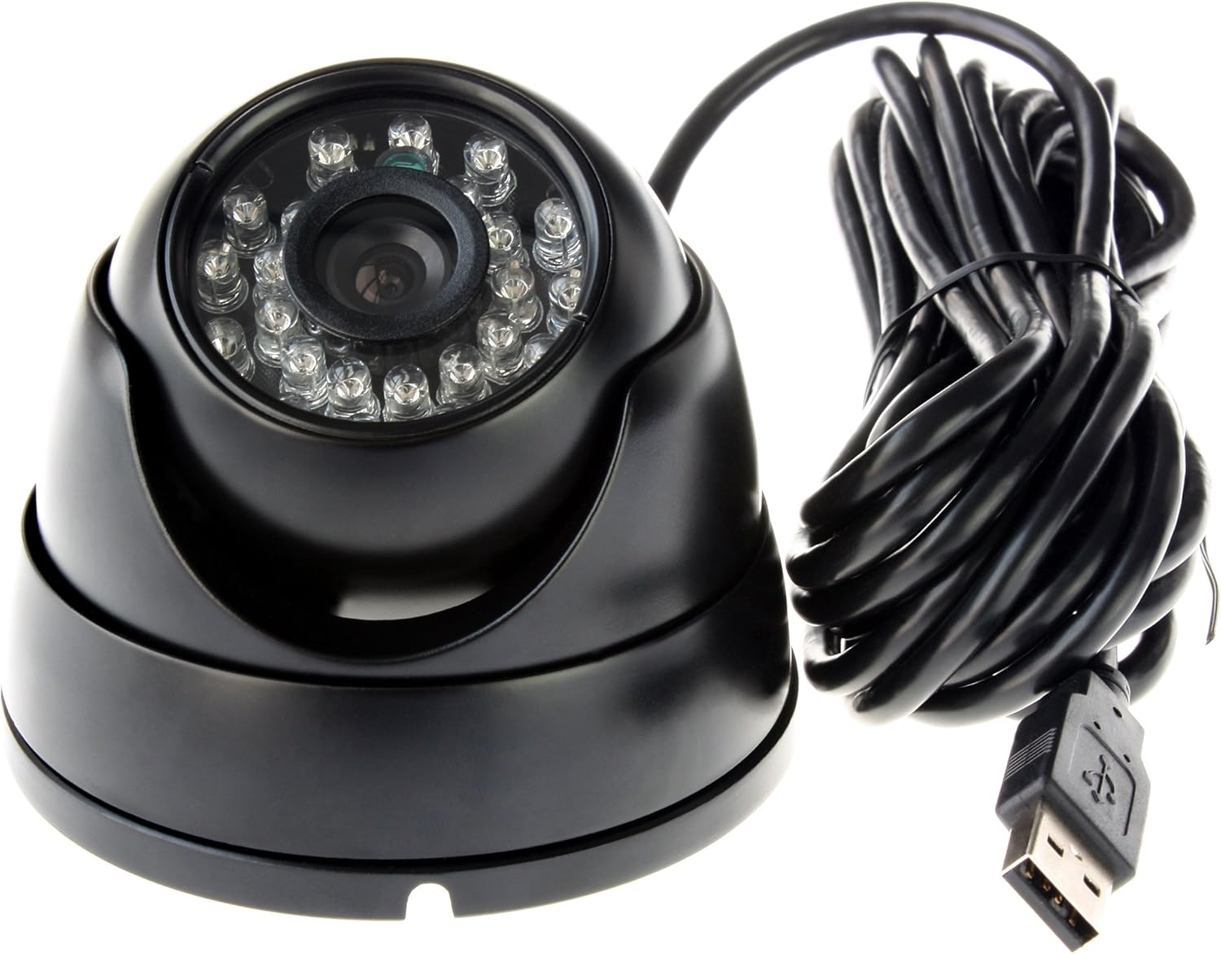
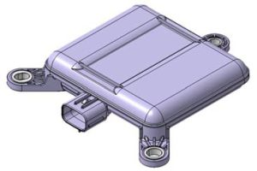
Measurement Campaign at FETI site

Slide 4
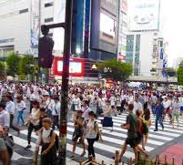
Scenario list
Ideas:
Student scenarios
  Running
  Pushing bike
  ZigZag (mix)
Pedestrian crowd
  Pedestrian crossing
  Swarm
  Separation
  Etc.
Sudden change of direction
Class change: Ped –> Cyclist -> Ped

Slide 5
Deadlines
Annotation of Camera Recordings (deadline: April 19)
Model Training (deadline: May 3)
Deliverables (deadline: May 24)
Presentation at BME (May 27)
Finalization (deadline: May 29, 12:00)
Presentation at FETI (June 1, 14:00)

Slide 6
Deliverables
All python source files:
  annotation_pipline.py, fusion_pipeline.py, grid_mapping.py, trainin_dataset.py, training.py
Final grid mapping pipeline as a self-contained, importable script.
The trained model exported in PyTorch (.pt) format.
A README file with clear instructions for setting up the environment and running the full pipeline from raw CSV input to inference output.
A written project report.
The presentation slides prepared for the final session.

Slide 7


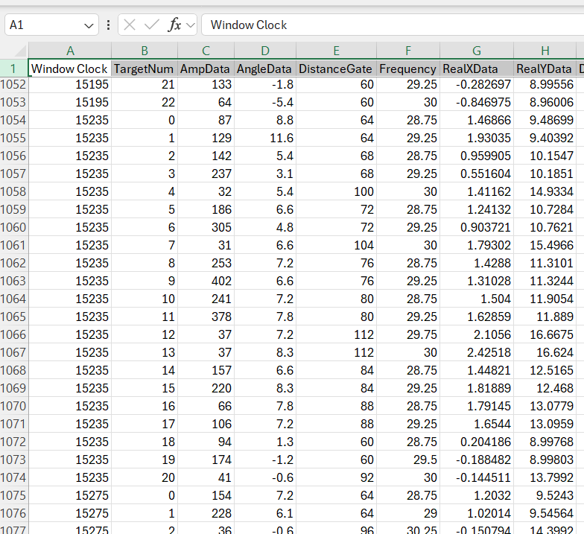

Inference Demonstration (on FETI side)
CSV Point cloud
Pseudo images with detections and classes
Pseudo images
Model
Grid Mapping
grid_mapping.py
final_model.pt

Slide 8
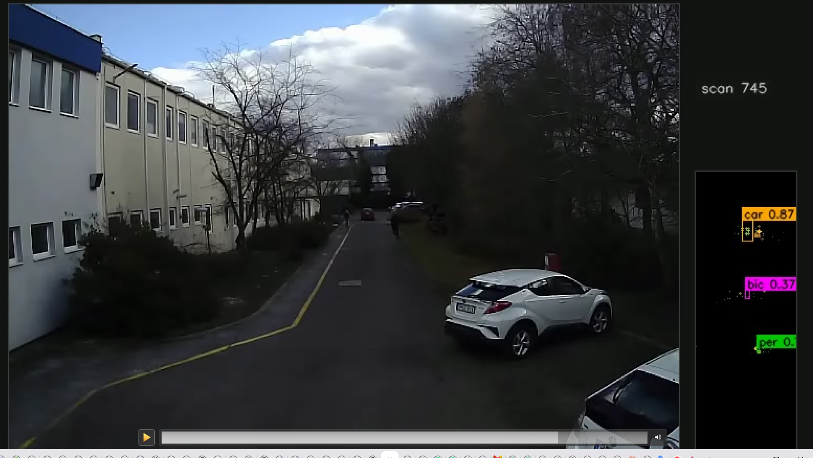
Visalization example

Slide 9
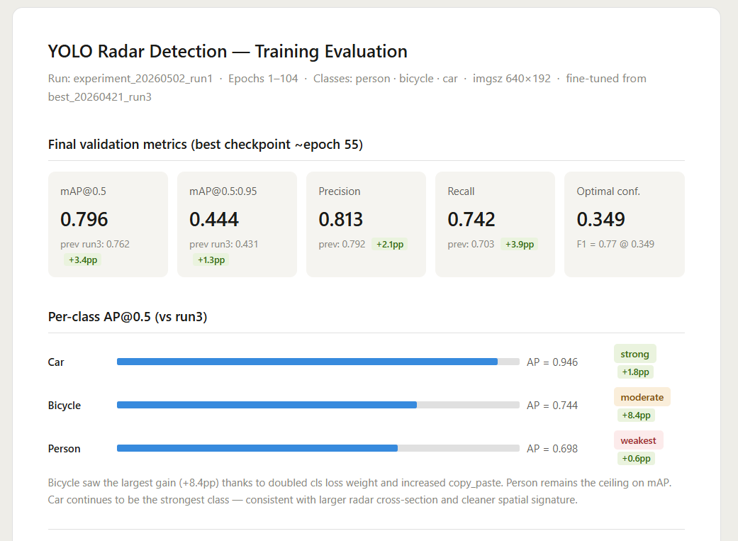
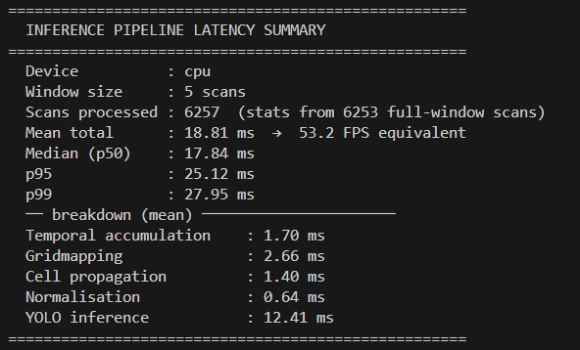
Performance evaluation
Model Benchmarking with Ultralytics YOLO
mAP@30 per class
Recall
Precision
Inference time (<40ms)
Etc.
(képek csak példák)

Slide 10
Presentation at FETI
June 1st Monday 14:00-16:00:
Presentation of Team1 – 15min
  QnA – 10min
Presentation of Team2 – 15min
  QnA – 10min
Presentation of Team3 – 15min
  QnA – 10min
Demonstration:
  Inference and performance comparison (by FETI)
Awards Ceremony

Slide 11
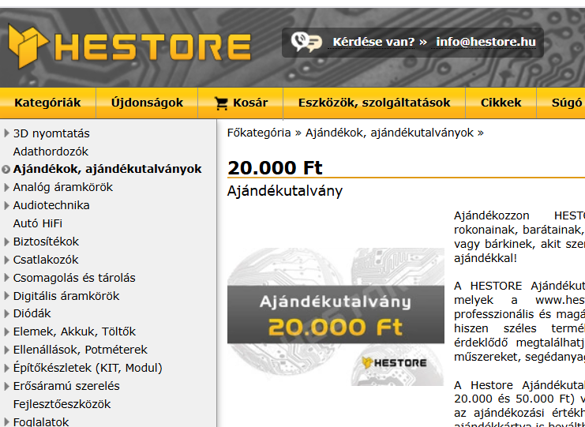
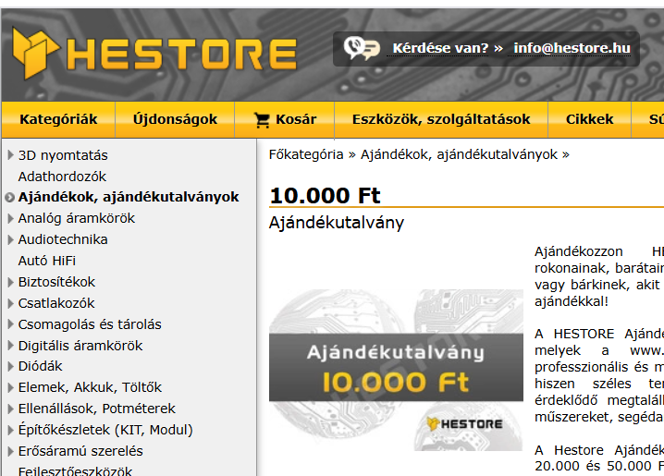
Prize
Gift voucher worth a total of 100,000 HUF

Slide 12
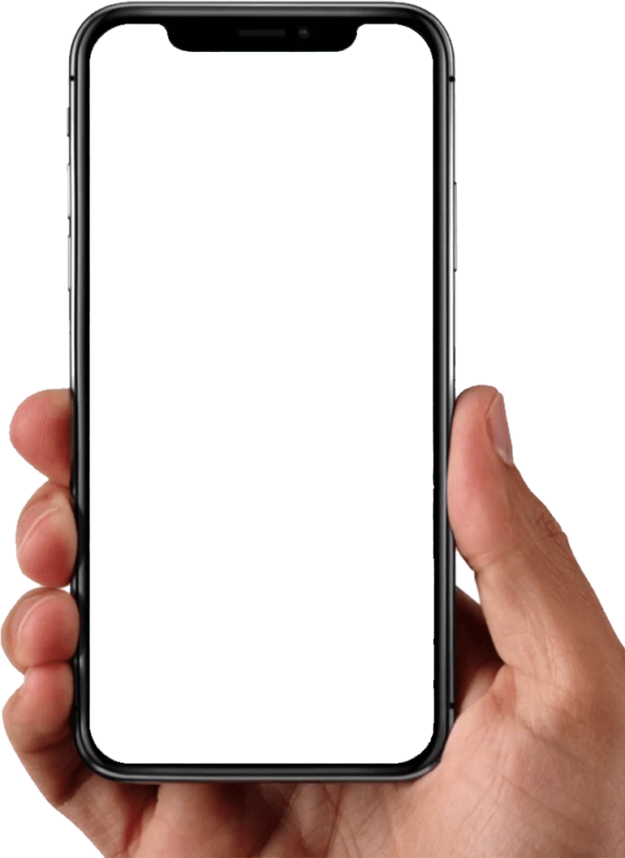
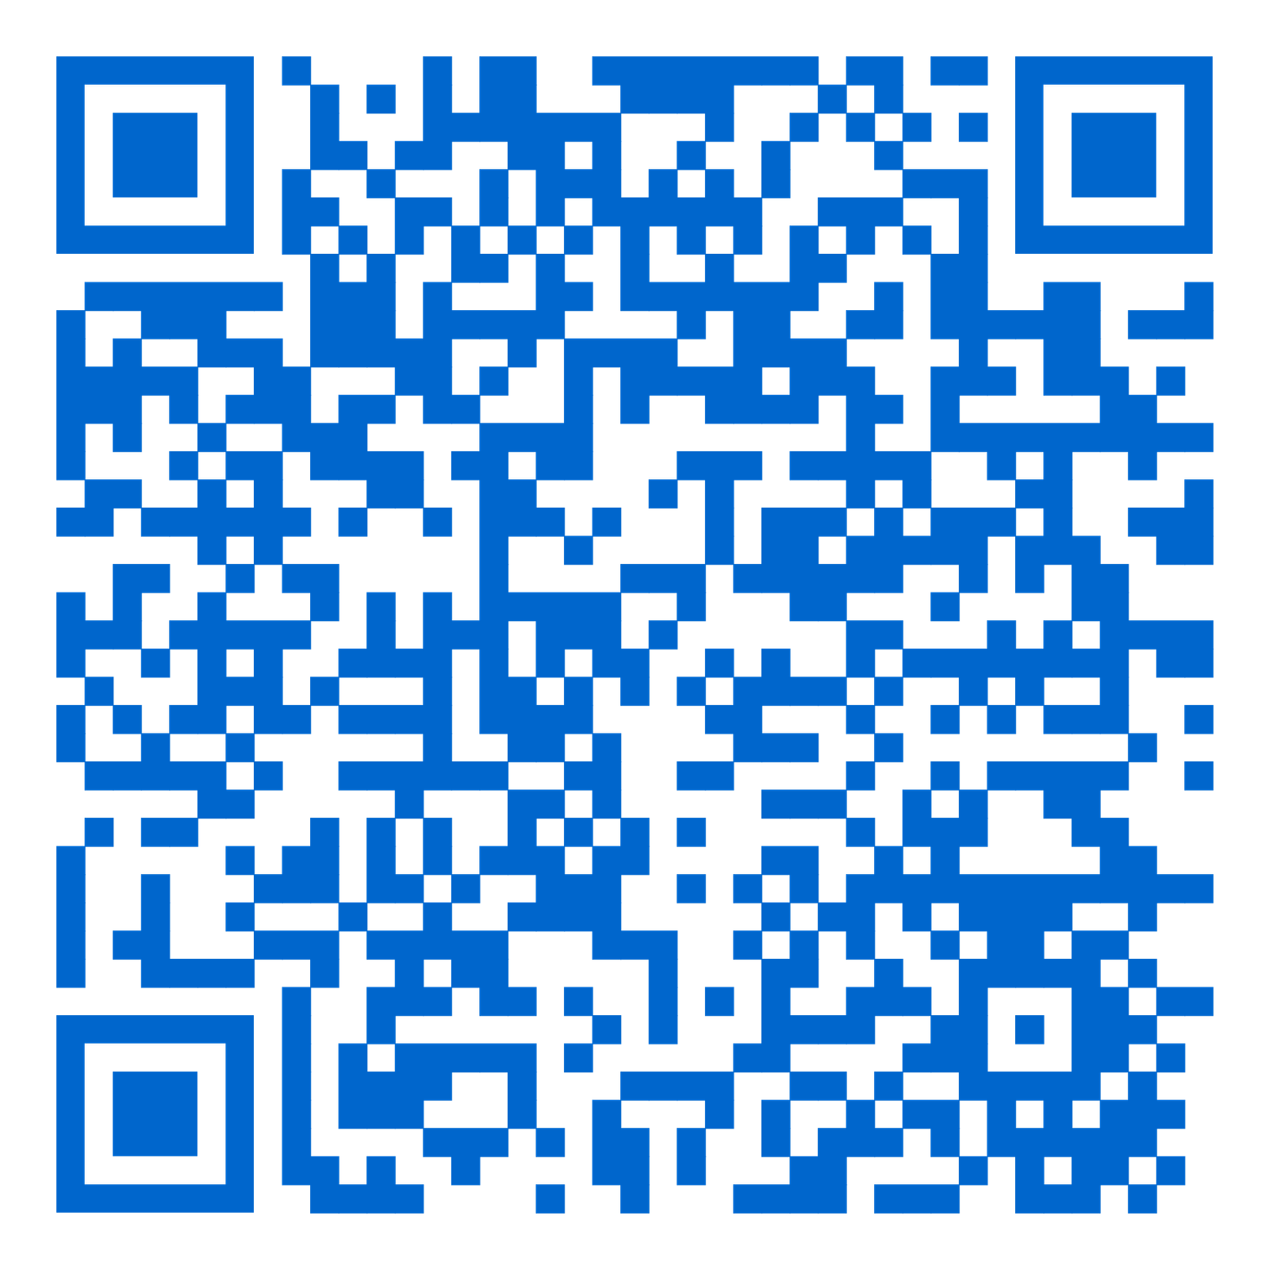

THANK YOU!
Furukawa Electric Institute of Technology
R&D FOR A SUSTAINABLE FUTURE
FETI Kft.
H-1158 Budapest, Késmárk u. 28/A
Telephone: +36 1 414 0250
Web: https://www.feti.hu
Email: robert.hajdu@furukawaelectric.com
Follow FETI on LinkedIn
Notes:
Thank you for your attention.
To stay up to date with our results and news, visit our website and follow us on LinkedIn.
Let's innovate together and make the future richer with our shared achievements!

