Slide 1


AI-Based Road User Detection Using Traffic-Monitoring Radar
Ármin Ihász, Gábor Tompos

Slide 2


To be presented on 27/05/2026
BME — TTK THE UNIVERSITY MODEL THAT SHAPES THE FUTURE

Slide 3
BME — TTK THE UNIVERSITY MODEL THAT SHAPES THE FUTURE
New model is currently being trained on Kaggle
Several models have been built, but the peak MAP@50 achieved was only ~0.34.
Hopefully we will be able to present the results of the new model.

Slide 4
BME — TTK THE UNIVERSITY MODEL THAT SHAPES THE FUTURE
Goal
Objective: Detect Pedestrians, Cars, and Cyclists in real-time (< 40ms) using a sparse 24 GHz pulse-Doppler radar.
The Challenges:
Extreme sparsity of radar point clouds (especially for pedestrians).
Class imbalance (cars dominate the reflections).
Camera-to-Radar BEV projection drift at long distances.

Slide 5
BME — TTK THE UNIVERSITY MODEL THAT SHAPES THE FUTURE
Annotation & Post-Processing (Camera)
Inference Setup: Used YOLOv11m on camera footage with a low confidence threshold (conf=0.10) to ensure high recall for heavily occluded pedestrians.
Tracking: Used ByteTrack for fast, reliable object ID consistency across frames.
Bike Merge: Applied custom post-processing to merge intersecting pedestrian + bicycle bounding boxes into a unified cyclist class, matching the physical reality of the scene.

Slide 6
BME — TTK THE UNIVERSITY MODEL THAT SHAPES THE FUTURE
Radar Grid Mapping (Preprocessing)
Temporal Accumulation: Merged 10 consecutive frames (400ms window) to build dense physical contours out of sparse point clouds.
Spatial ROI: Strictly constrained the 70mx20m roadway area.
Physics-Based Channel Encoding:
Ch0 (Red): Occupancy / Point Density.
Ch1 (Green): Normalized Amplitude (compensated by R^2 to offset the radar range degradation equation).
Ch2 (Blue): Skewed Doppler velocity (square-root scaling to highlight slow-moving pedestrians).
Cell Propagation: Applied spatial dilation to expand points into visible blobs for the CNN.

Slide 7
BME — TTK THE UNIVERSITY MODEL THAT SHAPES THE FUTURE
Dataset Preparation
The Problem: Camera homography drifts at long distances, misaligning boxes from radar points.
The Solution: Implemented a proximity search (1.5m radius). Bounding boxes were snapped to the median of the radar points, ensuring perfect alignment.
Ghost Filtering: If a camera bounding box had zero supporting radar points, it was deleted to prevent YOLO from learning "empty space."
Target Biasing: Heavily oversampled (x3) the complex May 6th target domain to force the network to prioritize the benchmark environment.

Slide 8
BME — TTK THE UNIVERSITY MODEL THAT SHAPES THE FUTURE
Network Architecture & Training Config
Architecture: Chosen YOLOv11n (Nano): To maintain inference speed well under the 40ms constraint and prevent overfitting on sparse radar graphics.
Hyperparameter Tuning: Switched to AdamW optimizer with a strictly tuned learning rate (lr0=0.002) and Cosine Annealing to stabilize gradient descent.
Augmentation Restraints: Disabled scaling, translation, and vertical flips. (Scaling alters the strict 0.1m/px physical rule, and vertical flips break the approaching/receding Doppler physics). Loss Weights: Adjusted cls=0.5 and box=7.5 to prioritize tight bounding-box regression over class-guessing.

Slide 9
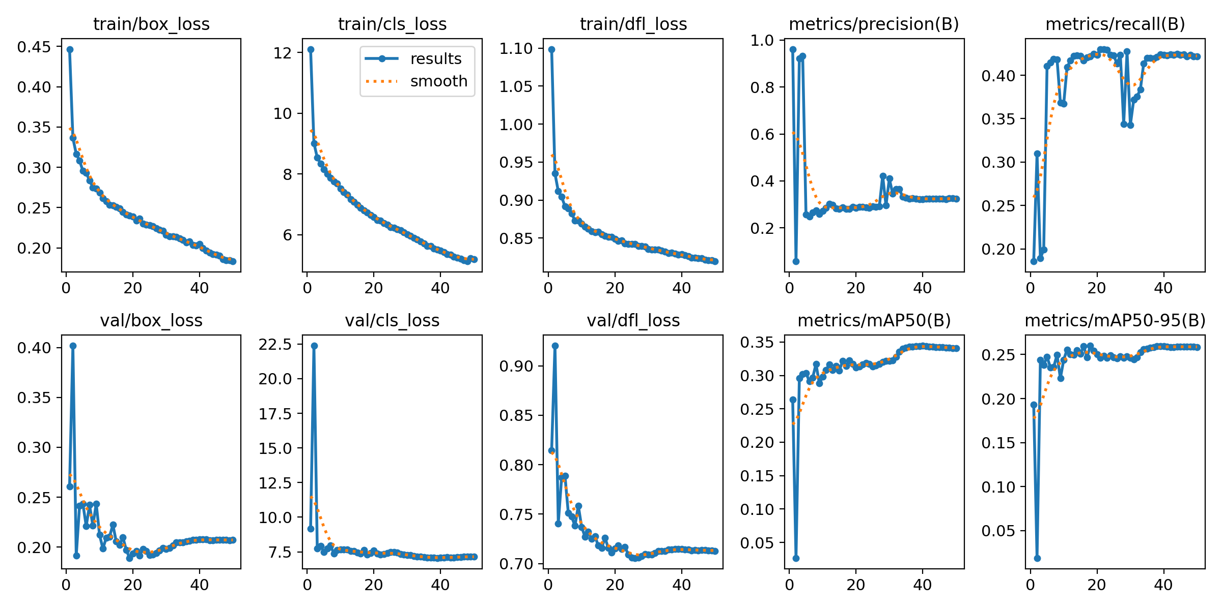
BME — TTK THE UNIVERSITY MODEL THAT SHAPES THE FUTURE
Training & Convergence
Current Status: The model is currently finalizing its 60-epoch training on a Kaggle T4 dual-GPU cluster.
Initially tried 2 stage training, but then the 0.34mAP@50 after first stage drastically fell off

Slide 10
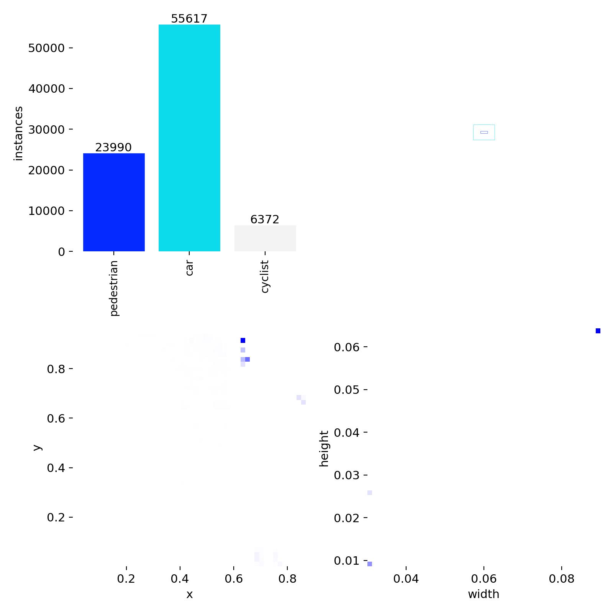
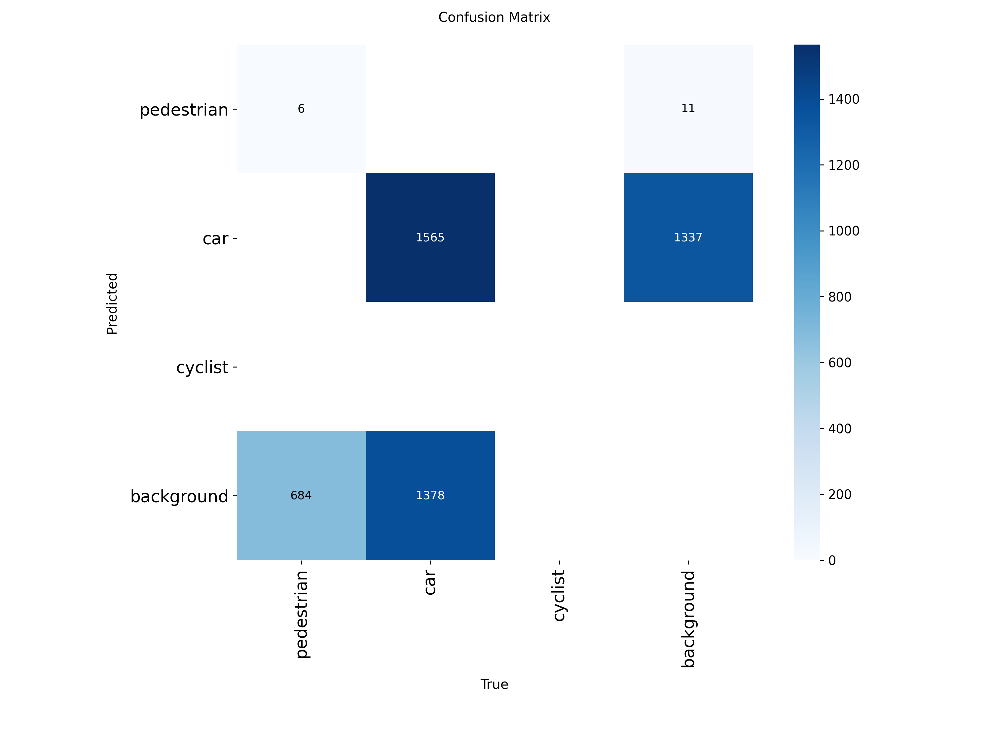
BME — TTK THE UNIVERSITY MODEL THAT SHAPES THE FUTURE
Training & Convergence

Slide 11
BME — TTK THE UNIVERSITY MODEL THAT SHAPES THE FUTURE
Finishing touches
Model Export: Converting the final PyTorch weights to an optimized ONNX graph.
Live Feeder Prep: Packaging the grid_mapping_pipeline.py into a callable module.
TensorRT Deployment for the live 40ms simulation

