Slide 1
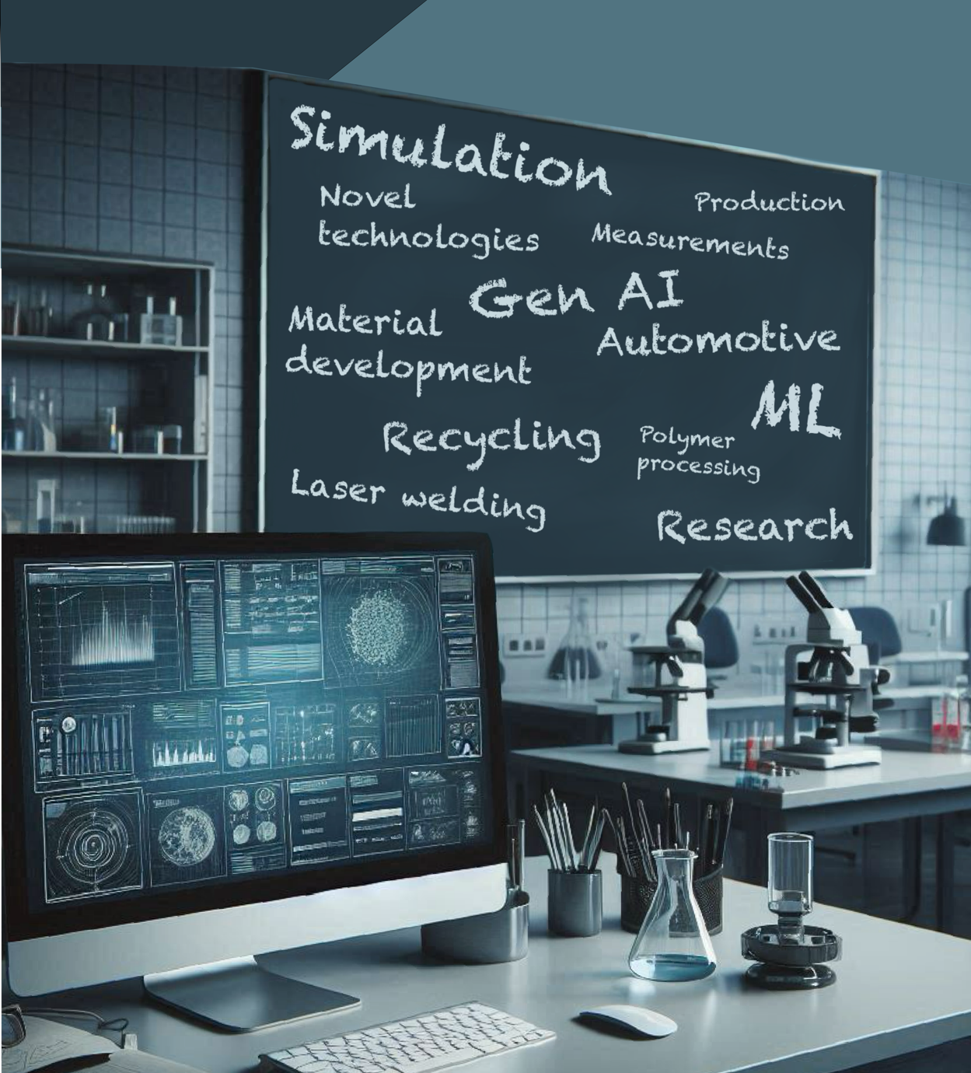
Furukawa Electric Institute of Technology (FETI)
BRIDGING SCIENCE AND INDUSTRY
WITH CUTTING-EDGE R&D

Slide 2
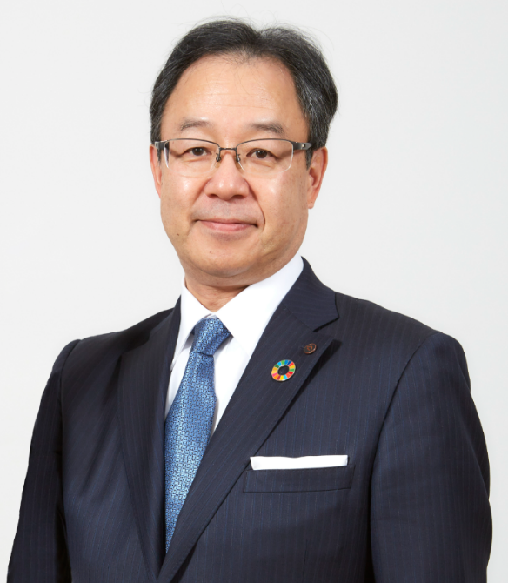
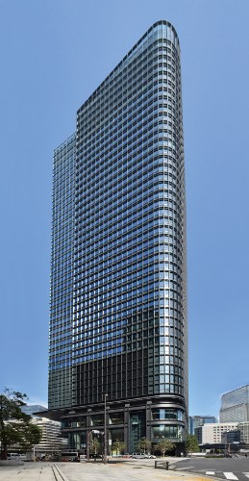
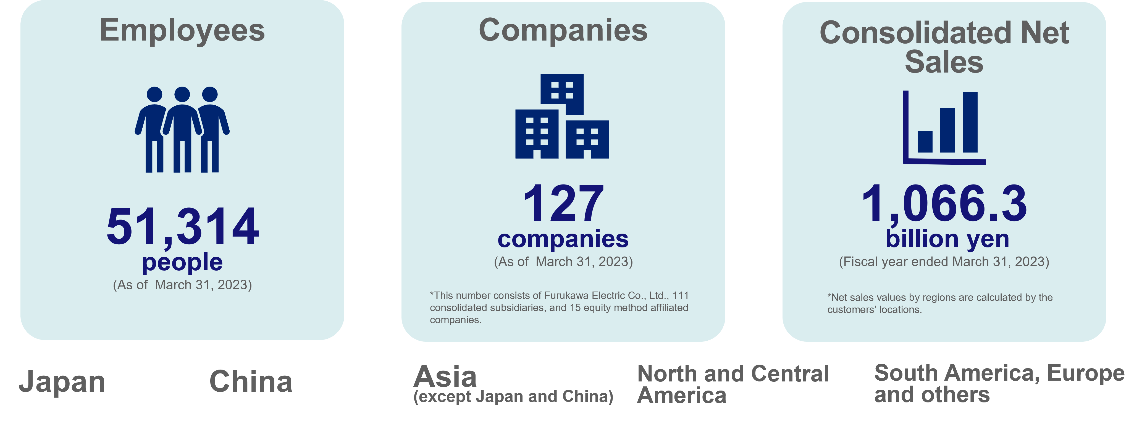

Corporate Profile
Company name: Furukawa Electric Co., Ltd.
President: Hideya Moridaira
Founded: 1884
Net sales: 1,066,326 million yen (Consolidated) **
Employees: 51,314 (Consolidated)
Head office: Tokyo Japan
Notes:
Furukawa Electric, one of Japan's most historically significant and prestigious companies, focuses on four core technologies: metals, polymers, photonics, and high frequency.
Founded in 1884, it now has more than 50,000 employees worldwide.

Slide 3
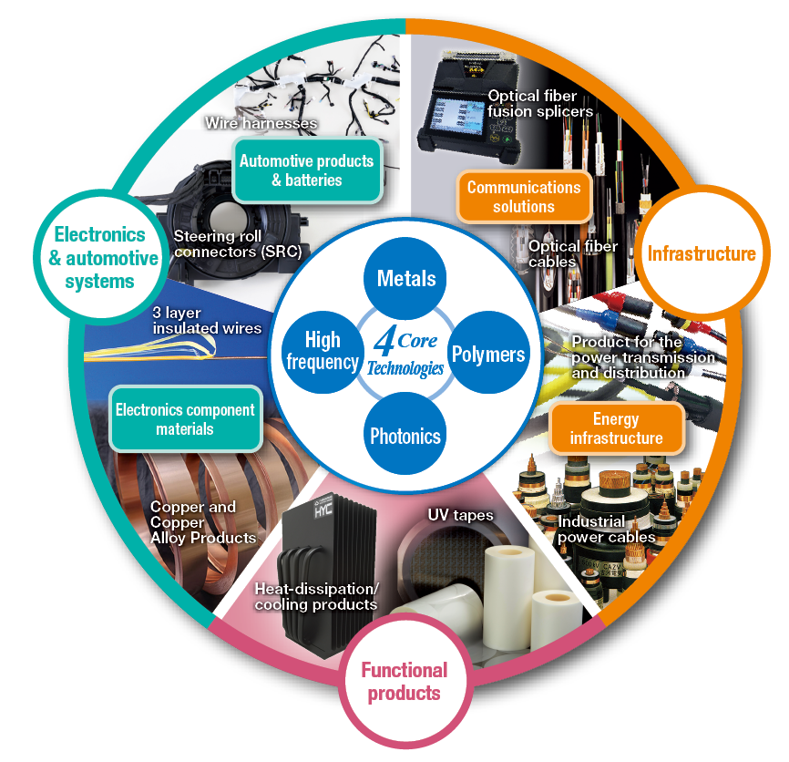
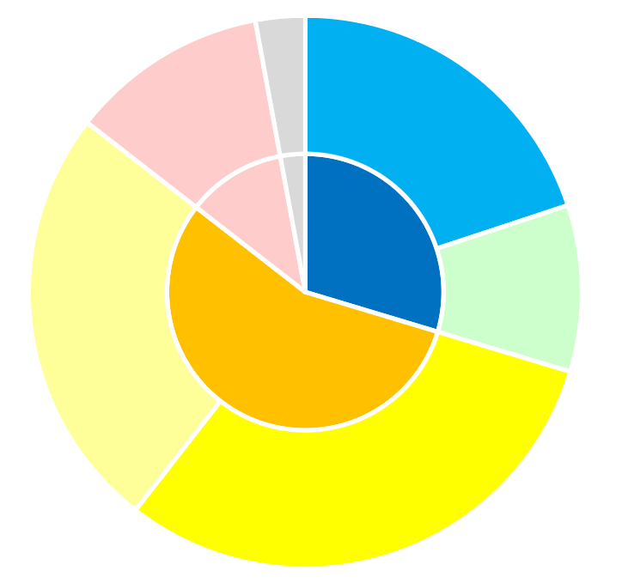
Major Products and Services
Total 1,066.3billion yen*
3 Business Segments
*Intra-company transactions are eliminated.
Functional Products
126.5 billion yen
Communications
Solutions
217.6 billion yen
Infrastructure
323.9 billion yen
Electronics
Component Materials
273.0 billion yen
Energy Infrastructure
106.3 billion yen
Electronics ＆
Automotive Systems
610.3 billion yen
Automotive Products
& Batteries
337.4 billion yen
Notes:
4 core technologies of metals, polymers, photonics and high frequency
wide range of products in the 3 business segments of
Infrastructure (Communications Solutions, Energy Infrastructure),
Electronics & Automotive Systems (Automotive Products & Batteries, Electronics Component Materials)
and Functional Products
The business started with electrical cables and non-ferrous metals and has expanded into areas such as telecommunications, electronics, new materials and automotive parts and components.

Slide 4
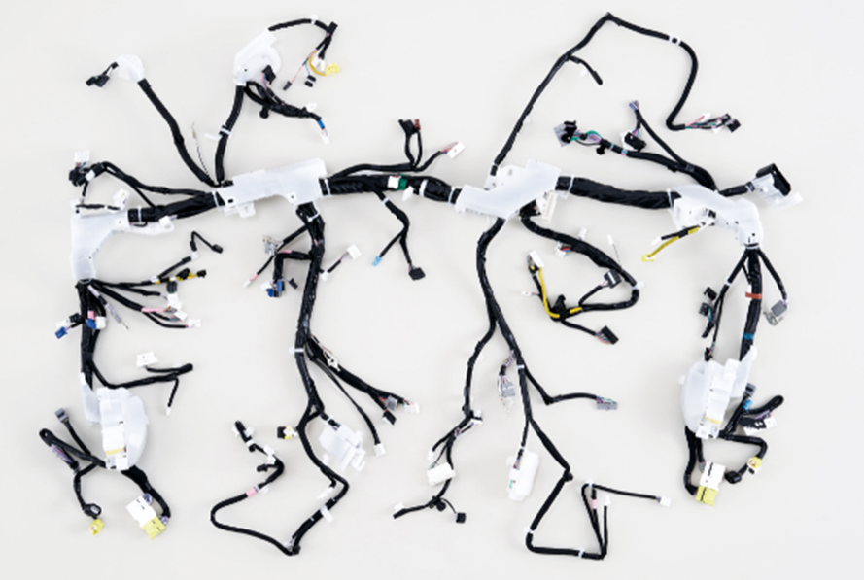
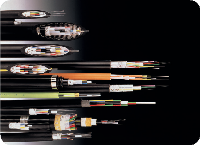
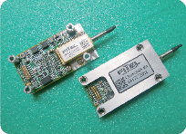
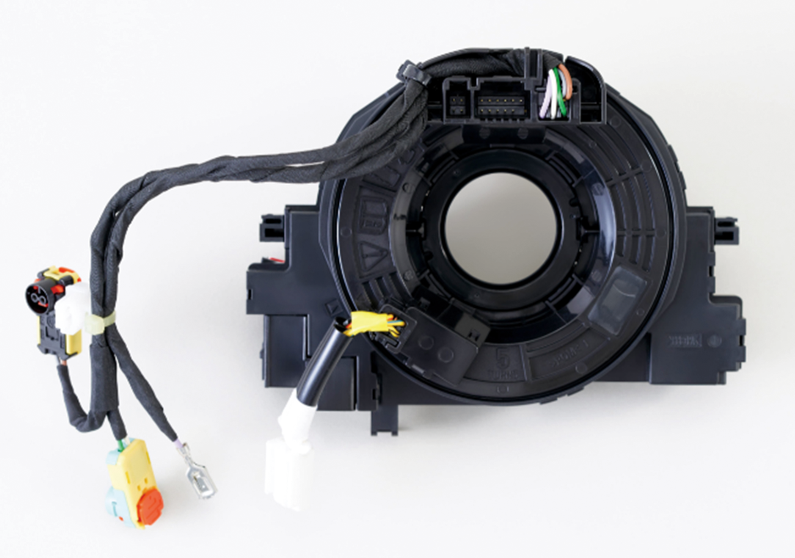
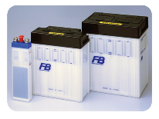
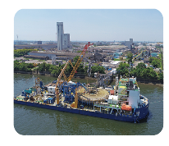

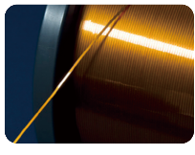
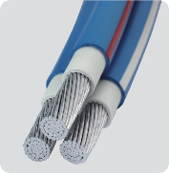
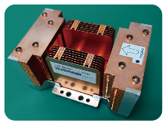

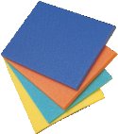
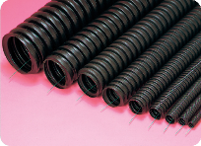
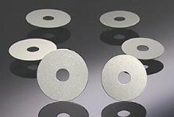
Major Products
Products with Top Level of
Market Share
Wire Harnesses
Optical Fiber Cables
Variable wavelength
laser modules
Steering Roll Connectors
(SRCs)
Domestic-leading market share
World-leading market share
World-leading market share
Alkaline Storage Battery
for Railroad
World's top market share
Domestic-leading market share
Submarine power cable
Domestic-leading market share
Rectangular magnet wires
for chip inductors
World's top market share
High-performance low-voltage aluminum conductor cable “Rakuraku Cable”
Domestic top market share
Copper foil (Electrolytic copper foil for printed wiring boards）
Heat sinks (Heat pipe type)
World-leading market share
Crosslinked foamed polyolefin
“Eflex” buried protective conduit for cables
Aluminum Blanks
for Hard Disk Drive (HDD)
Lowest level of transmission loss
in the world”
World-leading market share
Domestic top market share
World's second market share
Notes:
The main products are related to telecommunications, energy, automotive, electronics and construction.

Slide 5
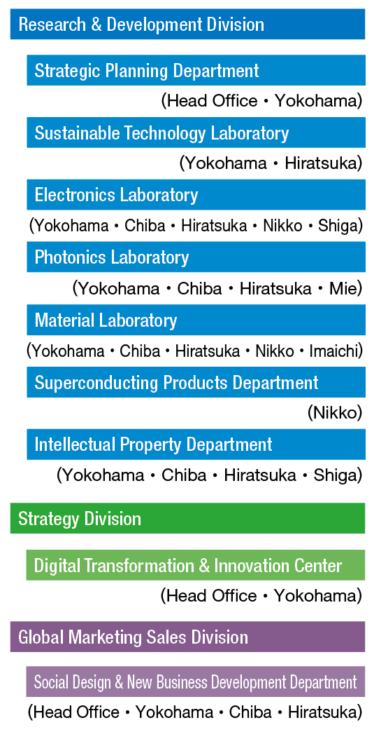
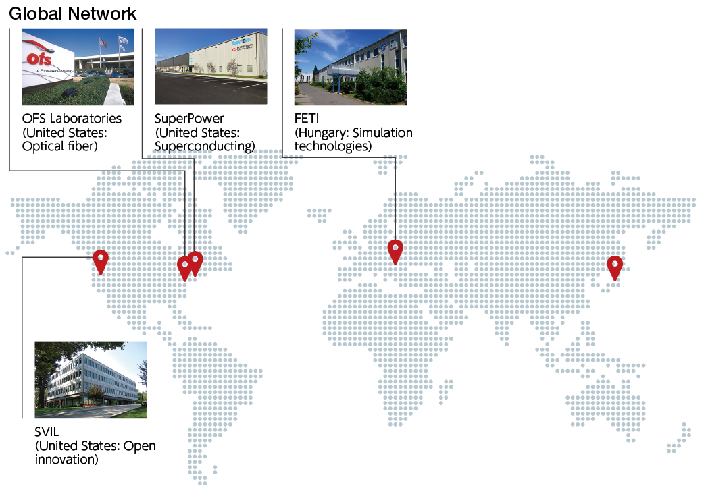
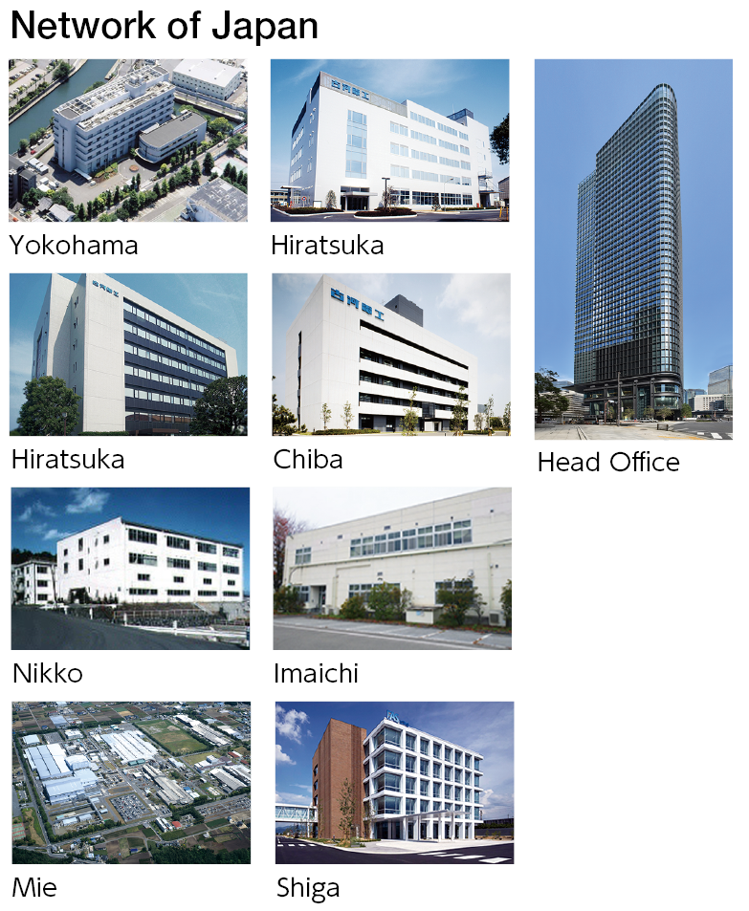
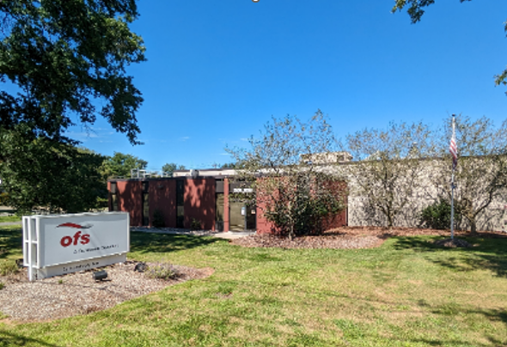
Furukawa Electric R&D and New business
All Rights Reserved, Copyright© FURUKAWA ELECTRIC CO., LTD. 2025
Notes:
R&D activity is mainly in Japan, but there are some interests in North and South America, where research and development is also taking place.
And the only centre in Europe that is specifically dedicated to R&D is Furukawa Electric Institute of Technology in Budapest,

Slide 6
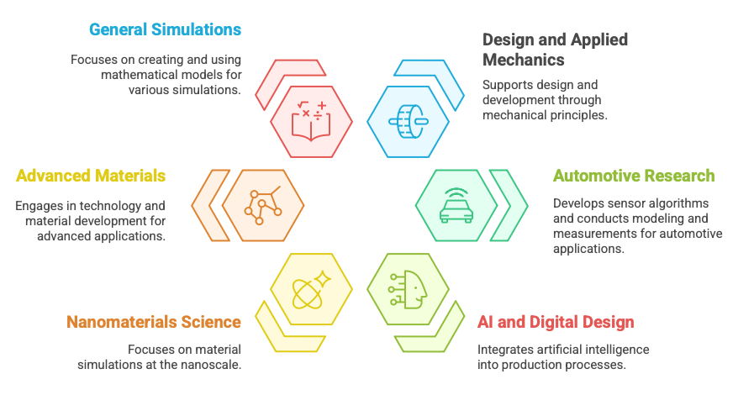
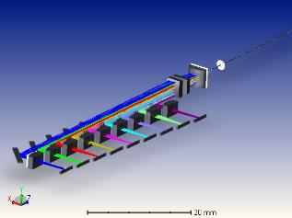
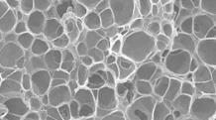
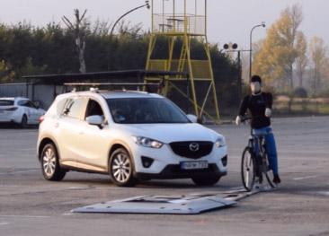
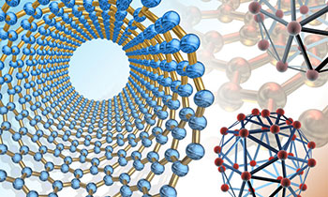
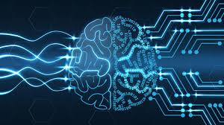
FETI Budapest Organisation 🇭🇺
The R&D center in Budapest is able to cover the entire process of research, design, development and implementation.
Furukawa Electric Institute of Technology has a history of more then 30 years, and its work in the field of research and development is demonstrated by numerous industrial applications, scientific publications and patents.
The highly qualified professional team of nearly 50 people operates primarily as the European R&D centre of Furukawa Electric Co., Ltd., but also supplies unique solutions to external partners in simulation tests, material development, automotive development, production technology optimization or precisely in the integration of AI-based solutions into production processes.
All Rights Reserved, Copyright© FURUKAWA ELECTRIC CO., LTD. 2025
Notes:
FETI has a history of more than 30 years. We have more than 50 highly qualified staff working in Budapest, physicists, chemists, mechanical engineers.
So far we have mainly served the R&D needs of the parent company, but now we also work for external partners.
We have six professional groups. The simulation department is one of the oldest.
It's not about using software available on the market, but about colleagues developing their own computing models. The researches focus on semiconductor physics, silicon photonics, fiber optics, signal processing related solutions and related fields, including telecommunications, wireless energy transfer, and optical and semiconductor devices
The autommotive group is involved in radar development, radar signal processing, battery sensor development and also the V2X. We also have two test cars to collect data on the roads of Europe.
Advanced Material Group has a lot of knowledge about polymers, they are developing a superhydrophobic material, they can laser weld a wide variety of materials together and we have a very promising recycling project where we are developing a really high quality material by recycling milk and beverage cartons.
Our Nanomaterials group is developing at almost academic level, building a reactor and developing a new CO2 capture material.
And our AI team is not riding on the current GEN AI hype, but rather delivering AI-based solutions, mainly quality control, that can be built into manufacturing processes.

Slide 7
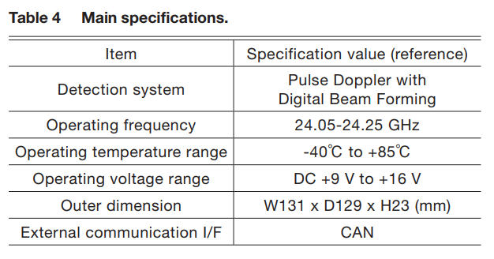
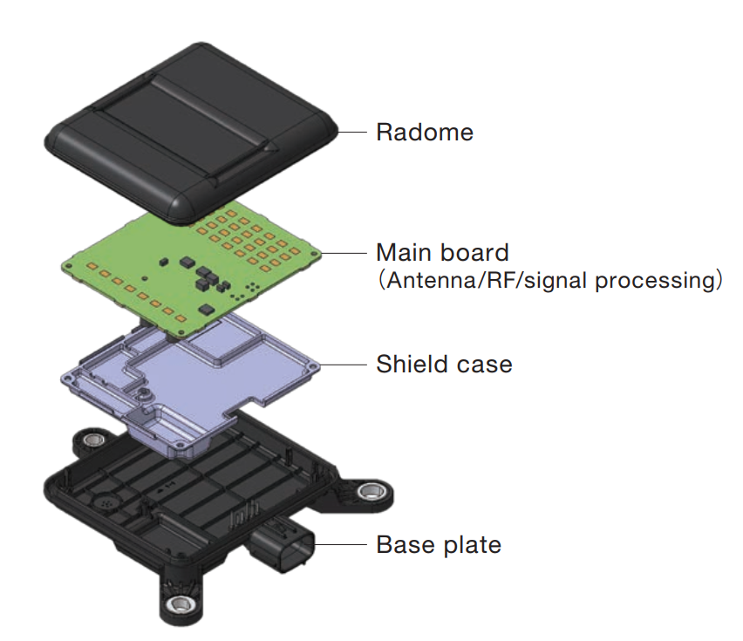
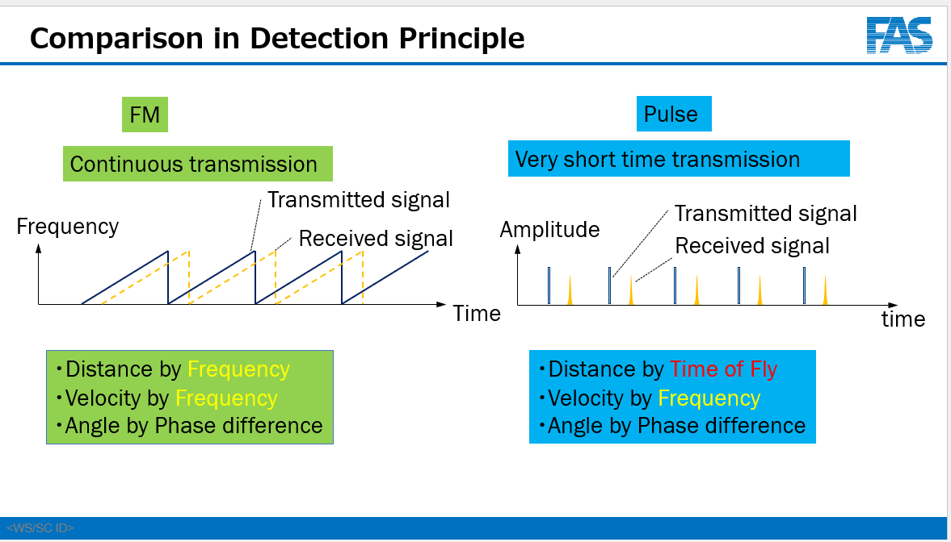
Furukawa Traffic Monitoring Radar

Slide 8
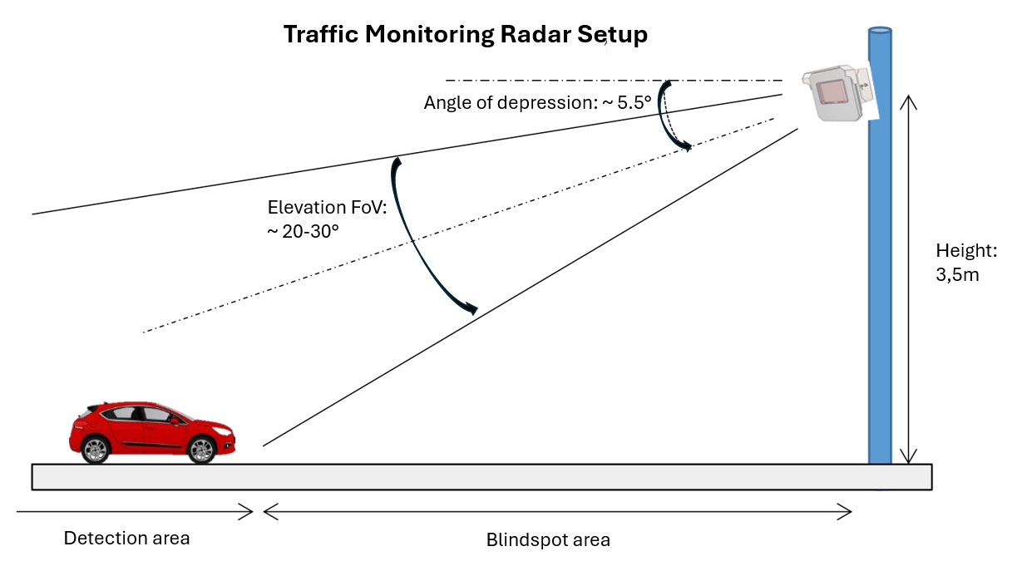
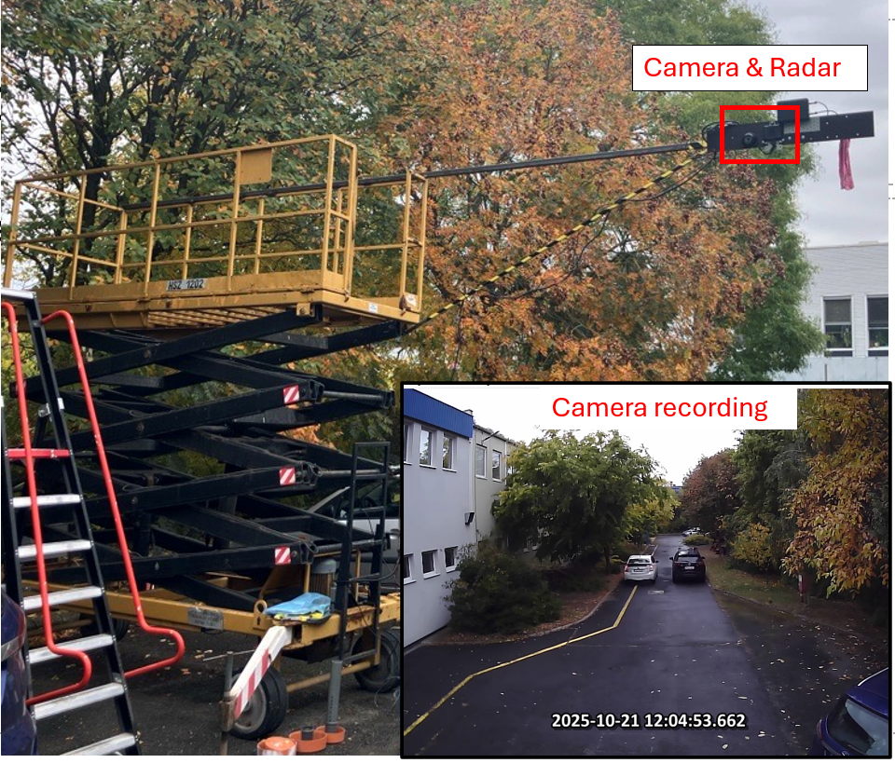
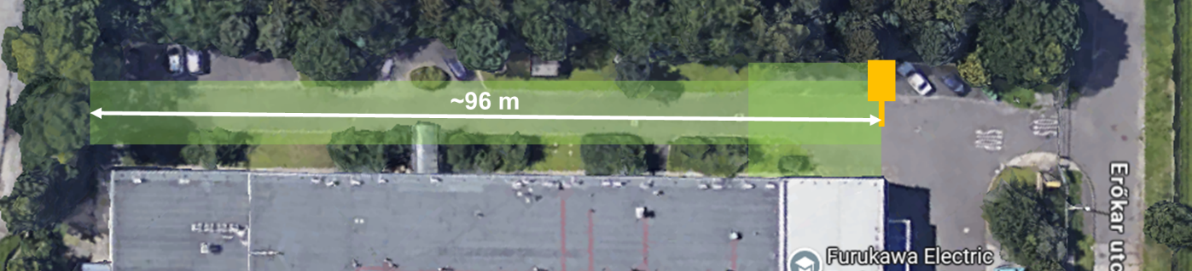
Measurment Campaign at FETI site

Slide 9
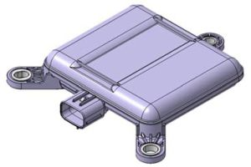
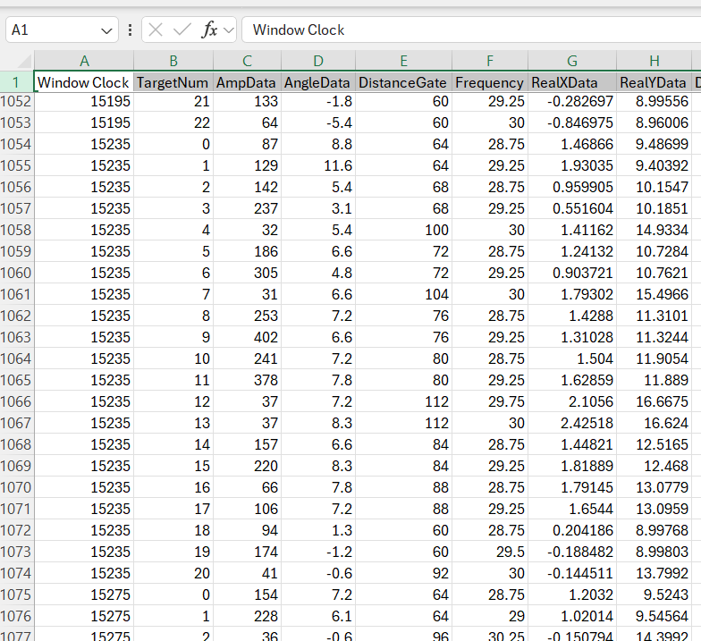
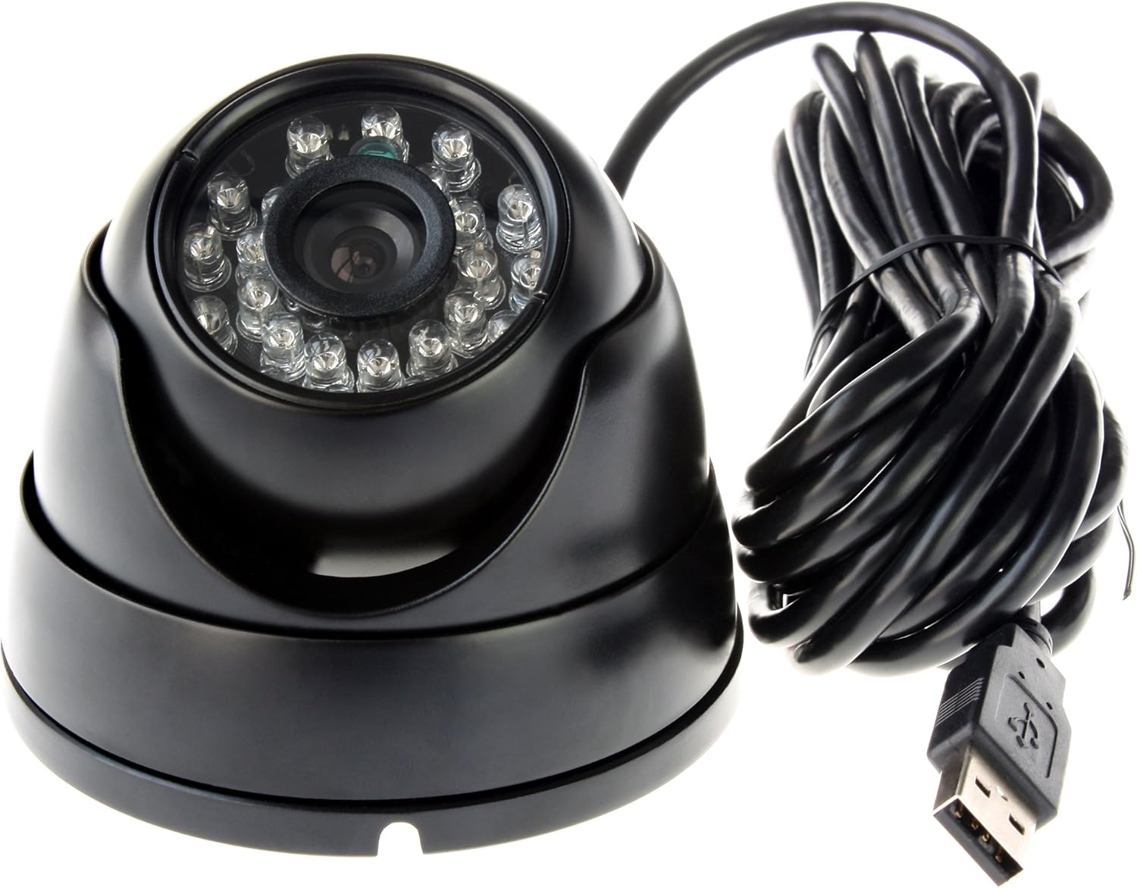
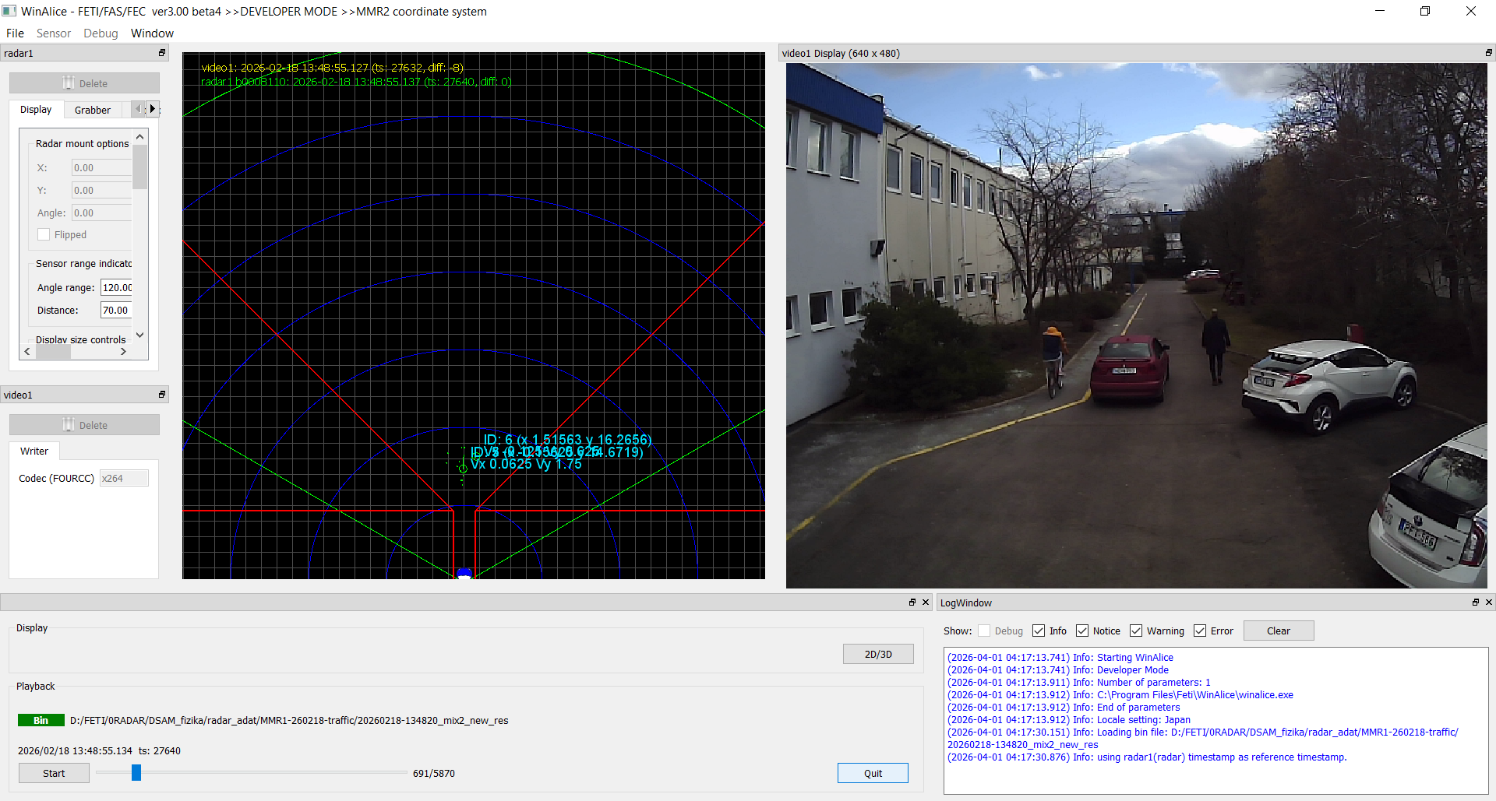
Radar and camera recordings

Slide 10
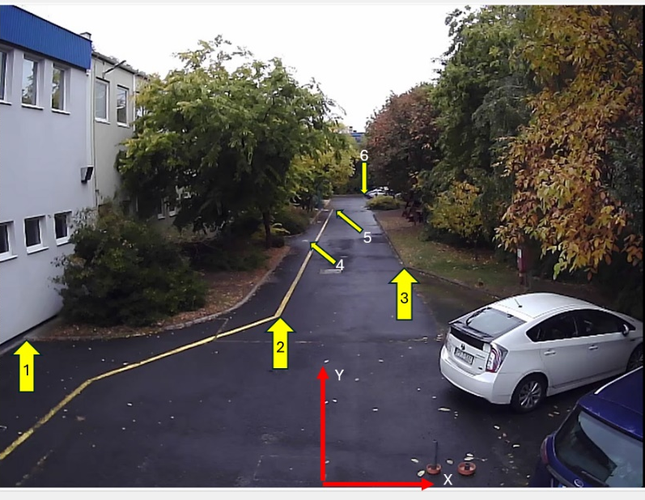
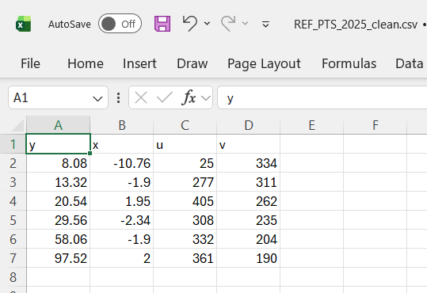
Homography

Slide 11
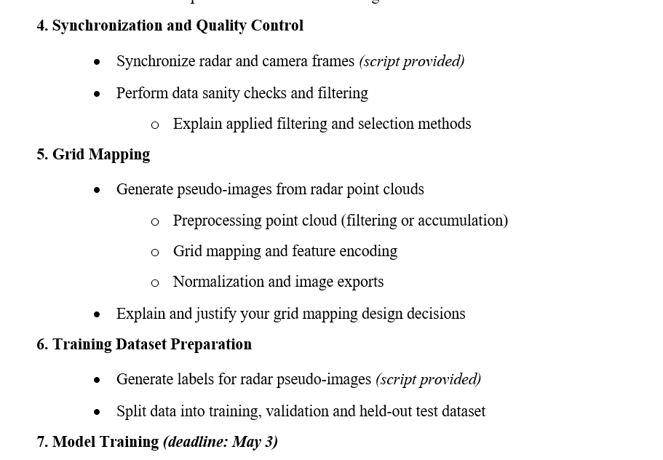
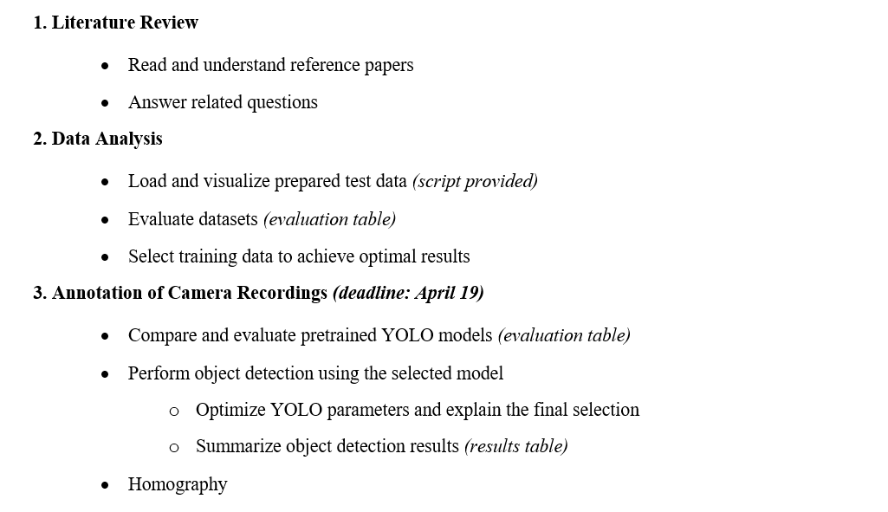
Task list
Notes:
14 tasks

Slide 12
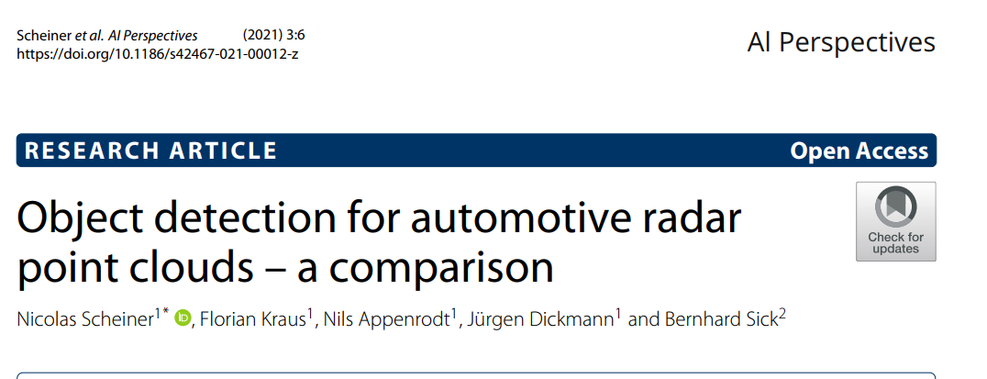
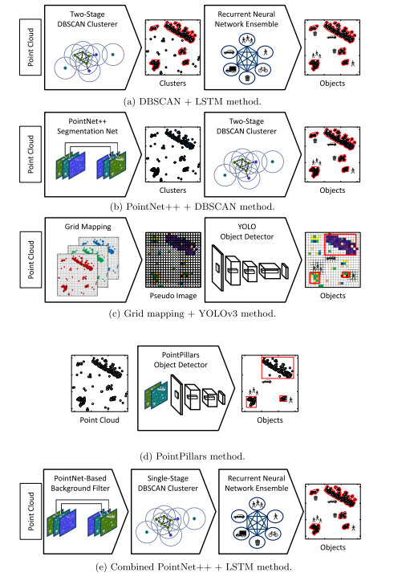
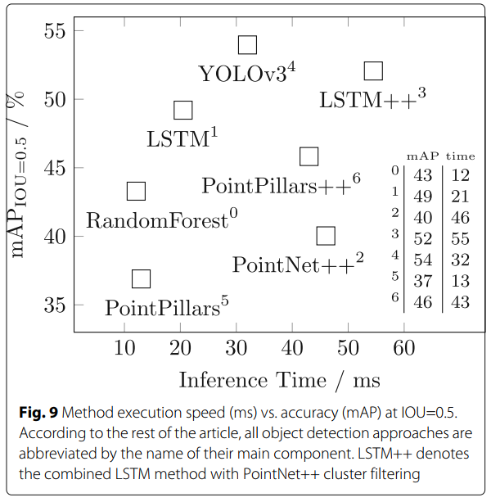
Literature Review
Notes:
Az LSTM (Long Short-Term Memory) egy speciális, rekurrens neurális hálózat (RNN), szekvenciális adatok – mint idősorok, szöveg vagy beszéd – feldolgozására terveztek
PointNet - mélytanulási architektúra, közvetlenül a 3D pontfelhőket (point clouds) dolgozza fel osztályozási, rész-szegmentálási és jelenet-szemantikai elemzési feladatokhoz.
A PointPillars egy népszerű mélytanulási módszer, amelyet a 3D objektumfelismerésre, a sűrű 3D adatokat függőleges oszlopokba (pillérekbe) rendezi, amivel jelentősen felgyorsítja a feldolgozást. 3D pontfelhőt egy 2D-s "pszeudo-képpé" alakítja, így a már jól bevált 2D konvolúciós neurális hálózatok (CNN) is használhatóak a felismeréshez.

Slide 13
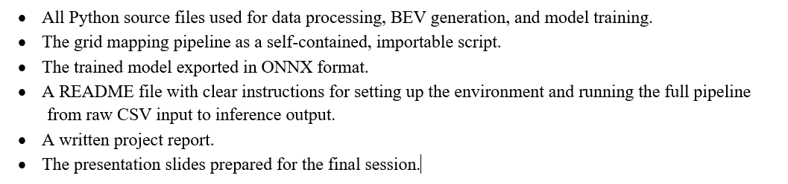
Deliverables

Slide 14
Deadlines
Annotation of Camera Recordings (deadline: April 19)
Model Training (deadline: May 3)
Deliverables (deadline: May 24)
Presentation at BME (May 27)
Finalization (deadline: May 29)
Presentation at FETI (June 1, 14:00)

Slide 15
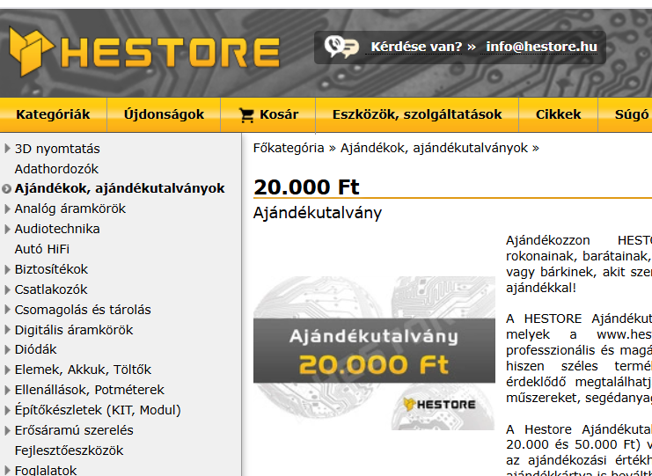
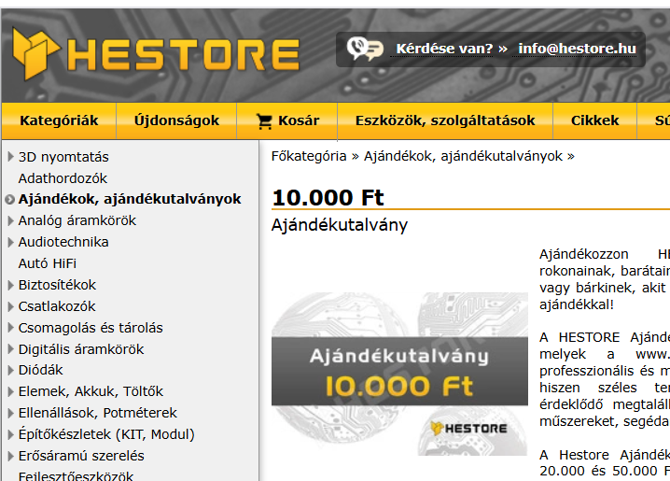
Prize
Gift voucher worth a total of 100,000 HUF

Slide 16
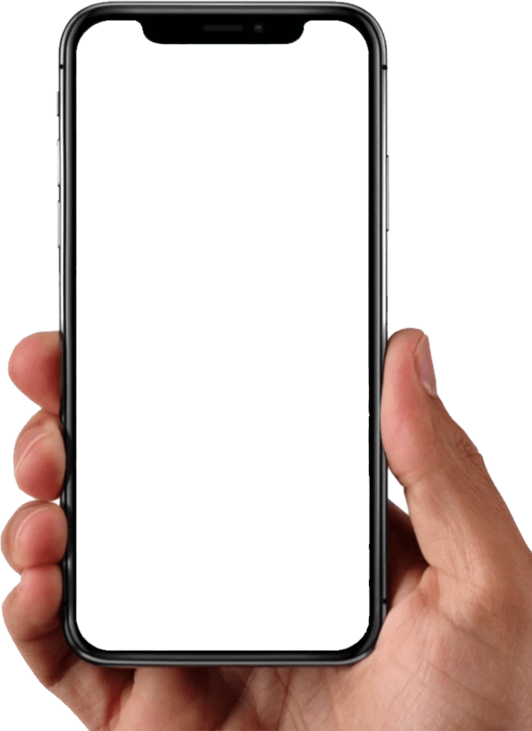


THANK YOU!
Furukawa Electric Institute of Technology
R&D FOR A SUSTAINABLE FUTURE
FETI Kft.
H-1158 Budapest, Késmárk u. 28/A
Telephone: +36 1 414 0250
Web: https://www.feti.hu
Email: robert.hajdu@furukawaelectric.com
Follow FETI on LinkedIn
Notes:
Thank you for your attention.
To stay up to date with our results and news, visit our website and follow us on LinkedIn.
Let's innovate together and make the future richer with our shared achievements!

