Slide 1
Adarsh pal My Self
Web designing
Tops Technology

Slide 2
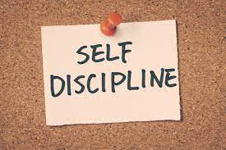
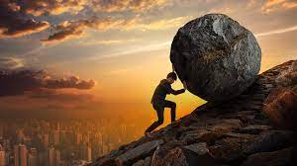




Introduction..
I
I am Disciplined person
I am Dedicated
I am Good Listener
I am Joyful
I am Helpful
I am Quick learner

Slide 3
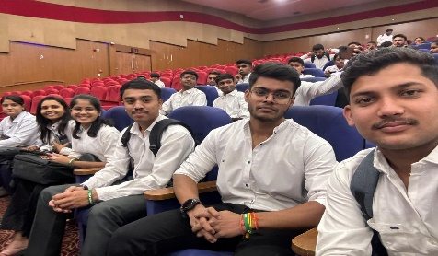
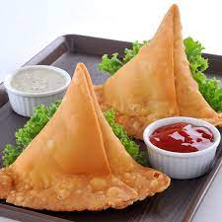

I LOVE…
I love friends
I am foodie
I love watching movies like fighting , love story
I love to play free fire game
I love long drive at night

Slide 4
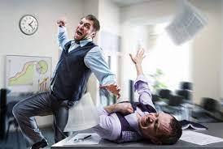
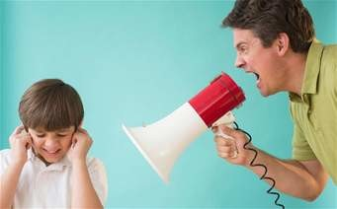
I HATEE….
Fighting
Pin of sound
I hate wrong people
I hate people who speak back of me
I hate if someone shout at me

Slide 5
SWOT
Strenght
Weakness
Quiet & honest
Enjoy being alone.
Family is my strength
1. I come to the senses any person quickly
2. difficulty following rather than leading
3. cannot focus well on independent work
Opportunities
Threats
1.Continued learning and professional development to expand skillset
1. lack of future growth opportunities as a software engineer

Slide 6
Believe in your infinite potential. You only limitations are those you set upon yourself

Slide 7
Thank you

