Slide 1

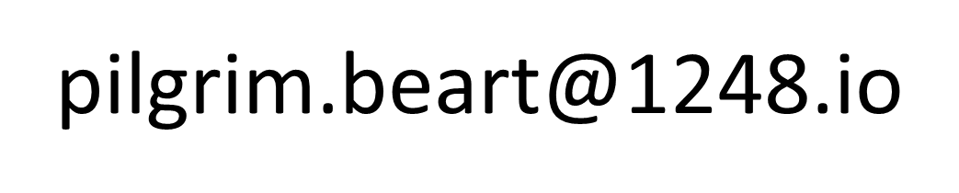
Interoperability on the Internet of Things IfM 2pm Thu 7 Nov 2013
http://1248.io

Slide 2
Today
My background
M2M and IoT today
Lessons from TSB IoT Interop Demonstrator
HyperCat: machine-discoverable APIs
1248 work in progress
Concluding thoughts

Slide 3

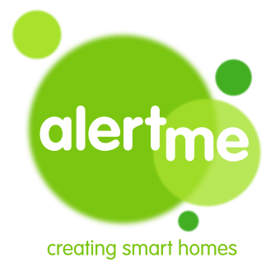
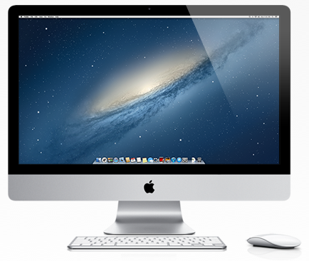
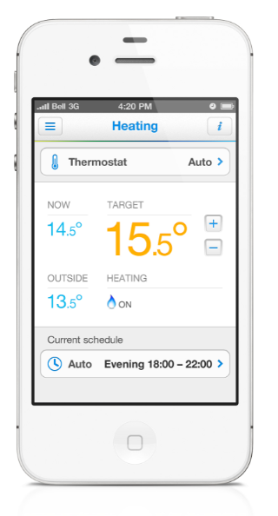
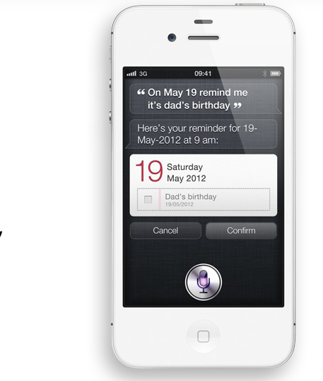
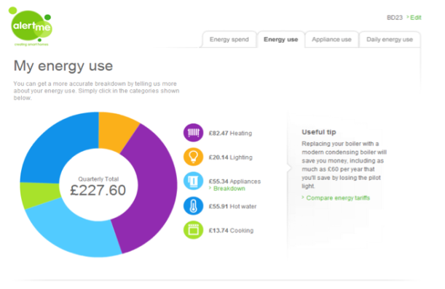
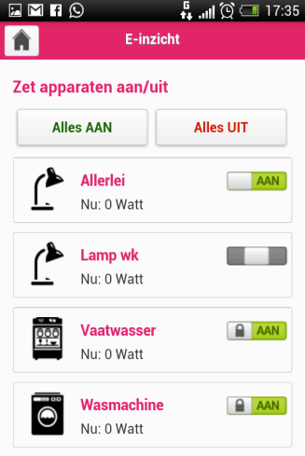
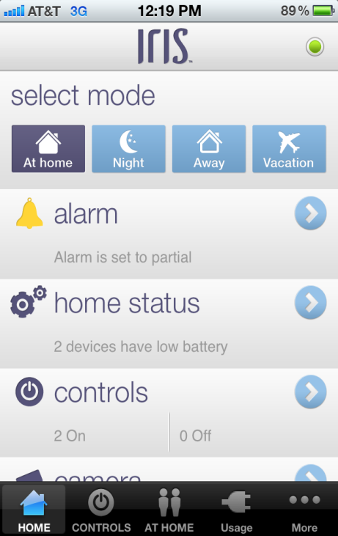
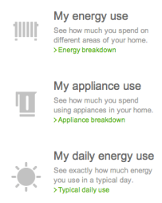






My background
Smart Energy Analytics
Smart Heating
Smart Appliances
Smart Home
Information
Remote Control
Analysis on how I & when I use energy to help understand my bill and advice on how to save.
Heating
Cooling
Hot water
Appliances
Lights
Locks
Security
Cameras

Slide 4

1248.io

Slide 5
M2M a precursor to IoT From vertical silos to horizontal IoT
old each provider delivered entire vertical
new each provider delivers horizontal slice
SUPPLY CHAIN
SUPPLY CHAIN
UX
ANALYTICS
STORAGE
SKYHOOKS
DATA CAPTURE
CONNECTED HOME
CONNECTED HOME
TRANSPORT SERVICES
TRANSPORT SERVICES
DRUG TRIALS
DRUG TRIALS
SMART METERS
…

Slide 6
TSB IoT Interoperability Demonstrator
£6m project, 1 year
Goal: Break down the vertical M2M silos!
~40 entities, most already with vertical end-to-end platforms
1248.io, Aimes Grid Services, AlertMe, Amey, ARM, Avanti, BalfourBeatty, BRE, British Telecom, Carillion, Critical Software, Ctrl-Shift, EDF, Enlight, ExplorerHQ, Flexeye, Guildford Borough Council, IBM, Intel, Intellisense.io, Intouch, LivingPlanIT, London City Airport, Merseyside Transport, Milligan Retail, Neul, Open Data Institute, Placr, SH&BA, Stakeholder Design, Traak, UK Highways Agency, Westminster City Council, Xively and the Universities of Birmingham, Cambridge, Lancaster, Surrey, UCL & Open University
8 clusters with diverse use-cases:
Airports
Transport logistics
Schools and Campuses
Homes
Streets
Q1: Work out what problem we all share
Q2: Implement
Q3: Interop
Q4: Serendipity

Slide 7
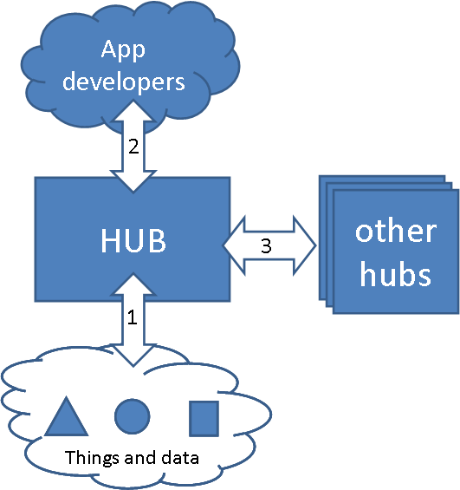
Everyone’s system architecture

Slide 8


Slide 9

You need data from several data services

Slide 10

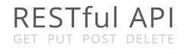

All services support the same open standards
https:

Slide 11
But each is organised differently
/customers/building/room/temperature
/users/hubs/devices/
/localauthority/street/post

Slide 12
So for each service you have to…
Read the documentation
Write code specific to that service

Slide 13
Everyone wants an ecosystem
If each application is specific to each service we call it “vertical-integration”.
To grow, we need to go “horizontal”
and build an ecosystem where all applications work with all services

Slide 14
…but Humans Don’t Scale
But adapting 10 Applications x 10 services = 100 pieces of code to write
(and imagine 1,000,000 Applications…)

Slide 15
Problem: Services not machine-browsable
An application cannot automatically discover a new service’s resources … so a human has to write code every time to enable it to do that.
I don’t know where to start

Slide 16

HyperCat: Makes services machine-browsable
What have you got?
This:
X/Y/Z
browse by structure
search by metadata

Slide 17
HyperCat makes life easier for everyone
Developers
More data, quicker
Service and Data providers
More customers
End-customers
More choice
Ecosystems and markets
Removes barriers

Slide 18
HyperCat Developer 101

Slide 19
Where to get started
Very simple spec (6 pages)
http://www.openiot.org/apis
Build on the open standards you already use
HTTPS, RESTful, JSON
Growing set of Catalogues to test against
Growing set of Tools for Client & Services
Online, and as Code Libraries
See http://wiki.1248.io

Slide 20
How to use HyperCat
GET http(s)://cat
Returns a catalogue:
Tagged with metadata
Containing zero or more Resource items
Each Resource item:
Has an HREF pointer to the resource
Is tagged with metadata, so you can tell what it is
The only defined metadata tag is for the catalogue itself
Catalogues can contain catalogues
Security model & basic search
Pathfinder
Scalable, Open-Source HyperCat server

Slide 21
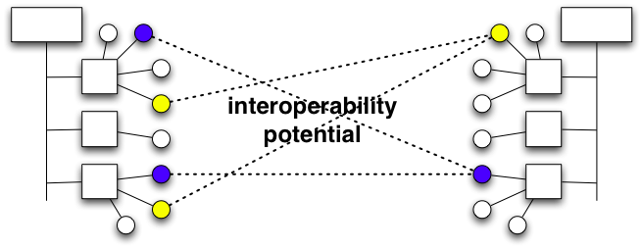
HyperCat is not a panacea
Applications and Services still have to agree on high level semantics
i.e. if a service provides temperatures in °C then the application needs to understand °C
What HyperCat does is enable an application to find those things that it does understand, in any service
e.g. “show me all the resources which are in °C”

Slide 22
IoT work in progress…
All the things we kicked out of scope!
Data formats: (JSON certainly, and…)
JSON-LD
SenML
Ontologies (general, and more & more specific)
Registration
Standard Licenses
Key management
Monetisation models
“run-anywhere” Rules
Rollups, triggers. Message-passing paradigm. Database-agnostic.

Slide 23

geras
1248 work in progress

Slide 24

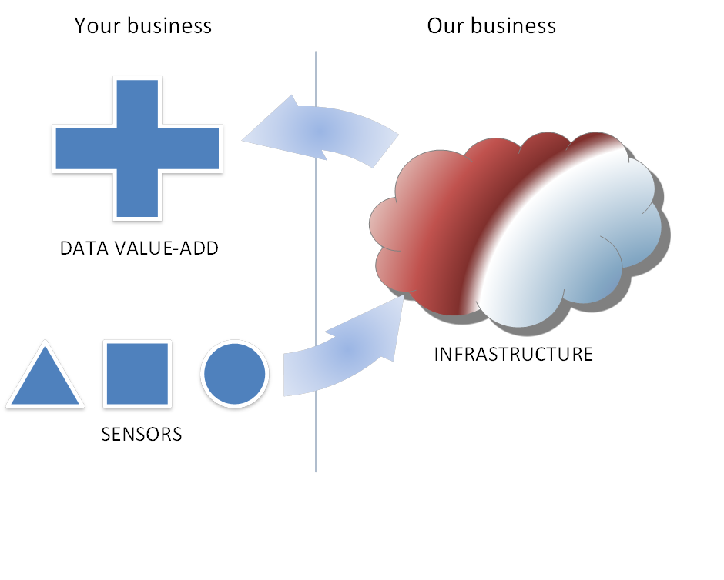
geras

Slide 25
Geras
geras
A live and historical streaming data service for IoT devices and hubs
Built for scale (C* & RabbitMQ)
Interfaces:
MQTT (streaming pubsub)
HTTP(S)
Supports pure HTML5 apps
MQTT over Websockets
JSONP

Slide 26
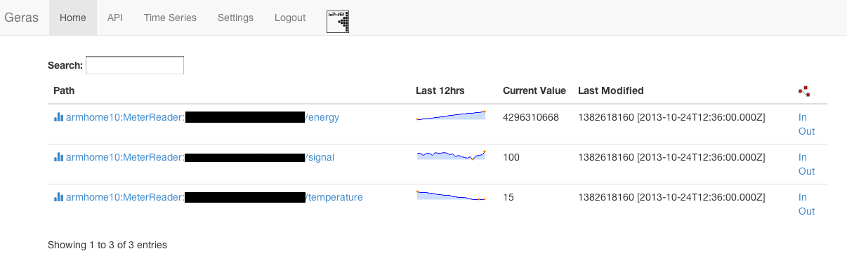
Management Dash (live data)
geras

Slide 27
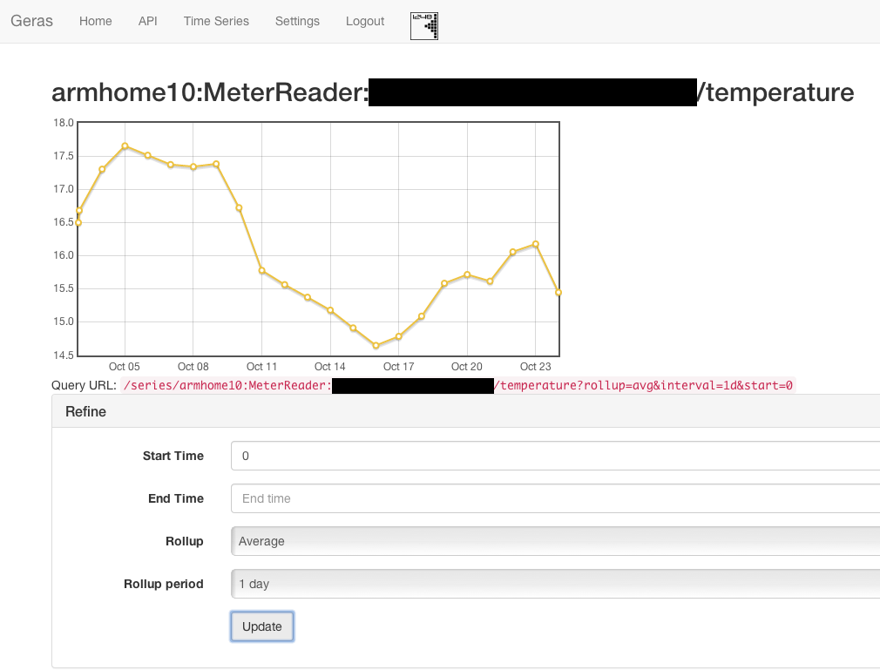
Charts, rollups, windowing
geras
“Weekly minimum this month”
“Yearly average”
“Daily sum”
etc.

Slide 28
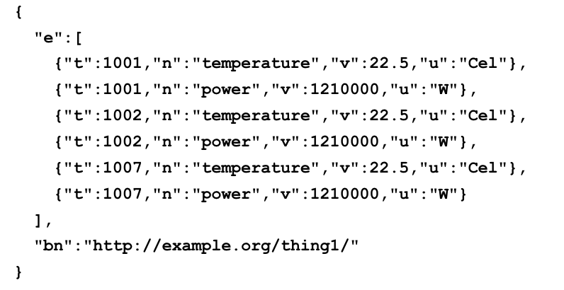
Data format is SenML
geras
Streaming JSON, in and out

Slide 29
Feeding data in
geras
HTTP(S) POST (bulk SenML)
curl -XPOST -u "APIKEY:" https://geras.1248.io/series/foo
--header "Content-Type: application/json“
-d@data.json
MQTT publish raw values
mosquitto_pub -v -u APIKEY
-h geras.1248.io
-t /foo/temperature
-m "22.5"

Slide 30
Reading data out
geras
HTTP(S) GET (SenML)
curl -XGET -u "APIKEY:" https://geras.1248.io/series/foo/temperature?
rollup=min&interval=1d
curl -XGET -u "APIKEY:" https://geras.1248.io/series/foo?recursive
MQTT subscribe (SenML)
mosquitto_sub -v -u APIKEY -h geras.1248.io -t /foo/#

Slide 31
Discovery
geras
Per-user HyperCat (SenML resources)
curl -XGET -u "APIKEY:" https://geras.1248.io/cat
Public HyperCat of user shares
Everything discoverable, optional keys for resources
curl -XGET http://geras.1248.io/publiccat

Slide 32
Metadata search and storage
geras
Per-stream searchable JSON properties
curl -XPOST -u "APIKEY:" -d@tags.json
https://geras.1248.io/tags/foo/temperature
curl -XGET -u "APIKEY:“
https://geras.1248.io/tags/foo/temperature
curl -XGET -u "APIKEY:“
https://geras.1248.io/tagsearch?manufacturer=acme

Slide 33

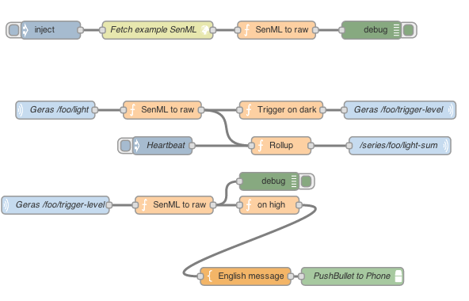
Streaming graph UI (MQTT)
geras

Slide 34
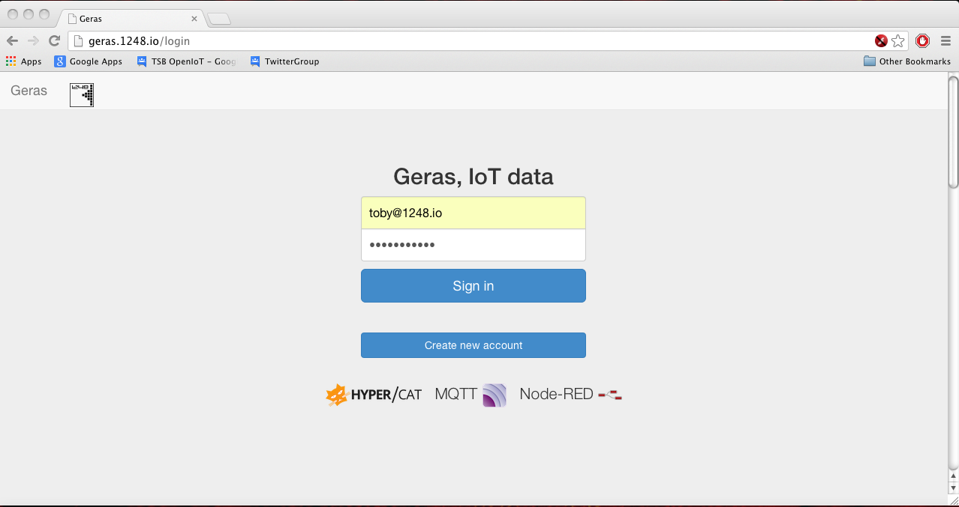
Sign-up as a beta tester!
geras
https://geras.1248.io

Slide 35
Thoughts

Slide 36
ARM’s acquisition of Sensinode (personal view)
NEWS
“Symmetry-breaking”
Sensinode literally wrote the book (& RFCs):
6LoWPAN (IPv6 over 802.15.4 radio)
CoAP (binary HTTP over UDP for constrained environs)
DTLS (SSL for UDP, ECC/RSA + AES)
LWM2M (OMA device management standard, bootstrap, registration, upgrade, telemetry)

Slide 37
From edge to centre
Open Data
IoT
They’re the same thing. One day, almost all Open Data will come from IoT
Billions of tiny sensors
Very large databases

Slide 38
“Open”
Not (necessarily):
Free
Public
Means:
My service works with your service
We can swap providers without a lot of effort
Requires less trust

Slide 39
We may think we’re “the” service

Slide 40
But our true value is to the graph

Slide 41
Interoperability on the Internet of Things
http://1248.io

