Slide 1
SOA Pattern: Asynchronous Queuing
Senaka Fernando
Dinesh Lakmal Kodithuwakku

Slide 2


About the Presenter(s)
Senaka Fernando
Architect- Solutions Architecture, WSO2
Senaka is a Solutions Architect at WSO2. Before moving to the Solutions Architecture team, Senaka focused on the WSO2 Governance Registry and WSO2 Cloud Services Gateway. In addition to his product R&D efforts, he has provided technology consulting on customer engagements, helping to successfully implement governance, enterprise application integration, SAP integration, and on-premise portal solutions. He also founded the WSO2 Web Services Framework/C++ during his internship with WSO2 in 2008.
Dinesh Lakmal Kodithuwakku
Solutions Engineer - Solutions Architecture, WSO2
Lakmal is a Solutions Engineer at WSO2. He has five years of hands-on experience with mobile computing technologies. His expertise spans analyzing, implementing and testing software solutions for mobile computing platforms as well as carrying out research and identifying technologies and methodologies to determine the optimum solutions for project tasks when required.
*

Slide 3
About WSO2
Global enterprise, founded in 2005 by acknowledged leaders in XML, web services technologies, standards and open source
Provides only open source platform-as-a-service for private, public and hybrid cloud deployments
All WSO2 products are 100% open source and released under the Apache License Version 2.0.
Is an Active Member of OASIS, Cloud Security Alliance, OSGi Alliance, AMQP Working Group, OpenID Foundation and W3C.
Driven by Innovation
Launched first open source API Management solution in 2012
Launched App Factory in 2Q 2013
Launched Enterprise Store and first open source Mobile solution in 4Q 2013
*

Slide 4
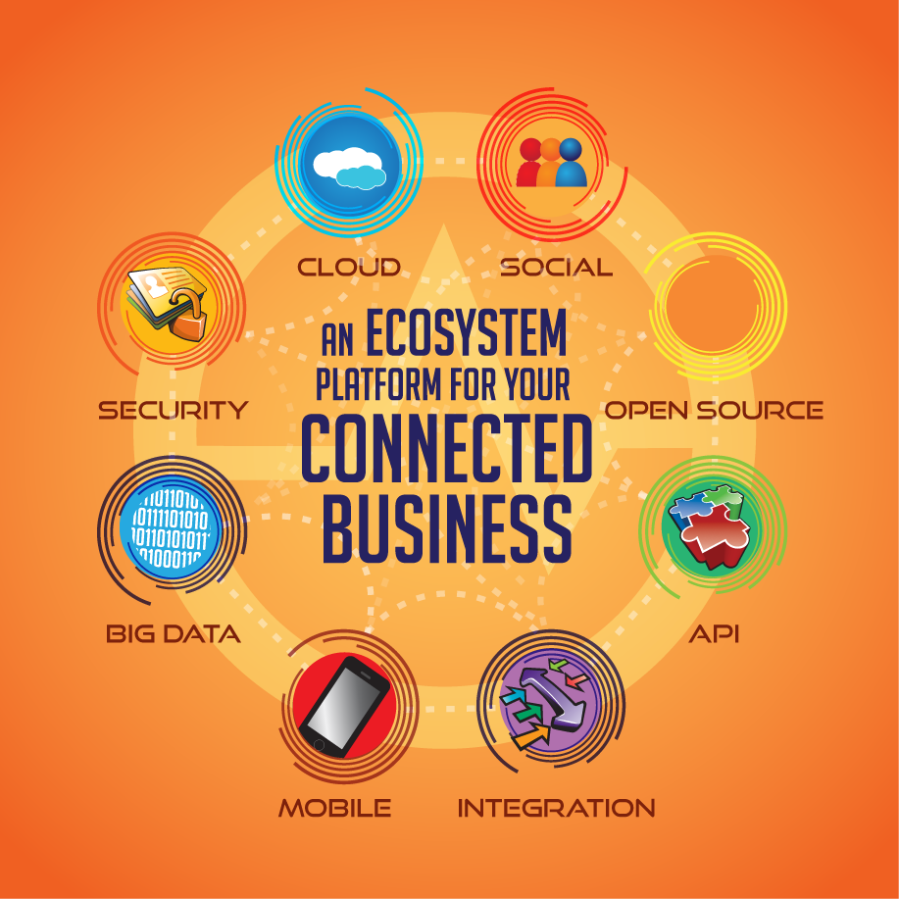
What WSO2 delivers
*

Slide 5
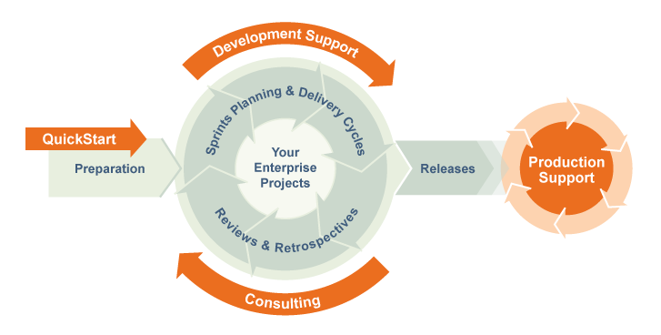
Business Model
*

Slide 6
One of the biggest pains
Services might require consumers to interact with them asynchronously
This can inhibit performance and compromise reliability by locking it’s resources
Services and their consumers run into isolated failures in this very disconnected setting
*

Slide 7
How to overcome this?
Services can exchange messages with consumers via intermediary buffers (or brokers)
Buffers allow services and consumers to process messages independently
Both service and consumer gets the freedom to process messages and report failures without depending on each other
*

Slide 8
Why Messaging?
Enhanced reliability
e.g: via Persistence, Transactions
Decoupling
Space
Time
Synchronization
*

Slide 9
Basic Messaging Model
Messaging is implemented with a broker
Participants send messages and broker delivers them to recipients
Two main models
Point-to-Point - Messages are delivered only once and held on a queue from which a consumer picks one at a time
Publish/Subscribe - Messages are broadcasted to many consumers at once
*

Slide 10
Queues
Ability to store a message in a temporary storage is a fundamental requirement in enterprise integration (but some may require more durable models)
Point to Point model: Queue is a destination that contains messages sent from a producer that awaits delivery to a designated consumer
Messages are delivered in-order
Guarantees that each message is processed only once
*

Slide 11

Queues...cont
A message is removed from the queue once it has been received by the consumer
May provide additional features
Persistence
Monitoring
Receiver
Receiver
Sender
Queue
Receiver
Receiver
*

Slide 12
Topics
Pub/Sub model
Multiple consumers subscribe for messages
Topics are used to send messages to one or more consumers
No guarantee that, messages are delivered in sent order
No guarantee that, each message is processed only once
*

Slide 13
Topics...cont
Producers publish messages to topics and each consumer subscribed to the topic receives a copy of the message
Receiver
Receiver
Sender
Topic
Receiver
Receiver
*

Slide 14
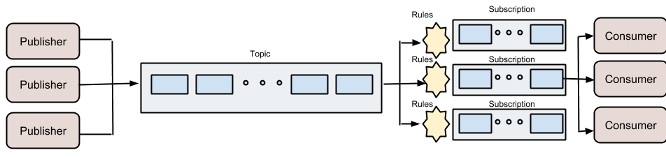
Durable Topics
Broker collects messages while subscriber is offline
Broker distributes messages to all interested parties
Each subscriber has its own internal queue until it unsubscribe
*

Slide 15
Durable Topics
Best of both worlds?
Or additional complexities?
*

Slide 16
What WSO2 Product(s) to use?
WSO2 Message Broker (MB)
Implements and supports JMS API using AMQP
JMS (Java Message Service)
A Standard Java API for programmers to handle messaging by interacting with a message broker
AMQP (Advanced Message Queuing Protocol)
Open Standard for passing business messages between applications or organizations
*

Slide 17
What WSO2 Product(s) to use?
WSO2 Message Broker (MB)
Will support MQTT from end of 2014 (ETA)
Implementation is already completed and has been demonstrated at some conferences
MQTT (Message Queuing Telemetry Transport)
A lightweight pub/sub protocol implemented on top of TCP/IP to facilitate machine-to-machine (M2M) and Internet-of-Things (IoT) integrations
*

Slide 18
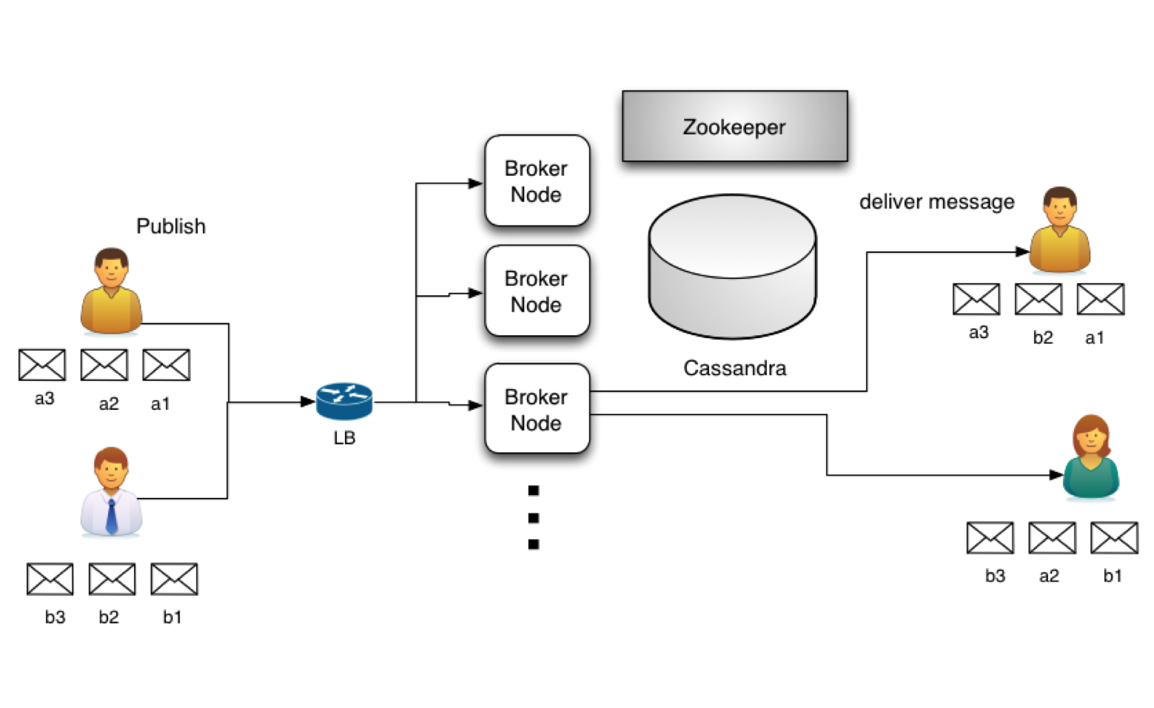
What WSO2 Product(s) to use?
*

Slide 19
How WSO2 MB is different?
Scalability - WSO2 MB can be clustered to handle complex business requirements
Uses Apache Cassandra as the storage for persistent messages
Supports distributed queuing
*

Slide 20
How WSO2 MB is different?
Can easily handle large message transfers
Highly available and fault tolerant
High interoperability via AMQP clients:
Java
C
C++
.Net
many more
*

Slide 21
UC 1: Rate Limiting
Some services only process messages at a specific rate
Clients may send messages at an arbitrary rate
Provides a virtualized service interface that stores all messages in a queue
Services can consume messages from the queue at their own pace
Or the broker can forward the stored messages to the actual service at a controlled rate
*

Slide 22
Pattern: Store & Forward
Client request
(Variable rate)
Forward
(Fixed rate)
Proxy Service
Message Sender
Service
Store
Fetch
Message Store
*

Slide 23
UC 2: Guaranteed Delivery
Sometimes we need to ensure that all requests are received and processed by the back-end systems
All requests can be stored in a persistent message queue
Back-end systems consume these messages whenever they are able to
Or use a persistent queue as the dead letter channel
*

Slide 24
Pattern: Dead Letter Channel
ERROR
Client request
Proxy Service
Send
Service
Store on Error
Retry
Message Store
*

Slide 25
UC 3: Separation of Concerns
Sometimes messages should be processed through expensive audit/logging routines
To avoid high response times, messages can be cloned and stored in a queue
Audit/logging systems consume the messages off the queues
*

Slide 26
Pattern: Separation of Concerns
Client request
Proxy Service
Service
Store copy of message
Message Store
Audit System
*

Slide 27
UC 4: Translation
Sometimes the client and service speak different protocols
Input and Outputs don’t tally with each other in terms of format or one of several aspects such as rate
A Message Bus controls and reshapes the communication between the client and service
*

Slide 28
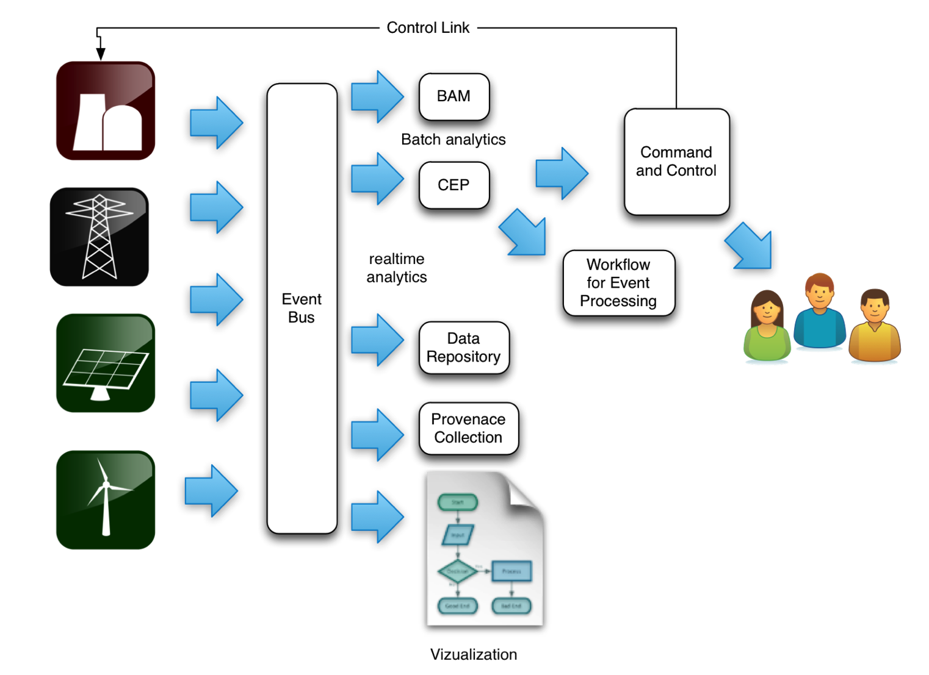
Pattern: Message Bus
*

