Slide 1

ServiceStack.Net
Brief overview sdg COP demo

Slide 2
What is ServiceStack.Net?
REST Web Service Framework
.NET and MONO
Web Services done right, REST services done easy

Slide 3
Design Goals
Simplicity
Speed
Best Practices (Remote Services and Code)
Model-driven, code-first, friction-free development
Fuse C# and HTTP as DRY as possible
Write once, support for all XML, JSON, SOAP...
No XML Config, No Code-gen
Smart. Infers intelligence from strong-typed DTOs
First class cross-platform support for OSS/Linux

Slide 4

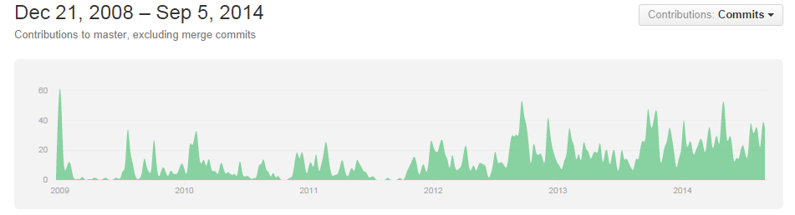
History
Invented and maintained by Demis Bellot
Started as open source, #2 github project in 2013

Slide 5
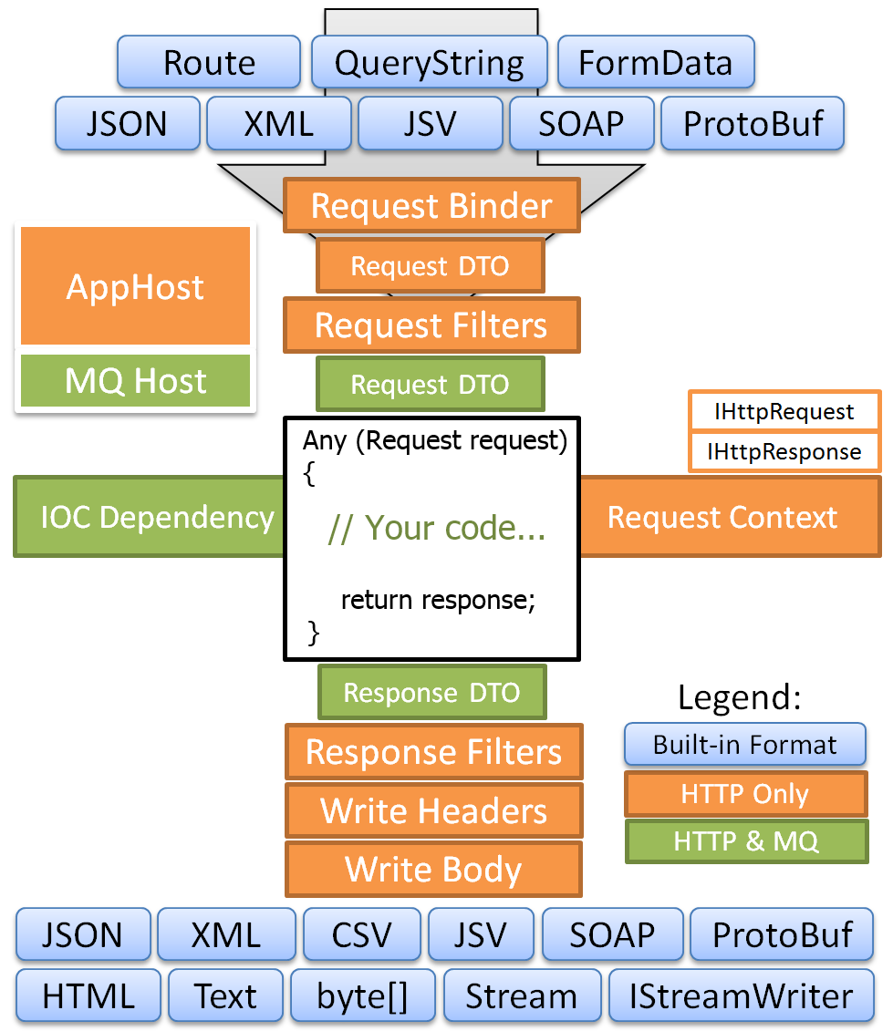
Architecture
POCO Based messaging
Request/Response or Message Queuing
built on top of Raw ASP.NET IHttpHandler

Slide 6
Simple
C# Model-driven development,
Define Web Service API using YOUR strong-typed DTOs
No Code-gen
No Artificial layers or constructs
Complete control over HTTP Headers and serialized output
Endpoint ignorant
C# only, code to interfaces and types not specific formats or endpoints
C# object IN -> C# object OUT
No config required with Sensible defaults
No code-gen, same DTO used in strong-typed client API
Same C# client can call any web service at any endpoint
Generic C# Service Clients: XML, JSON, JSV and Soap11/Soap12
Both Sync and Async clients support 1 LOC web service calls
Provides ErrorCode, ErrorMessage from WebServiceException

Slide 7
Fast
Built on raw IHttpHandlers
No runtime reflection or regular expressions
Uses Built-in Funq IOC
Funq is 55x faster than Windsor
Fastest JSON, JSV text serializers for .NET
ServiceStack.Text is 3.6x faster DataContractJsonSerializer
Includes #1 C# Redis Client
Redis is the fastest in-memory NoSQL database
Includes ASP.NET config-free caching providers
Memcahed
Redis
In-Memory
FileSystem

Slide 8
Best Practices
Influenced by Martin Fowlers Data Transfer Object Pattern
Encourage batch-full, re-usable web services
Discourage chatty, client-specific APIs
Importance of a Coarse-grained, well-defined API
Resilient serializers with better versioning support
Decoupling of message from operation and endpoint
Clean separation of DTO from implementation

Slide 9
C# and HTTP as DRY as possible
Develop Service using only C# POCO types
Implement IService<TRequest> or IRestService<TRequest>
Same service with no config or code-gen
Callable via REST, RPC POX/J or SOAP endpoints
Callable on any format (XML, JSON, SOAP, JSV, CSV, HTML)
via HTTP Accept: or ?format=type. JSONP with ?callback=cb
Can process HTTP File Upload multipart/form-data
Strong-typed Request DTO can be populated by:
HTTP GET QueryString
HTTP POST DTO Content-Type (i.e. XML, JSON, etc)
HTTP FORM POST x-www-form-urlencoded
Can return any of:
Any DTO object -> serialized to Response Content-Type
HttpResult, HttpError for Customized HTTP response
String
Stream
IStreamWriter

Slide 10
“No” Config
Very little web.config work required with acceptable defaults
Connection strings
Additional 3rd party library configuration

Slide 11
Smart - Infers from service metadata
Serializes C# Exceptions into your Response DTO
Auto-generated web services metadata api page
Links to XSDs and WSDLs
Auto HTML5 JSON Report format
Quickly visualize web service data at a glance
Generates a self-contained snapshot of web service data in a human-friendly and programmatically accessible document
Auto CSV format
Picks best candidate property to serialize into CSV resultset

Slide 12
Cross platform - Run in .NET and MONO
Supports both ASP.NET and HttpListener hosts:
Runs on Windows with .NET 3.5, 4.0, 4.5
IIS 6/7+ (uses IHttpHandler)
VS.NET WebDev server
Console App or Windows GUI
Windows Service
Linux/OSX with MONO
Apache + mod_mono
Nginx + MonoFastCGI
XSP
Console App
Haz demo running inside iOS with MonoTouch :)

Slide 13
DEMO

Slide 14
Questions?

